Slide 1
Can We Predict California Legislator Votes?
By Owen Poindexter

Slide 2





Tech Stack

Slide 3
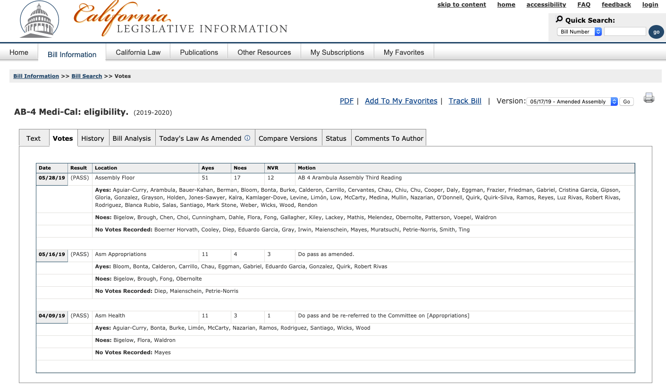
Predicting Vote Totals by Bill Sponsors
First we scrape a bunch of government data…

Slide 4
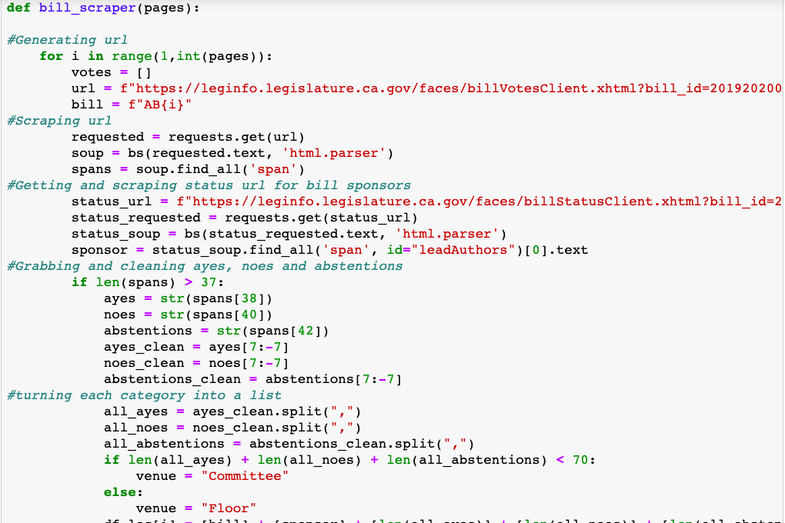
Scraping, organizing and cleaning data by bill and legislator
Separate scrapes to gather data on bill sponsors and votes
Lots of debugging due to Assemblymembers with the same last name and other random quirks
Combine cleaned data with info on party affiliation
Throw it all into sklearn to create a vote predictor

Slide 5
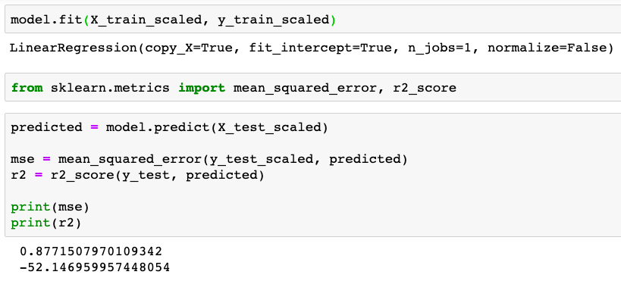
Wha…?

Slide 6
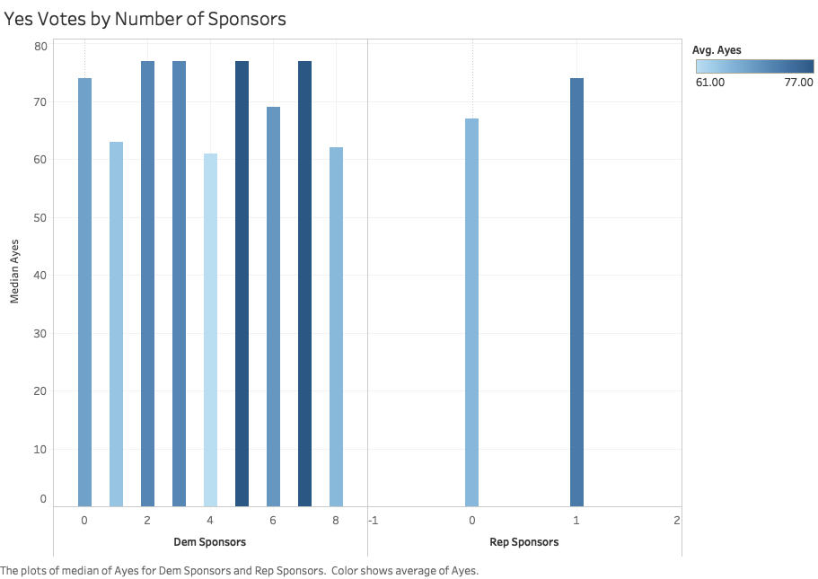

Slide 7
Maybe the more interesting question is…
Who is voting no?

Slide 8
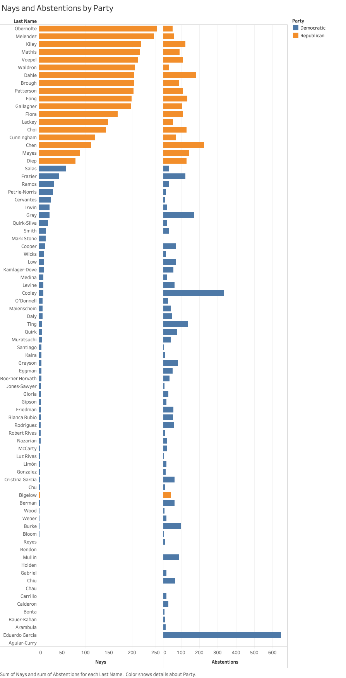

Slide 9
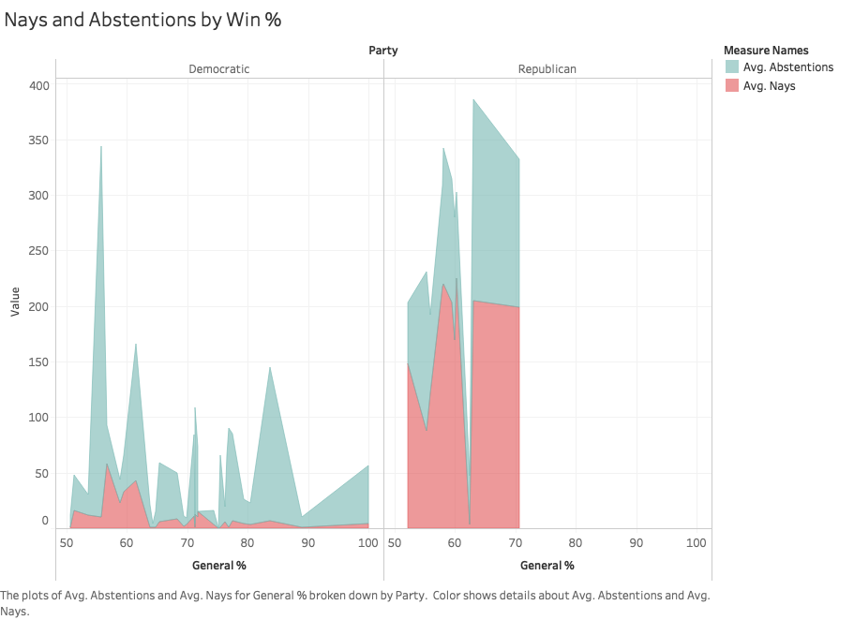

Slide 10
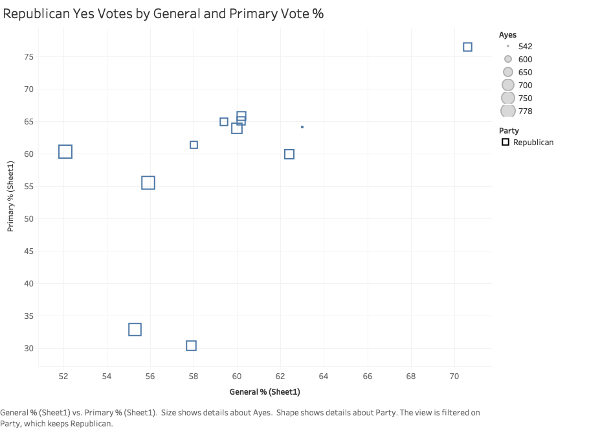

Slide 11
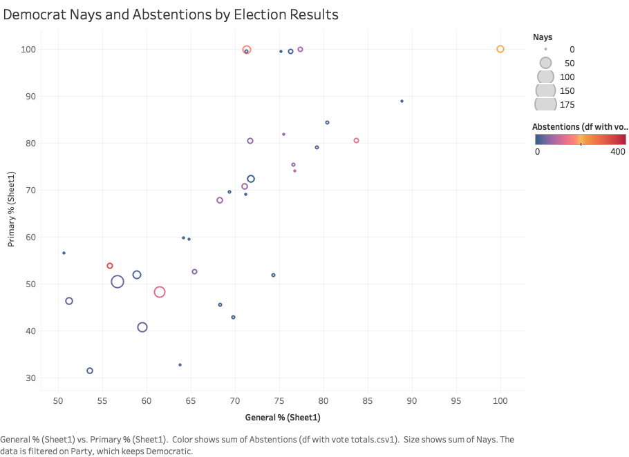

Slide 12
Conclusions
Average vote totals are too consistent to make predicting vote totals by sponsor a worthwhile exercise
Party homogeneity and leadership vote counting ensure that the majority of bills have broad support among Democrats
Political pressure to be more centrist is visible in a handful of Assemblymembers who had close elections in 2018
This correlation is thrown off in a few cases due to California’s top-two primary system
Vote!

