Slide 1
Tiling a Calendar
Live Free or Die Hard

Slide 2
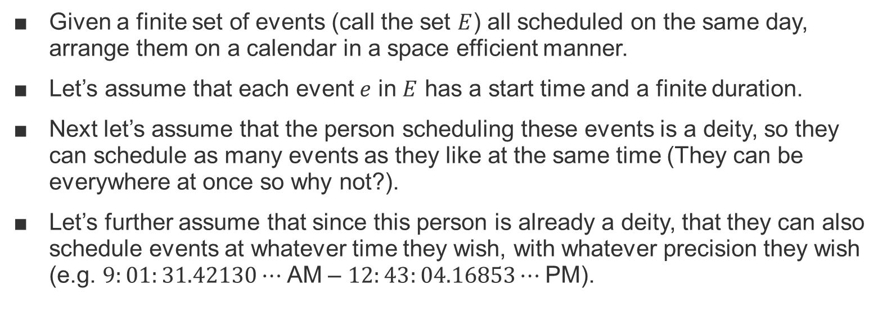
Motivation
Given a finite set of events (call the set $E$) all scheduled on the same day, arrange them on a calendar in a space efficient manner.
Let’s assume that each event $e$ in $E$ has a start time and a finite duration.
Next let’s assume that the person scheduling these events is a deity, so they can schedule as many events as they like at the same time (They can be everywhere at once so why not?).
Let’s further assume that since this person is already a deity, that they can also schedule events at whatever time they wish, with whatever precision they wish (e.g. $9:01:31.42130⋯$AM – $12:43:04.16853⋯$PM).

Slide 3

What we need
To tile a calendar day, it suffices to know four things about each event $e$ in $E.$
Start Time ($s$)
Duration ($d$)
Horizontal Placement ($x$)
Width ($w$)

Slide 4
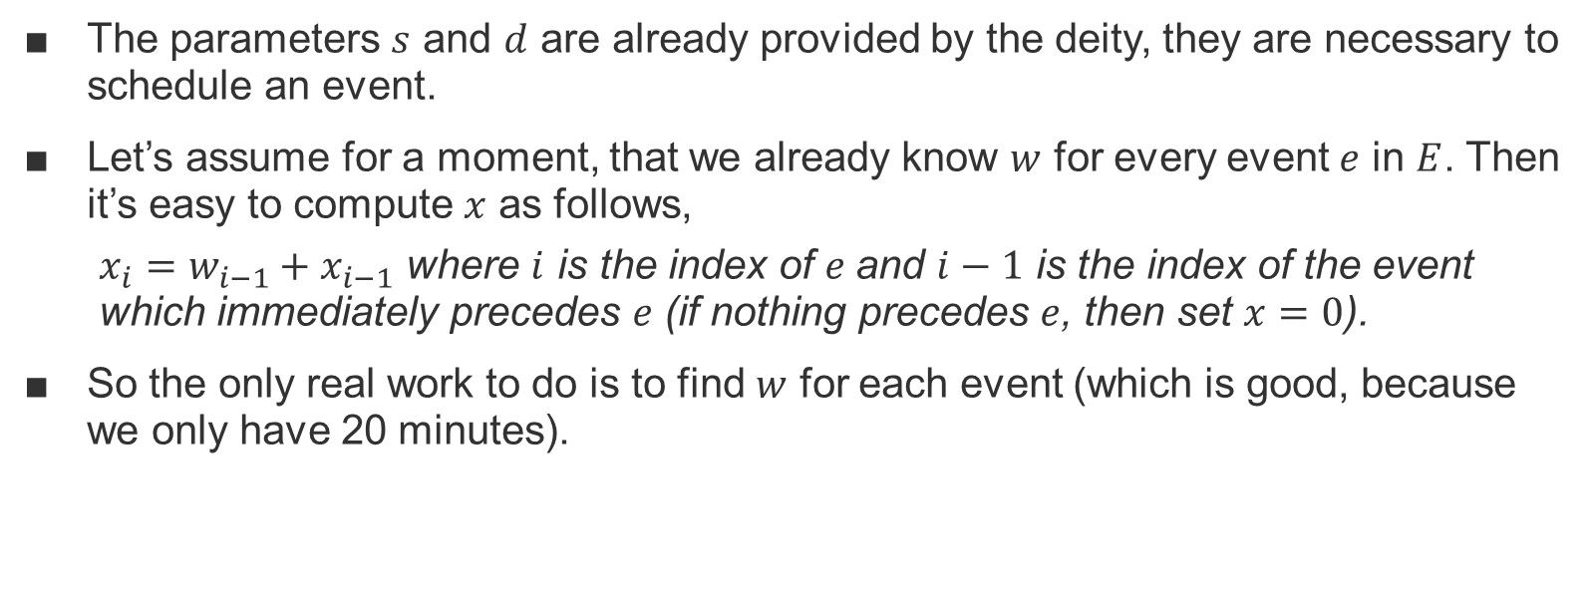
What we have
The parameters $s$ and $d$ are already provided by the deity, they are necessary to schedule an event.
Let’s assume for a moment, that we already know $w$ for every event $e$ in $E$. Then it’s easy to compute $x$ as follows,
$x_{i}=w_{i−1}+x_{i−1}$ where $i$ is the index of $e$and $i−1$ is the index of the event which immediately precedes $e$ (if nothing precedes $e$, then set $x=0$).
So the only real work to do is to find $w$ for each event (which is good, because we only have 20 minutes).

Slide 5
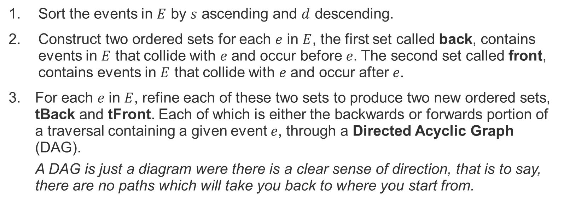
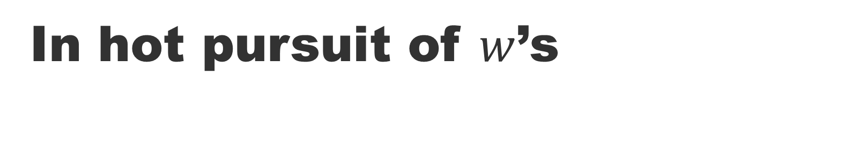
In hot pursuit of $w$’s
Sort the events in $E$ by $s$ ascending and $d$ descending.
Construct two ordered sets for each $e$ in $E$, the first set called back, contains events in $E$ that collide with $e$ and occur before $e$. The second set called front, contains events in $E$ that collide with $e$ and occur after $e$.
For each $e$ in $E$, refine each of these two sets to produce two new ordered sets, tBack and tFront. Each of which is either the backwards or forwards portion of a traversal containing a given event $e$, through a Directed Acyclic Graph (DAG).
A DAG is just a diagram were there is a clear sense of direction, that is to say, there are no paths which will take you back to where you start from.

Slide 6
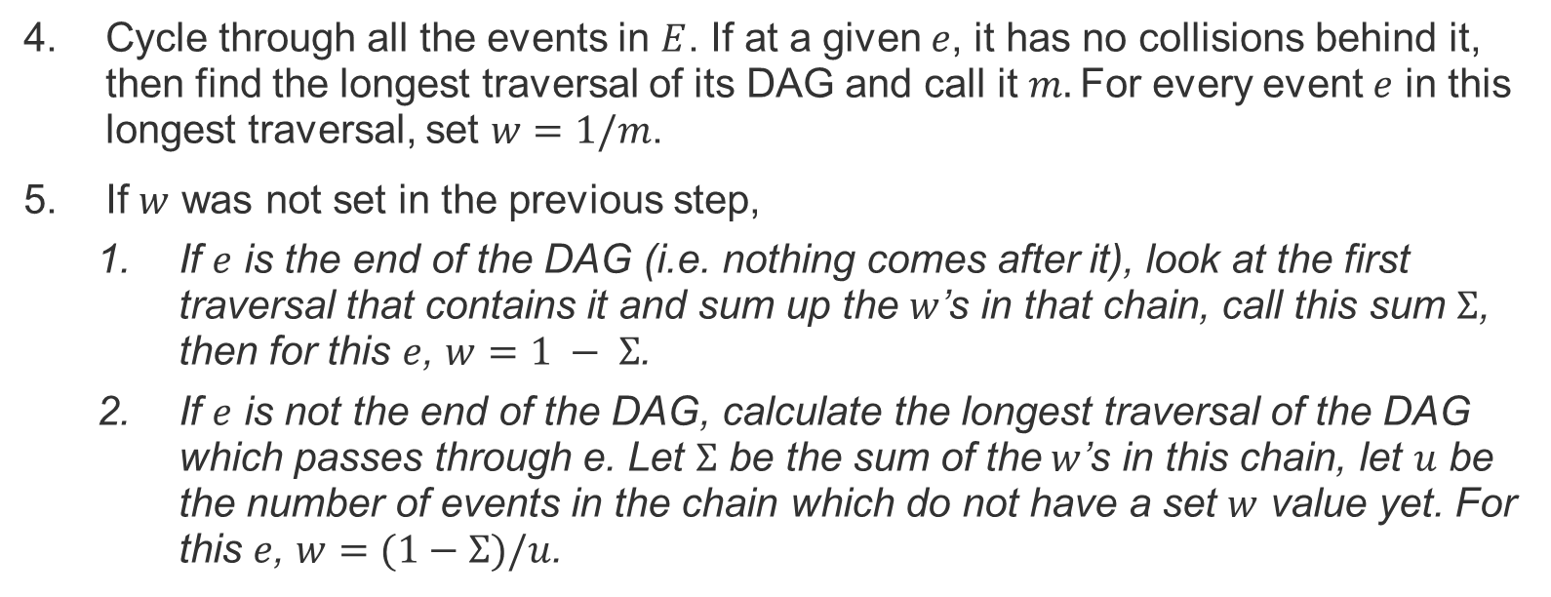
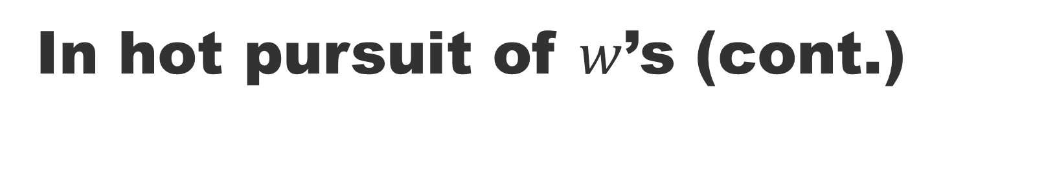
In hot pursuit of $w$’s (cont.)
Cycle through all the events in $E$. If at a given $e$, it has no collisions behind it, then find the longest traversal of its DAG and call it $m.$For every event $e$ in this longest traversal, set $w=1/m$.
If $w$ was not set in the previous step,
If $e$ is the end of the DAG (i.e. nothing comes after it), look at the first traversal that contains it and sum up the $w$’s in that chain, call this sum $Σ$, then for this $e$, $w=1 − Σ$.
If $e$ is not the end of the DAG, calculate the longest traversal of the DAG which passes through e. Let $Σ$ be the sum of the$w$’s in this chain, let $u$ be the number of events in the chain which do not have a set $w$ value yet. For this $e$, $w=(1−Σ)/u$.

