Slide 1
Applied Data Science Capstone
Predicting the Successful Landing of the Falcon 9 First Stage
SpaceX Launch Records · Machine Learning · Interactive Analytics
IBM Data Science Professional Certificate
Author: Pointsd · 2026

Slide 2
Executive Summary
Methodologies
Data collection via SpaceX REST API and Wikipedia web scraping; data wrangling; EDA with SQL and visualization; interactive maps (Folium) and dashboard (Plotly Dash); predictive classification models.
Key Results
Overall landing success rate of ~67%. Success improves with flight experience and varies strongly by orbit and launch site. Four classifiers reached ~83% test accuracy in predicting first-stage landing.
Goal: determine if the Falcon 9 first stage will land, enabling launch-cost estimation (a reused stage costs ~$62M vs ~$165M).

Slide 3
Introduction
Background
Questions to answer
SpaceX advertises Falcon 9 launches at $62M; other providers cost up to $165M.
Much of the saving comes from reusing the first stage.
If we can predict whether the first stage lands, we can estimate launch cost.
This is valuable for any company competing to bid against SpaceX.
What factors determine a successful landing?
How do payload, orbit and launch site affect success?
How has success rate changed over the years?
Which classification model best predicts landing?

Slide 4
Methodology
1
2
3
4
5
Data Collection
Data Wrangling
EDA
Interactive Viz
Predictive Analysis
SpaceX REST API + Wikipedia web scraping
Cleaning, one-hot encoding, landing label
SQL queries + visual exploration
Folium maps + Plotly Dash dashboard
LogReg, SVM, Decision Tree, KNN + GridSearch

Slide 5
Data Collection — SpaceX API
1. GET request to the SpaceX REST API (/launches/past)
2. Decode JSON response into a DataFrame with pd.json_normalize()
3. Query helper endpoints (rocket, payload, launchpad, cores) to enrich rows
4. Filter to Falcon 9 launches; replace missing PayloadMass with the mean
5. Export the cleaned dataset to CSV
API → JSON
↓ json_normalize
DataFrame
↓ enrich + clean
90 Falcon 9 launches
GitHub: https://github.com/Pointsd/Applied-Data-Science-Capstone

Slide 6
Data Collection — Web Scraping
1. HTTP GET on the Wikipedia 'List of Falcon 9 and Falcon Heavy launches' page
2. Parse the HTML with BeautifulSoup
3. Locate the launch records table (wikitable)
4. Extract column headers, then iterate rows to collect each launch record
5. Build a DataFrame and export to CSV
Wiki page
↓ requests.get
HTML
↓ BeautifulSoup
↓ find table + rows
DataFrame
GitHub: https://github.com/Pointsd/Applied-Data-Science-Capstone

Slide 7
Data Wrangling
Computed launches per site, per orbit, and per landing outcome with value_counts().
Landing outcomes (True ASDS, True RTLS, True Ocean ...) were mapped to a binary label.
Class = 1 for a successful landing, Class = 0 for an unsuccessful one.
Resulting training label has 60 successes and 30 failures (mean success ≈ 0.667).
60
successful
landings (Class = 1)
30
failed
landings (Class = 0)
GitHub: https://github.com/Pointsd/Applied-Data-Science-Capstone

Slide 8
EDA with Data Visualization — Approach
Scatter plots: Flight Number vs Launch Site / Orbit, and Payload vs Launch Site / Orbit, to reveal how experience and payload relate to success.
Bar chart: success rate per orbit type, to compare orbits directly.
Line chart: yearly average success rate, to expose the long-term trend.
GitHub: https://github.com/Pointsd/Applied-Data-Science-Capstone

Slide 9
EDA with SQL — Queries Performed
Unique launch sites and launches beginning with 'CCA'.
Total and average payload mass (e.g. by booster version F9 v1.1).
First successful ground-pad landing date; boosters with success on drone ship in a payload range.
Counts of mission outcomes; boosters that carried the maximum payload.
2015 failed landing records and a ranked count of outcomes between 2010-06 and 2017-03.
GitHub: https://github.com/Pointsd/Applied-Data-Science-Capstone

Slide 10
Interactive Visual Analytics
Folium Maps
Plotly Dash Dashboard
Marked all launch sites on an interactive map.
Colored markers/clusters by success vs failure.
Measured proximity to coast, railways and cities.
Dropdown to select launch site.
Pie chart of successful launches.
Payload-range slider + payload-vs-outcome scatter.
GitHub: https://github.com/Pointsd/Applied-Data-Science-Capstone

Slide 11
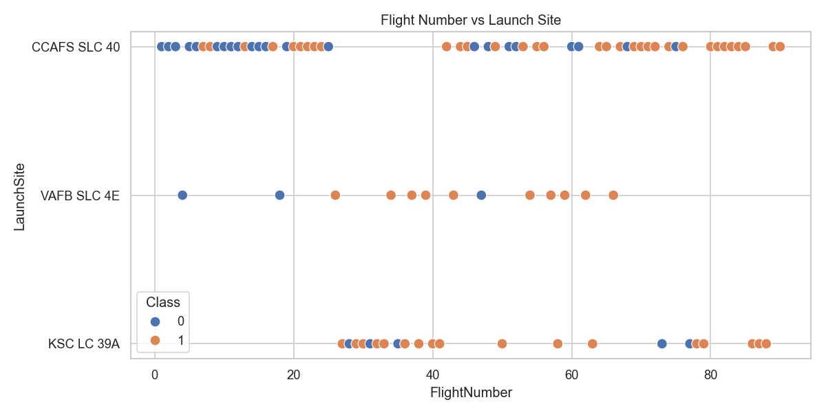
EDA Results — Flight Number vs Launch Site
Later flights (higher experience) show more successes. CCAFS SLC 40 carries the most launches across all phases.
GitHub: https://github.com/Pointsd/Applied-Data-Science-Capstone

Slide 12
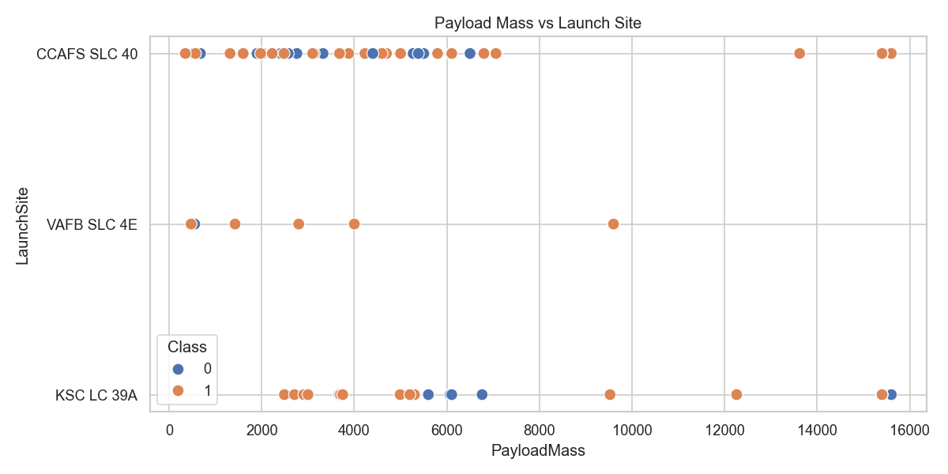
EDA Results — Payload vs Launch Site
Heavier payloads are associated with more successful landings, especially at KSC LC 39A.
GitHub: https://github.com/Pointsd/Applied-Data-Science-Capstone

Slide 13
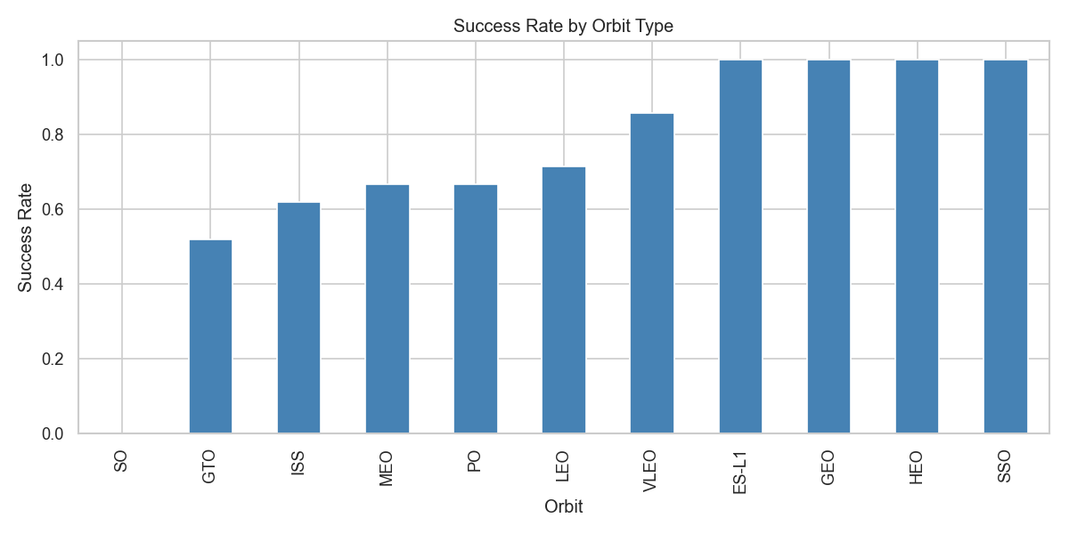
EDA Results — Success Rate by Orbit
Orbits such as ES-L1, GEO, HEO and SSO show the highest landing success; GTO is among the weakest.
GitHub: https://github.com/Pointsd/Applied-Data-Science-Capstone

Slide 14
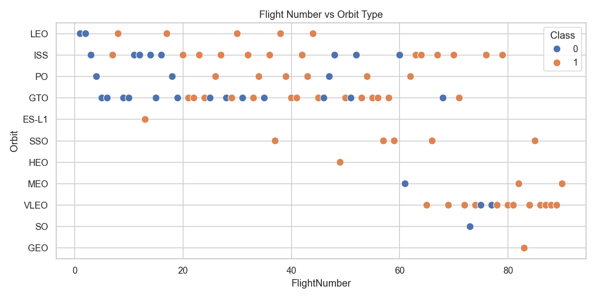
EDA Results — Flight Number vs Orbit
In LEO, success is linked to flight number; in GTO there is no clear relationship.
GitHub: https://github.com/Pointsd/Applied-Data-Science-Capstone

Slide 15
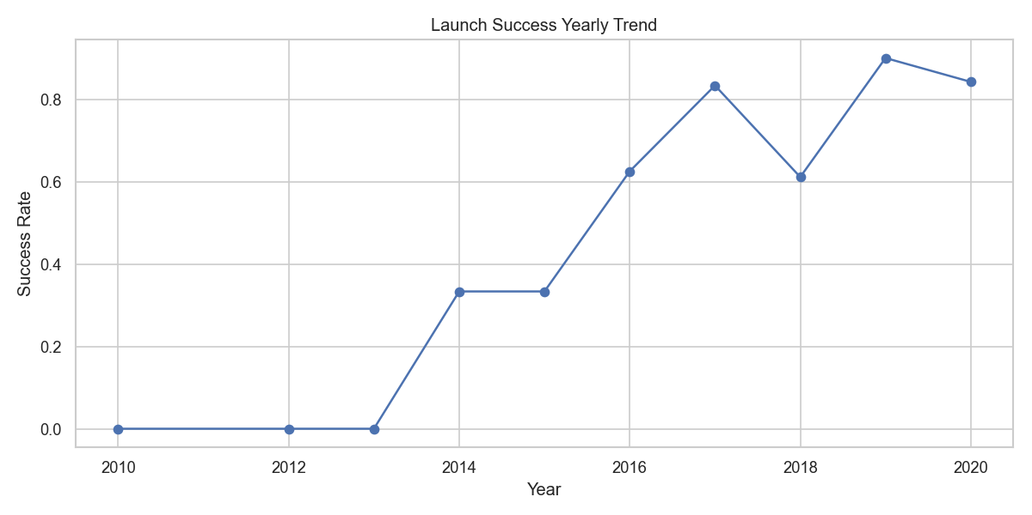
EDA Results — Yearly Success Trend
Success rate climbs steadily from 2013 onward as SpaceX accumulates landing experience.
GitHub: https://github.com/Pointsd/Applied-Data-Science-Capstone

Slide 16
EDA with SQL — Key Findings
4 launch sites
619,968 kg
CCAFS LC-40, KSC LC-39A, VAFB SLC-4E, CCAFS SLC-40
total payload carried by NASA (CRS) boosters
2015-12-22
F9 B5 B1048+
first successful ground-pad (RTLS) landing
boosters carrying the maximum payload (15,600 kg)
GitHub: https://github.com/Pointsd/Applied-Data-Science-Capstone

Slide 17
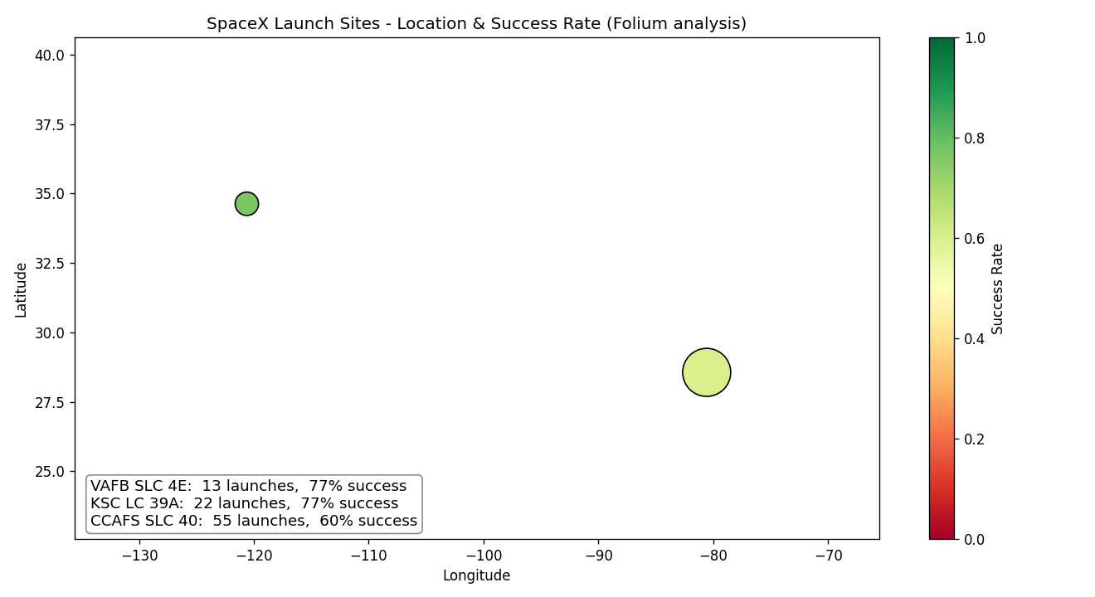
Interactive Map — Folium
All launch sites sit near the coast and the equator.
Marker color = success rate, size = number of launches.
Sites are close to railways and highways but away from cities.
GitHub: https://github.com/Pointsd/Applied-Data-Science-Capstone

Slide 18
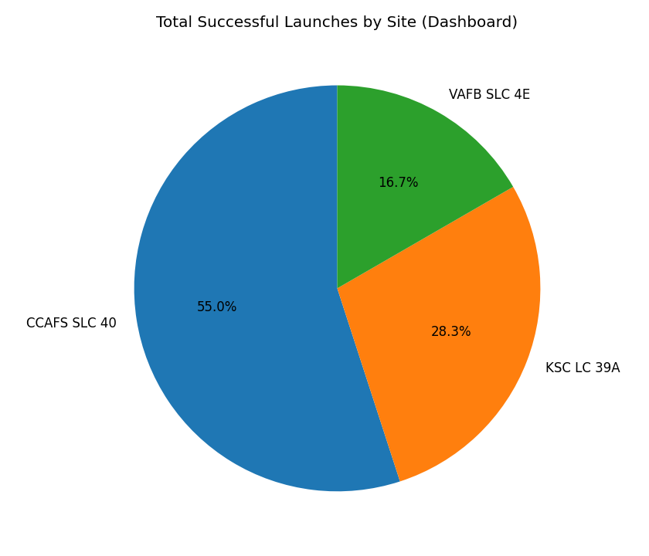
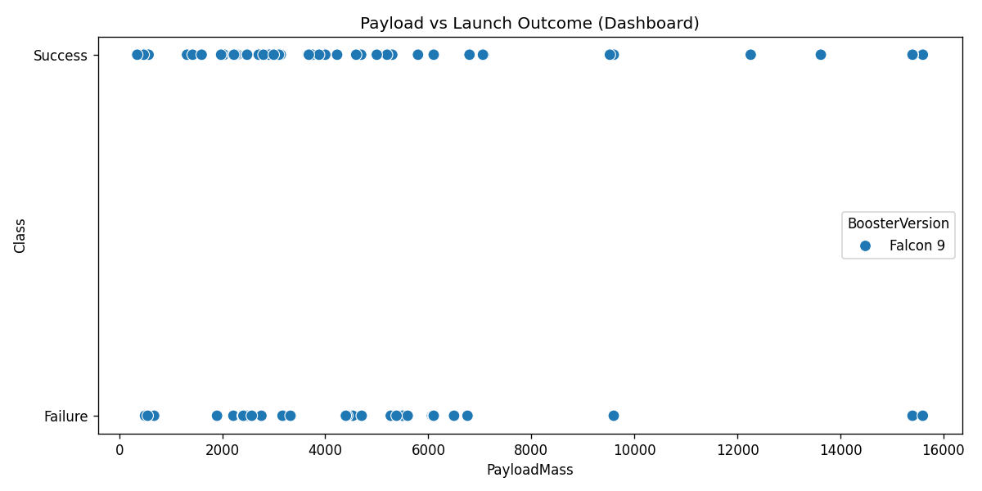
Plotly Dash — Dashboard Results
Success share by site (left) and payload vs outcome by booster version (right).
GitHub: https://github.com/Pointsd/Applied-Data-Science-Capstone

Slide 19
Predictive Analysis — Methodology
Standardized the feature matrix and split into train / test (80 / 20, 18 test rows).
Trained Logistic Regression, SVM, Decision Tree and KNN.
Tuned hyperparameters with GridSearchCV (10-fold cross-validation).
Selected the best model by accuracy and inspected the confusion matrix.
GitHub: https://github.com/Pointsd/Applied-Data-Science-Capstone

Slide 20
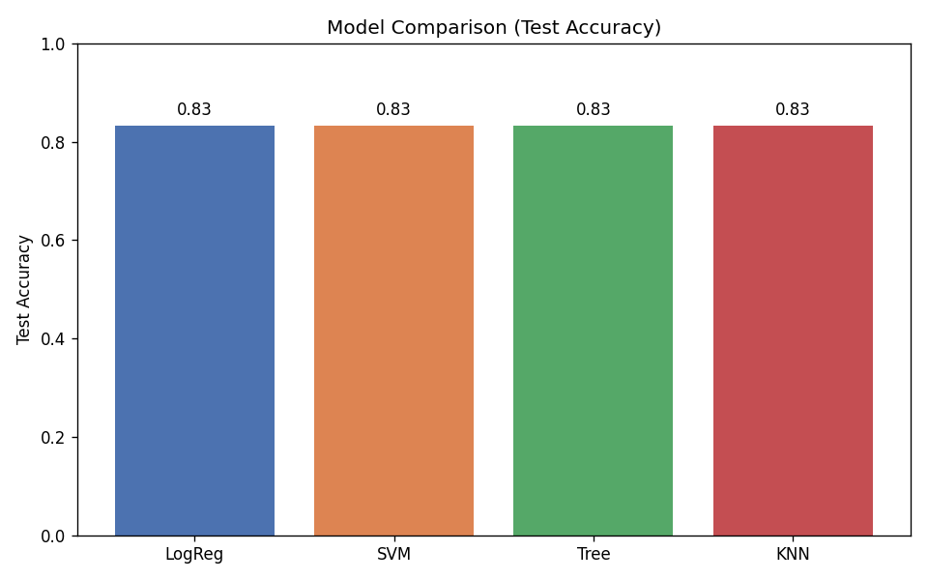
Predictive Analysis — Model Comparison
83.3%
test accuracy
All four models reach the same accuracy on the small test set; Decision Tree had the best validation score.
GitHub: https://github.com/Pointsd/Applied-Data-Science-Capstone

Slide 21
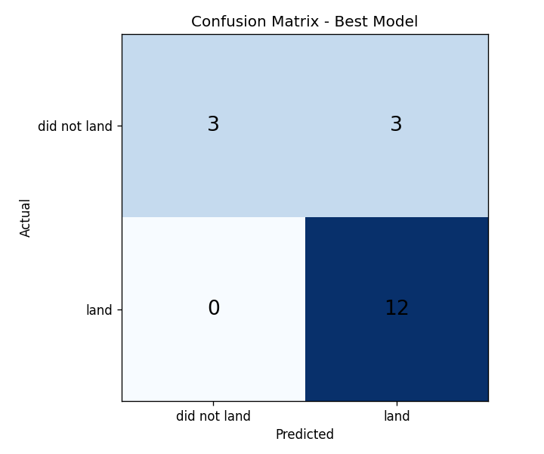
Predictive Analysis — Confusion Matrix
The model correctly identifies most successful landings.
The main weakness is false positives — predicting a landing that did not occur.
More data would help separate the classes further.
GitHub: https://github.com/Pointsd/Applied-Data-Science-Capstone

Slide 22
Conclusions
Landing success has risen markedly since 2013 as SpaceX gained experience.
Flight number, payload mass, orbit type and launch site are all predictive of success.
Low-weight orbits and certain sites (KSC LC 39A) show the highest success rates.
All four tuned classifiers predict landings with ~83% test accuracy.
Future work: enrich with weather and booster-reuse history, and gather more launches to reduce false positives.
Innovation: a deployable bid-estimation tool that turns landing probability into a launch-cost forecast.

Slide 23
Appendix & Resources
All notebooks (data collection, wrangling, EDA SQL, EDA viz, Folium, Dash, ML):
https://github.com/Pointsd/Applied-Data-Science-Capstone
Dataset: SpaceX REST API + Wikipedia launch records (90 Falcon 9 launches).
Thank you!

