Slide 1
Outlier Injection in K-Means Clustering
Poison Cluster Team
Regina Izsa, Máté Balogh, Anass El Aqli, Levente Malecz, Henrik Berényi
Budapest, 2025.05.06

Slide 2
Project Description
Data poisoning attacks: inserting false data to manipulate clustering results
Challenges in detecting poisoned data
K-Means Clustering
Partition-based clustering
Sensitive to outliers and initialization
Iris dataset
Well-known dataset for classification/clustering
Three natural clusters (species)

Slide 3
Attack Strategies
Data Poisoning Attacks
Injecting false data to alter cluster formation
Creating adversarial examples
Outlier Injection:
Synthetic data
Inserting data on cluster borders
Mimicry based attack
Semi-supervised model exploitation
Classification for comparison
Randomized data
Random noise
Label shuffling
Injecting subtle data

Slide 4
Contributions
Regina
Synthetic data based outlier injection between two clusters to blur borders
Máté
Synthetic outlier injection around cluster centroids
Anass
Comparing SVM classification to classification attacks
Levente
Random noise based outlier injection methods
Henrik
Clustering and evaluation of random noise outlier injection methods

Slide 5
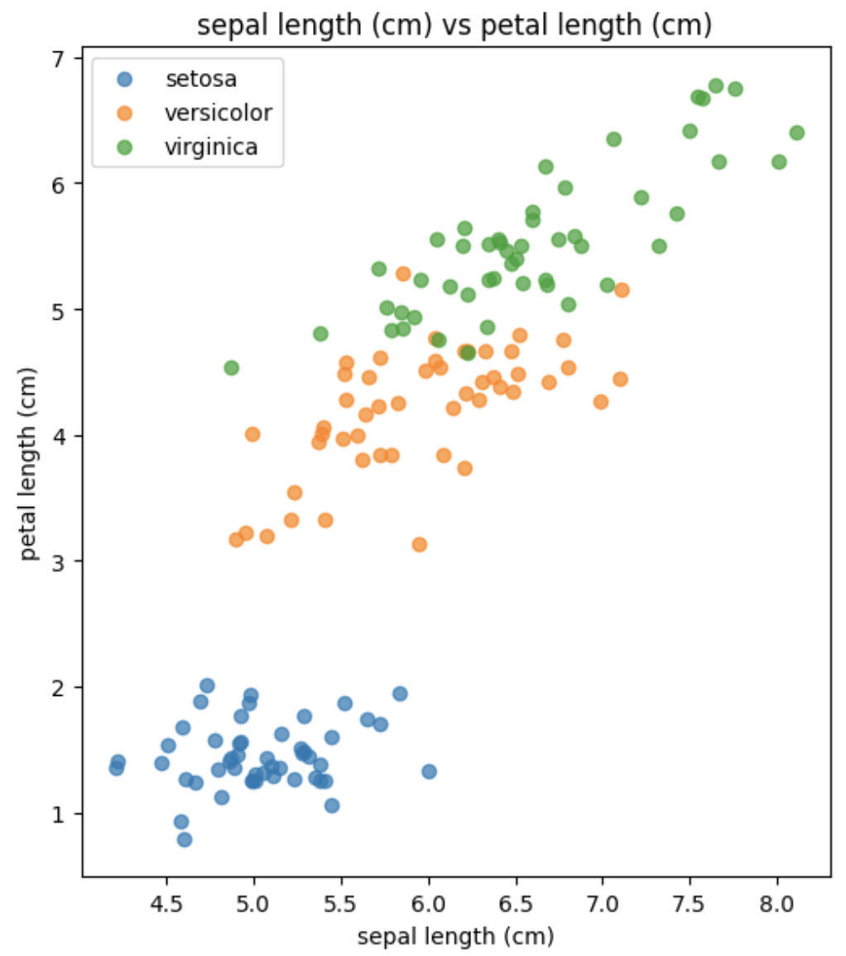
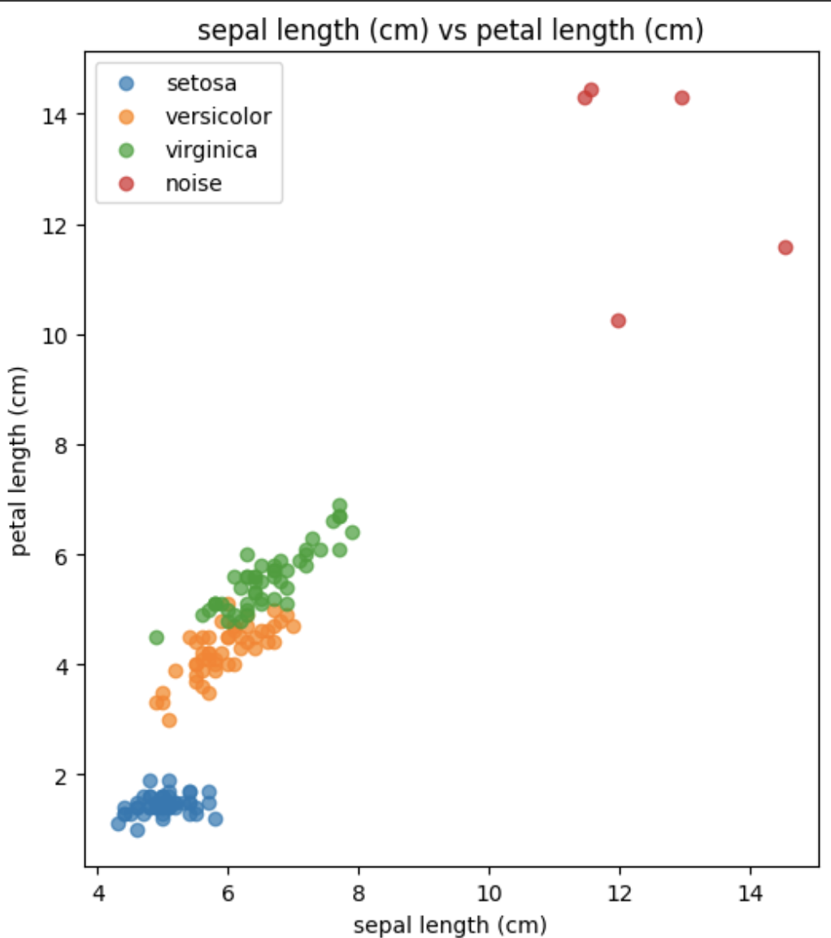
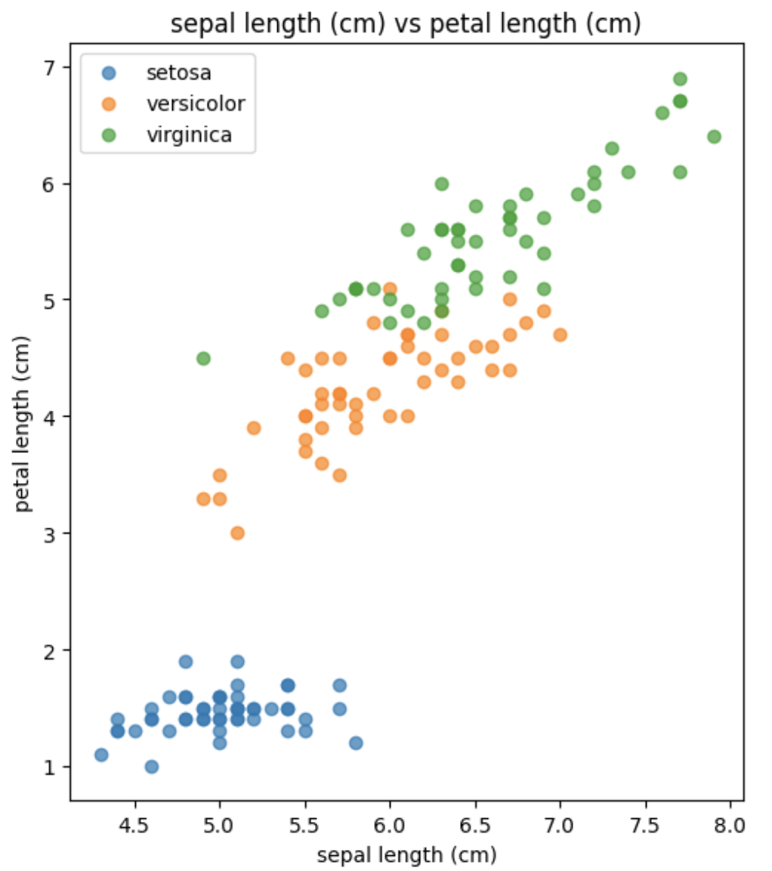
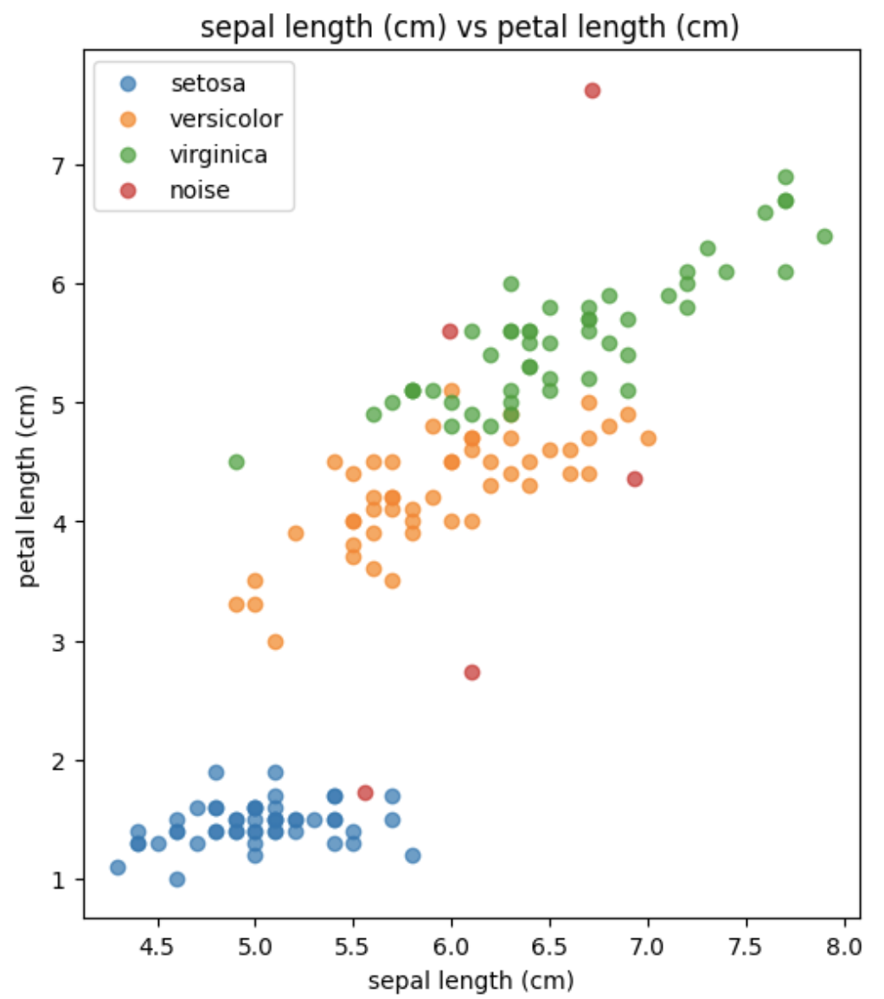
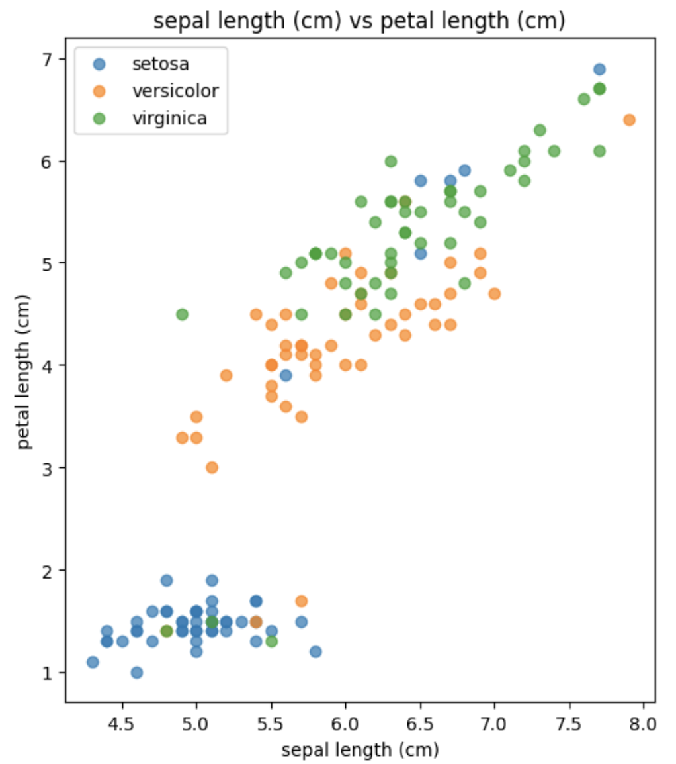
Randomized Injection
Gaussian Noise
Uniform Outliers
Subtle outliers
Shuffled labels

Slide 6
Randomized Injection
 | Noisy | Uniform | Subtle | Shuffled
Pros | Makes clusters fuzzy Reduces cluster boundaries | Creates extreme values | Hard to detect | Greatly disturbs the data
Cons | Varied success due to randomization | Easy to detect | Needs a lot of injected data to cause mass disruption | Has no effect in purely unsupervised settings

Slide 7
Thank you for your attention!

