Slide 1
Did the 2023 electricity price shock speed up rooftop solar in Switzerland?
Y
New PV installations per commune and year
OUTCOME
X
2023 increase in the household electricity tariff
MAIN EXPLANATORY
Z
Share of dwellings lived in by their owner
HETEROGENEITY
[Giraffe] Daoud, Marie, Jieyu

Slide 2
Why it matters
A rooftop panel pays off through two prices: the electricity you no longer buy, and what the grid pays for the rest. The local operator sets both.
35 TWh
+28%
495
renewable electricity excluding hydropower by 2035 (federal target)
household tariff in 2023 for the median commune (+5.1 ct/kWh)
main operators set these prices in our 2,098 communes

Slide 3
Literature
Three studies of prices and solar adoption
Feger et al.
Kiso et al.
Filippini & Garnache
2022 · canton of Bern · structural model
2022 · Japan · prefecture panel, Fukushima
2026 · Norway · south vs north price regions
FOUND
FOUND
FOUND
Prices raise adoption; adopters mostly own homes
Higher prices raised retrofits, barely new builds
Installations surged; buyers overweighted current prices
LIMIT FOR US
LIMIT FOR US
LIMIT FOR US
Little price variation
Ten utilities, a slow rise
One north–south border

Slide 4
Literature · our gap
Each study had one narrow source of price variation
Bern
Japan
Norway
little price variation
ten utilities, a slow rise
one border
Our gap : No solar study we found uses the 2023 Swiss tariff jump: one sudden shock, passed on by hundreds of operators by different amounts, so we can compare communes within the same canton.

Slide 5
Ingredients
Three variables: nature, preparation, limits
Y · OUTCOME
X · MAIN EXPLANATORY
Z · HETEROGENEITY
SFOE plant register
ElCom tariffs
FSO census 2000
PREPARED
PREPARED
PREPARED
Select only solar plants
Place each plant in a commune thanks to its coordinates
Select only H4 tariffs
X = 2023 tariffs – 2022 tariffs
Z = owner-occupied / all occupied dwellings
LIMIT
LIMIT
Commission date is not decision date
The census is 26 years old.
New PV installations
2023 tariff increase
Owner share
Count
Continuous, ct/kWh
Share from 0 to 1
Swiss communes merge every year ⮕ FSO mutation register lists every merger since 2010 ⮕ link each commune with its 2026 number

Slide 6
Data and sample
Result of data cleaning
PLANTS
COMMUNES (OUT OF 2,110)
YEARS
297,633
2,098
2015–2025
SFOE plant register, ElCom, FSO, swisstopo

Slide 7
Summary statistics
 | N | Mean | SD | Min | Median | Max
Y · installations per year, 2017–21 | 2,098 | 8.0 | 9.8 | 0 | 5.2 | 113
Y · installations per year, 2023–24 | 2,098 | 28.4 | 33.5 | 0 | 18.5 | 484
Y · growth, log(1 + n) | 2,098 | 1.10 | 0.44 | −0.82 | 1.13 | 2.41
X · 2023 tariff increase, ct/kWh | 2,098 | 6.6 | 5.0 | −0.5 | 5.1 | 43.0
Z · owner-occupier share | 2,063 | 0.54 | 0.15 | 0.04 | 0.56 | 0.96
Growth: log(1 + installations per year 2023–24) − log(1 + installations per year 2017–21)

Slide 8
Univariate · Y over time
Installations jumped in 2023 and fell in 2025
+165%
2021 → 2023
23,291 → 61,682
SFOE plant register, new PV installations per year, 2,098 communes

Slide 9
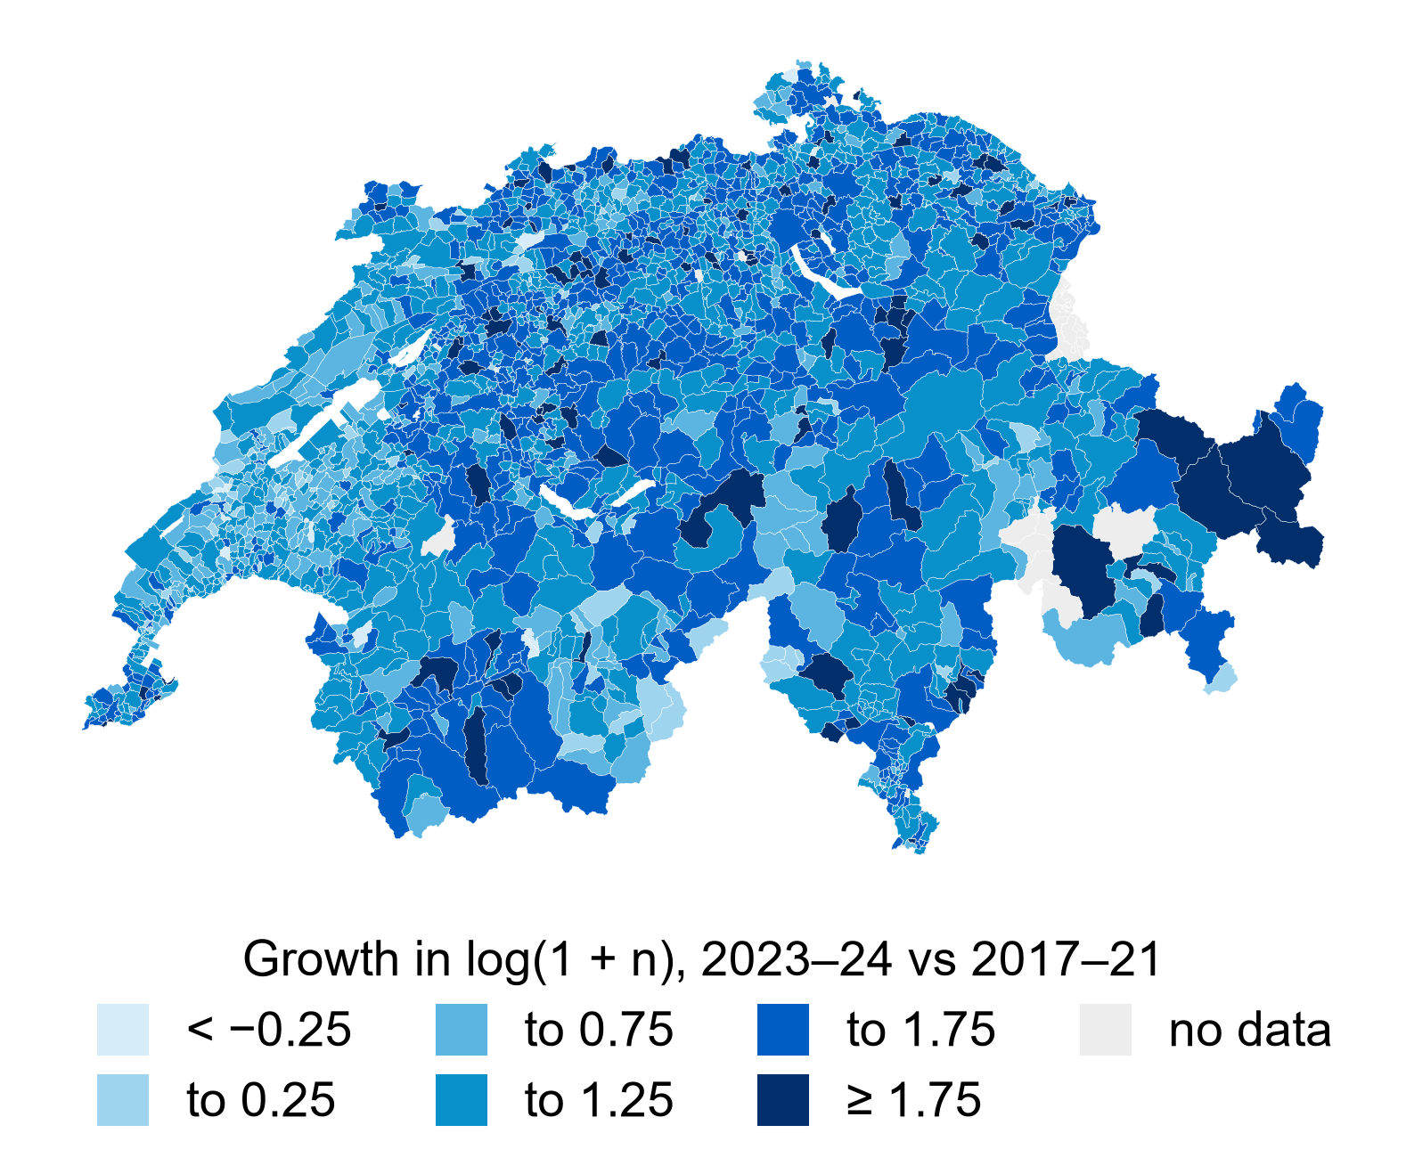
Univariate · Y across communes and space
A skewed count that grew almost everywhere
Median 18.5 per year; 5.2 in 2017–21
98% of communes grew

Slide 10
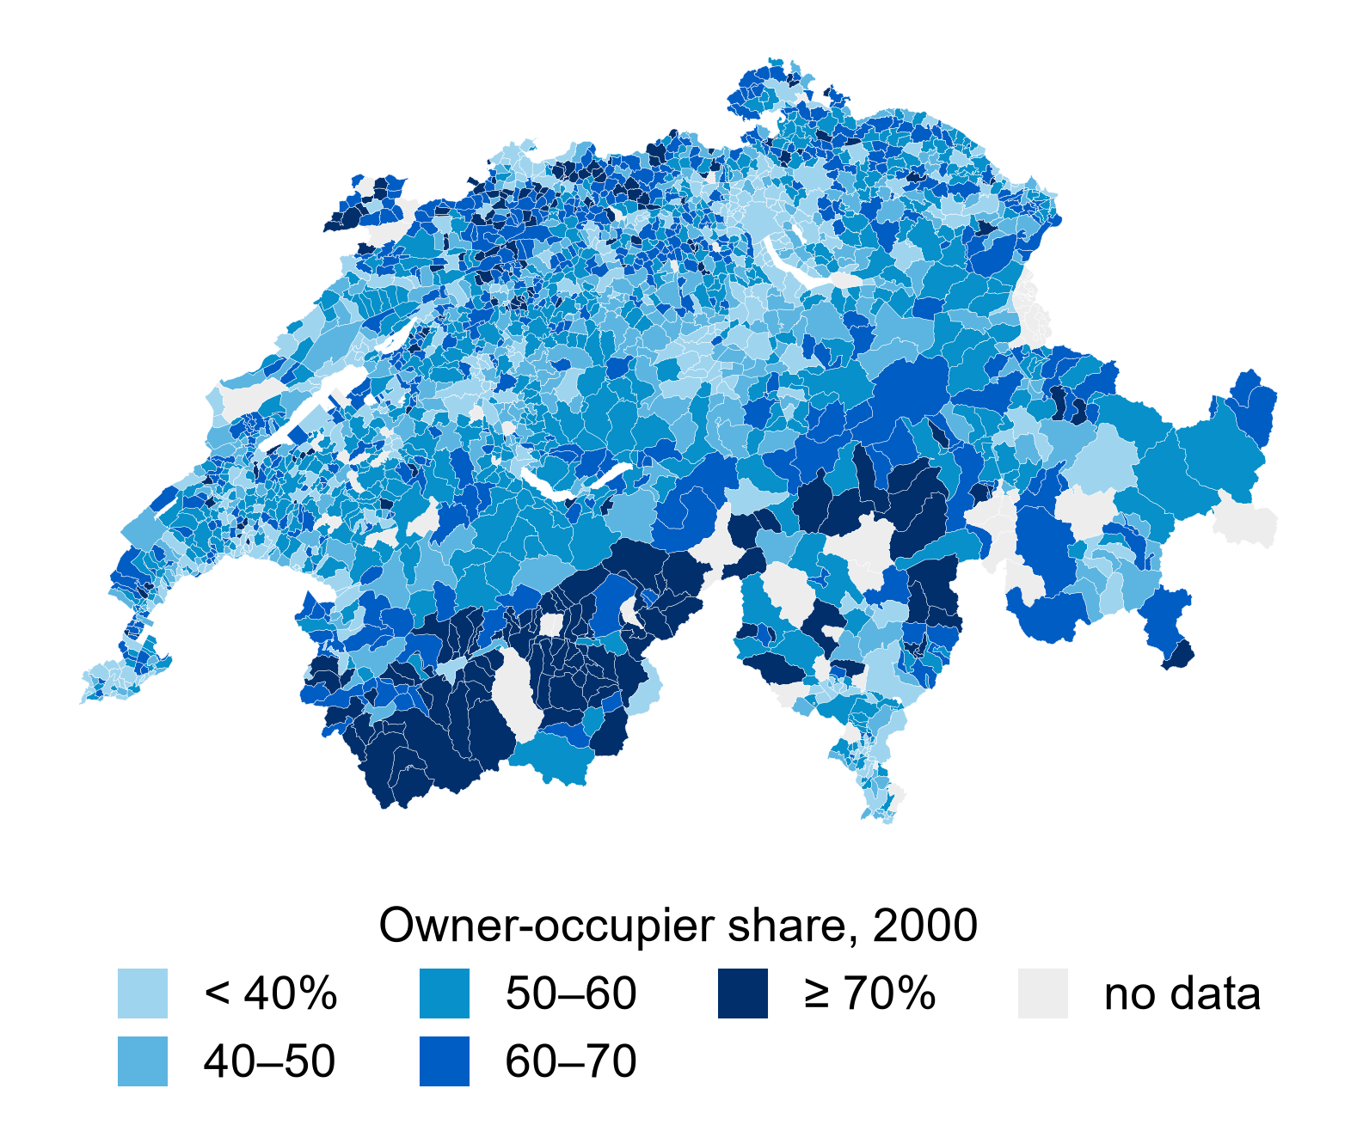
Univariate · Z
Most communes have 40–70% owner-occupiers
Median 56% fixed in time: one census
35 communes without data
FSO census 2000

Slide 11
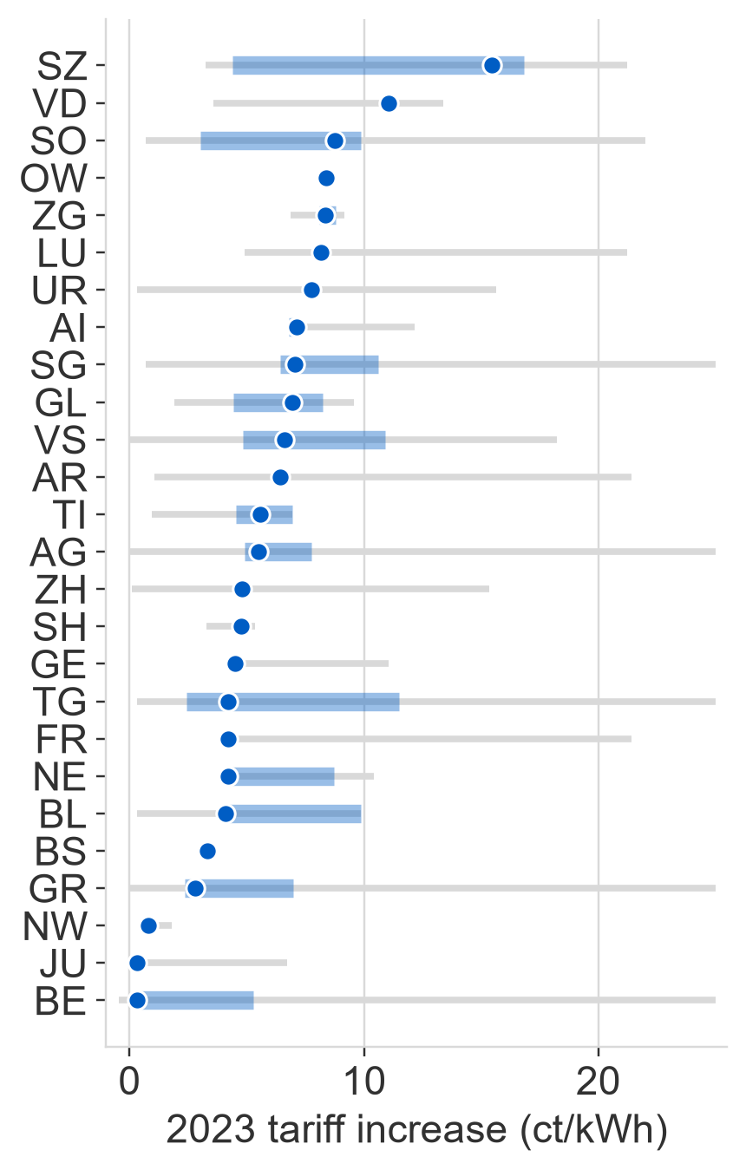
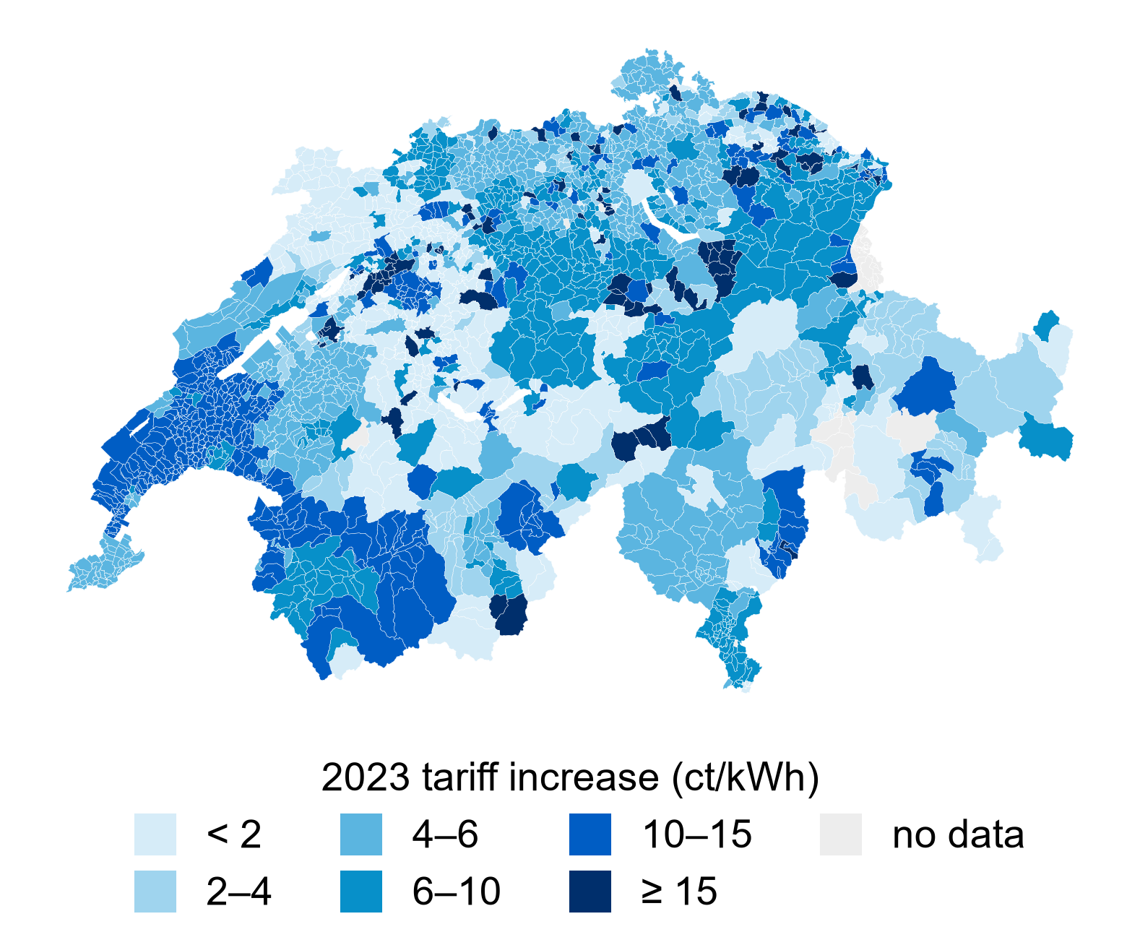
Univariate · X across space
Tariff increases varied widely, even within cantons
+5.1 ct/kWh median tariff increase
74% Variation within cantons
87% Energy share of the average increase
Sources: ElCom household tariffs (H4); swisstopo boundaries
Left chart: dot = median; blue bar = middle 50%; grey line = range, capped at 25 ct/kWh

Slide 12
Bivariate · thirds of X
High-shock communes grew more in 2023, relative to 2021
Mean 2022-2023 tariff increases: +2.0 / +5.9 /+12.3 ct/kWh
2023 installation index: 238 / 265 / 290
Groups based on 2023 tariff increases. Installation totals indexed to 2021 = 100.
Sources: ElCom; SFOE.

Slide 13
Bivariate · commune by commune
Within cantons, larger increases went with faster growth
+0.24
Log points of growth per +10 ct/kWh
95% CI: 0.20 to 0.28
0.02
Placebo: same slope before the shock
2017-2018 vs 2020-2021
95% CI: −0.03 to 0.07
Growth: change in log(1 + average annual installations), from 2017–2021 to 2023–2024.
Axes: deviations from canton means. 95% CIs clustered by main operator (495).
Sources: ElCom; SFOE. 19 communes outside plot limits; included in analysis.

Slide 14
Heterogeneity · Z
A larger shock-group gap in high-homeownership communes
Descriptive Comparison
280 vs 241 2023 index: high vs low shock
308 vs 237 2023 index: high vs low shock
Above the median: gap already in 2022 (160 vs 139)
Same full-sample X groups in both Z halves. Installation totals indexed to 2021 = 100.
Sources: ElCom; SFOE; FSO census 2000. Z split at the median (56%).

Slide 15
Causality · Is there something else? (endogeneity)
The shock was not random
Operator type matters
Two price incentives changed
Low-shock groups caught up
Other factors may matter
5.8 vs 8.5 ct/kWh
r = 0.79
8.6 → 4.3 ct
not measured
Lower average increases with operators serving 10+ communes
Retail and feed-in tariff changes moved together
The high–low tariff gap halved in 2024
Local subsidies and installer queues
Larger operators serve 10+ sample communes. Feed-in comparison: 2021–2023, N = 1,994.
Sources: ElCom; VESE / pvtarif.ch (feed-in tariffs).

Slide 16
Causality · the reverse? can we extrapolate?
A positive association, but causality remains uncertain
Could solar growth affect tariffs?
Can we extrapolate?
2023 tariffs were announced in 2022, before the post-shock installations.
X has little correlation with existing PV per resident in 2021 (r = 0.03).
One exceptional price shock during an energy crisis
Commune-level results, not individual household responses
PV installations in our sample: 12% exceed 30 kW
These checks do not rule out reverse causality.
Sample bias: 12 communes excluded; Z missing for 35.
NEXT, FOR THE FINAL
01. Better data
02. Test homeownership
03. Other explanations
Find more recent homeownership data and improve coverage.
Test whether the price–solar relationship differs by homeownership.
Account for feed-in tariffs and other local factors.

