Slide 1
Battleship
Shubham Bhardwaj

Slide 2
Objective
Making a bot for optimal targeting of ships.
A Goal Based Agent
Sequentially call shots to eventually drown all the player’s ships
Strategically and dynamically in an partially visible environment.

Slide 3
Rules
The object of Battleship is to try and sink all the opponent's ships before the other does the same.
Opponents board is not visible.
The board is a 10x10 matrix.
Ships can be placed vertically and horizontally but cannot overlap.
Position of ships is constant
There only two results of a shot, either a HIT or a MISS.

Slide 4
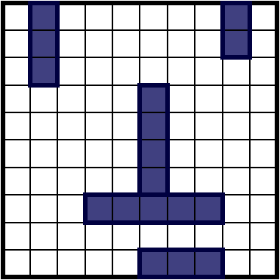
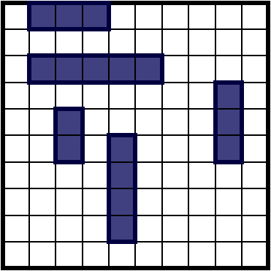
Placement of Ships

Slide 5
Targeting Method
Targeting method is the algorithm used for sinking the opponents ships.
There are a few common algorithms we need to look at before developing one on our own.
The algorithms we will be discussing are:
Random Play
Hunt / Target
Parity

Slide 6
Random Play
The most basic form of targeting is random play.
It is to make shots totally at random.
Mathematically, the chances of playing a perfect game with random firing are: 1.5 x 10-19.
This equates to, on average, once in every 6,650,134,872,937,201,800 games!

Slide 7
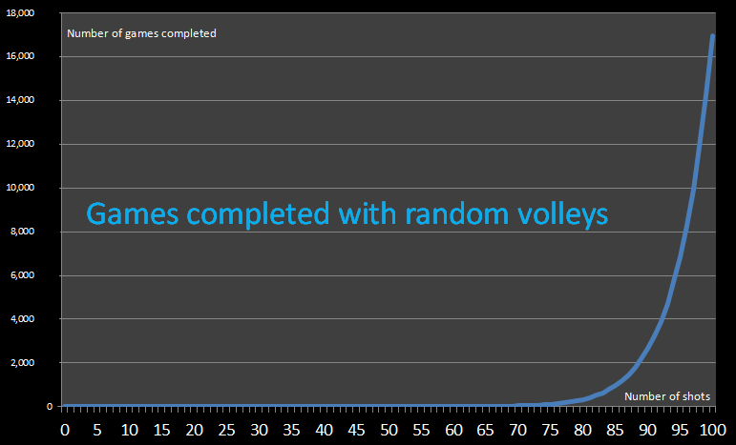
Random Play
Notes:
I studied 100 thousand simulations of random games, and the smallest number of moves I encountered was 44 shots.
It should be no surprise that number of games that required all 100 shots to be fired is 17 million. After all, there is a 17/100 chance that the last square visited will contain a ship.
96 shots are required to complete approx. 50% of the games, and 99% of the games will take more than 78 shots.

Slide 8
Hunt / Target
Initially, shots can be fired at random, but once part of a ship has been hit (Hunt Mode).
Then search up, down, left and right looking for more of the same ship (Target Mode).
After sinking a ship in target mode it reverts back to hunt mode looking for the next ship.
Even though far from elegant, this algorithm produces significantly better results than random firing.

Slide 9
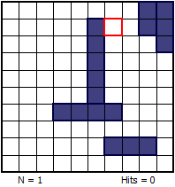
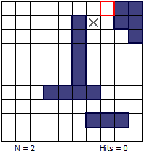
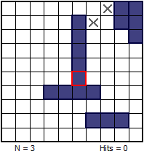
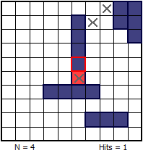
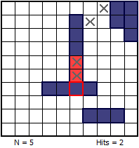
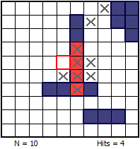
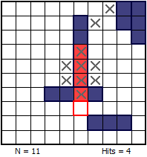
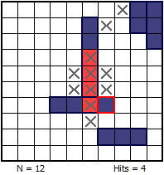
Hunt / Target
Notes:
In the first 3 pictures you can see the system is in hunt mode, from the 4th when we get the first hit system goes into target mode.

Slide 10
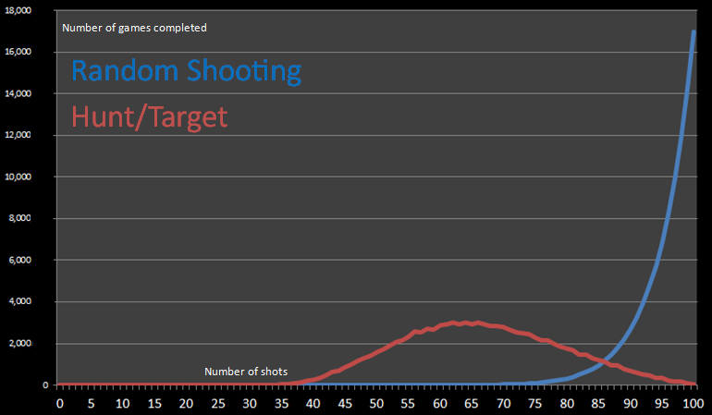
Hunt / Target
Notes:
The best result here was 32, and event thought the worst was still 100 the frequency is really low.
50% of the games end by the time 63 shots are taken.

Slide 11
Parity
We can make a slight improvement to the Hunt part of the algorithm using parity.
As the minimum length of a ship is two units long, we don't need to search every location on the board.
We can use our Hunt algorithm to only randomly fire into unknown locations with even/odd parity.
It's impossible to place any ship so that it does not touch that parity.

Slide 12
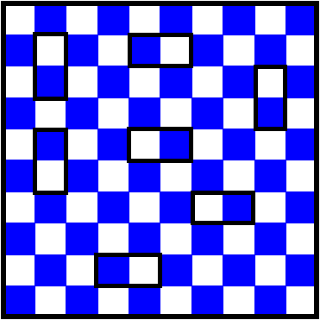
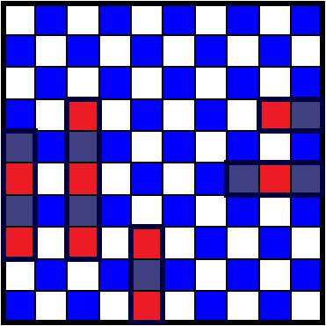
Parity
Notes:
Hitting one block will be equivalent to hitting 2 blocks.

Slide 13
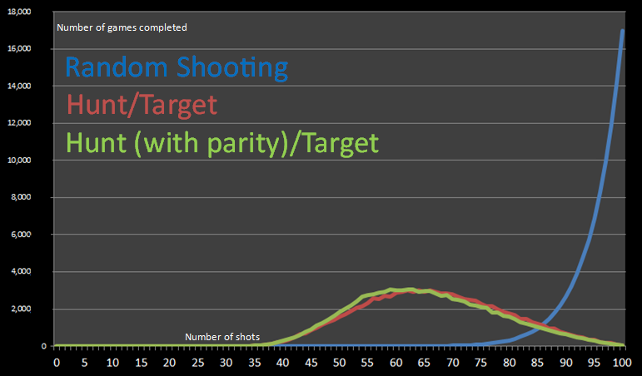
Parity
Notes:
The parity algorithm gives improvement over the entire range, but the incremental gain is small.
The biggest drain on shots is the unnecessary walking around the edges of targets. Using the parity filter in Hunt mode has reduced the shot count, but once the algorithm gets into Target mode, it is just as inefficient as it was.
50% games were completed within 61 shots.

Slide 14
Probability Density
Our new algorithm will need to hit the most probable location to fire at next based on positions already revealed.
At the start of every new turn, based on the ships still left in the battle, we’ll work out all possible locations that every ship could fit.
Initially, the shots will be pretty much anywhere, but as more and more shots are fired, some locations become less likely, and some impossible.

Slide 15
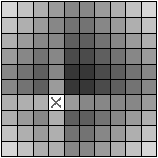
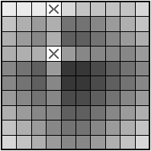
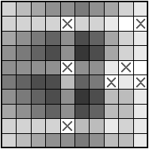
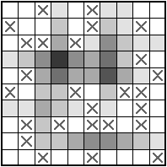
Probability Density
Notes:
In all these examples, shading is used to depict the probability. Dark colours represent high probability, and light colours represent low probability.
In 3rd configuration we can see a white square. It is impossible for the aircraft carrier to pass through this square.
At last a fictitious board layout with lots of misses marked. Many of the locations are impossible to host the carrier. The darker the shading, the more possible ways that the carrier could use this square.

Slide 16
New Algorithm
This algorithm still has a hunt mode and target mode, though both operate essentially the same way.
There are only three states to worry about: unvisited space, misses and sunk ships.
Sunk ships and misses are mostly considered the same.
Instead of using parity to search at two locations, I am searching three locations at once.

Slide 17
New Algorithm
2 | 2 | 4 | 4 | 4 | 4 | 4 | 4 | 3 | 2
4 | 4 | 5 | 5 | 5 | 5 | 5 | 5 | 4 | 3
4 | 3 | 6 | 6 | 6 | 6 | 6 | 6 | 5 | 4
4 | 4 | 6 | 6 | 6 | 6 | 6 | 6 | 5 | 4
4 | 5 | 6 | 6 | 6 | 6 | 6 | 6 | 5 | 4
4 | 5 | 6 | 6 | 6 | 6 | 6 | 6 | 5 | 4
4 | 5 | 6 | 6 | 6 | 6 | 6 | 6 | 5 | 4
4 | 5 | 6 | 6 | 6 | 6 | 6 | 6 | 5 | 4
3 | 4 | 5 | 5 | 5 | 5 | 5 | 5 | 4 | 3
2 | 3 | 4 | 4 | 4 | 4 | 4 | 4 | 3 | 2
Probability Density for searching at three locations.
Division of grid into blocks to find best region to shoot.

Slide 18
New algorithm
2 | 3 | 4 | 4 | 4 | 4 | 4 | 4 | 3 | 2
3 | 4 | 5 | 5 | 5 | 5 | 5 | 5 | 4 | 3
4 | 5 | 6 | 6 | 5 | 6 | 6 | 6 | 5 | 4
4 | 5 | 6 | 6 | 4 | 6 | 6 | 6 | 5 | 4
4 | 5 | 5 | 4 | 0 | 5 | 6 | 6 | 5 | 4
4 | 5 | 6 | 6 | 4 | 6 | 6 | 6 | 5 | 4
4 | 5 | 6 | 6 | 5 | 6 | 6 | 6 | 5 | 4
4 | 5 | 6 | 6 | 6 | 6 | 6 | x | 5 | 4
3 | 4 | 5 | 5 | 5 | 5 | 5 | 5 | 4 | 3
2 | 3 | 4 | 4 | 4 | 4 | 4 | 4 | 3 | 2
-1 | -1 | -1 | -1 | -1 | -1 | -1 | -1 | -1 | -1
-1 | -1 | -1 | -1 | -1 | -1 | -1 | -1 | -1 | -1
-1 | -1 | -1 | -1 | -1 | -1 | -1 | -1 | -1 | -1
-1 | -1 | -1 | -1 | -1 | -1 | -1 | -1 | -1 | -1
-1 | -1 | -1 | -1 | 0 | -1 | -1 | -1 | -1 | -1
-1 | -1 | -1 | -1 | -1 | -1 | -1 | -1 | -1 | -1
-1 | -1 | -1 | -1 | -1 | -1 | -1 | -1 | -1 | -1
-1 | -1 | -1 | -1 | -1 | -1 | -1 | 5 | -1 | -1
-1 | -1 | -1 | -1 | -1 | -1 | -1 | -1 | -1 | -1
-1 | -1 | -1 | -1 | -1 | -1 | -1 | -1 | -1 | -1
2 | 2 | 0 | 0 | 0 | 0 | 0 | 4 | 0 | 0
0 | 0 | 0 | 0 | 0 | 0 | 0 | 4 | 0 | 0
0 | 0 | 3 | 0 | 0 | 0 | 0 | 4 | 0 | 0
0 | 0 | 3 | 0 | 0 | 0 | 0 | 4 | 0 | 0
0 | 0 | 3 | 0 | 0 | 0 | 0 | 0 | 0 | 0
0 | 0 | 0 | 0 | 0 | 0 | 0 | 0 | 0 | 0
0 | 0 | 0 | 0 | 0 | 0 | 0 | 0 | 0 | 0
0 | 0 | 0 | 0 | 5 | 5 | 5 | 5 | 5 | 0
0 | 0 | 0 | 0 | 0 | 0 | 0 | 0 | 0 | 0
0 | 0 | 3 | 3 | 3 | 0 | 0 | 0 | 0 | 0
Probability Density
Sea Matrix
Input

Slide 19
New Algorithm
Generate the Probability Density Matrix
Select the highest density block
While not a hit
keep hitting according to the map
While hits is less than ship length
n = M[i,j]
if it’s a hit and n == M[hit coord]

Slide 20
If not all ships drowned
goto step 2
End

Slide 21
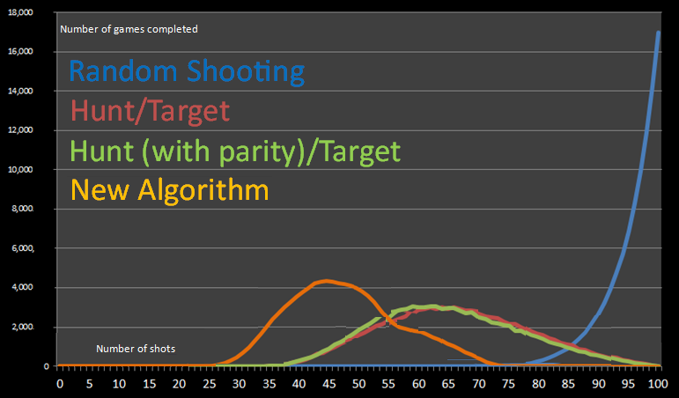
New Algorithm
Notes:
As you can see, the results are a lot better. No game took longer than 78 moves to complete, and approximately one in every 3.8 million games played with random boards was a perfect game.
50% were over by 49 moves.

Slide 22
References
Wikipedia
Data Genetics
New Mexico State University

Slide 23
Thank You

