Slide 1
Introduction to Github and Webstorm
by
Arthur H. Hendela, Ph.D.
Senior University Lecturer,
NJIT
IS117

Slide 2
What is Github?
An open source version control system
Version control is the use of a system to keep track of changes to source code or other documents
Allows the ability for multiple people to work on the same document at the same time
Can revert to a previous version if serious bugs are introduced
Free version is available
Created by Linus Torvalds, creator of Linux
2

Slide 3
Benefits of Github
Tracks changes to source code
Provides a single point for potential employers to see your projects
Resolve change conflicts between contributors
Documents why change was made
Splits code between a local work area and an online repository, Github
Can work with Git, the command line version, available for Windows, Mac, Linux, and browser based Github.
3

Slide 4
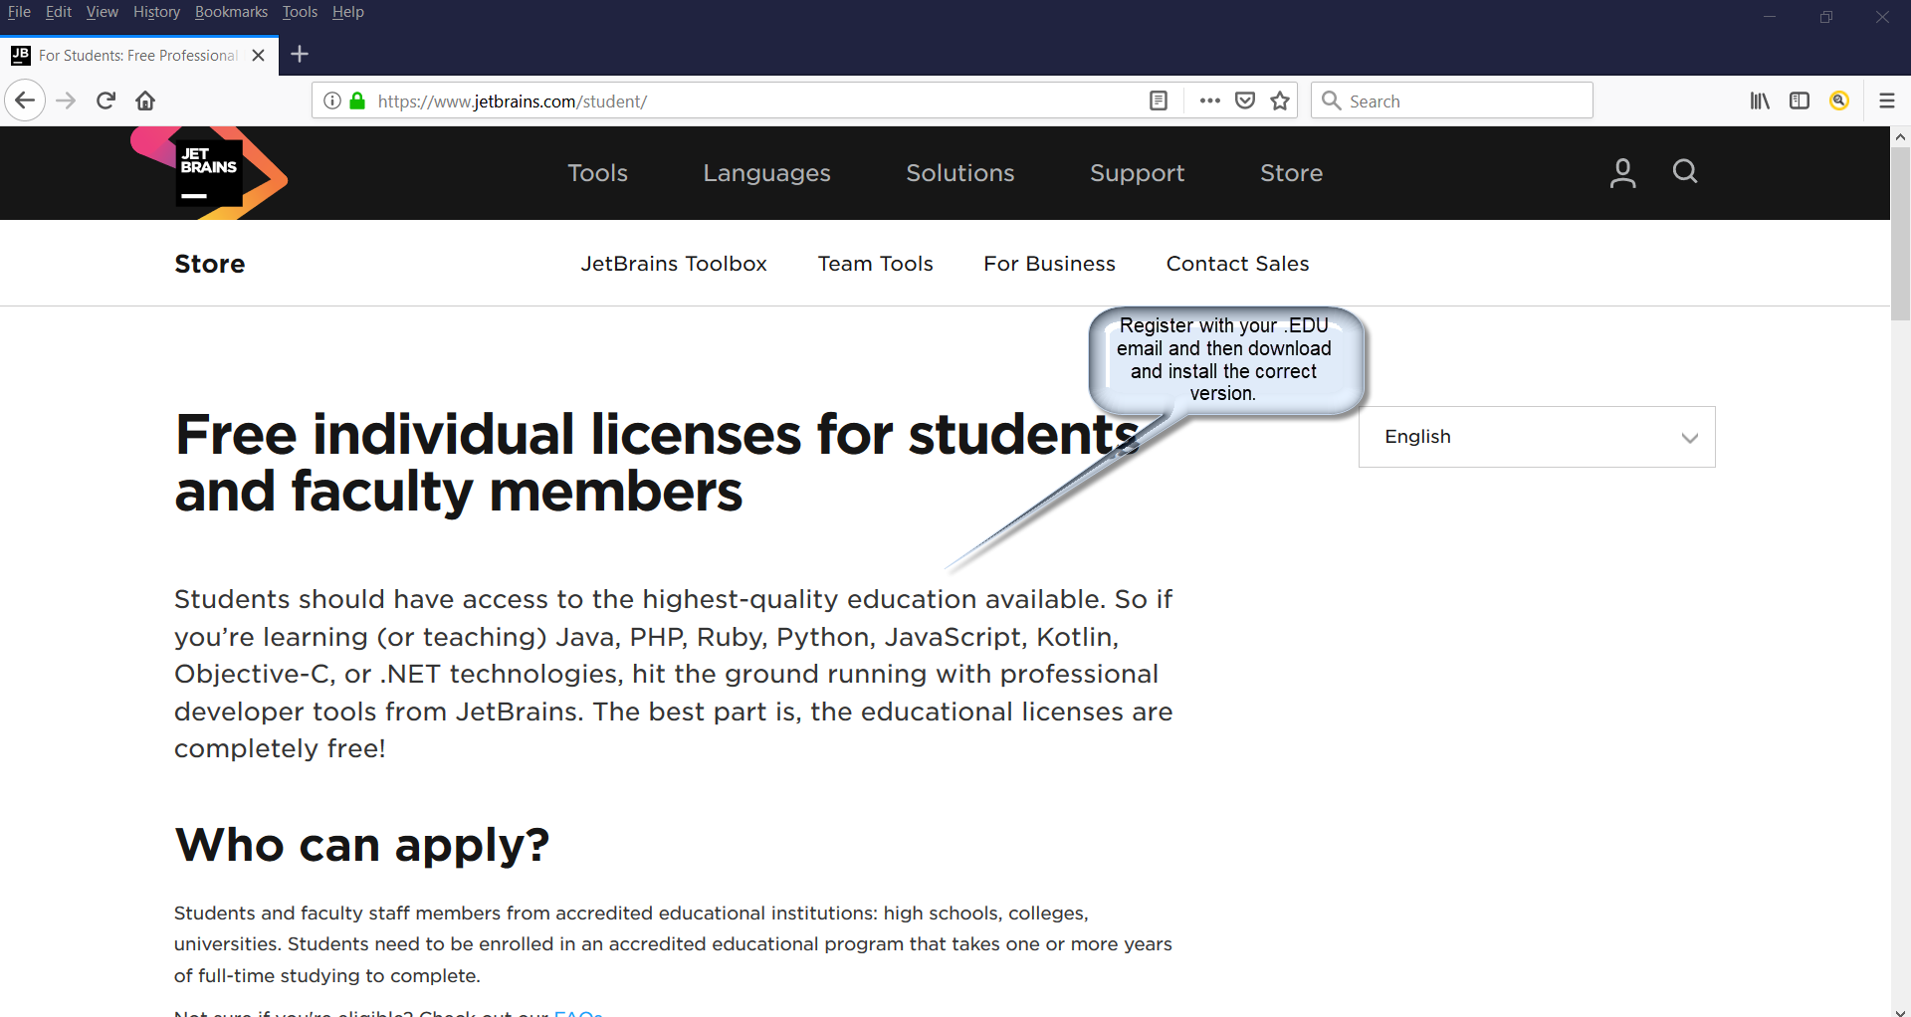
Install Webstorm
Download from : https://www.jetbrains.com/student/
4

Slide 5
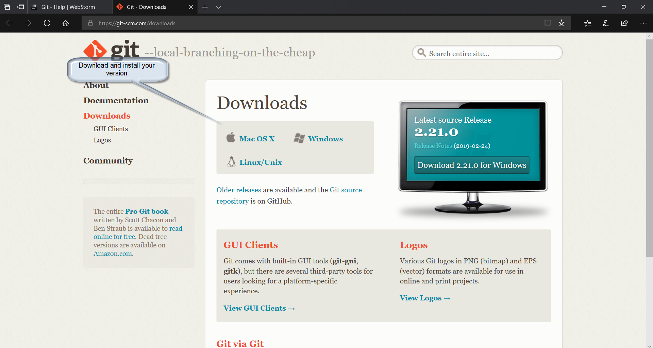
Install Git as a Local Program
Download from : https://git-scm.com/downloads
5

Slide 6
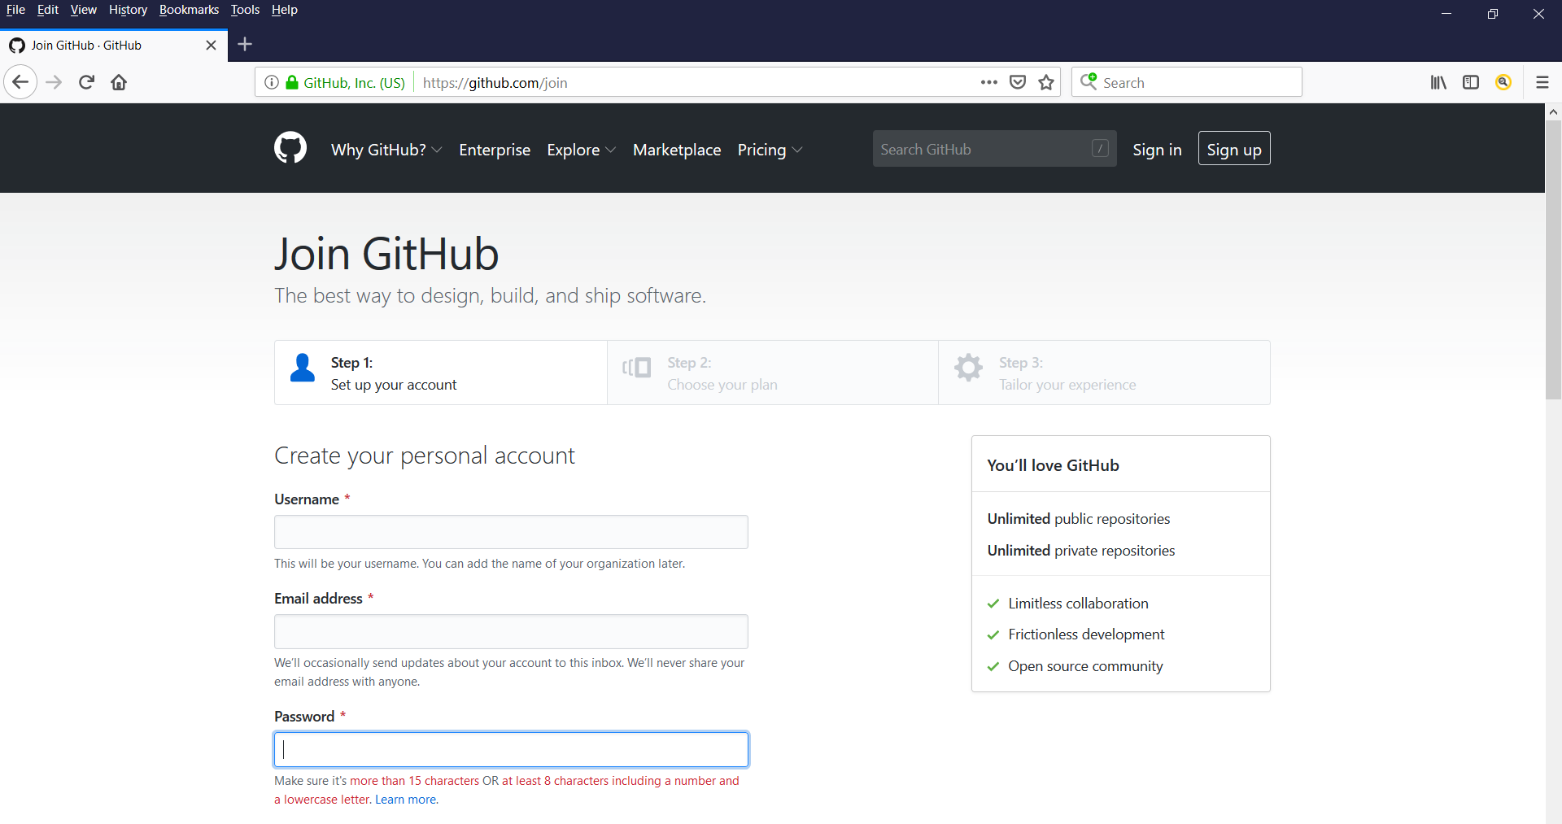
Set Up Github
Create a Github account: https://github.com/join
6

Slide 7
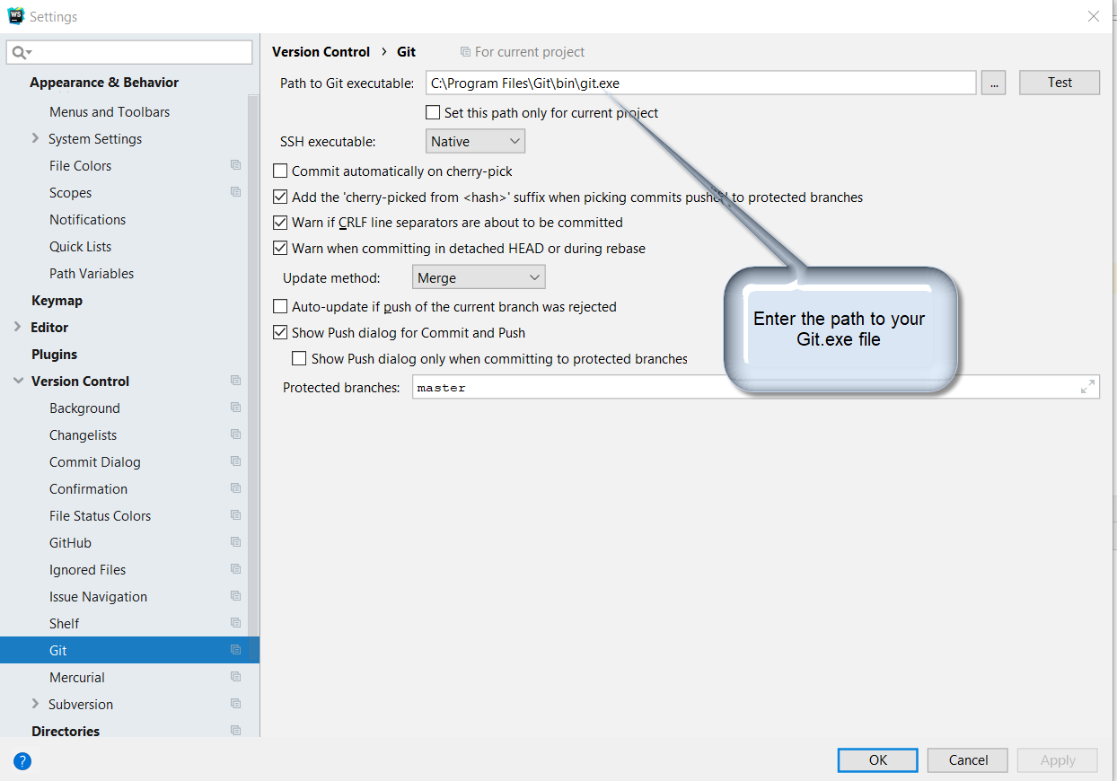
Connect Github with Webstorm
In Webstorm press (Ctrl+Alt+S) for system preferences.
Select Version control Git. Enter the path to the git.exe
7

Slide 8
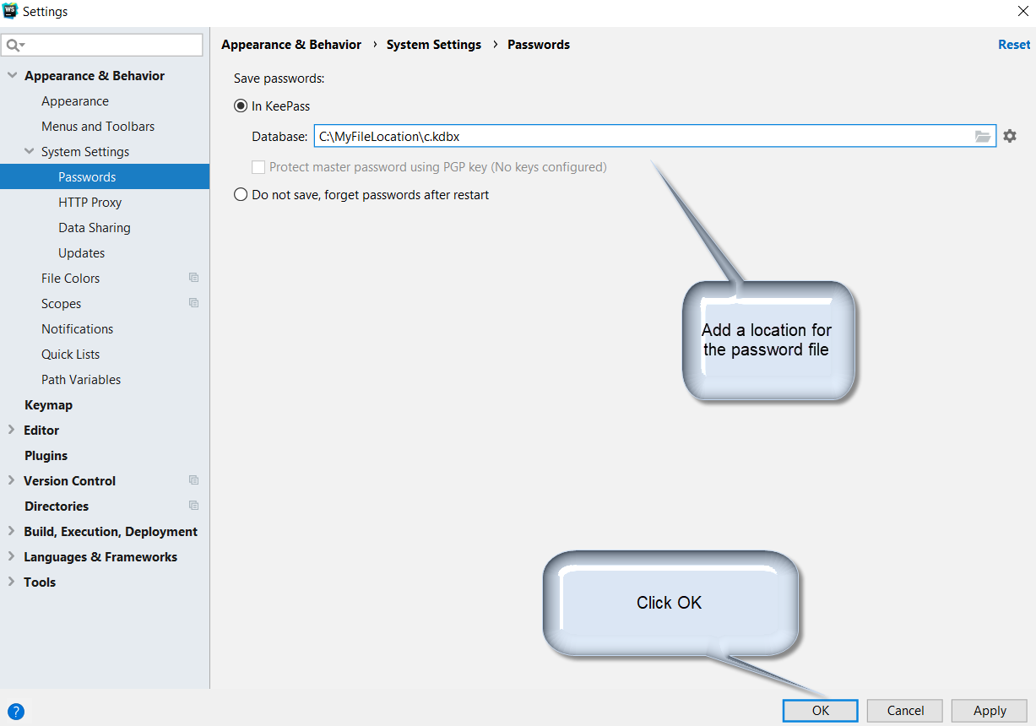
Add Github Password to Webstorm
In Webstorm press (Ctrl+Alt+S) for system preferences
Select Appearance and Behavior | System Settings | Passwords
8

Slide 9
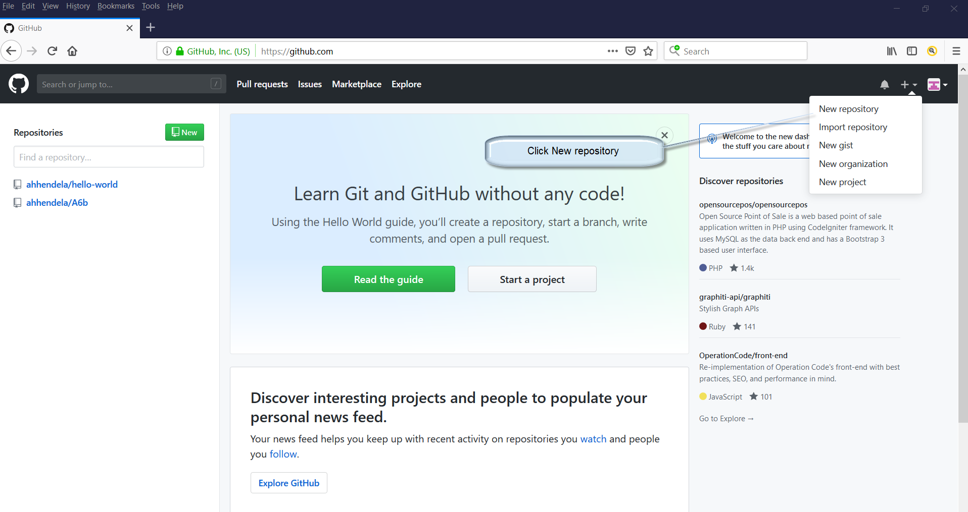
Create a Repository
Click the + sign in the upper right corner
Choose “Create New repository”
9

Slide 10
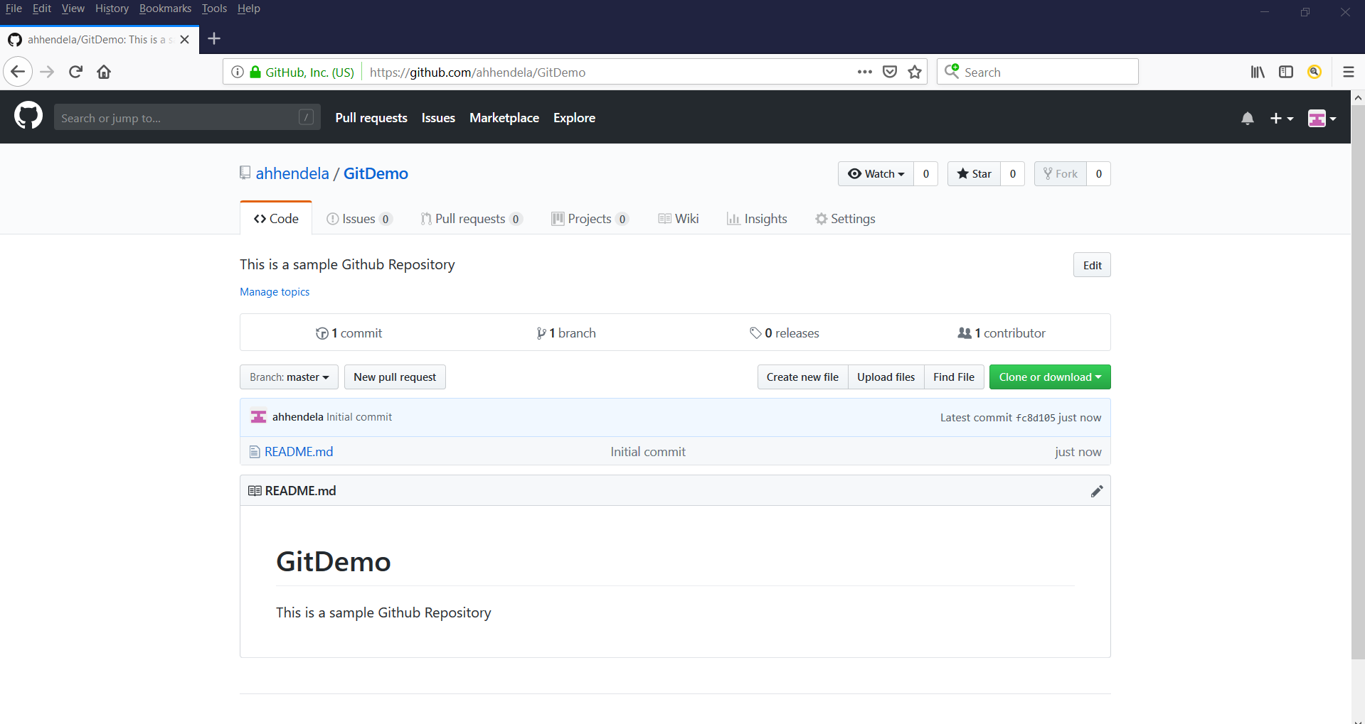
The Repository is Set-up
Make the repository public and add the readme file. Click Create
10

Slide 11
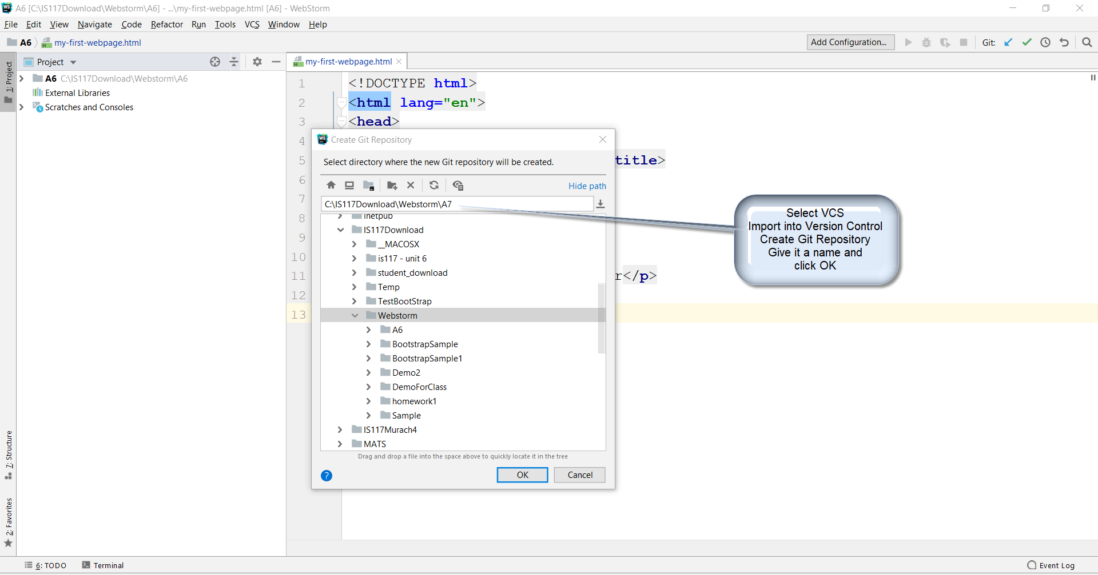
Create a Repository from Webstorm
Select VCS and Import into Version Control

Slide 12
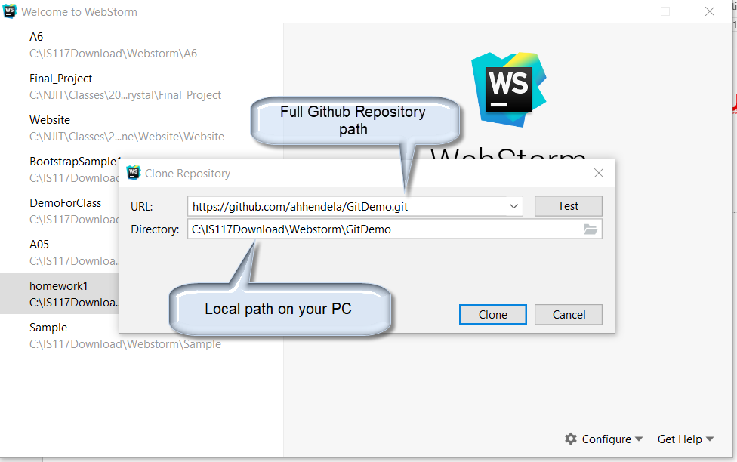
Import a Repository from Github
From Main page Select Checkout from version control→ Git OR
From within Webstorm Select VCS → Checkout from version control→ Git
Enter Github repository name
Enter local path name
12

Slide 13
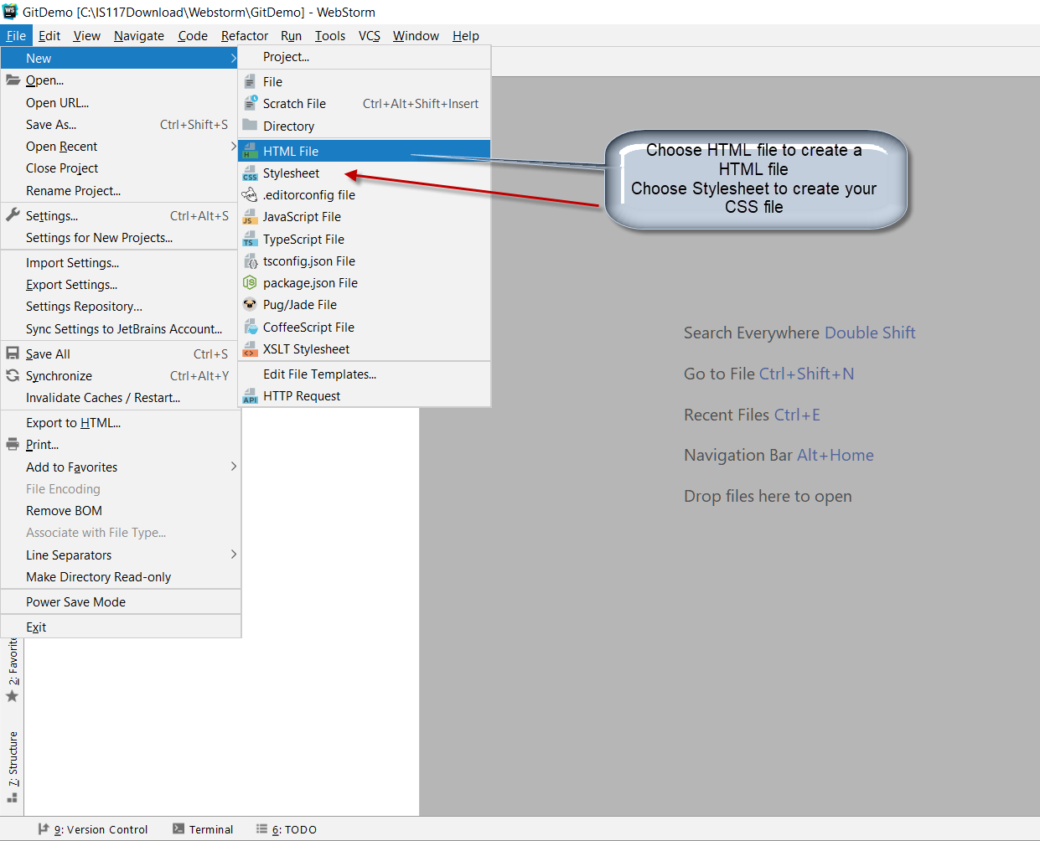
Creating a Webstorm File
Choose File → HTML→HTML 5 or File→Stylesheet
13

Slide 14
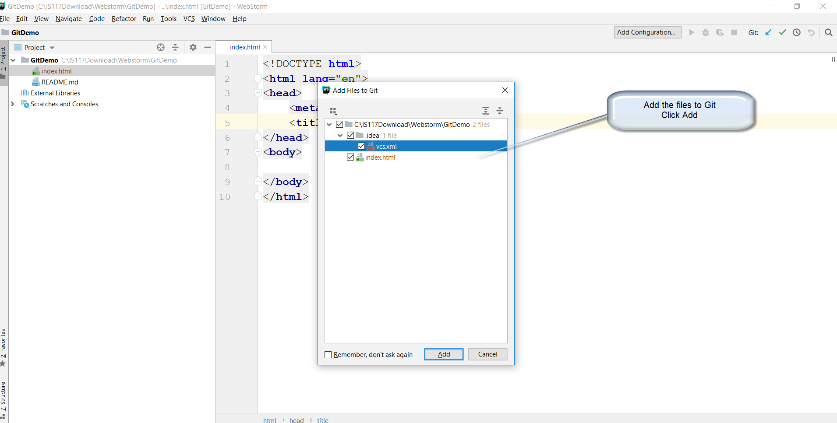
Add files to Git
The Add to Git dialog opens. Click Add. This adds to local file system
14

Slide 15
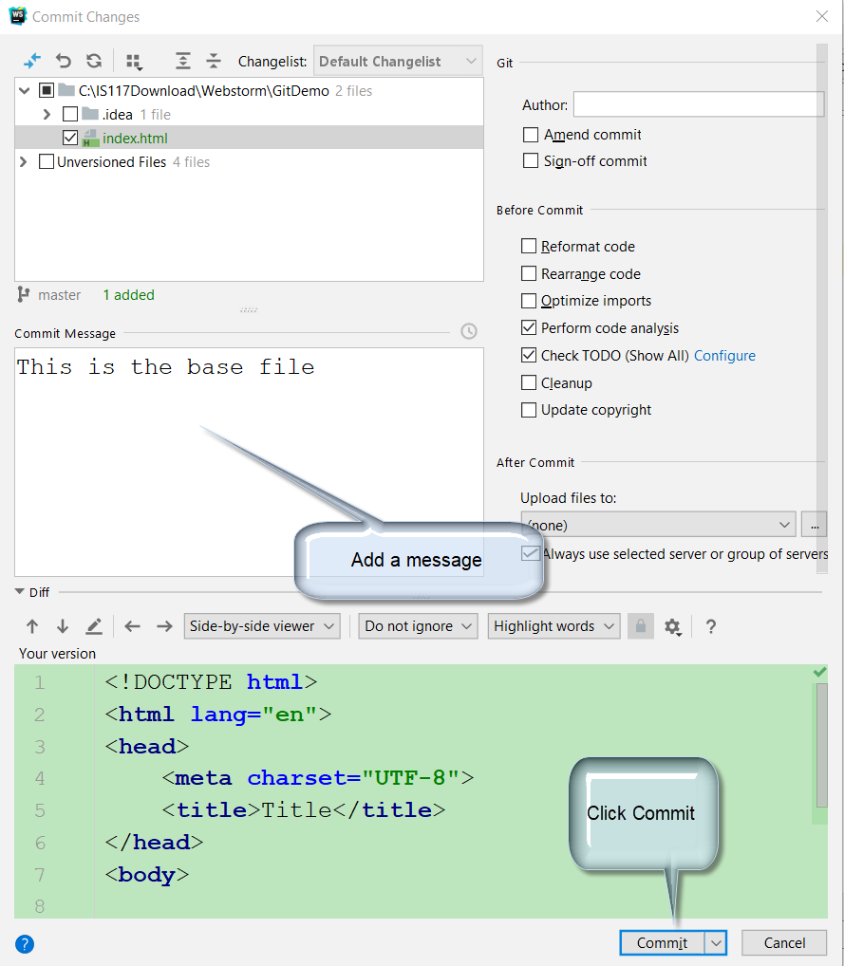
Commit Your Changes
15

Slide 16
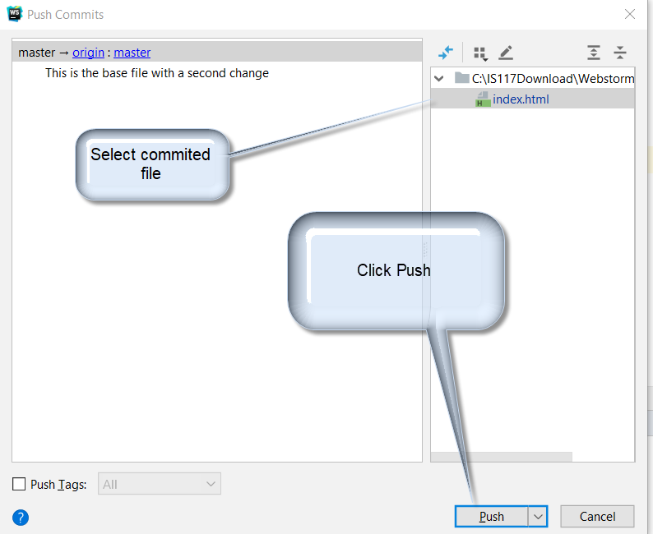
Push Change to Remote Repository
Click “Ctrl→ Shift → K” Or “VCS → Git → Push”
16

Slide 17
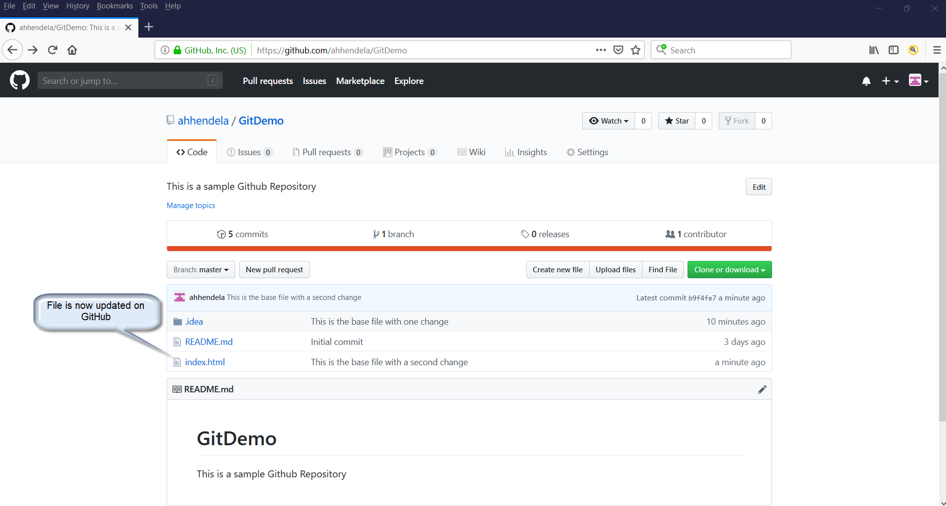
File is now on Github
17

Slide 18
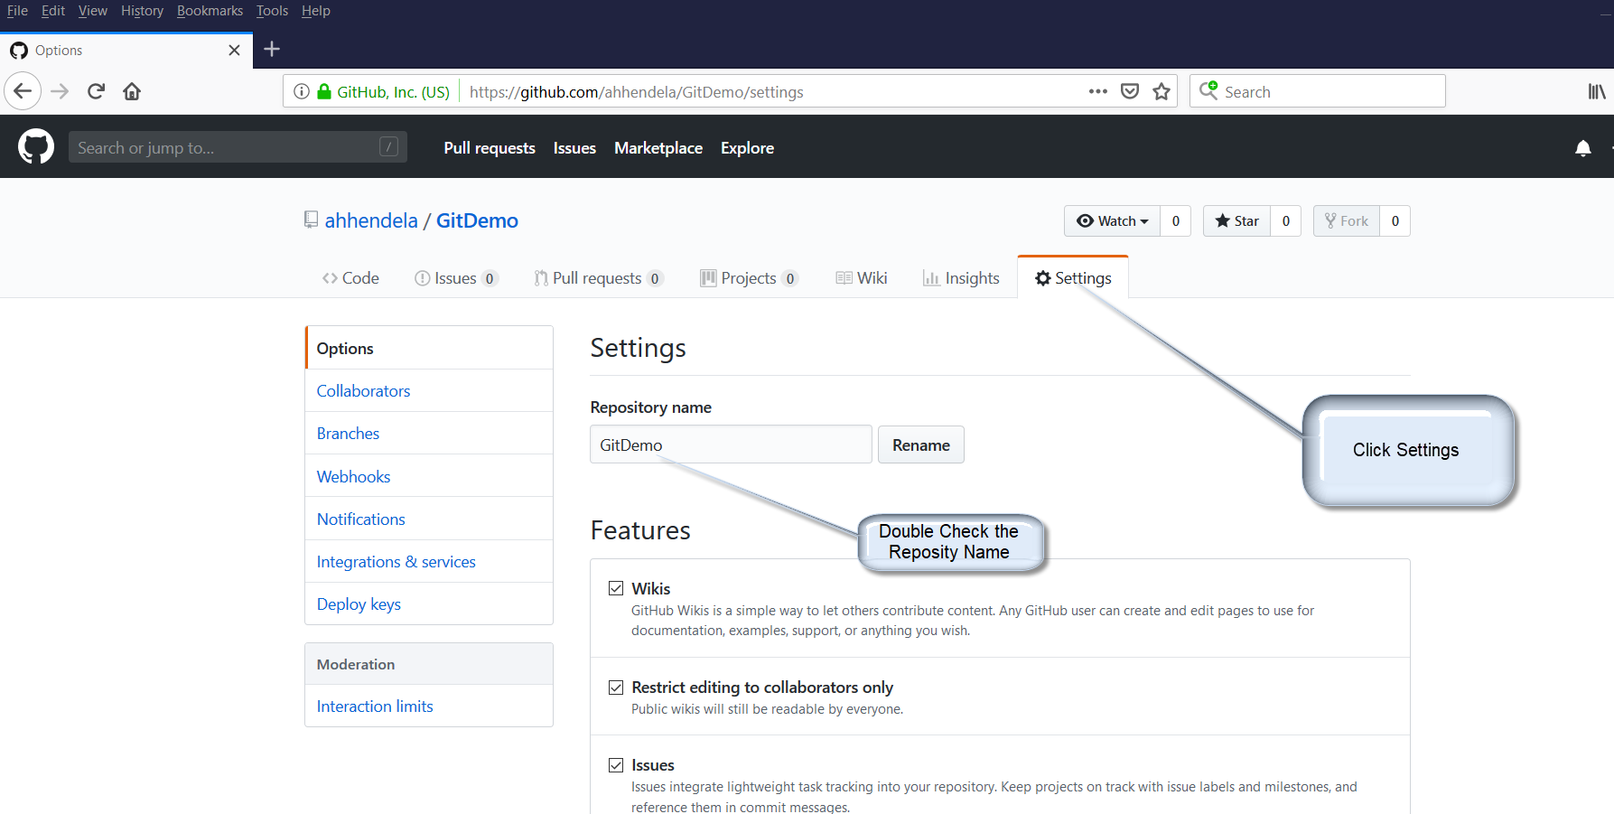
Set up Github Pages
Click Settings Check the repository name
18

Slide 19
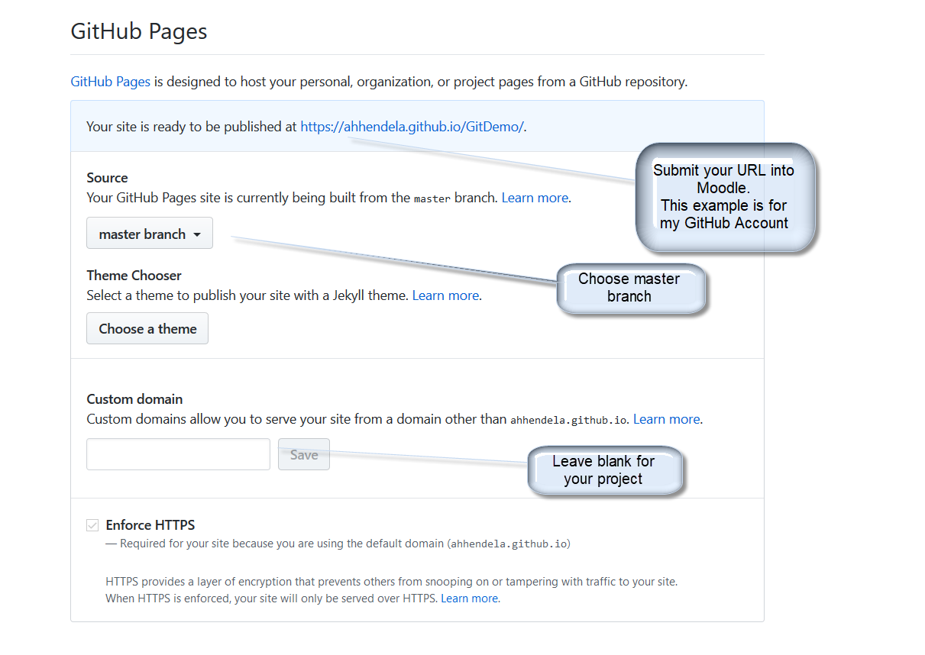
Choose GitHub Page Location
Select “Master branch”
Note the published URL
19

Slide 20
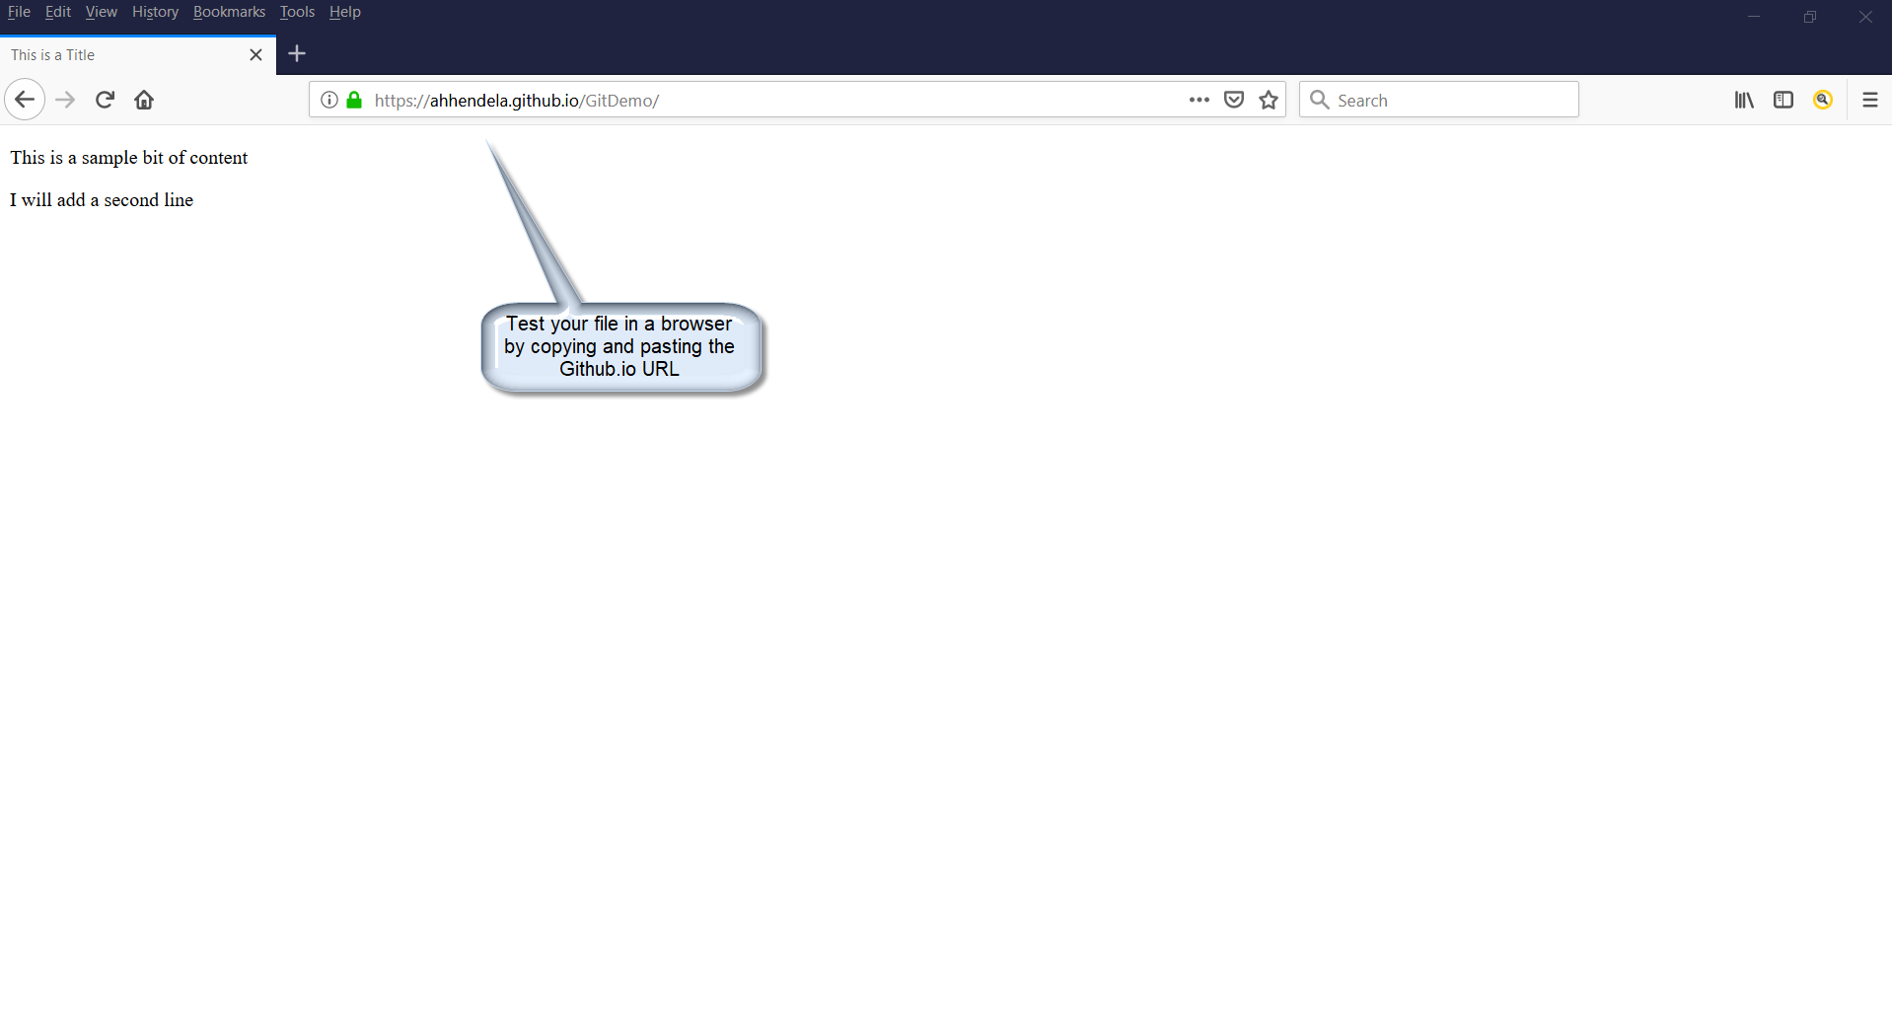
Check your GitHub Pages
Copy the Github.io URL into a browser
Post the URL into Moodle with your Github account URL
20

Slide 21
References
Beer, B. (2018). Introducing GitHub. 2ed. O’Reilly Press.
Jetbrains. (2019). Git. Retrieved March 21, 2019, from https://www.jetbrains.com/help/webstorm/using-git-integration.html
GitHub (2019) GitHub Guides Tutorial. Retrieved March 19, 2019, from https://guides.github.com/activities/hello-world/
21

Slide 22


