Slide 1
altEco
ECO FRIENDLY PRODUCT RECOMMENDATION SYSTEM

Slide 2


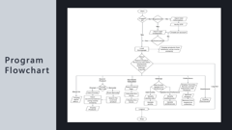
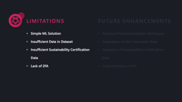
altEco – ECO FRIENDLY PRODUCT RECOMMENDATION SYSTEM
Rochak Adhikari | Aditya Pokharel | Suyog Basnet | Nerish Shrestha | Nikunj Pokharel
OVERVIEW AND OBJECTIVES
LIMITATIONS AND FUTURE NEED
DESIGN AND IMPLEMENTATION

Slide 3
CONCLUSION

Slide 4
ANY QUERIES?

Slide 5
THANK YOU!

Slide 6

INTRODUCTION

Slide 7
Greenwashing and mislabeling
Lack of transparency
Limited product insights
Inconsistent sustainability data
PROBLEM

Slide 8
Recommend sustainable products
Display eco scores
Customize user filters
Track environmental impact
OBJECTIVES

Slide 9
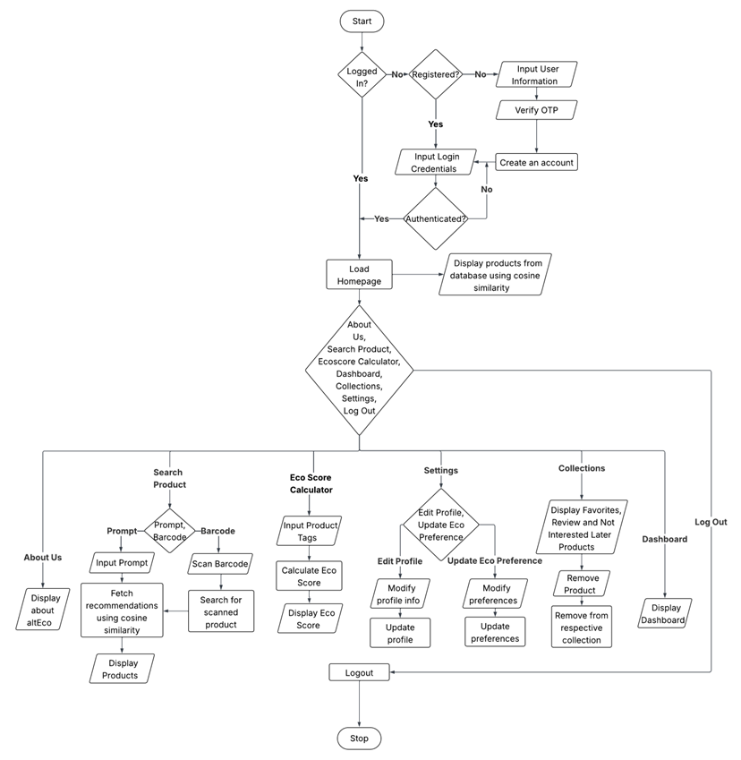
Program Flowchart

Slide 10
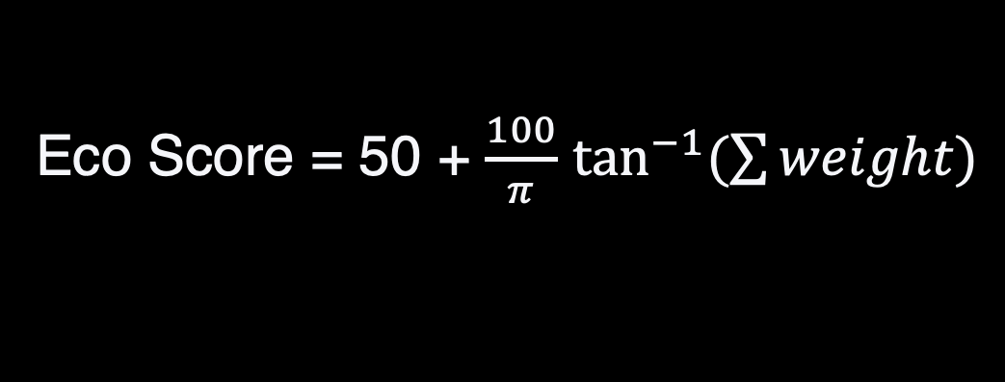
Eco Score = 50 + $\frac{100}{π}$ $\tan^{−1}{(\sum{weight})}$
EcoScore Formula

Slide 11
Vectorizing Tags
Cosine Similarity
Sort according to EcoScore
Recommendation
System

Slide 12

LIMITATIONS
FUTURE ENHANCEMENTS
Simple ML Solution
Insufficient Data in Dataset
Insufficient Sustainability Certification Data
Lack of 2FA
Advanced Recommendation Techniques
Integration of User Interaction Data
Expansion of Sustainability Certification
Data
Implementation of 2FA

Slide 13
LIMITATIONS
FUTURE ENHANCEMENTS
Simple ML Solution
Insufficient Data in Dataset
Insufficient Sustainability Certification Data
Lack of 2FA
Advanced Recommendation Techniques
Integration of User Interaction Data
Expansion of Sustainability Certification
Data
Implementation of 2FA

