Slide 1
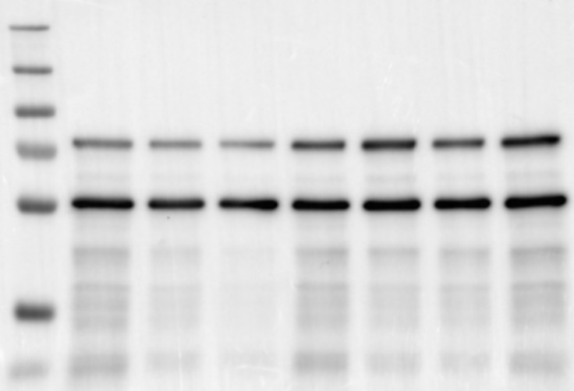
The following boxed blot is used for generating the figure S1F in the article
Control
Control
ahcy-1 RNAi
Control
gfp RNAi
ahcy-1 RNAi
gfp RNAi
ahcy-1 RNAi
gfp RNAi
250
250
130
130
250
100
100
130
70
AHCY-1::GFP
70
100
α-tubulin
55
70
55
55

