Slide 1
IBM University Engagement Project Submission
“Exploring the Power of Agentic AI with IBM Granite and LangFlow”

Slide 2

Project Tile – Recipe Preparation Agent
Domain of Project – Artificial Intelligence (AI) / Generative AI
Student Name | Recent Passport Photo | Email ID | Mobile number [WhatsApp]
POKURI LAHARI |  | 2420030552cse@gmail.com | 8978263679

Slide 3
Problem Statement -
Problem Statement : Recipe Preparation Agent
The Challenge
Many people want to cook but are unsure what they can make with the groceries already in their kitchen, running into ingredient limitations, food waste, and time constraints. Recipe ideas are often scattered across unreliable sources and rarely account for what is actually available at home. Without a smart, RAG-based recipe recommendation system, many end up wasting food, ordering takeout, or struggling to turn pantry items into a practical, satisfying meal.
The Objective
Build an AI-powered Recipe Preparation Agent that helps users cook meals using only the ingredients they have on hand. The solution should provide tailored recipe suggestions using a RAG-based AI system that retrieves relevant recipes and generates step-by-step instructions adapted to ingredient limitations. The solution should:
Ingredient-Based Recipe Suggestions – Retrieve relevant recipes tailored to the groceries a user already has, using a RAG-based AI system.
Step-by-Step Adaptive Instructions – Generate step-by-step cooking instructions adapted to the user’s ingredient limitations.
Smart Substitutions & Tips – Offer substitutions, cooking tips, and dietary adjustments based on user preferences or restrictions.
Food Waste Reduction – Reduce food waste and save time by turning pantry items into practical meal solutions.
Smarter, Simpler Cooking – Make everyday cooking smarter, simpler, and more sustainable.

Slide 4
Proposed Solution -
Proposed Solution: AI-Powered Recipe Preparation Agent
The proposed solution is an AI-powered recipe recommendation engine built with Flask, ChromaDB, SentenceTransformers, and IBM Granite (via watsonx.ai) to help users turn any set of ingredients into a restaurant-quality recipe in seconds. The system addresses two common cooking pain points — ingredient waste and decision fatigue — through a grounded, retrieval-first architecture.
At its core, the solution uses a Retrieval-Augmented Generation (RAG) pipeline: user ingredients are converted into a semantic query, embedded using the all-MiniLM-L6-v2 model, and matched against a curated dataset of ~4,998 recipes stored in ChromaDB using cosine similarity. The top-K retrieved recipes are hydrated with full recipe data and passed as grounded context to the IBM Granite model (ibm/granite-8b-code-instruct) on watsonx.ai, which generates the final personalized response — eliminating hallucinated ingredients or steps that a pure-LLM approach would risk. The system is organized into four cooperating modules rather than separate agents:
vector_store.py — semantic search layer; embeds and retrieves recipes from ChromaDB.
rag.py — orchestrates retrieval → context hydration → prompt construction → generation.
granite.py — handles IBM Cloud IAM authentication and Granite/watsonx.ai inference calls.
recipe_loader.py — loads, normalizes, and filters the underlying recipe dataset.
The solution includes a responsive, mobile-first dashboard (Bootstrap 5.3, dark/light mode) that surfaces suggested recipes, substitutions, cuisine and dietary filters (Indian, Chinese, Italian, Mexican, vegetarian, vegan, gluten-free, etc.), an auto-generated shopping list for missing ingredients, session-persisted favorites, and query history.
Overall, this solution delivers an end-to-end, retrieval-grounded recipe assistant that pairs the precision of vector search with the fluency of a generative model — giving users accurate, low-hallucination, personalized cooking guidance while promoting sustainable, low-waste cooking.

Slide 5
Technology Used
Langflow platform -For designing and orchestrating multi-agent workflows visually
IBM Grainte model - for eg – ibm-granite-3-2-8b – For natural language understanding, reasoning, and personalization
IBM Cloud – It provides the infrastructure to build, deploy, and scale the Recipe Preparation Agent efficiently. IBM Cloud enables a reliable, secure, and scalable environment for deploying the Recipe Preparation Agent.
RAG– RAG to fetch real data first, then generate intelligent answers, making the Recipe Preparation Agent more trustworthy and effective.
IBM Watsonx.ai - For model deployment, embeddings, and AI governance
Vector Database (FAISS/Chroma) – For RAG-based recipe and ingredient retrieval

Slide 6
Langflow component Used -
1) Chat Input – Interface where users enter the ingredients they have on hand, along with any preferences or restrictions (text/voice/image).
2) IBM watsonx AI Agent - Processes user input using Granite models to retrieve relevant recipes and generate personalized cooking recommendations.
3) Name of IBM Granite model - Granite-4.0-8B-Instruct → Fast, efficient for real-time recipe recommendations
4) Chat output -Displays AI-generated responses such as recipe suggestions, step-by-step instructions, and substitution tips.
5) File component - Stores and retrieves user ingredient inputs, recipe data, and past preferences for analysis and tracking.

Slide 7
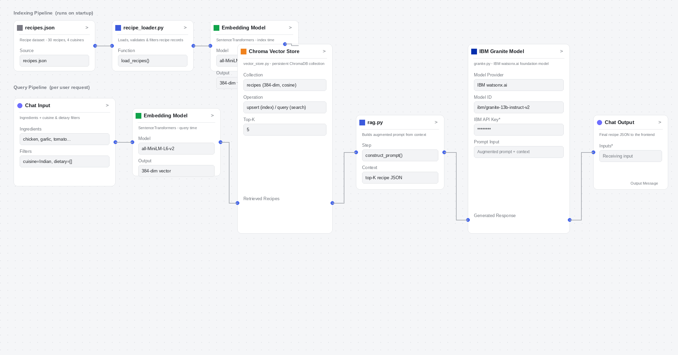
Langflow workflow –

Slide 8
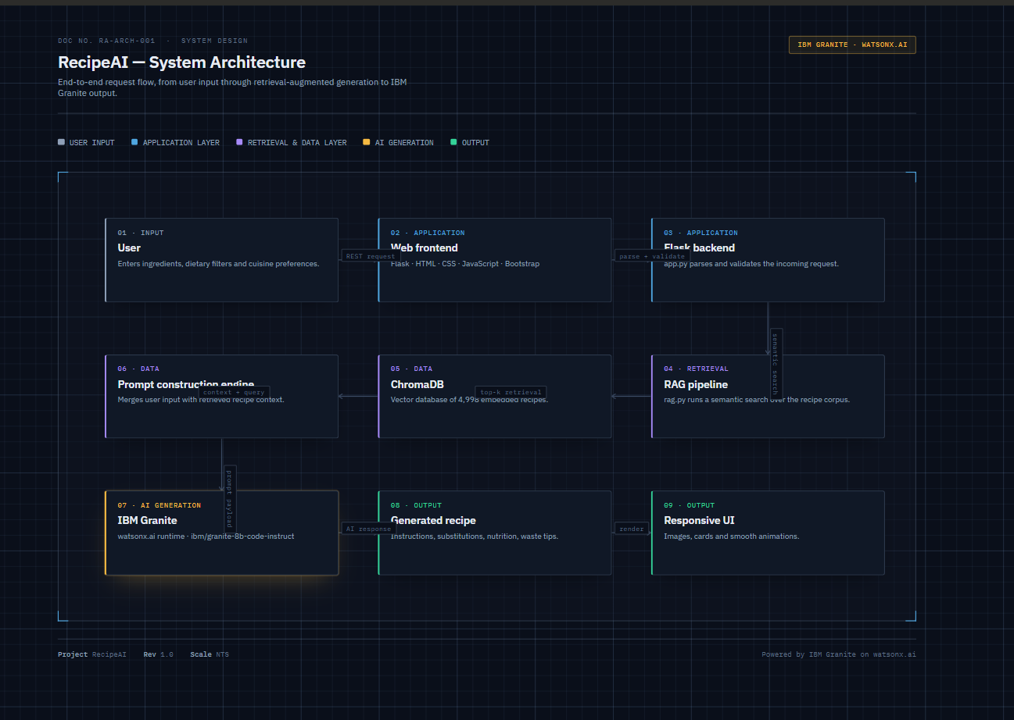
Architecture blueprint

Slide 9

Role of Agentic AI in the solution
Role of Agentic AI in Recipe Preparation Agent
Agentic AI enables the Recipe Preparation Agent to function as an intelligent, autonomous system rather than a simple chatbot. Using IBM watsonx.ai and IBM Granite models, it coordinates multiple specialized agents to deliver tailored recipe guidance.
Each agent performs a specific role—such as retrieving relevant recipes, generating step-by-step instructions, suggesting substitutions, and tracking food waste—while working collaboratively. This multi-agent approach ensures efficient task execution and accurate results.
Agentic AI also brings context awareness, understanding the ingredients a user has on hand and their dietary preferences to generate tailored recipe suggestions. It supports real-time adaptation, continuously updating recipe suggestions based on the user’s available ingredients.
Additionally, agents communicate with each other, enabling better decision-making and improved outcomes.
Overall, Agentic AI makes the system proactive, personalized, and goal-driven, acting like a smart digital cooking assistant that helps users cook practical, waste-reducing meals every day.

Slide 10
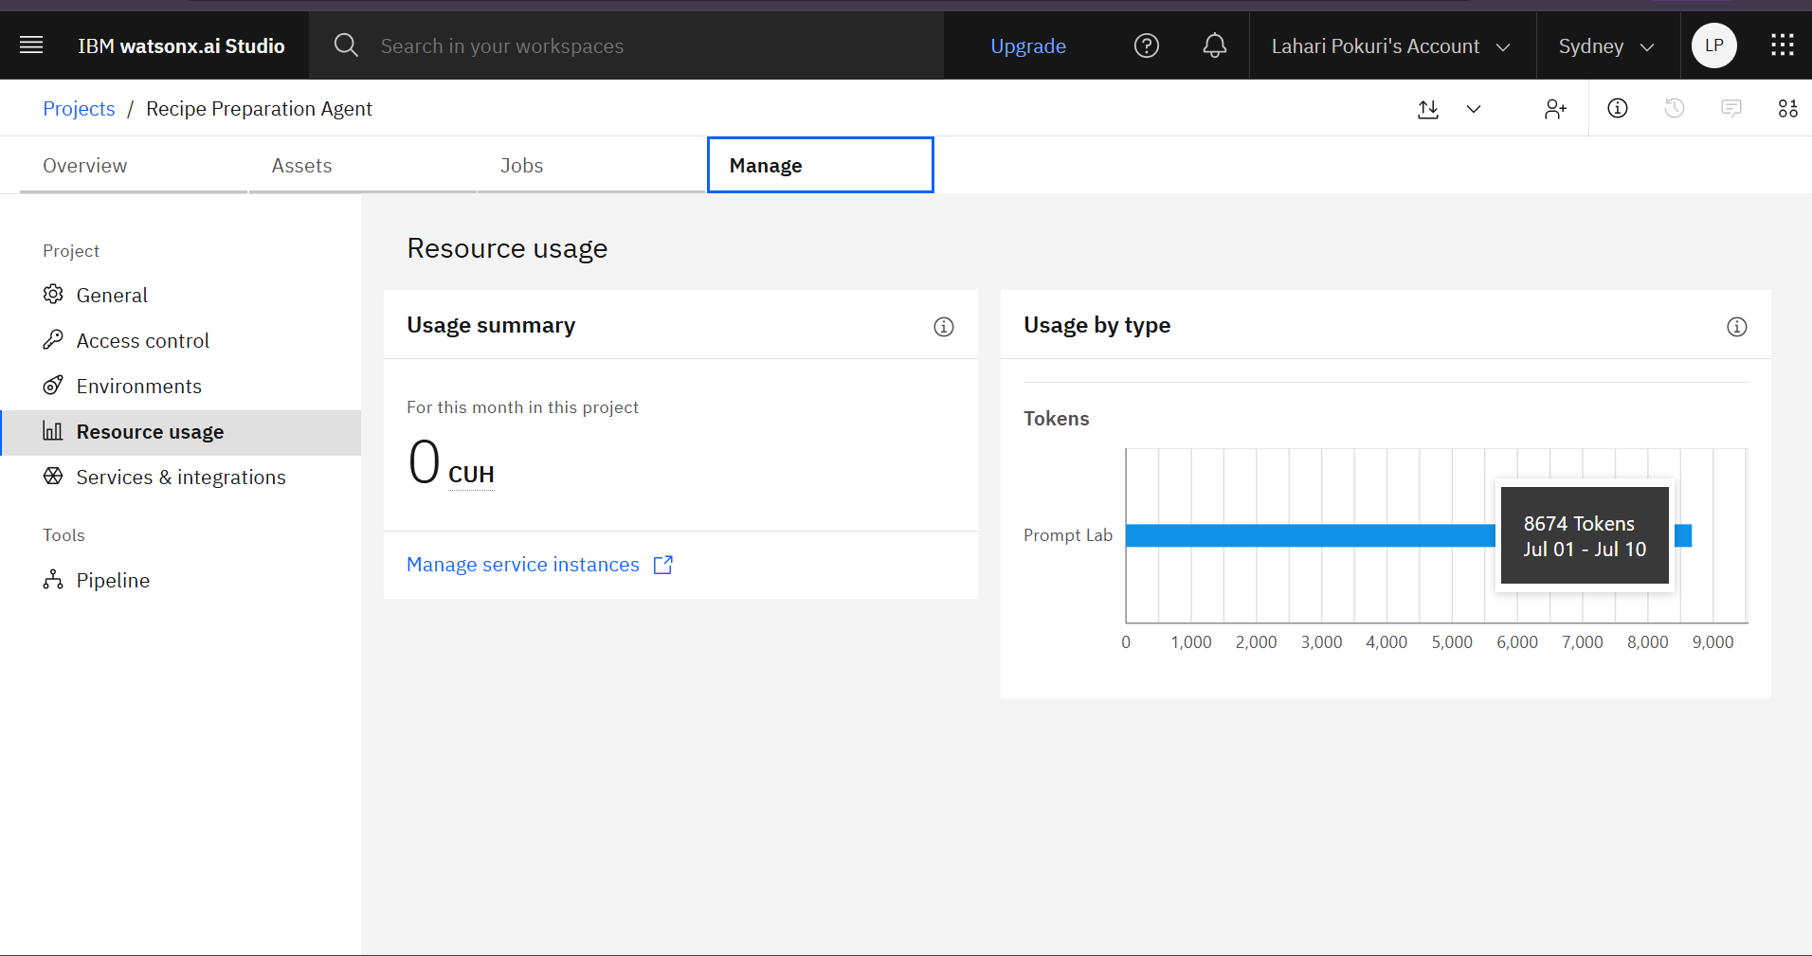
Token Usage
8,674 token are used
Before Prompt
After the Prompt
·
·
·

Slide 11
Novelty and Uniqueness
The proposed Recipe Preparation Agent stands out by combining Agentic AI, RAG, and personalization into a single intelligent system.
Multi-Agent Intelligence – Instead of a single chatbot, multiple specialized agents collaborate to deliver accurate and context-aware recipe guidance.
RAG-Based Accuracy – Integrates real-time recipe retrieval with AI generation, reducing irrelevant suggestions and ensuring practical, usable recipes.
Hyper-Personalization – Tailors recipe suggestions based on the ingredients on hand, dietary restrictions, and cooking preferences.
Real-Time Feedback Loop – Continuously adapts suggestions based on the user’s available groceries and preferences.
Multi-Modal Input – Supports text, voice, and image-based ingredient entry for better usability.
Food Waste Reduction Focus – Goes beyond recipe suggestions to actively help reduce food waste and save time.
Scalable & Enterprise-Ready – Built on IBM watsonx.ai with IBM Granite models, ensuring reliability and governance.
This makes the solution a smart, adaptive, and proactive digital cooking assistant, not just a static recipe lookup tool.

Slide 12
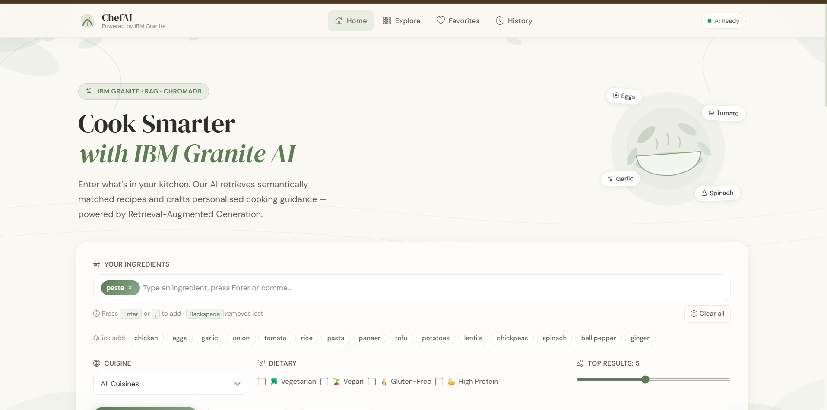
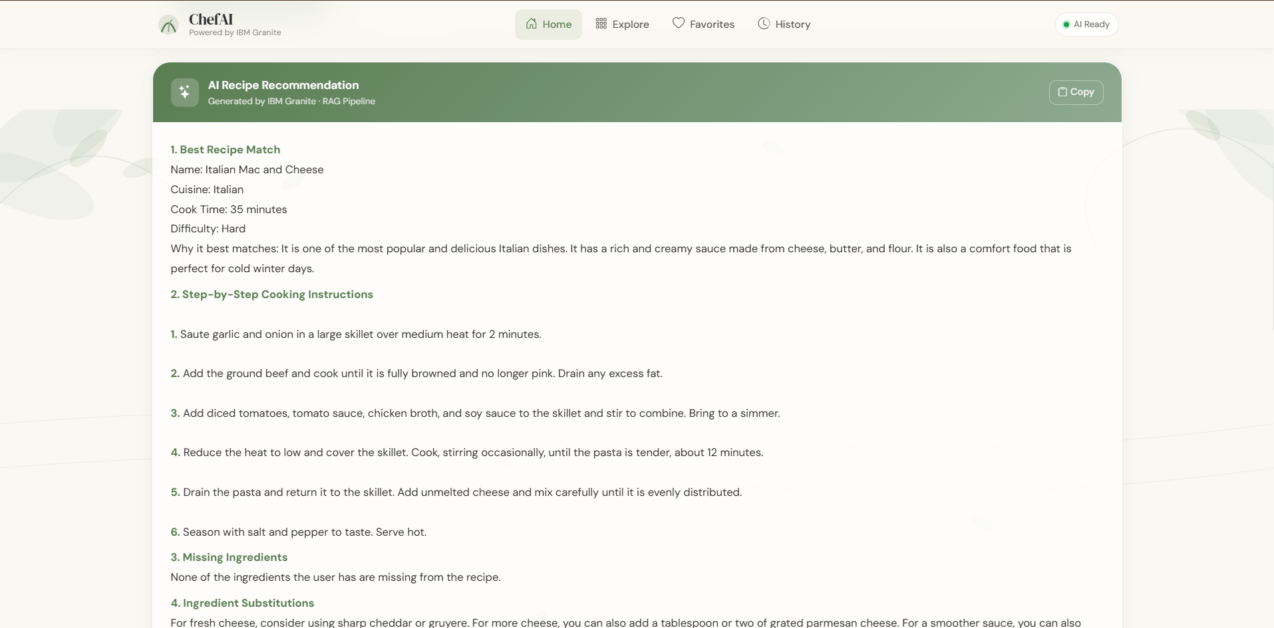
Git Hub Link
https://github.com/PokuriLahari/IBM_GRANITE_CHEFAI
·
·
·

Slide 13
Future Scope
1.Smart Kitchen & Inventory Integration –
The system can be integrated with smart fridges and pantry inventory apps to automatically detect available ingredients and expiry dates. This will enable the Recipe Preparation Agent to provide more accurate, real-time recipe suggestions and proactively flag ingredients that need to be used soon to reduce food waste.
2.AI-Powered Voice Assistant & Multilingual Support –
Enhancing the system with a voice-enabled assistant and support for multiple languages will improve accessibility. Users can interact naturally in their preferred language while cooking hands-free, making the solution more inclusive and suitable for diverse populations, especially in regions with varied linguistic backgrounds.
·
·
·

Slide 14
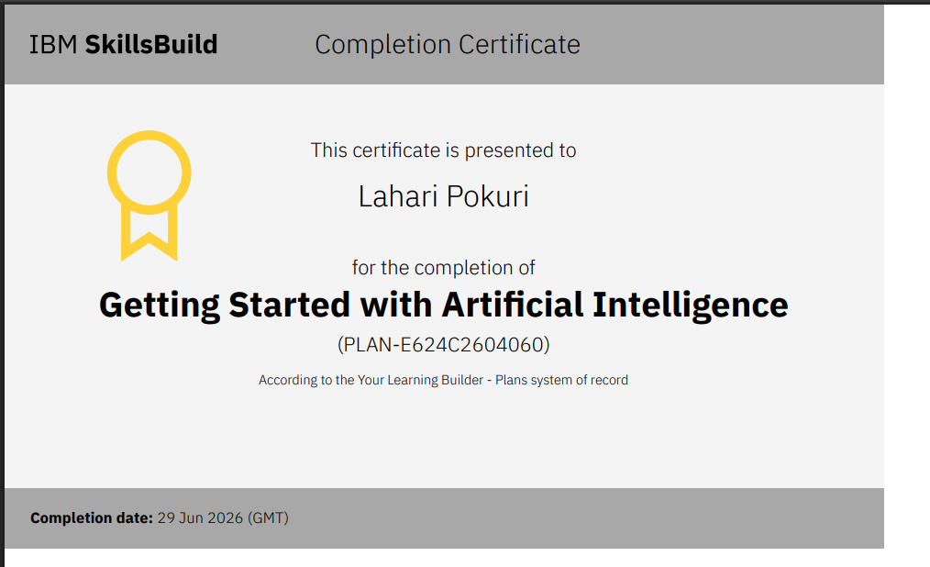
Certificates Earned:
Please add your credly certificate

Slide 15
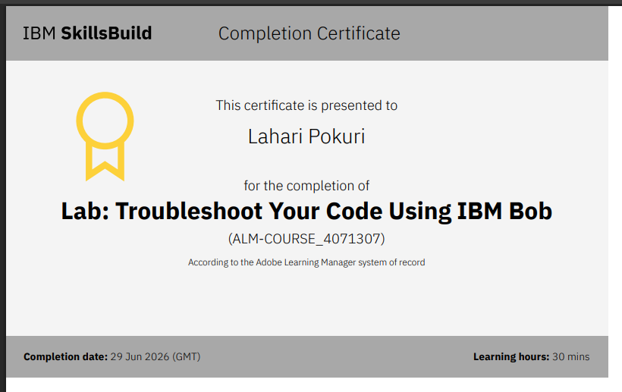
Certificates Earned:​
Add your IBM BOB Certificate

Slide 16


