Slide 1
Scale Space
Blob detection
Paolo Innocenti
Johan Andrey Bosso
MICC, 20/03/2020

Slide 2
Scale Space
Blob detection
MICC, 20/02/2020
Introduction
In this presentation:
we describe blob detection through difference of gaussians, presenting a sequential implementation.
we present and discuss two parallelization of the program.
we explain the performed tests and analyze the obtained result in order to compare the performance between the sequential and the two parallel versions.

Slide 3
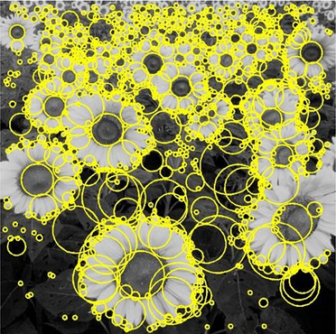
Scale Space
Blob detection
MICC, 20/02/2020
Blob Detection
Technique to detect points and/or regions of a digital image that differ in properties, such as brightness or color, compared to surroundings.
Properties constant or almost constant in the image.
Many possible approaches:
Laplacian of Gaussians;
Difference of Gaussians ;
Determinant of the Hessian.
Esempio di blob detection

Slide 4
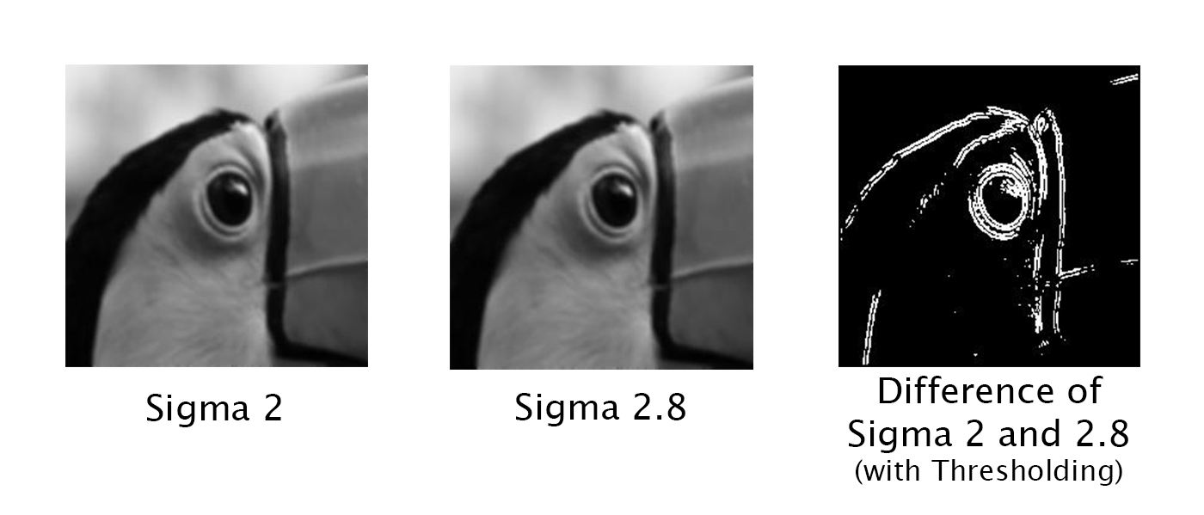
Scale Space
Blob detection
MICC, 20/02/2020
Difference of Gaussians 1/2
Feature enhancement algorithm based on the subtraction from one blurred version of an image of another, less blurred, version of the same image.
Preserves only the information contained within the range frequencies maintained by the blurred images.
Uses a scale space representation that enables the detection of blobs at different scales.
Difference of Gaussians example obtained with blur deriving from two different standard deviations
(Original image Copyright: Carlos Spitzer, Composed Image Copyright: Vinny DaSilva)

Slide 5
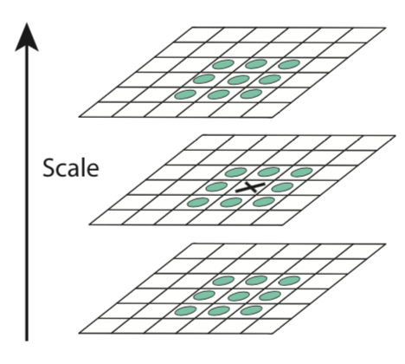
Scale Space
Blob detection
MICC, 20/02/2020
Difference of Gaussians 2/2
Algorithm can be divided into 3 sections:
Creation of difference of gaussians pyramid;
Finding of extrema within the obtained pyramid
By comparing each pixel with its neighbors within the 3x3x3 cube centered on the pixel;
Filtering of the candidates.
Comparison of the center pixel with its 26 neighbors
(Copyright: Sam Lerner)

Slide 6

Scale Space
Blob detection
MICC, 20/02/2020
Implementations
We implemented the algorithm using Python.
We developed:
A sequential version;
A parallel version based on the MultiProcessing library;
A parallel version based on the PyCuda library.
OpenCV and Scikit-Image libraries used to build the first section.
Third section achieved by applying the same technique used for SIFT keypoints.
Parallelization focused on the second section.

Slide 7
Scale Space
Blob detection
MICC, 20/02/2020
Sequential Version
3 For loops
To consider the 3 pyramid axes(image width, image height, image scale)
Computes one pixel at a time
Particularly inefficient for high resolution images

Slide 8
Scale Space
Blob detection
MICC, 20/02/2020
PyCuda 1/2
Parallelization obtained using PyCuda library, based on NVIDIA Cuda, to exploit the GPU computational power.
3x3x3-sized Cuda Blocks leading to a Cuda Grid having size (W-2, H-2, K-2) for K images with WxH size.
Compute the maximum and minimum within each block using the __shfl_down() function, without using shared memory.
Verify that maximum or minimum is in the center of the block
With threadIdx.x=1, threadIdx.y=1 and threadIdx.z=1

Slide 9

Scale Space
Blob detection
MICC, 20/02/2020
PyCuda 2/2
Flatten the pyramid from a 3-dimensional array to a 1-dimensional one
Load the flattened pyramid on the GPU memory
Assign one value for each thread using the formula
$$index=imageSize∗\left(bZ+tZ\right)+ imageWidth∗ (bY+tY) + bX + tX$$
Compute the reduction problem to find the extrema using the __shfl_down() function
Verify if either the maximum or the minimum is in the center of the block
Save the pixel coordinates

Slide 10
Scale Space
Blob detection
MICC, 20/02/2020
MultiProcessing
Python library.
Bypasses the Global Interpreter Lock enabling the usage of multi-core architectures.
Used to remove one of the three For loops and parallelize the computation of the two remaining.
Important to remove the right axis from the sequential loop.
We chose the pyramid height axis, in order to avoid excessive context switching overhead.

Slide 11
Scale Space
Blob detection
MICC, 20/02/2020
MultiProcessing
Create a MultiProcessing.Pool instance with as many process as the amount of images within the pyramid;
Assign one image of the pyramid to each process, focusing the finding of extrema for that particular scale;
Compute the remaining double For loop in parallel.

Slide 12




Scale Space
Blob detection
MICC, 20/02/2020
Hardware
Mainly:
CPU Intel Core i5-6600K @ 3.6GHz
16GB RAM DDR4 2133MHz
Ubuntu 19.10
EVGA GTX950 SC+
768 Cuda Cores, 2GB DRAM, 1164MHz Core Clock
However, to compare the performance of the GPU in the PyCuda implementation, also
NVIDIA GTX980
2048 Cuda Cores, 4GB DRAM, 1405MHz Core Clock

Slide 13
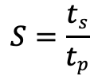
Scale Space
Blob detection
MICC, 20/02/2020
Tests
For each implementation:
3 resolutions:
640x480
FullHD (1920x1080)
4K (3840x2160)
6 images for each resolution
Execution time for each resolution as average of the 6 measured times
SpeedUp as , with t_{s} time for the sequential version and t_{p} time for the parallel one
Profiling of Cuda code execution time to compare GPUs
$$S=\frac{ts}{tp}$$

Slide 14
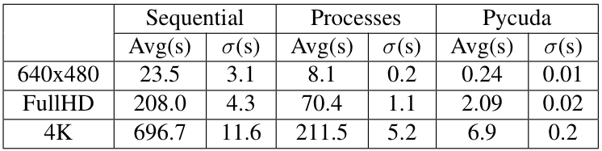
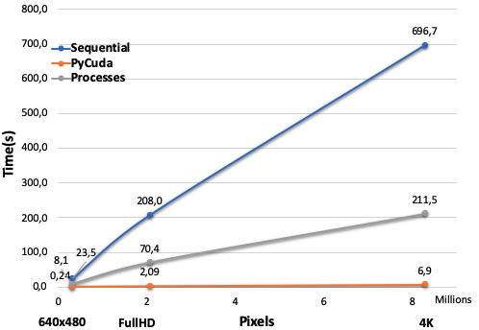
Scale Space
Blob detection
MICC, 20/02/2020
Results
Average execution time

Slide 15
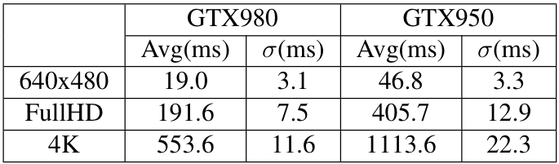
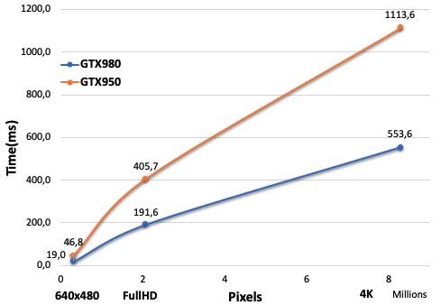
Scale Space
Blob detection
MICC, 20/02/2020
Results
Cuda computation time

Slide 16
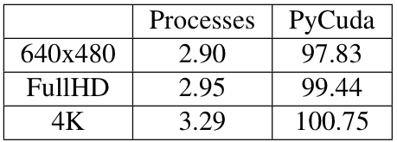
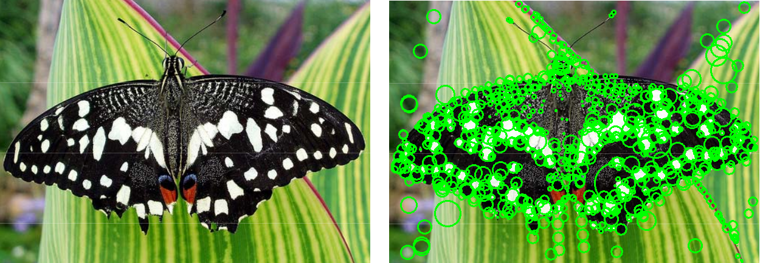
Scale Space
Blob detection
MICC, 20/02/2020
Results
SpeedUp
One of the images used for testing, before and after applying the blob detection

Slide 17
Thank you

