Slide 2
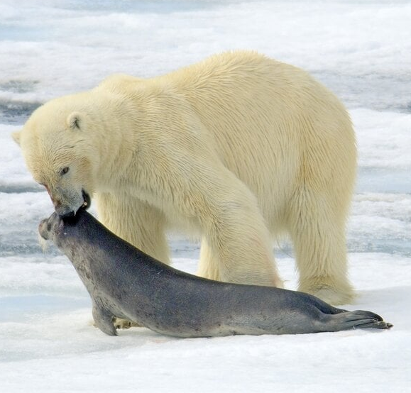
Predator-Prey modelling.
Polar bear – Seal interaction in the Arctic
MB – Fall 2026
Pol Bassols – s253606
Fall 2026 Technical University of Denmark
Notes:
Ringed seals are the main prey of polar bears, which will catch one seal about every five and a half days.
https://www.nathab.com/know-before-you-go/alaska-northern-adventures/greenland/wildlife-guide/ringed-seal-facts
Densities found inshore in Scoresby Sund Fjord and in Kong Oscars Fjord in the southern part of the assessment area were 2.00 seals/km2 and 1.04 seals/km2, respectively (Born 1998). The average density in the total area (including offshore) is likely to be substantial less than 1 seal/km2.
https://backend.orbit.dtu.dk/ws/files/236261036/WGIEAGS_Report_2020_1_.pdf
Polar bear density was approximately 5 times lower within 50 km of subsistence hunting communities (0.06 bears 100 km⁻²) compared to the rest to the study area (0.31 bears 100 km⁻²). The best estimate of abundance for the EG subpopulation, adjusted for animals located outside the sampling area, was 2275 bears (CV = 0.27, 95% CI = 1360-3807). https://www.int-res.com/journals/esr/articles/esr01479

Slide 3
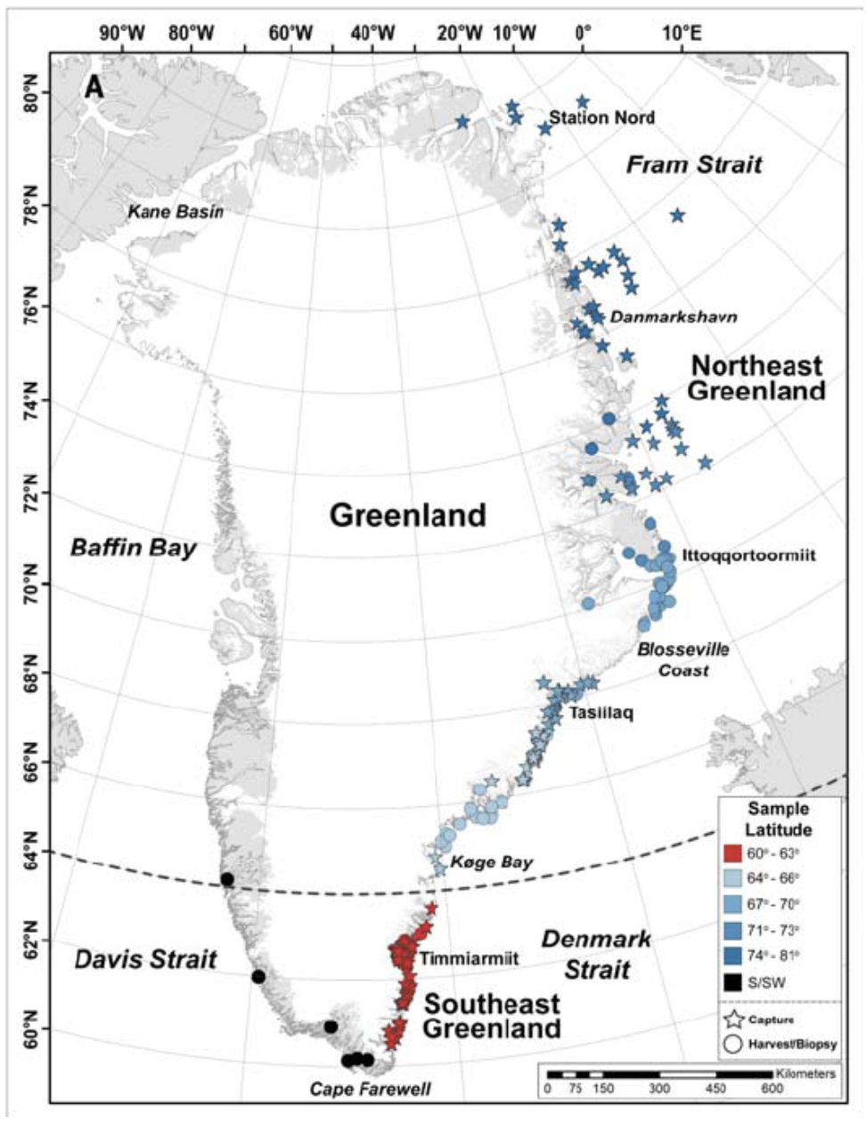
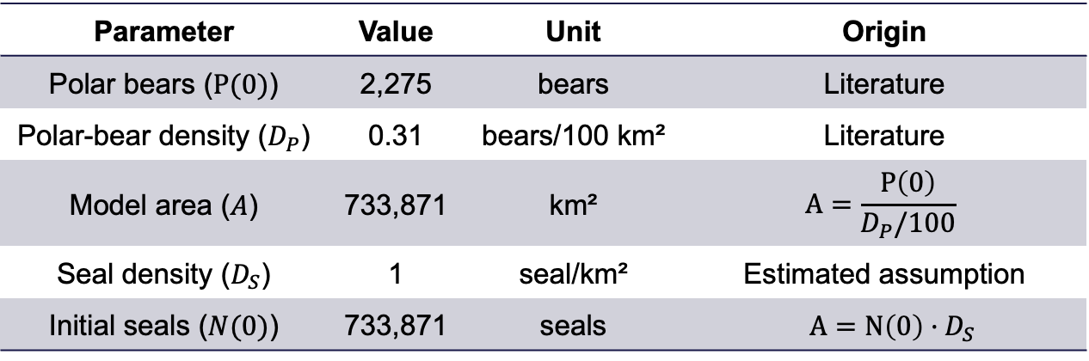
Polar Bear and Ringed seal in Eastern Greenland
Populations parameter
Eastern Greenland
Simulated period 100 years
Parameter | Value | Unit | Origin
Polar bears ($P(0)$) | 2,275 | bears | Literature
Polar-bear density ($D_{P}$) | 0.31 | bears/100 km² | Literature
Model area ($A$) | 733,871 | km² | $$A=\frac{P\left(0\right)}{D_{P}/100}$$
Seal density ($D_{S}$) | 1 | seal/km² | Estimated assumption
Initial seals ($N(0)$) | 733,871 | seals | $A=N\left(0\right)·D_{S}$
Fig.1 Polar Bear distribution in Greenland. Crockford (2022)

Slide 4
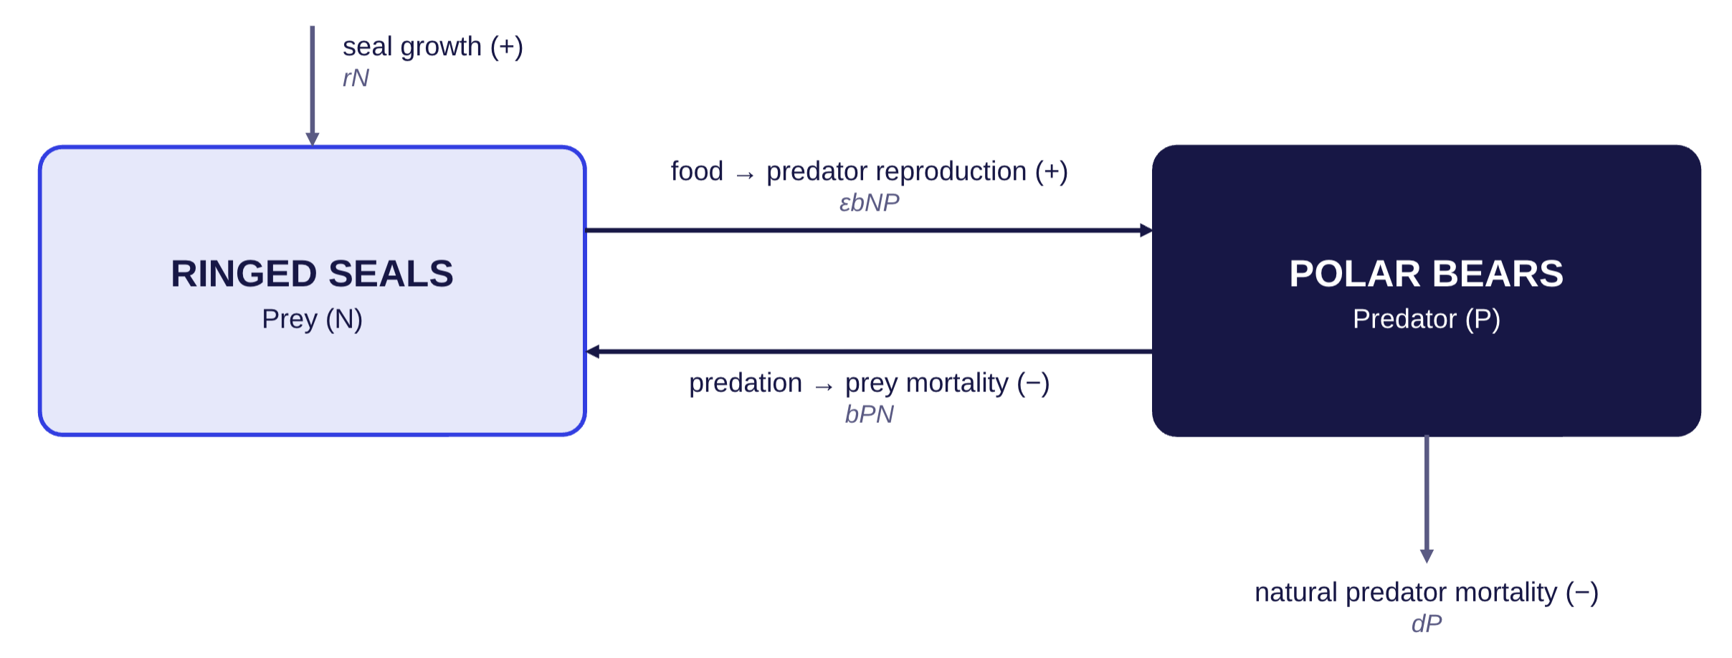
The model: baseline sketch
Notes:
In the wild, polar bears live an average of 15 to 18 years, although biologists have tagged a few bears in their early 30s.
https://polarbearsinternational.org/polar-bears/polar-bear-facts/life-cycle/

Slide 5
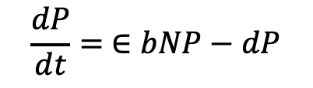
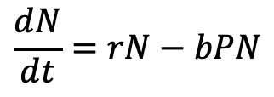
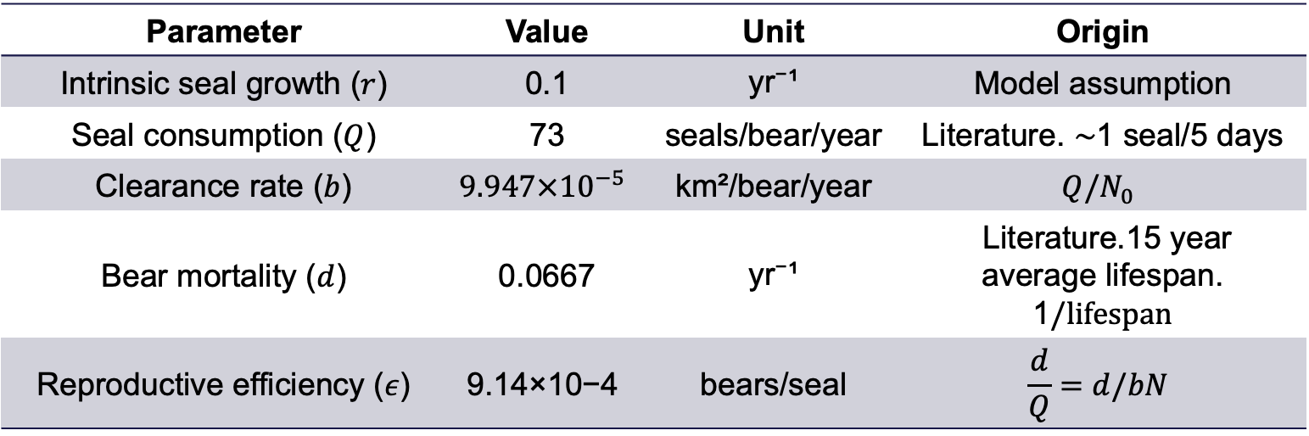
The model: parameters & equations
$$\frac{dN}{dt}=rN−bPN$$
$$\frac{dP}{dt}= ∈bNP−dP$$
Parameter | Value | Unit | Origin
Intrinsic seal growth ($r$) | 0.1 | yr⁻¹ | Model assumption
Seal consumption ($Q$) | 73 | seals/bear/year | Literature. $\sim$1 seal/5 days
Clearance rate ($b$) | $$9.947×{10}^{−5}$$ | km²/bear/year | $$Q/N_{0}$$
Bear mortality ($d$) | 0.0667 | yr⁻¹ | Literature.15 year average lifespan. 1$/lifespan$
Reproductive efficiency ($ε$) | $$\text{9.14×10−4}$$ | bears/seal | $$\frac{d}{Q}=d/bN$$

Slide 6
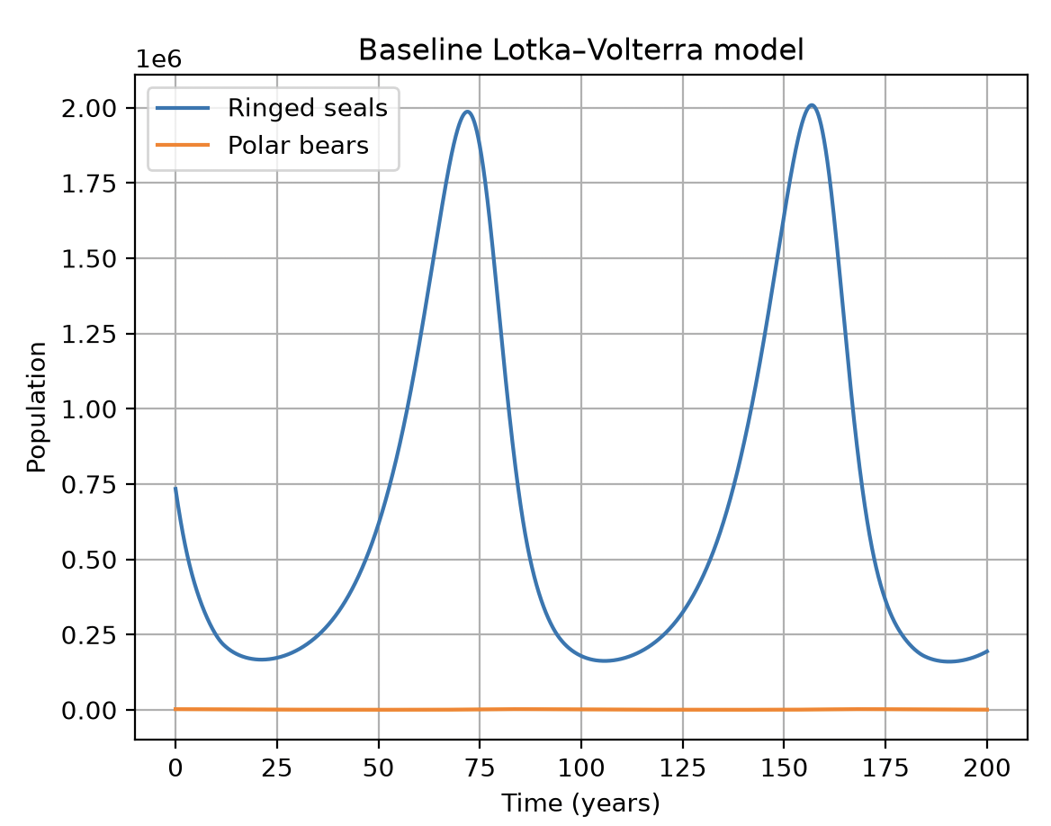
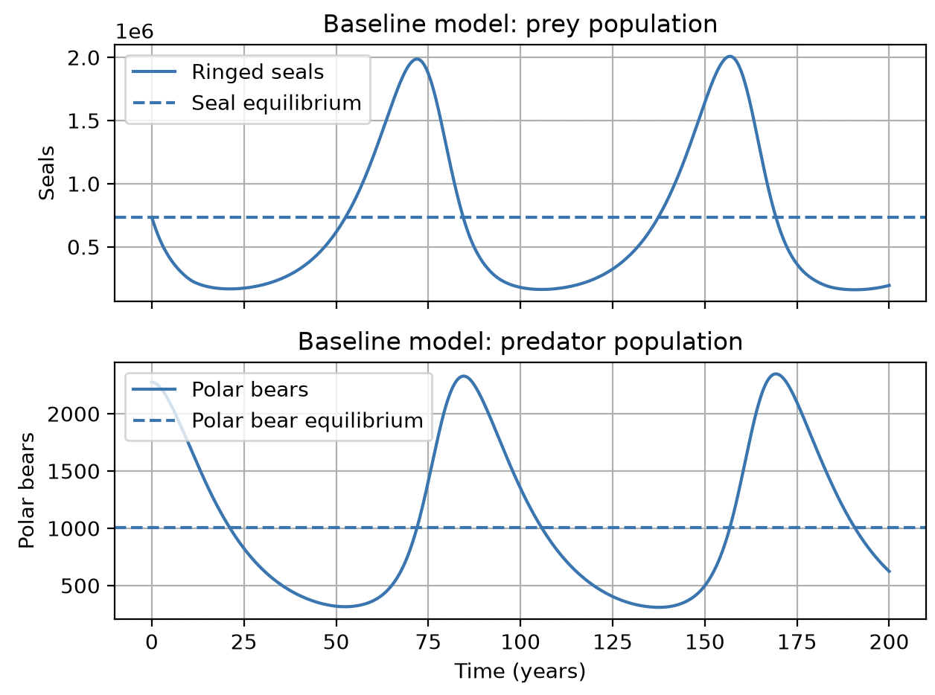
Results - baseline
text

Slide 7
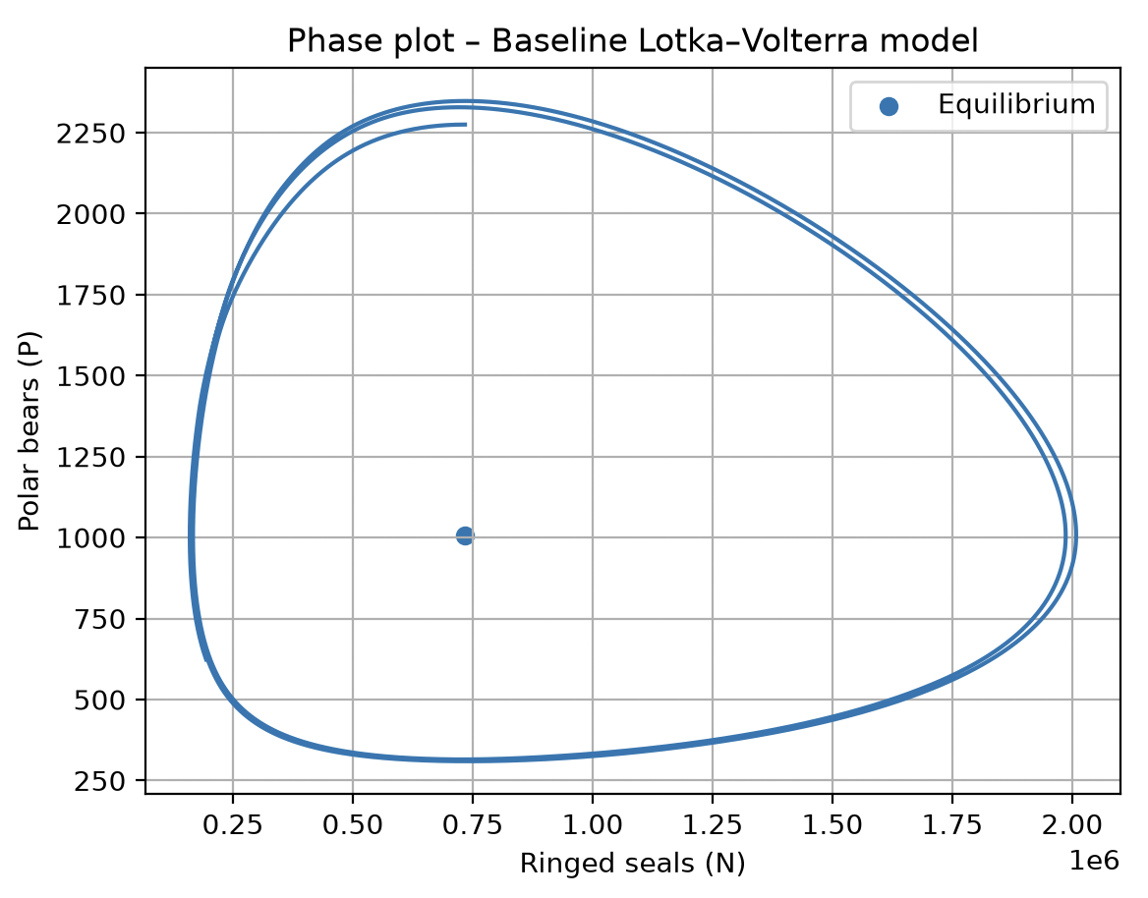
Results - baseline

Slide 8
Logistic growth and unsustainable removal
Extended Scenario 1.

Slide 9
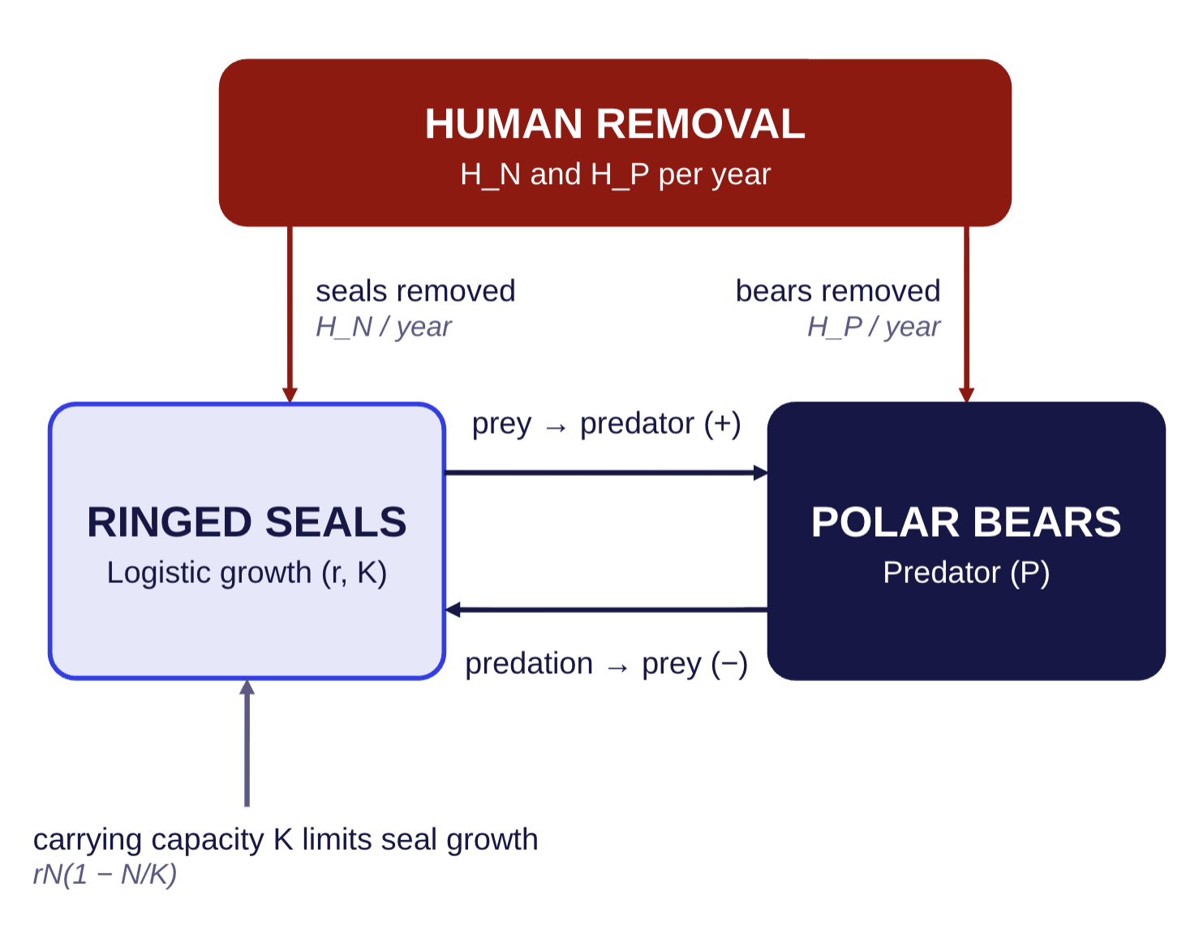
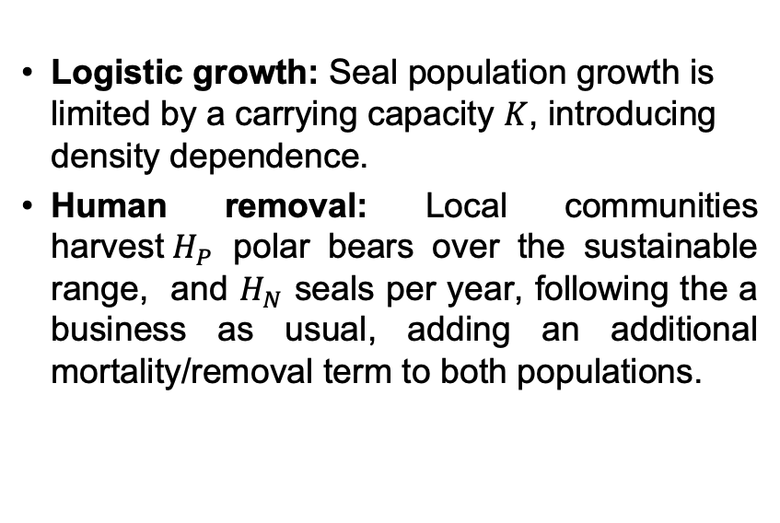
The model: sketch
Logistic growth: Seal population growth is limited by a carrying capacity $K$, introducing density dependence.
Human removal: Local communities harvest${ H}_{P}$ polar bears over the sustainable range, and $H_{N}$ seals per year, following the a business as usual, adding an additional mortality/removal term to both populations.
Notes:
In the wild, polar bears live an average of 15 to 18 years, although biologists have tagged a few bears in their early 30s.
https://polarbearsinternational.org/polar-bears/polar-bear-facts/life-cycle/

Slide 10
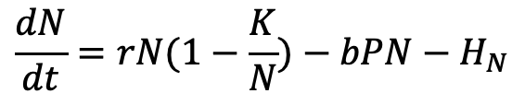
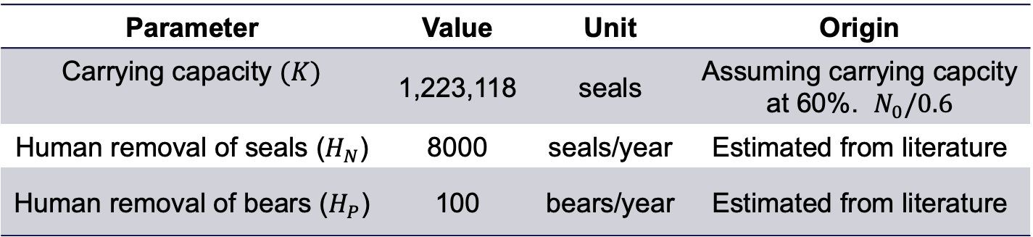
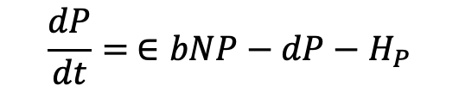
The model: Parameters & Equation
$$\frac{dN}{dt}=rN(1−\frac{K}{N})−bPN−H_{N}$$
$$\frac{dP}{dt}= ∈bNP−dP−H_{P}$$
Parameter | Value | Unit | Origin
Carrying capacity $(K)$ | 1,223,118 | seals | Assuming carrying capcity at 60%. $N_{0}/0.6$
Human removal of seals ($H_{N}$) | 8000 | seals/year | Estimated from literature
Human removal of bears ($H_{P}$) | 100 | bears/year | Estimated from literature
Notes:
https://nammco.no/ringed-seal/?utm_source=chatgpt.com#1475844711542-eedf1c7b-5dde
Estimated value for x = 8000 based on catches reports
Over the next 34 years (approximately three polar bear generations) and assuming a 2:1 male‐to‐female harvest sex ratio, the starting sustainable harvest ranged from 63 bears/year in the absence of scientific monitoring, to 93 bears/year if updated demographic parameters are estimated after 15 years and used to adjust the harvest, if necessary. We also identified an intermediate harvest strategy of up to 78 bears/year that requires a moderate level of monitoring and uses a threshold harvest rule.
I will assume an unssutainable case of 100 polar bears / year
https://www.researchgate.net/publication/411848467_Evaluating_harvest_risk_with_limited_data_A_case_study_on_polar_bears_Ursus_maritimus_in_East_Greenland

Slide 11
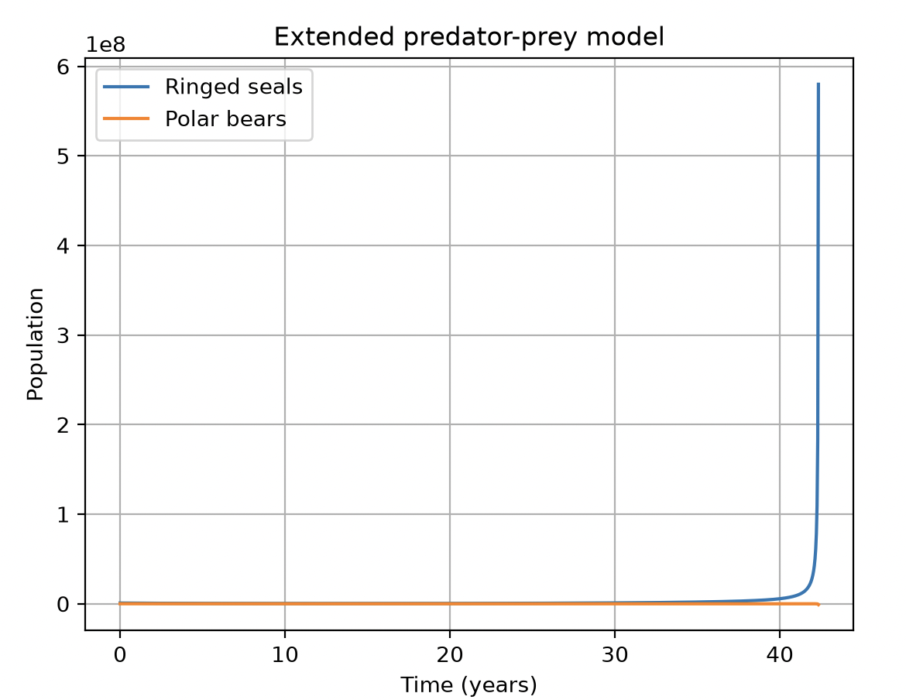
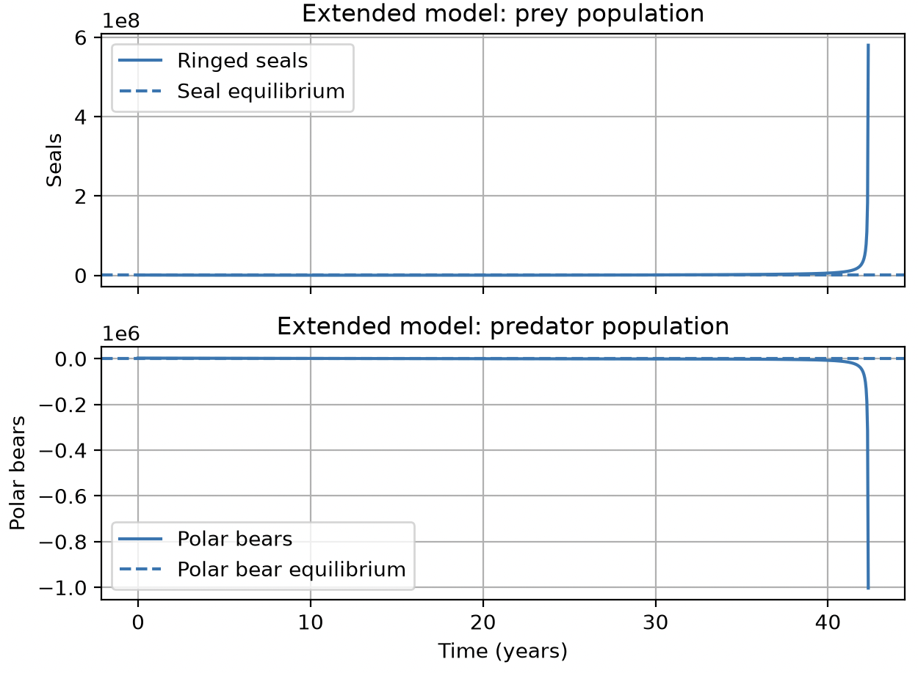
Results – Logistic growth and unsustainable removal

Slide 12
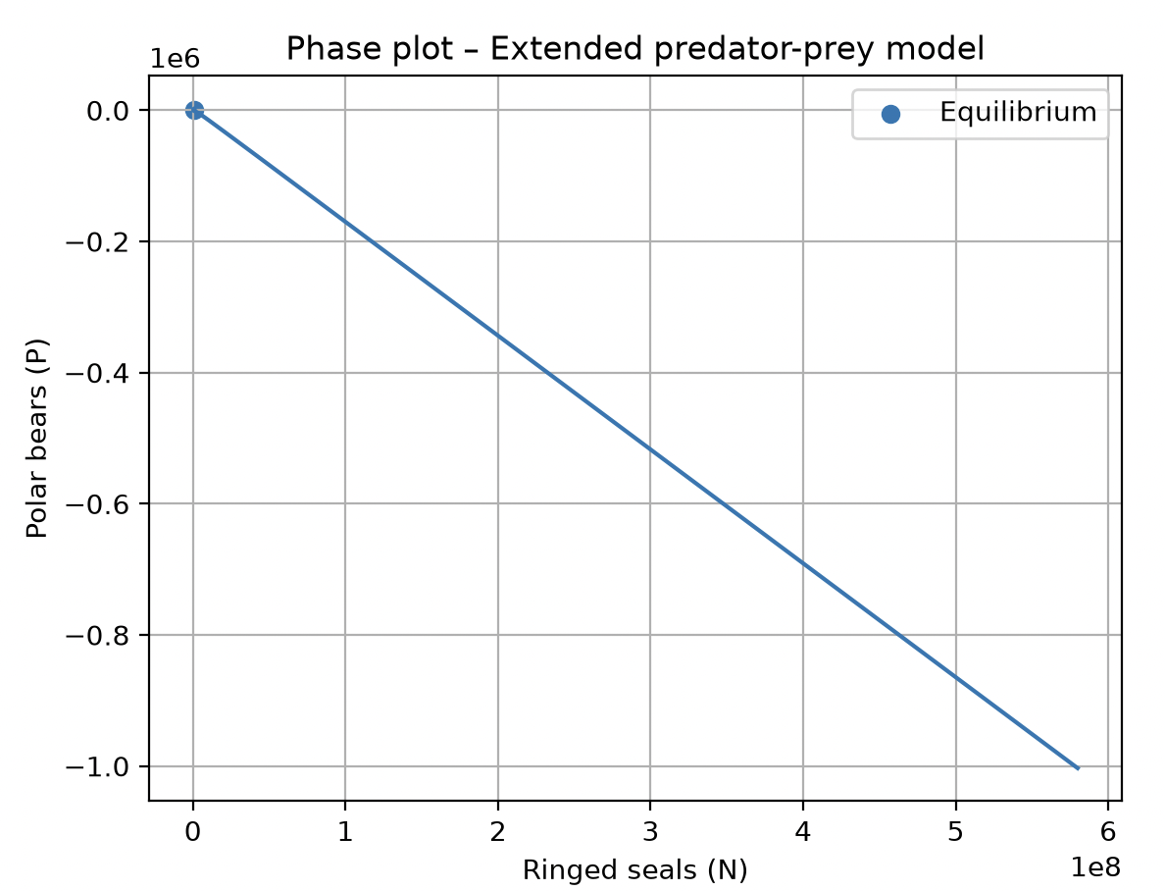
Results – Migration & added mortality (hunger)

Slide 13
Logistic growth and controlled removal
Extended scenario 2.
The first extension produced a strong decline in the predator population. I therefore introduced a management threshold to explore a regulated scenario.

Slide 14
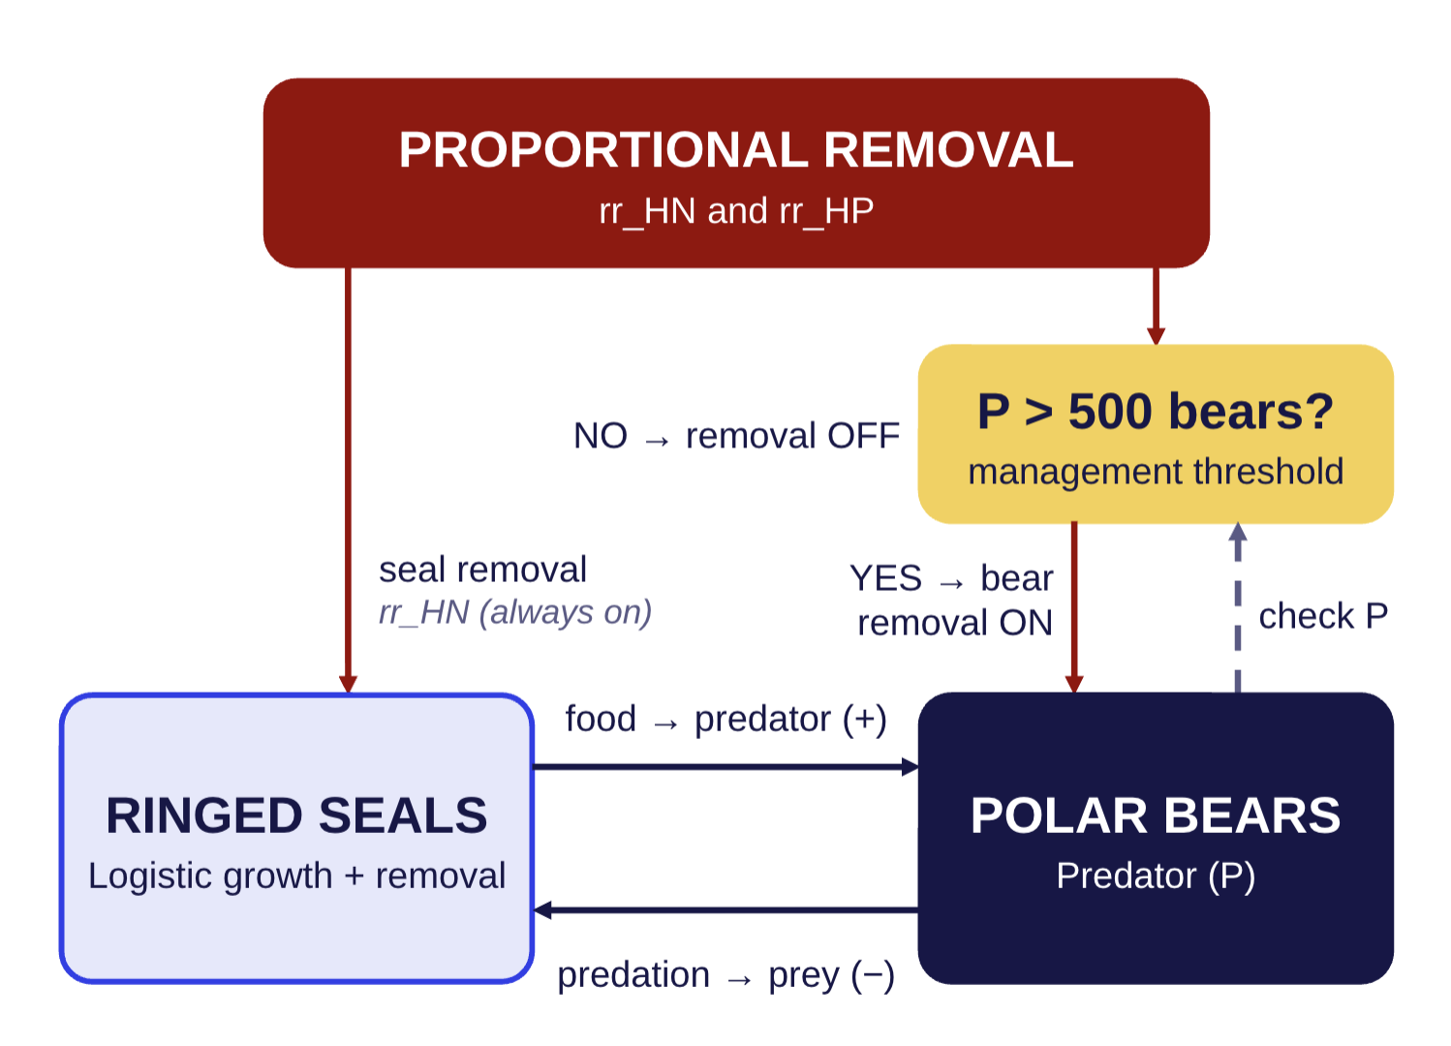
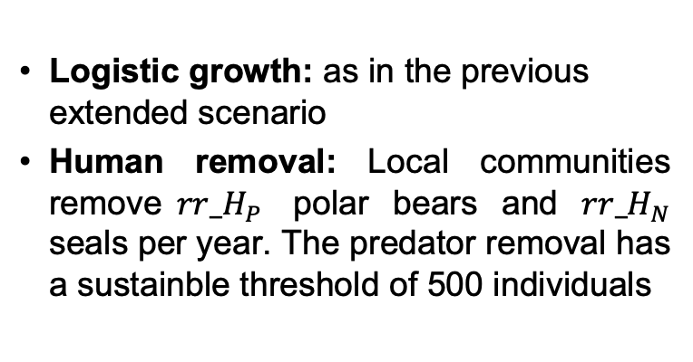
The model: sketch
Logistic growth: as in the previous extended scenario
Human removal: Local communities remove${ rr_H}_{P}$ polar bears and ${rr_H}_{N}$ seals per year. The predator removal has a sustainble threshold of 500 individuals
Notes:
In the wild, polar bears live an average of 15 to 18 years, although biologists have tagged a few bears in their early 30s.
https://polarbearsinternational.org/polar-bears/polar-bear-facts/life-cycle/

Slide 15
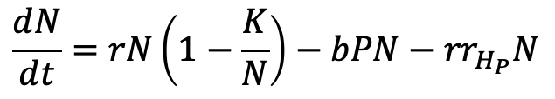
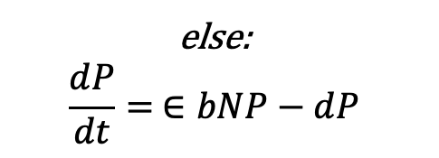
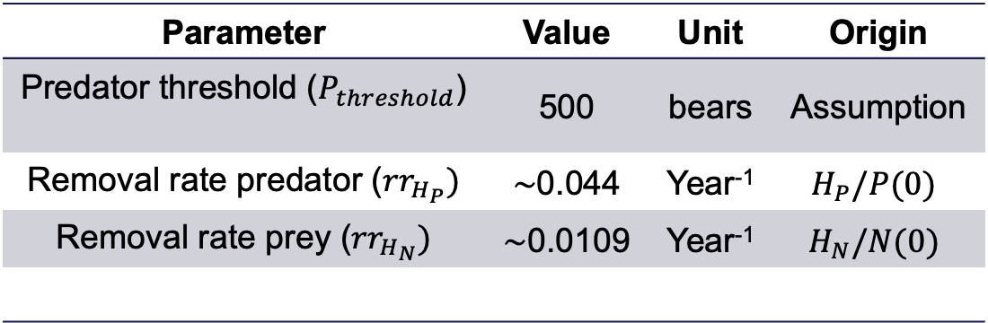
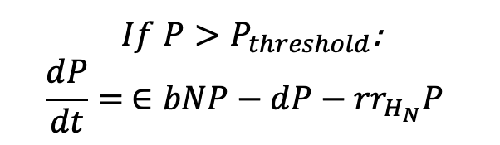
The model: equations & parameters
$If P>P_{threshold}$:
$$\frac{dP}{dt}= ∈bNP−dP−{rr}_{H_{N}}P$$
$$\frac{dN}{dt}=rN\left(1−\frac{K}{N}\right)−bPN−{rr}_{H_{P}}N$$
else:
$$\frac{dP}{dt}= ∈bNP−dP$$
Parameter | Value | Unit | Origin
Predator threshold ($P_{threshold}$) | 500 | bears | Assumption
Removal rate predator (${rr}_{H_{P}})$ | $\sim$0.044 | Year⁻¹ | $$H_{P}/P(0)$$
Removal rate prey (${rr}_{H_{N}})$ | $\sim$0.0109 | Year⁻¹ | $$H_{N}/N(0)$$
Notes:
https://nammco.no/ringed-seal/?utm_source=chatgpt.com#1475844711542-eedf1c7b-5dde
Estimated value for x = 8000 based on catches reports
Over the next 34 years (approximately three polar bear generations) and assuming a 2:1 male‐to‐female harvest sex ratio, the starting sustainable harvest ranged from 63 bears/year in the absence of scientific monitoring, to 93 bears/year if updated demographic parameters are estimated after 15 years and used to adjust the harvest, if necessary. We also identified an intermediate harvest strategy of up to 78 bears/year that requires a moderate level of monitoring and uses a threshold harvest rule.
I will assume an unssutainable case of 100 polar bears / year
https://www.researchgate.net/publication/411848467_Evaluating_harvest_risk_with_limited_data_A_case_study_on_polar_bears_Ursus_maritimus_in_East_Greenland

Slide 16
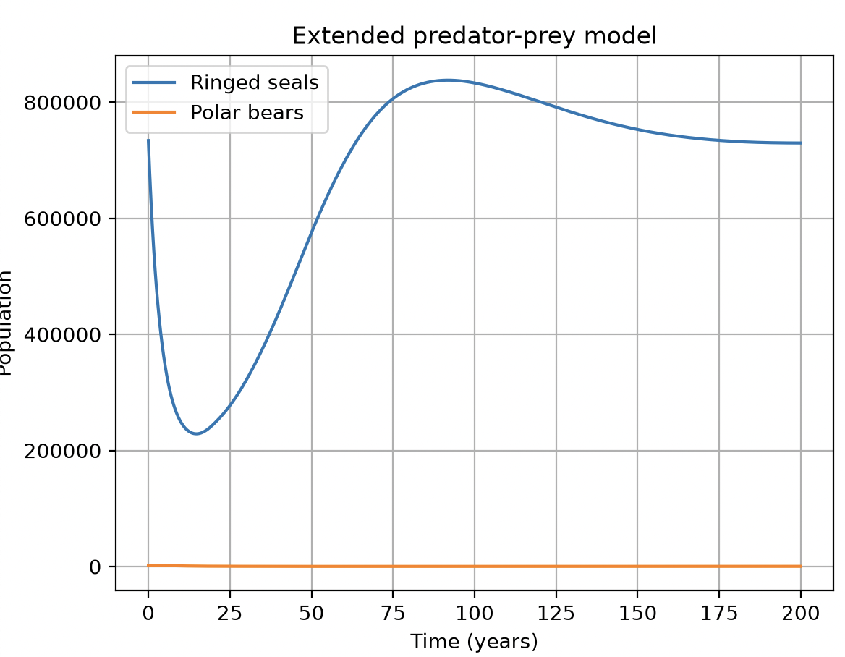
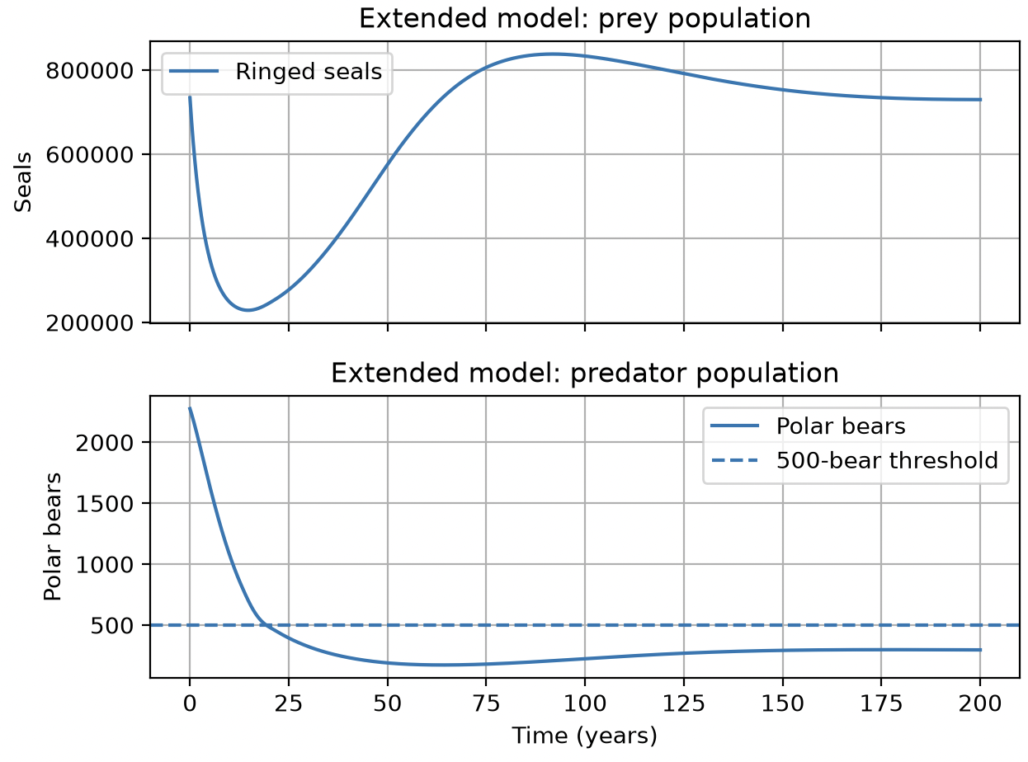
Results – Logistic growth and controlled removal

Slide 17
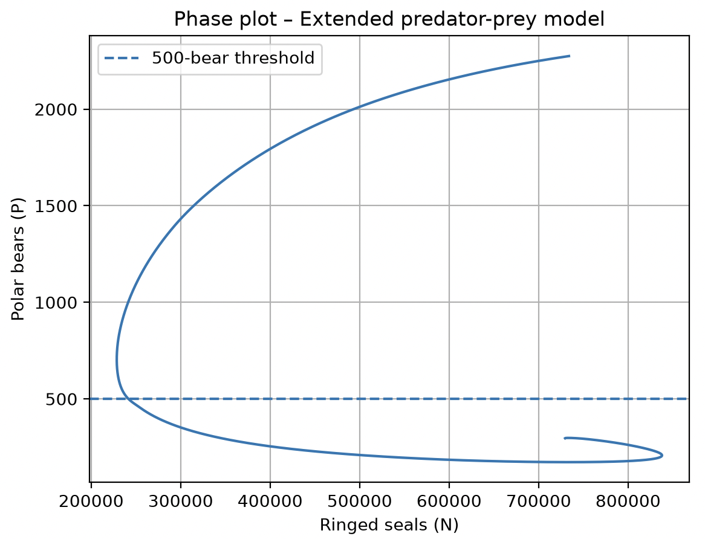
Results – Logistic growth and controlled removal

Slide 19
Evolution of the extended model

Slide 20
AI declaration & code
AI tools were used to assist with debugging the code and improving plots visual aspect. The model sketchs were also done with the help of AI tools
The code is pasted in the notes of this slide. If it is not clear, the link below is connected to a github repository where I will paste the source codes.
  https://github.com/PolBassols/mathematicalbiology/blob/main/pinna_nobilis.py

Slide 21
References
Gamblin, H. E., Derocher, A. E., Richardson, E. S., McGeachy, D., Roth, J. D., & Pilfold, N. W. (2026). Predators and scavengers: Polar bears as marine carrion providers. Oikos, 2026(1), e11628.
Crockford, S. J. (2022, June 16). Newly-discovered SE Greenland polar bear subpopulation: Another assumption proven false. Polar Bear Science. https://polarbearscience.com/2022/06/16/newly-discovered-se-greenland-polar-bear-subpopulation-another-assumption-proven-false/
Natural Habitat Adventures. (n.d.). Ringed seal facts | Greenland wildlife guide. Natural Habitat Adventures.
https://www.nathab.com/know-before-you-go/alaska-northern-adventures/greenland/wildlife-guide/ringed-seal-facts
Stedmon, C., Boje, J., Christensen, H. T., Nogueira, A., Winding, M. S., Jónsson, S., Friis Møller, E., Sejr, M., Mosbech, A., Post, S., Munk, P., Emblemsvåg, M., Schou Christiansen, J., Frie, A. K., Asvid-Rosing, A., Pedersen, T. J., & Blicher, M. (2020). Working Group on Integrated Ecosystem Assessment of the Greenland Sea (WGIEAGS). International Council for the Exploration of the Sea. ICES Scientific Report, 2(75). https://doi.org/10.17895/ices.pub.7450
Laidre, K. L., Marques, T. A., Cohen, B., Hansen, R. G., Regehr, E. V., Zahn, M. J., Aars, J., Ware, J., Stern, H. L., & Ugarte, F. (2026). First abundance estimate for the East Greenland polar bear subpopulation. Endangered Species Research, 59, Article esr01479. https://doi.org/10.3354/esr01479
Polar Bears International. (n.d.). Life cycle. Polar Bears International.
https://polarbearsinternational.org/polar-bears/polar-bear-facts/life-cycle/
North Atlantic Marine Mammal Commission (NAMMCO). (n.d.). Ringed seal. NAMMCO.
https://nammco.no/ringed-seal/

