Slide 1

Technical Design Document
Project II – Personal Research
Pol Recasens Sarrà - UPC

Slide 2

Technical Design Document
What is it?
Why is it important?
What does it contains?
Important points

Slide 3
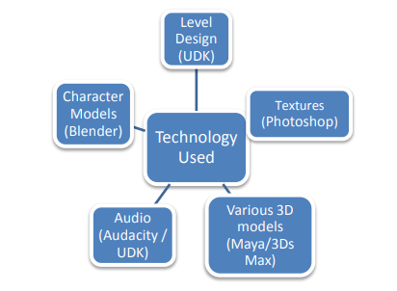
What is it?
It specifies the technical resources that will be used
Preproduction phase of a video game development
Seasoned programmer, technical director or a lead
programmer
Set up the experimental features

Slide 4

Why is it important?
Make the reviewers optimistic about the
game’s chance of succeeding(the project is under control)
Reduces wasted efforts and confusion
Helps the team make their decisions

Slide 5
What does it contains?
Introduction
Technical goals
Technical risks
Development environment
Estimated schedule
Code style guidelines
Code architecture
Graphics
Audio

Slide 6
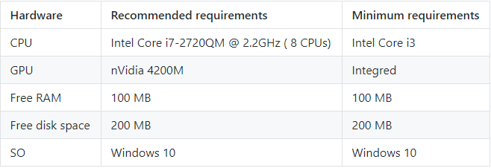
Introduction
Include a game summary(just a few lines)
Which platform the game is directed to?

Slide 7
Technical goals
Experimental features (unproven technologies and techniques or unique ideas)
Don’t include features that have been already proven by existing games, even if they are new to the development team
Experimental features generally need more time in the schedule.
This experiments are seen as worthwhile investments to create a good renown in the future

Slide 8

Technical risks
Cause a set back if they fail.
List technologies that your company has never developed or has little experience with them.
Every risk must have a solution.
Makes the impression that the project is under control.

Slide 9
TODO 1
Create a list of technical risks that you think may arise during development
Remember that every risk must have a solution

Slide 10


Development environment
Development Hardware
Development Software
External code (External libraries)
List of all Hardware, Software and external code that we will use(if the company has already them or they need to buy)

Slide 11
TODO 2
List all the Hardware, Software and external code your team will use during the development
Do not be afraid if your software list is too large, unless they cost money :)

Slide 12
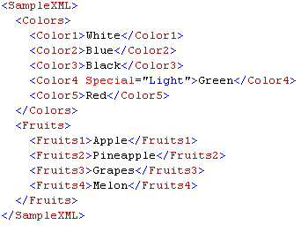
Code style guideline
A code regulation will avoid confusions when programming
Creates a great organization
Here is an example of code style guidelines that are important in our case
Naming conventions Conditionals
Classes and structs Variables
Loops XML

Slide 13
TODO 3
Create a simple code style guideline
For now just focus on the most common
Even if the person in charge of the code is in charge of making these guidelines, in our case, discuss it with the entire team

Slide 14
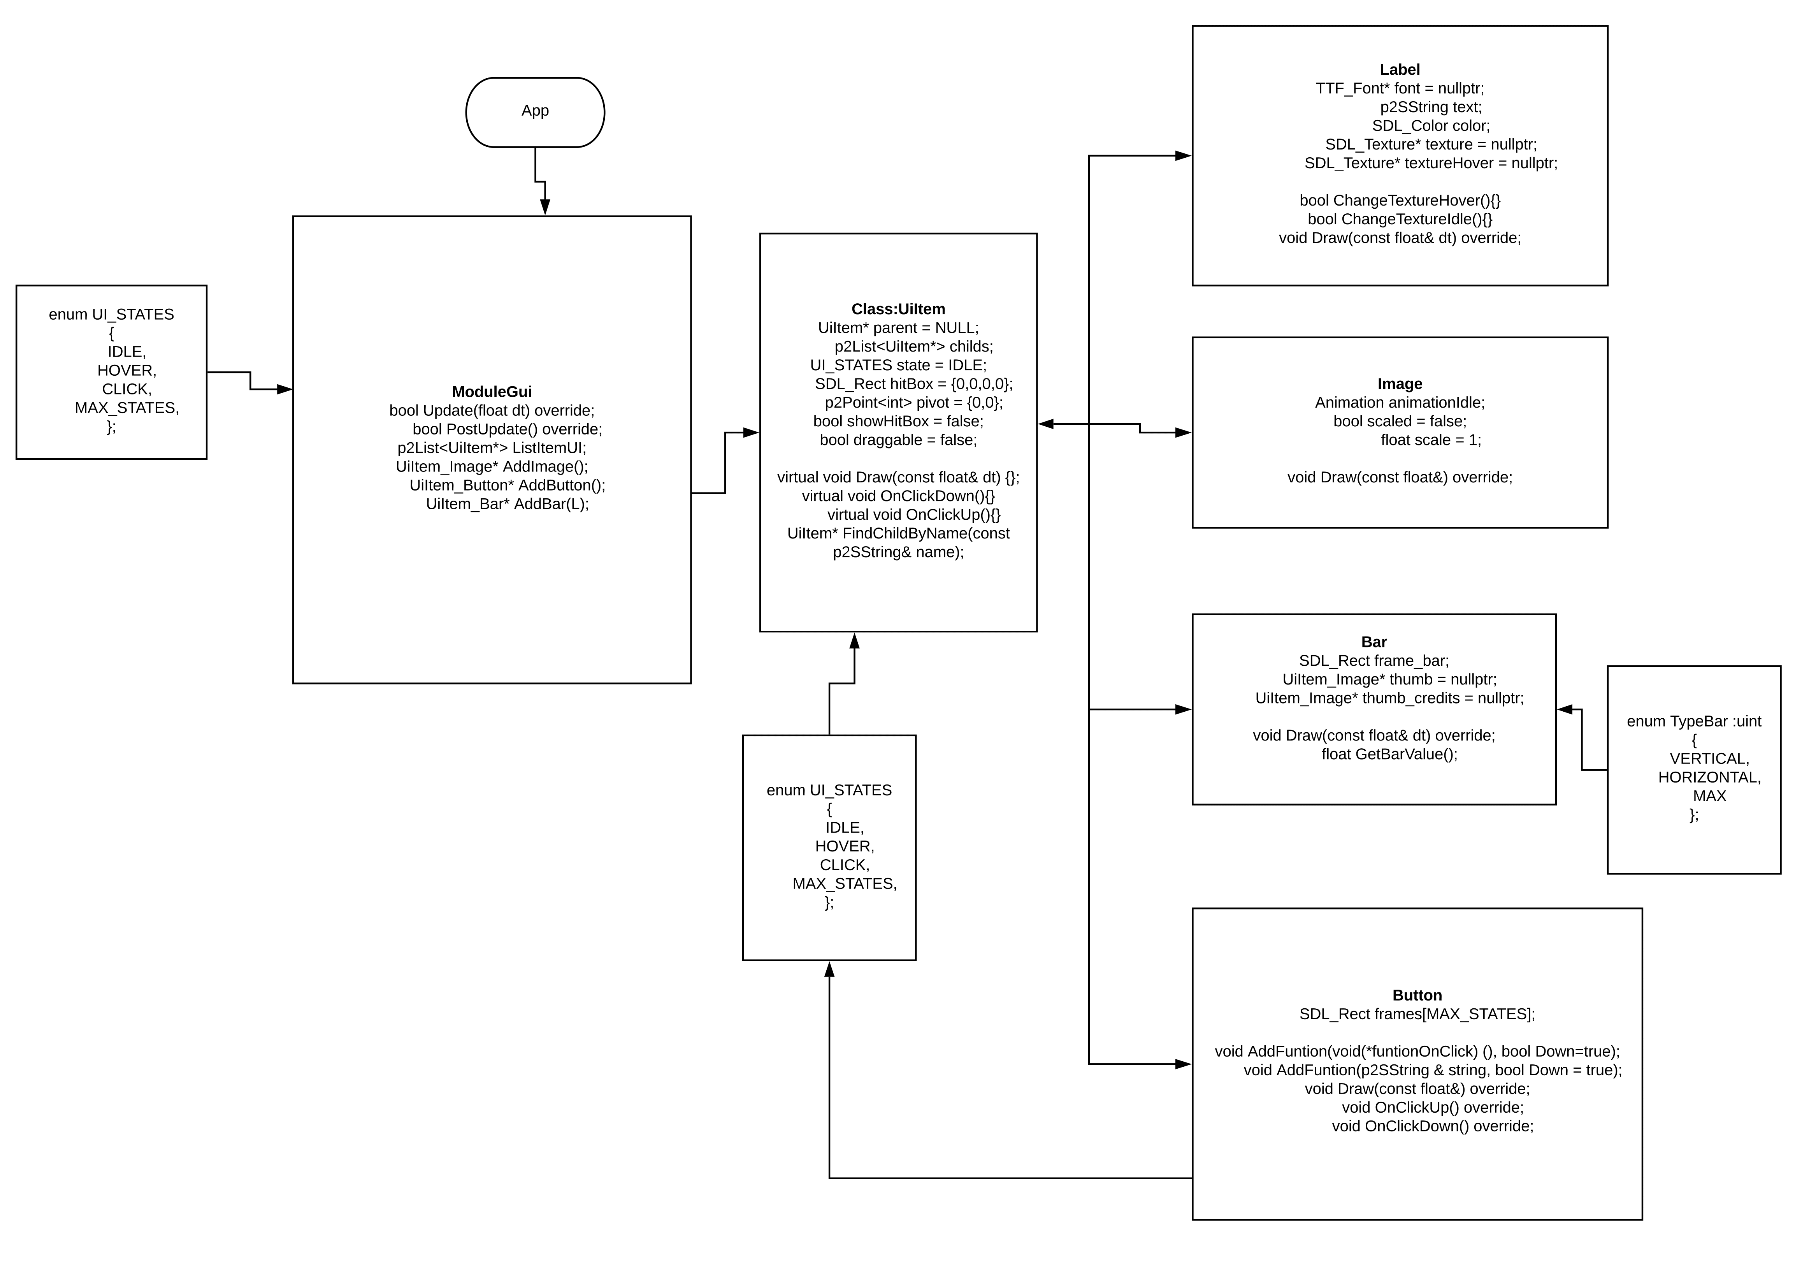
Code architecture
It provides a wide vision of the
structure of the code
It helps to understand the structure
Utilization of the UML

Slide 15
Graphics & Audio
Resolution of the platform screen(pc screen, smart phone, etc.)
Size of the tiles
Texture loading(XML)
Audio format(.wav, .ogg, MP3…)
Most remarkable features(audio 2D, audio 3D, control over volume, etc.)

Slide 16
Important points
It sets all software and hardware that is going to be used
Reviewers will have the impression that the project is under control
It helps the programmers to have all organized

Slide 17


THANKS FOR YOUR ATTENTION
Contact
Pol Recasens Sarrà
polrecasenssarra@hotmail.com
polrs

Slide 18
Sources
https://github.com/GameDesign/Zero/wiki/Technical-Design-Document http://www.nuclearmonkeysoftware.com/documents/narbacular_drop_technical_design_document.pdf https://www.gamasutra.com/view/feature/3384/the_anatomy_of_a_design_document_.php?print=1 https://github.com/DevCrumbs/Warcraft-II/wiki/7.-Tech-Design-Document https://computergamesmmu.files.wordpress.com/2012/10/technical-design-document-final.pdf https://www.studytonight.com/3d-game-engineering-with-unity/tdd-and-gdd

