Slide 1

U.S.-CANCER DATA EXPLORATORY ANALYSIS USING SQL
BY-
NIKHITHA POLADI

Slide 2
INTRODUCTION
This project involves the use of US-Cancer data and I performed some basic data cleaning, data manipulation, and lastly data analysis to interpret the outcome
Dataset used: https://www.kaggle.com/datasets/thedevastator/us-county-level-cancer-mortality-and-incidence-r
Steps:
Download cancer incidents and cancer deaths.
Performing data cleaning in excel(Adding new columns from existing column )
Importing data into MS SQL server
Performing data manipulation and data analysis
Interpreting Results
This presentation will showcase the code with the output in each slide.
Questions :
Which states has the highest incidence of cancer.
Which states has the highest count of deaths due to cancer.
What is the mortality to incidence ratio.

Slide 3
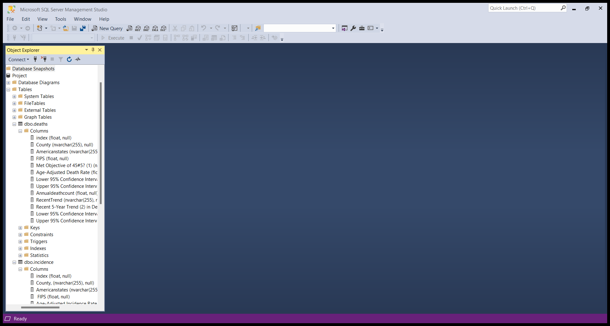
DATABASE OVERVIEW
Here we have the database name “Project" that has 2 datasets
deaths
incidence
Each dataset has set number of columns that we will use to do our analysis
We can also see the type of data and if null values are allowed within the columns.

Slide 4
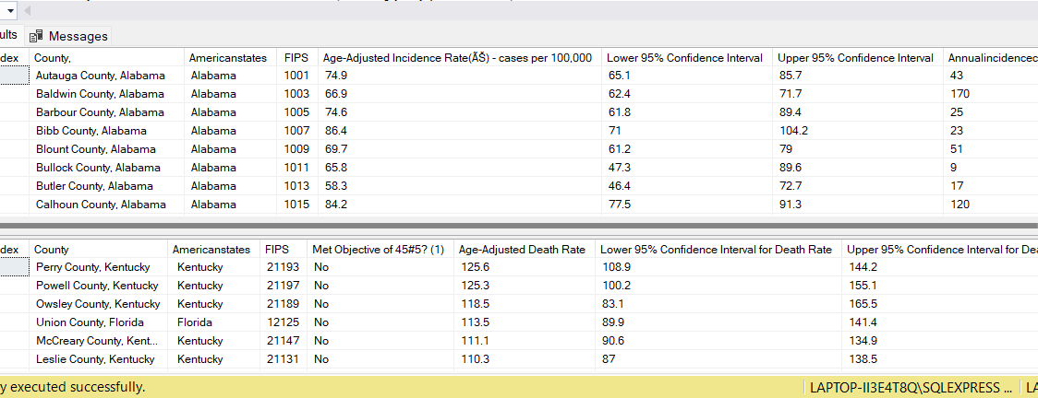
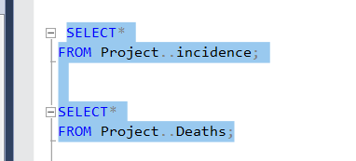
DATA EXPLORATION
We used a SELECT statement to retrieve both tables to display all columns.

Slide 5
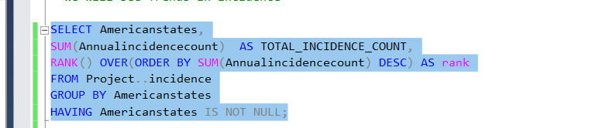
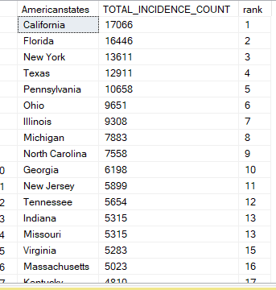
DATA EXPLORATION
We used GROUPBY, AGGREGATE, OVER, AND RANK FUNCTIONS to answer which states in the U.S. are most affected by cancer.
we can see California has reported many incidence cases and ranked 1 followed by Florida.

Slide 6
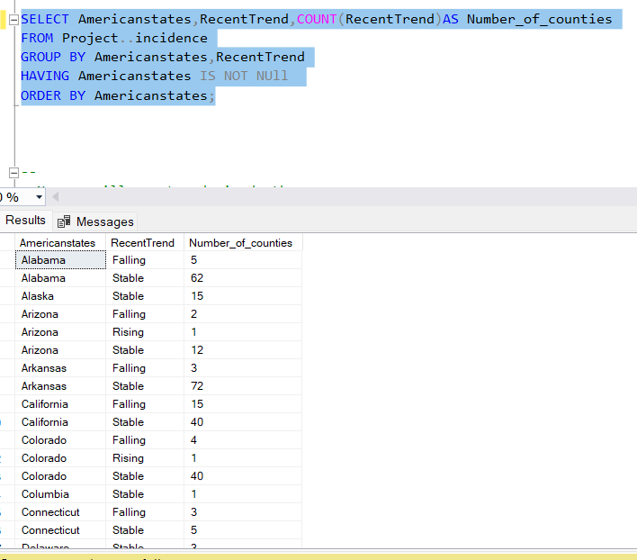
We can see the recent trend on how many counties are falling, stabilizing, or rising in each state regarding the number of incidence cases.
For example in Alabama there are 5 counties where the number of incidence cases started declining recently.

Slide 7
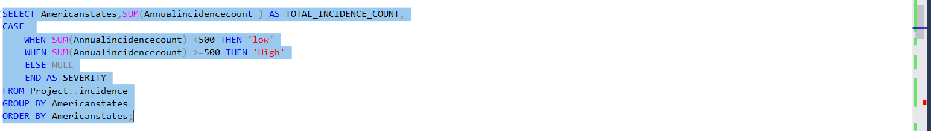
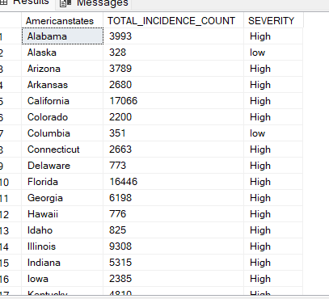
We used CASE statements to compare the severity of the cases among all states.
As we can see there is a high severity of incidence cases in most of the states.

Slide 8
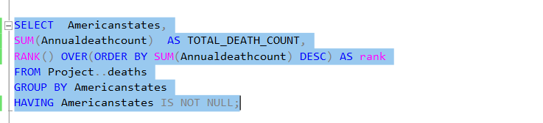
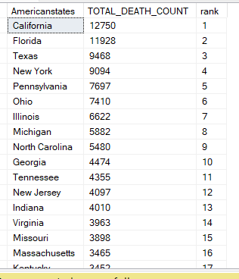
Here we analysed number of deaths due to cancer in each state using SELECT and GROUP BY statements.
California and Florida topped the list.

Slide 9
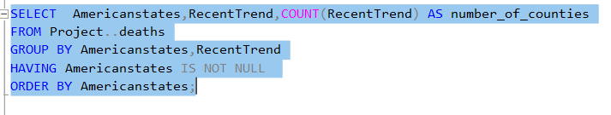
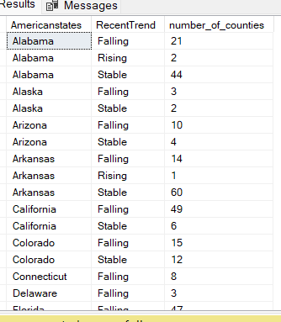
We can see the recent trend on how many counties are falling, stabilizing, or rising in each state regarding the number of death cases.
For example in Alabama there are 21 counties where the number of death cases started declining recently.
.

Slide 10
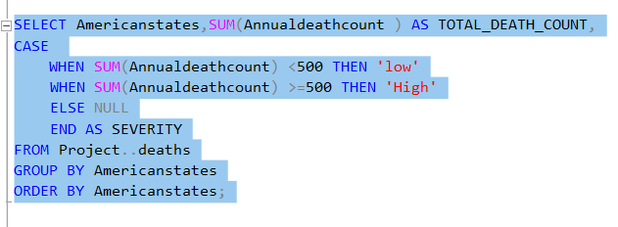
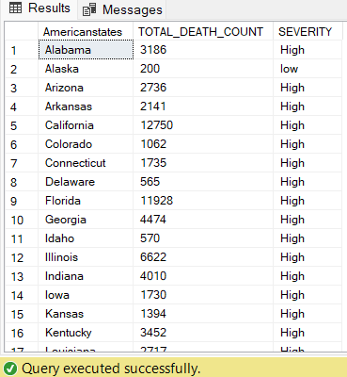
We used CASE statements to compare the severity of the cases among all states.
As we can see there is a high severity of death cases in most of the states

Slide 11
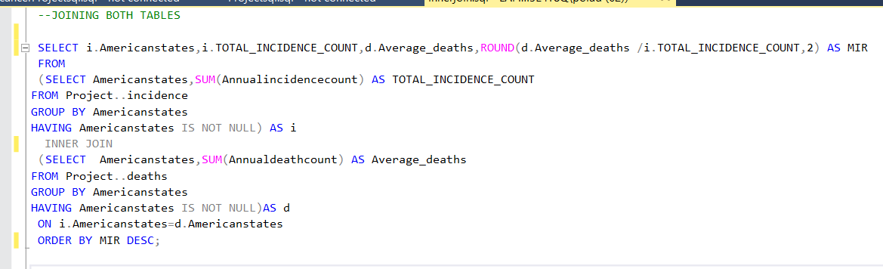
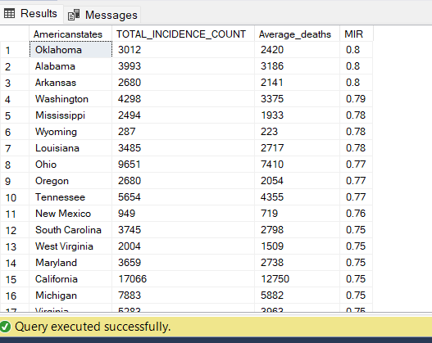
Here I joined two tables using INNER JOIN and also used SUBQUERY to calculate MIR for each state. We can see Oklahoma,Alabama and Arkansas are reported with the highest mortality to incident rate(MIR).

Slide 12
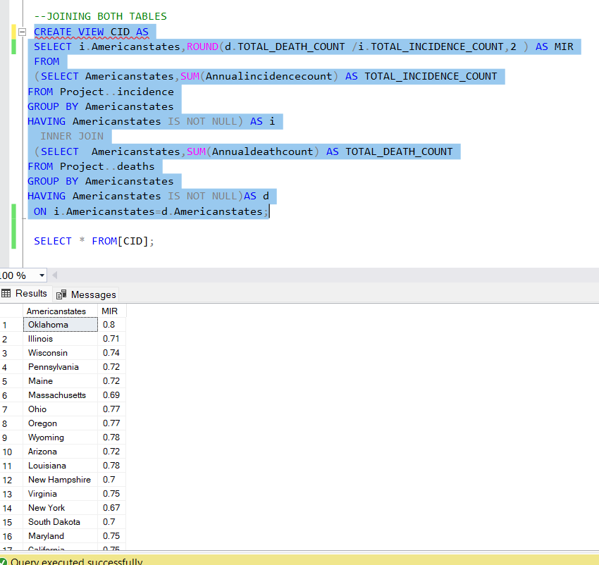
We created a view CID to store the SQL query and view it anytime.

Slide 13

CONCLUSION
Analysis:
We used SQL to perform a Exploratory analysis on this cancer data set which include both incident and death data of each county in a particular state.
We saw California and Florida are more affected with cancer deaths .On the contrary we can see highest Mortality to incidence rate in states like Oklahoma,Alabama and Arkansas.We take MIR as the best indicator to assess the cancer rate in a state.
We need to take proper preventive actions to reduce the risk of cancer.(Cancer screening taste,Health awareness programmes)

Slide 14


