Slide 1

Chess Games
Oct.16
2020
Ben Xiong, DSI
https://github.com/PolarBearXBK/1030Chess.git

Slide 2
Intro
Chess
Games

Slide 3
The Elo system
Chess
Games

Slide 4
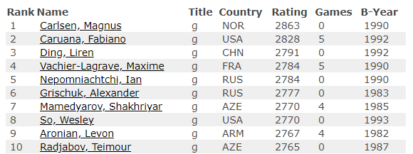
Current top players Oct 2020
Chess
Games

Slide 5
EDA
Chess
Games

Slide 6
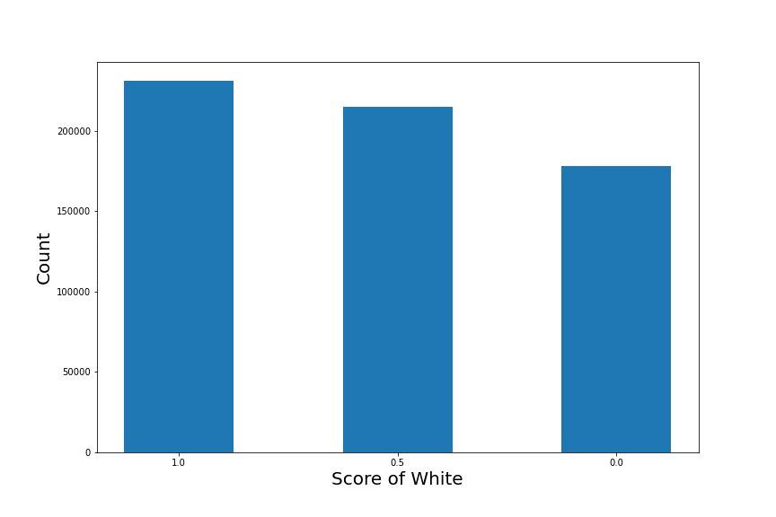
EDA
White victories amongst all games
(~600,000 games)
Chess
Games

Slide 7
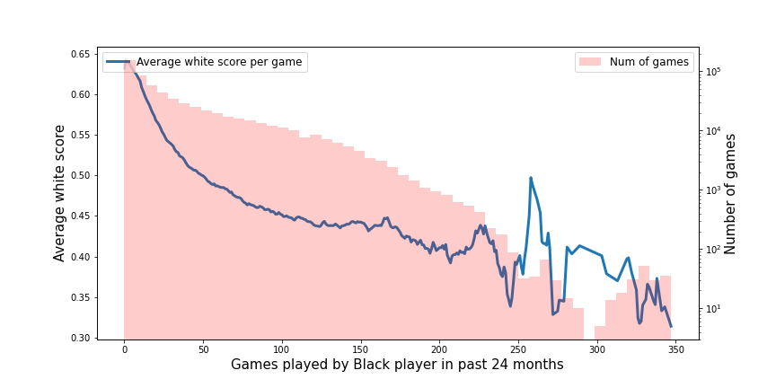
EDA
White victories against experience of black player, (~600,000 games)
Chess
Games

Slide 8
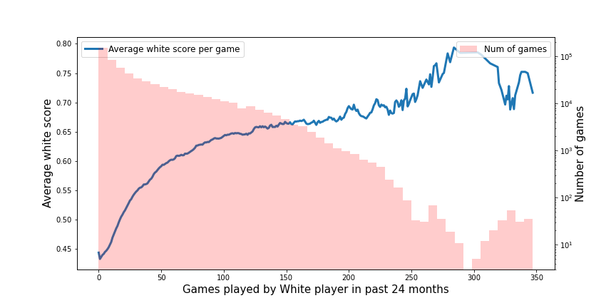
EDA
White victories against experience of white player, (~600,000 games)
Chess
Games

Slide 9
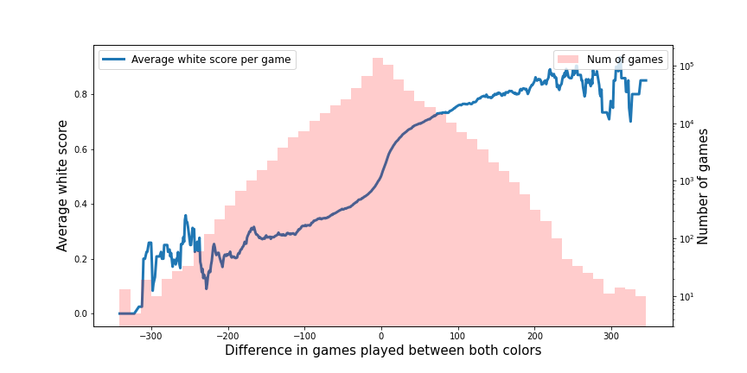
EDA
White victories against difference in experience, (~600,000 games)
Chess
Games

Slide 10
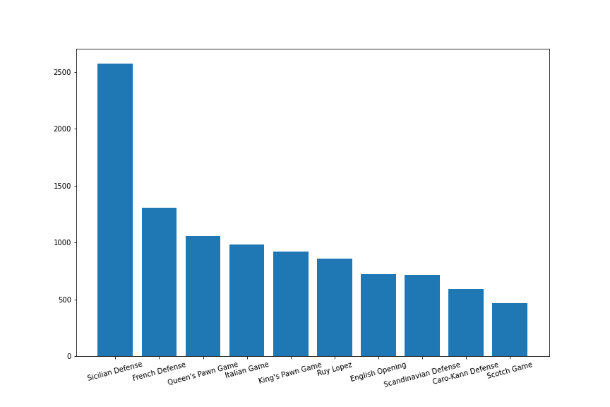
EDA
Opening Statistics (~20000 games)
Chess
Games

Slide 11
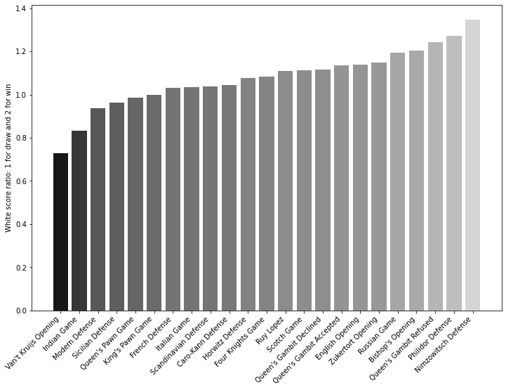
EDA
Opening Statistics (~20000 games)
Chess
Games

Slide 12
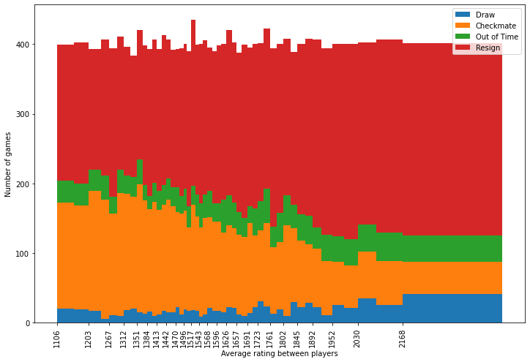
EDA
Result vs rating (~20000 games)
Chess
Games

Slide 13
Preprocessing
Chess
Games

Slide 14
Preprocessing main dataset
Feature engineering
Games of the player in the past
Player rating filing
Chess
Games

Slide 15
Preprocessing secondary dataset
String Processing - openings
Time control
Label Encoding - winner
Chess
Games

Slide 16
Thank you!
Chess
Games

