Slide 1
CCNC and SMPS data analysis
Data from 2019/09/18-20
Ivo Beck

Slide 2
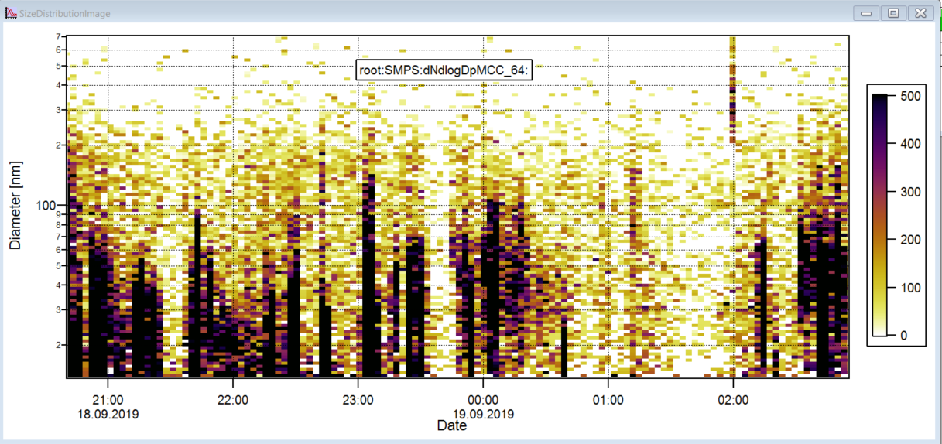
SizeDistribution Image of SMPS: A lot of Pollution and sometimes almost no particles…

Slide 3
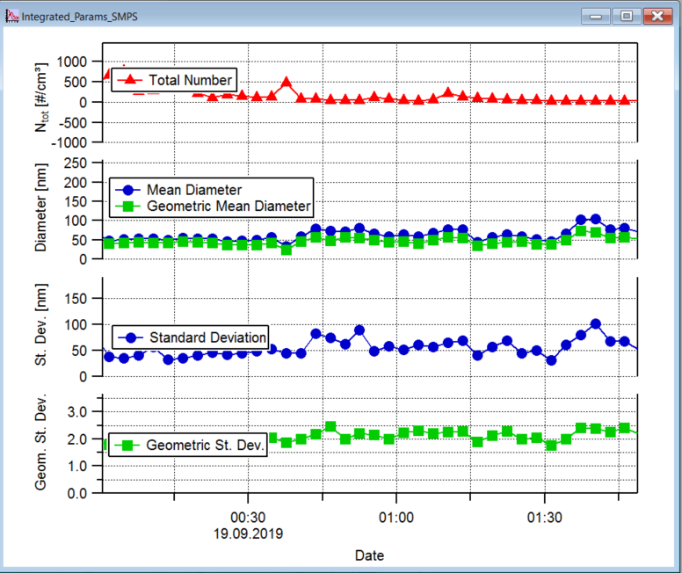
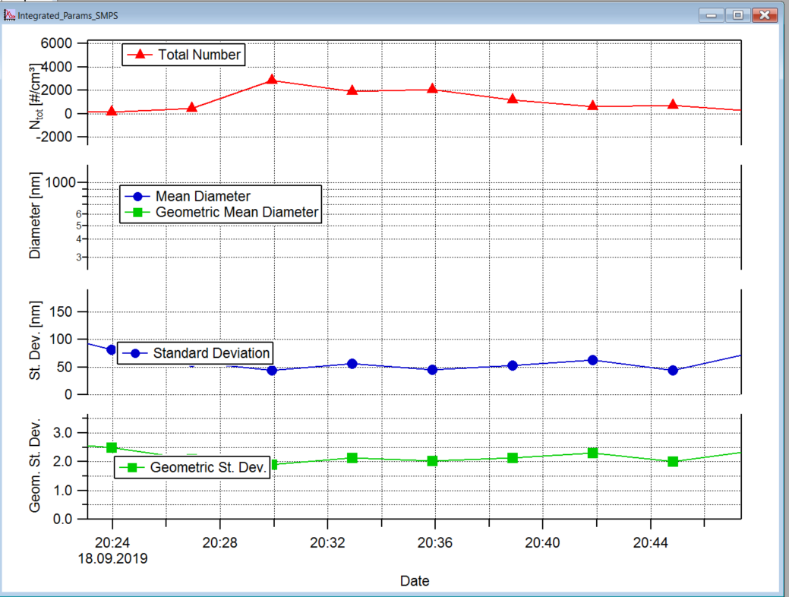
SMPS data without pollution (left) vs data with pollution (right)

Slide 4
SMPS total concentration vs. CCNC SS1 total concentration
SMPS concentrations are much higher (note that the scale on the y axis is logarithmic).

Slide 5
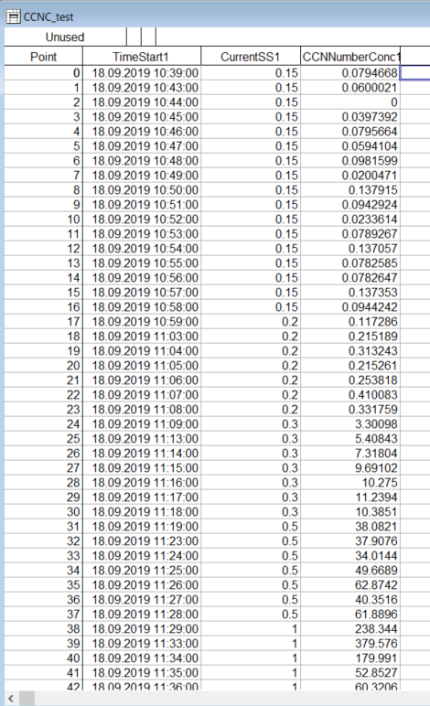
CCNC number concentrations for each SS. From this data we pick the values for one certain SS (eg. 1%) and plot all concentrations for this SS.

Slide 6
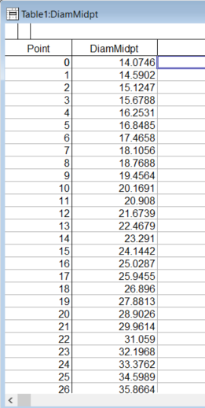
SMPS: The DiamMidpt table shows the diameter of each measured diameter.

Slide 7
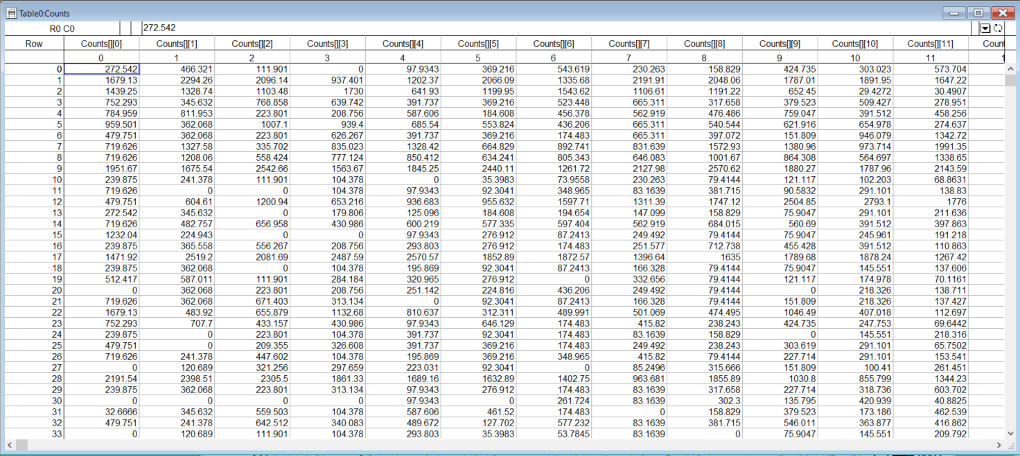
The Counts table shows the counts (concentrations, dNdlogDp) for each diameter (columns) for each time (rows). So column 1 shows the counts for 14.07nm for each measurement

Slide 8
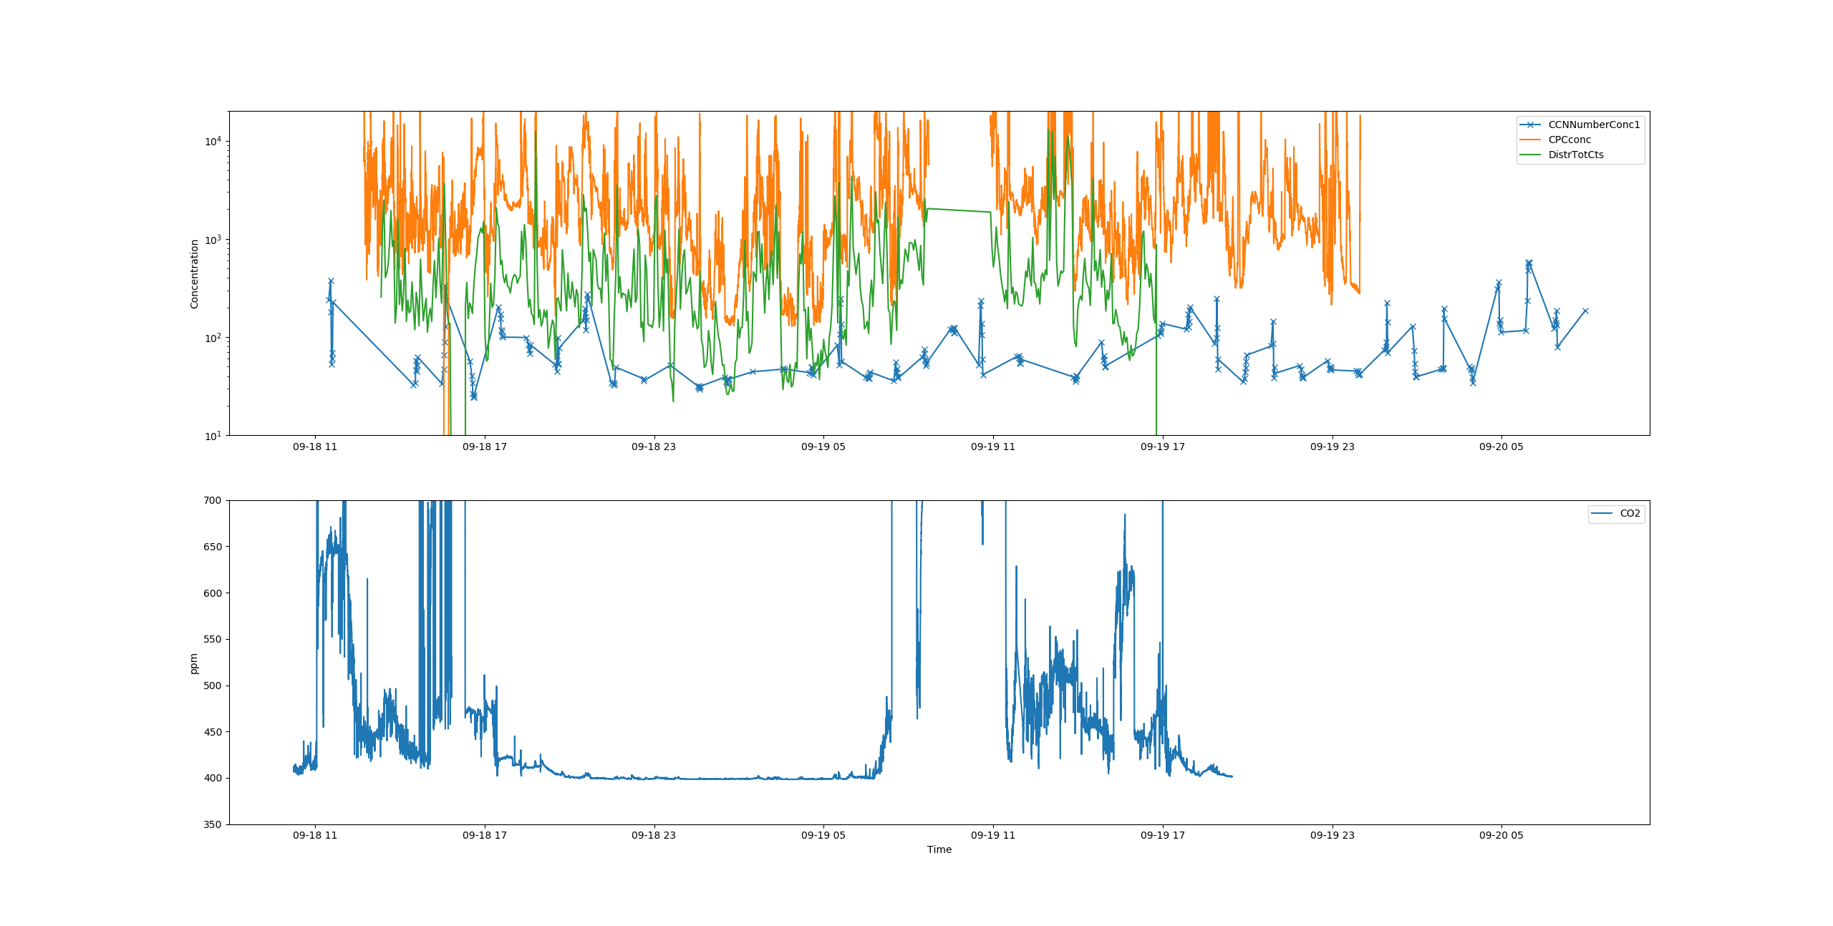
Intercomparison CPC, CCNC (1%SS) and SMPS (full spectrum)

Slide 9
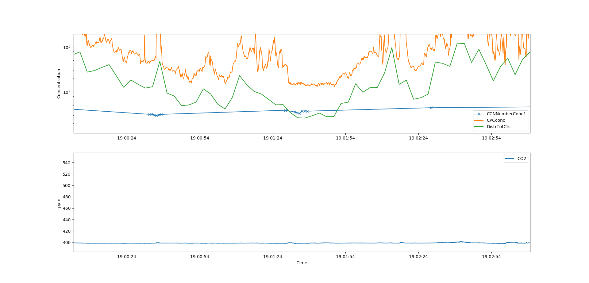
Intercomparison CPC, CCNC (1%SS) and SMPS (full spectrum), ZOOM

Slide 10
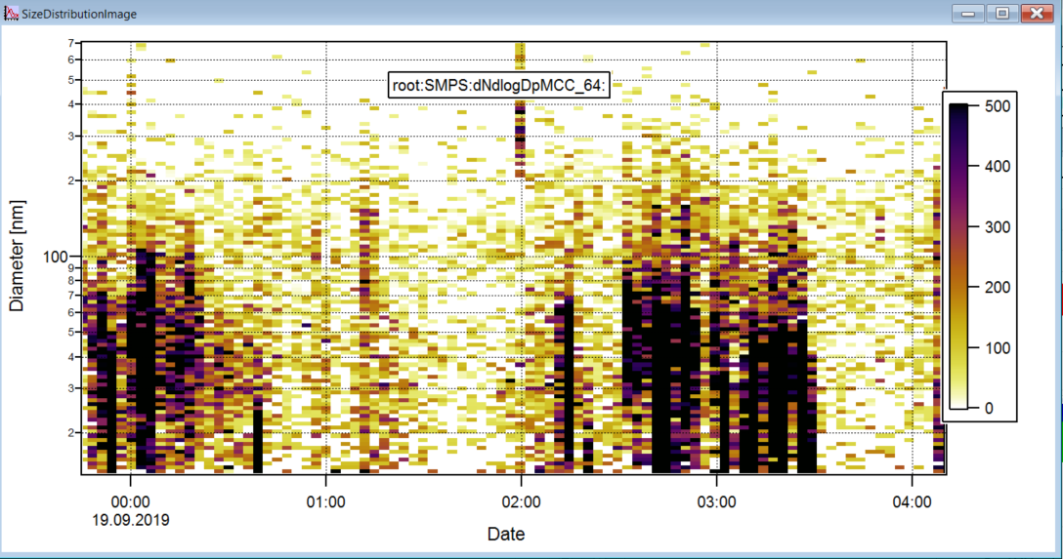

Slide 11
SMPS/CPC comparison July 2019
2019/07/29 – 2019/07/31

Slide 12
Load SMPS data into SMPS Toolkit 1520.ptx
First message: Edit procedure, than close window (quit)
Load mode: all
File type: daily matrix
Load SMPS scans (type in path to data)
Button: calc size dist
dNlogDp multiple charge correction
Check “correct sps eff.”
64bins
Red arrow to SMPS
Graphs: diagnosis → get overview
Graphs: size dist → should get the distribution window

Slide 13
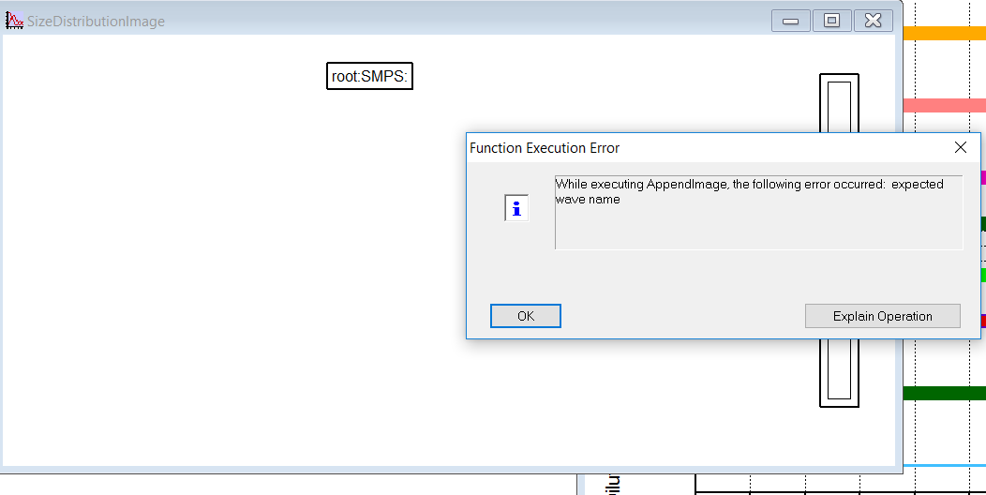
I get this error message:

