Slide 1
IE Calibration AMS
Calibration data from 08./09.07.2019
Analysis: Ivo Beck, 09.10.19
Path: M:\BeckOnly\Data\20190709_IEcal\AMS_IE_cal_data\good

Slide 2
Import good runs (folder “good”)

Slide 3
M/Z cal 282703
C+ 12 0 3 1
CH+ 13.0078 2 3 1
N+ 14.0031 0 3 1
O+ 15.9949 0 3 1
OH+ 17.0027 0 3 1
H2O+ 18.0106 0 3 1
C2H+ 25.0078 0 3 1
N2+ 28.0061 0 3 1
O2+ 31.9898 2 3 1
C3H2+ 38.0157 0 3 1
C3H3+ 39.0235 0 3 1
Ar+ 39.9624 2 3 1
CO2+ 43.9898 2 3 1
SO+ 47.967 0 3 1
C4H2+ 50.0157 0 3 1
C4H9+ 57.0704 0 3 1
C5H2+ 62.0157 0 3 1
SO2+ 63.9619 0 3 1
C6H5+ 77.0391 0 3 1
SO3+ 79.9568 0 3 1
C7H7+ 91.0548 0 3 1
W183++ 91.4751 0 4 1
C8H5O3+ 149.024 0 6 1
W182+ 181.948 2 8 1
W184+ 183.951 2 8 1
W186+ 185.954 2 8 1
C16H23O4+ 279.16 0 12 1

Slide 6
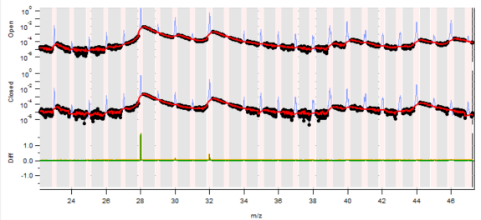
Baseline 282700

Slide 7
PreProcess

Slide 8
Airbeam Correction

Slide 9
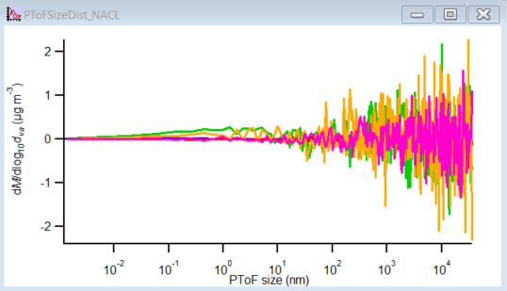
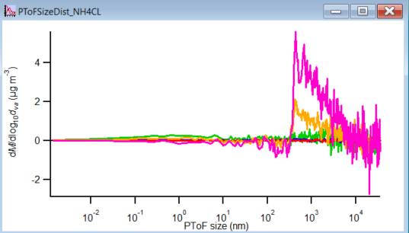
PToF

Slide 10
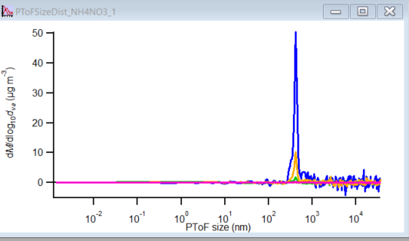
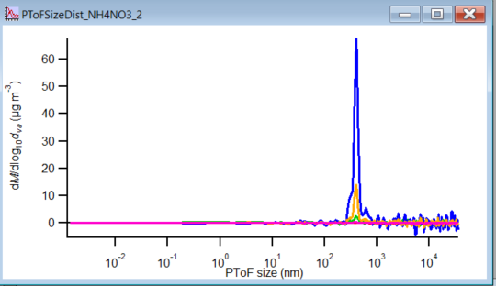
PToF

Slide 11
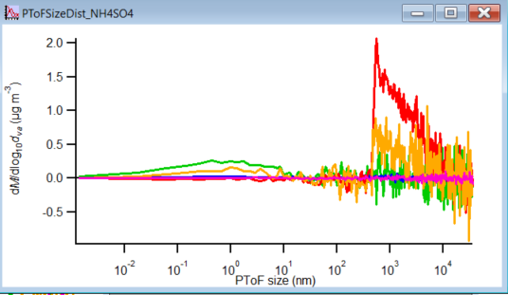
PToF

Slide 12
Old IE from diagnostics (data Browser)
1.16e-07
1.16e-07
1.16e-07
1.16e-07
1.16e-07
1.16e-07
1.16e-07
1.16e-07

Slide 13
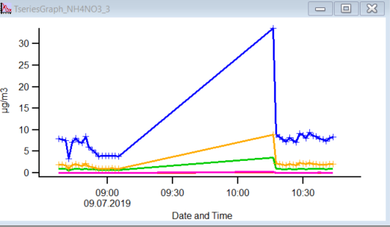
Time Series MS
Too low masses?

Slide 14
From Logbook we know what concentrations and which salt species we measured during which period (runnumbers). In IGOR we create ToDo waves for those periods and plot them. From the runtable in IGOR we find the time when there runs were performed. We separate them and check the MS signals for those runs to choose which time period we consider for calculations.
Measurement time and runnumber from IGOR, example
NH4NO3, 9.7.2019
09.07.2019 12:52:02 282788
09.07.2019 12:53:33 282789
09.07.2019 12:55:05 282790
09.07.2019 12:56:37 282791
09.07.2019 12:58:08 282792
09.07.2019 12:59:40 282793
09.07.2019 13:01:12 282794
09.07.2019 13:02:44 282795
09.07.2019 13:04:15 282796
09.07.2019 13:05:47 282797
09.07.2019 13:07:19 282798
09.07.2019 13:08:51 282799
09.07.2019 13:10:23 282800
09.07.2019 13:11:55 282801
Run number | Run Stop | Particle size (nm) | Particle conc. p/cc | Nitrate mass [ug/m3]
282648 | went down to 400 p/cc since it was varying a lot. Closed inlet valve
282659 | 282665 | 300 | 1000 | 8.2
282673 | 282677 | 300 | 460 | 4.9
Stopped measurements at 282686 due to power outage, all ok, wait for pressure and pumps to stabilize
Did a new singleIon calibration: Set MCP to 1930V and SingleIon value is at 1.68 mV
282686 | 282692 | 300 | 1300 | 10
282700 | 282704 | 300 | 1650 | 10
1000p: 282663 - 282666
470P: 672-677
Left are runnumbers 282659 – 282677.
We choose to take 282663-282666 for 1000p/cc concentration. more would be better, but signal is a bit unstable in this case. For these runnumbers we check the time when they were measured and take the CPC data during thist time to calculate the average concentration during the period. Whith this concentration and the size of the particles and the species, we find the CPC based Mass for NO3 and NH4.

Slide 15
Stats for NH4NO3
Chemical | Runnumber | Run stop | AMS NO3 (ug/m3) | AMS NH4 (ug/m3) | particles from CPC (display) | Particles from CPC corrected | Particle Size | dva | CPCbased NO3 Mass | CPCbasedNH4 Mass
NH4NO3 | 282663 | 282666 | 7.035772857 | 1.768930286 | 1064.721777 | 3549 | 300 | 413 | 53 | 16
 | 282672 | 282677 | 3.948616 | 0.9886854 | 479.7475492 | 1599.158497 | 300 | 413 | 24 | 7
 | 282700 | 282704 | 7.90582 | 1.955966 | 1203.639852 | 4012.13284 | 300 | 413 | 60 | 18
Not used cause of CPC 3025, no flow correction.
Are these values correct?
Wrong! It’s a CPC 3025.

Slide 16
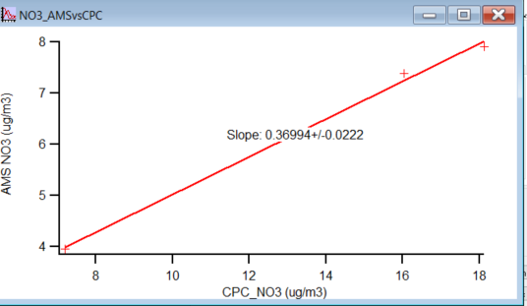
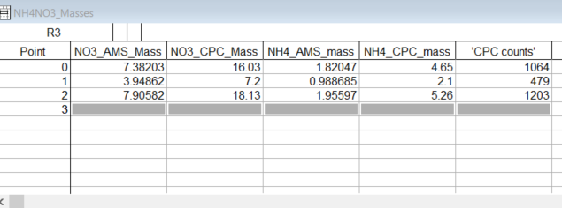
IE calculation:
Plot these 3 points and fit linear. Slope is needed.
IE_new = IE_old * slope
IE Calc NO3
Old IE: | 1.16E-07
Slope: | 0.36994
New IE: | 4.29E-08

Slide 17
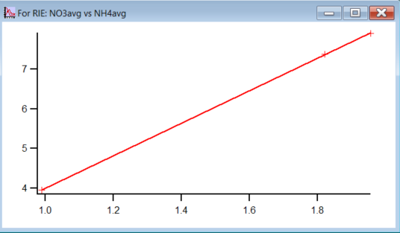
RIE
Airbeam Mean value: 83911
IE/AB ratio: 5.11E-13
RIE NH4: 4/(0.29*slope of NO3/NH4 AMS) =
(Mass ratio NH4/NO3 = 0.29, slope shows measured mass ratio)

Slide 18
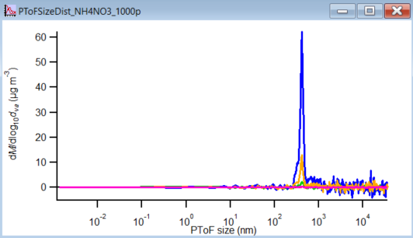
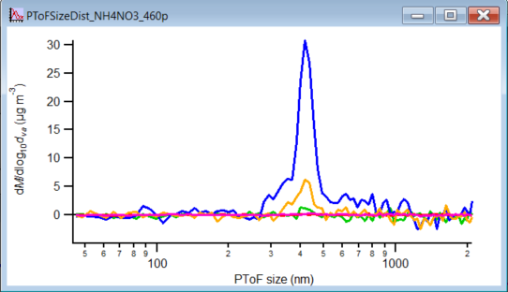
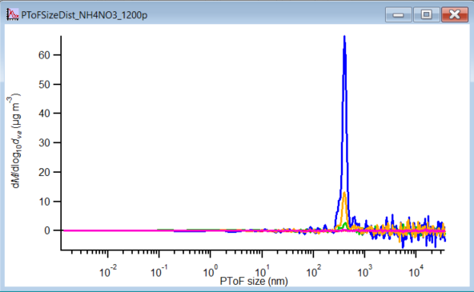
NH4NO3

Slide 19
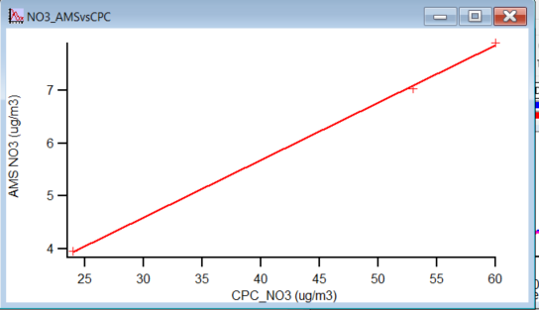
IE calulation
Old IE: 1.16E-07
Slope: 0.11
New IE: 1.28E-08

