Slide 1

AB Testing tool
Ben Noyes

Slide 2



Business Context
Question:
How do certain segments perform
over time?
Website measurement
Market
segmentation
Category performance
Ex) A/B Testing on different versions of an app / landing pages on a website
Ex) CLV analysis on different segments in your market, want to test your hypothesis
Ex) FMCG brand creating a new product in one of
several categories,
Data on segments
This tool
Clear-cut decision
Notes:
Business Context: Questions to answer
How do certain segments perform over time?
Use cases
Website measurement:
You have several updates of a online site or app, and you want to see how these different updates stack up for a set amount of time, you could compare to see a clear winner
For example, you are performing A/B testing in an app environment
Market segmentation
You have a great product, but are new to the market, and want to identify who among your audience is likely one to focus on
For example, you have performed a CLV analysis on different segments in your market, and you want to see how they stack up over time
Product-market fit: (marketing side)
You are interested product innovation, and you want to see how certain categories have been performing over a set amount of time.
For example, you are able to expand into a new category or market, but want to see historical data as a place to get started
Data -> This Tool -> Clear-cut decision
This tool reads in a set of data on segments, and gives you a clear cut decision on which data is performing better.

Slide 3
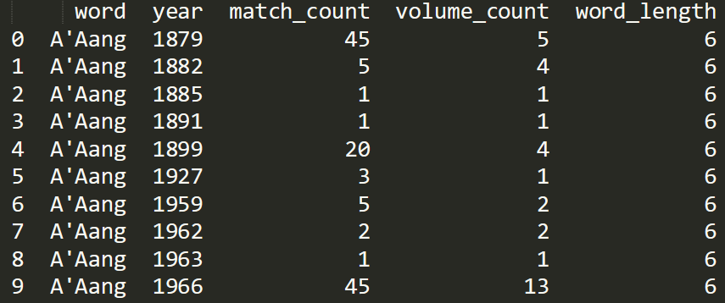
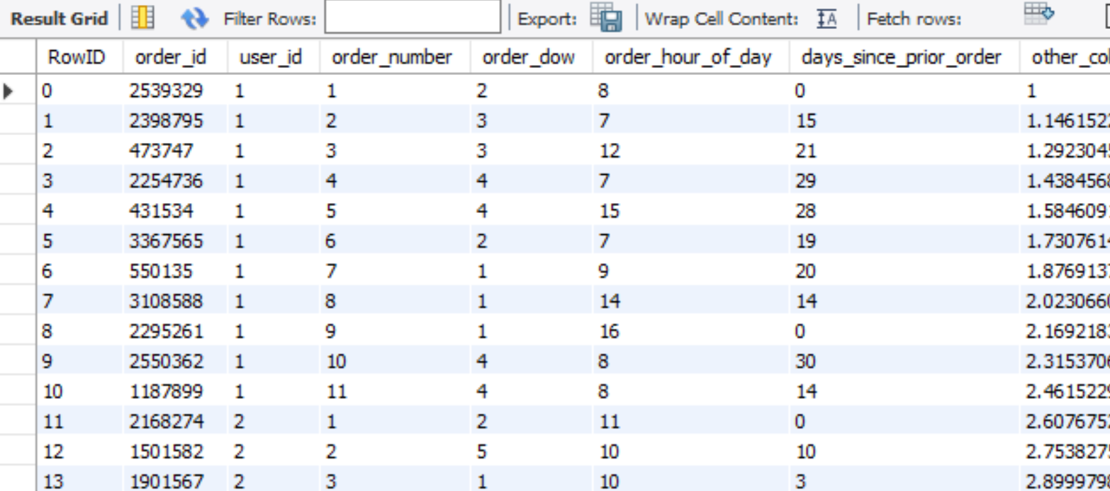
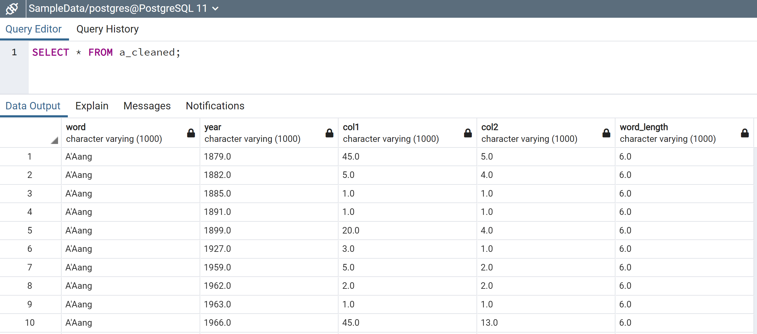
Our Data
pandas
MySQL
Google Books
26 sets of data (1-grams)
Millions of rows
36 useable sets
Ease of use, limitation
A lot of waiting
Throwing errors
→ 1.14 gb per file (41 million rows)
Postgres
Create a Fluid dataframe that can be read across environments
Notes:
The Data
Structure & Breakdown
Breakdown
26, 1 gram letters
Tens of millions of rows
Altogether 36 useable sets of data
Easily downloading the data was the key –
A lot of waiting
Throwing errors
Data was around 1.14 gb per set, so roughly 41 million rows
Here is an example of what 5 rows in the dataset looked like
Pandas
PostgreSQL
MySQL

Slide 4

Understanding the Data Background on nGram
Initial
structure
Desired
structure
My approach
Subsample the data
Subsample that data
Working prototype
Datapiece by letter, groupby year
Continuous features vs sentiment analysis
Pandas > SQL
Expand analysis to 42 million rows
Word – year – count
Letter –
year – count
Group by the right features –
in this case, segment and year
Notes:
Why this data,
Data Wrangling
Challenge:
Data on performance is not easy to obtain
Wanted a large pool of data to work with
Wanted pre-made segments – focusing on the analysis rather than segmentation creation
Solution:
Google nGram
Words in the English language
Of the 26 Letters, which performed the best?
→ Google nGram
Research study ongoing since 2009 which reads every word in every book published since 1500, and measures the counts of each word
BIG
My approach
Researched download methods, found a way to extract the data with pandas native functions, built a function to load the data into SQL
Used groupby functions to Combine, concatenate, filter based on the question at hand – wrangling the data
( huge shoutout to the instructors here – boosted performance by about 100x)
**One note here: Because I was working with continuous variables, this was a lot easier to perform analysis on. I’ve seen other analyses of language where it’s all about sentiment, which in the end, may not be quite as useful for statistical inference
This project focused on numerical features and the statistics behind them to generate a recommendation strategy

Slide 5
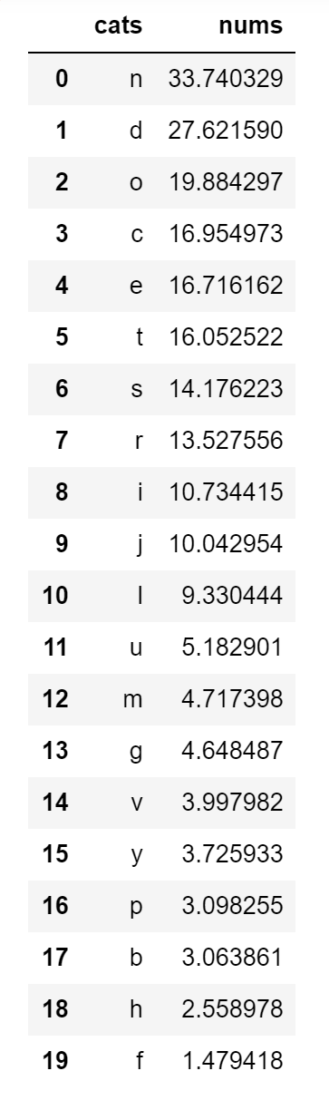
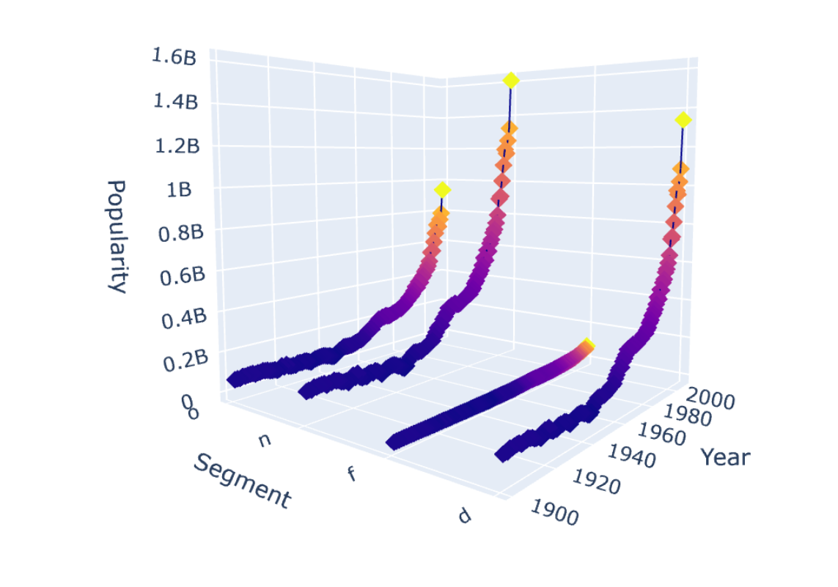
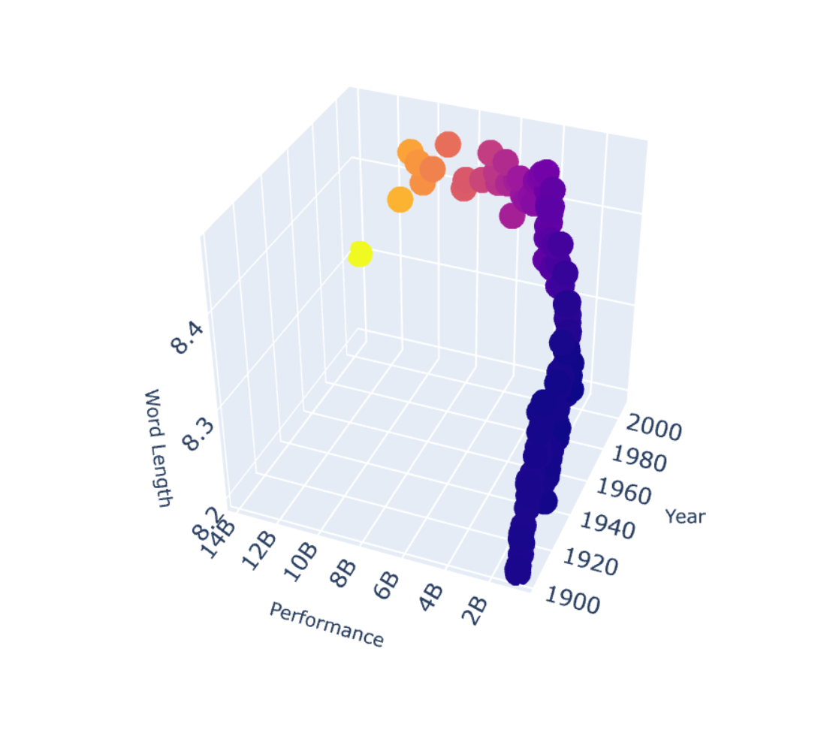
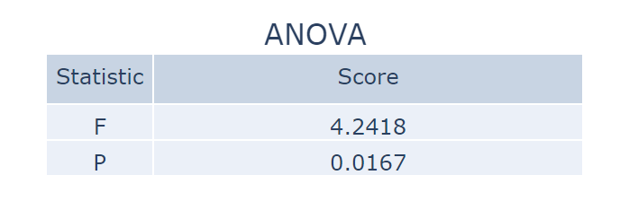
Interpreting the data
Segment “N”: 33.7 B
Segment “D”: 27.6 B
Segment “O”: 19.8 B
Break down the 3d matrix
Performance by year
Length by year
Performance by length
Perform statistical testing
on top segments to confirm
our assumptions

Slide 6
Demo
Notes:
Result:
Input the letter
Shows performance over time of that letter
Stats:
F-Score
P-Value
Aggregate Charts ( aggregated by year)
Length by year
Performance by length
Performance by year
Full Data (year x performance x length)

Slide 7
Limitations and Next Steps
Subset of the data
nGrams that started with the letter ‘A’, were published more recently than 1900, and included at least 70 counts in a year
Made it significantly more handle-able; 41 million to just under 3 million rows
Representative of subset ‘A’ since 1900
Not representative of the English language as a whole
Refine analysis: confirm if ‘N’ still most performant segment, by looking at all subsamples from each letter
PySpark running Plotly in a Jupyter Notebook environment (hdfs)
Plain pandas with greater sub-sampling
Koalas
Machine learning
Develop NN model that reads the data and creates a forecast prediction
Application
Use for content types on a site / new website changes / anything with a tag
Feed data into
a neural network model
Notes:
Limitations and Next Steps
Limtations
Subset of the data
Subset of that data
Made the data significantly more handle-able, to just under 3 million rows
We used nGrams that started with the letter a, were published more recently than 1900, and included at least 70 counts in a given year
So because of this, the sample is not representative of the English language as a whole – just those words that start with the letter A
Next Steps
Include subsamples from each letter in the alphabet and combine for further analysis
A) PySpark running Plotly in a Jupyter notebook
B) plain pandas with greater sub-sampling
C) Koalas – anyone?
Machine Learning
Develop a NN that builds a model from the data and applies it to a forecasting prediction
Application
Use for content types on a site / anything with a tag that you want to measure in an A/B test environment

Slide 8
Questions
Notes:
Questions?

