Slide 1
MLB Season Stats
Extraction, Transformation, and Loading Pipeline (ETL)

Slide 2
Goals
1
One notable insight
2
ETL pipeline
File -> Python - > R -> Dashboard

Slide 3
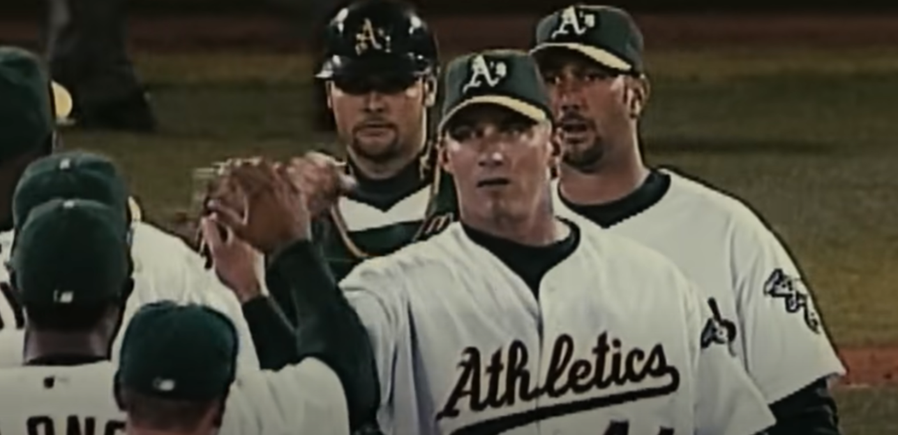
In History
Moneyball
Billy Beane creates a new strategic approach to picking baseball’s top talent
Theoretical projections based on hard stats (RBIs, ERA, Saves, etc.)
The A’s won 18 games in a row, tying the 1908 White Sox
Impressive stats
The right stats

Slide 4
Project overview
Step 1
Preprocessing
General data cleaning
Split feature creation
Confirmation on R (0.05), (continuous and categorical)
Export as csv
Step 2
Data Analysis
Exploratory analysis
Problem statements
Insights
Further research
Step 3
Dashboard
Takeaways from exploratory analysis (Insights)
Interactivity

Slide 5
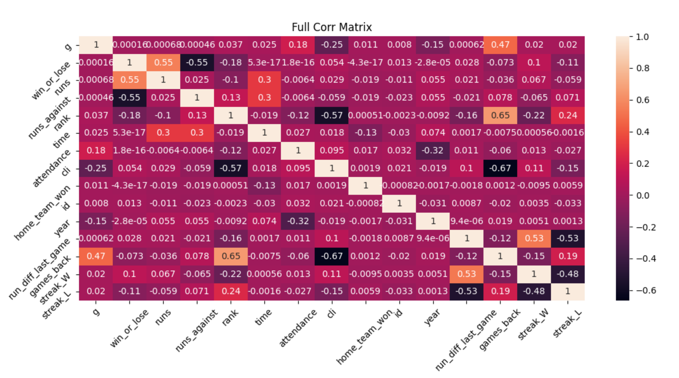
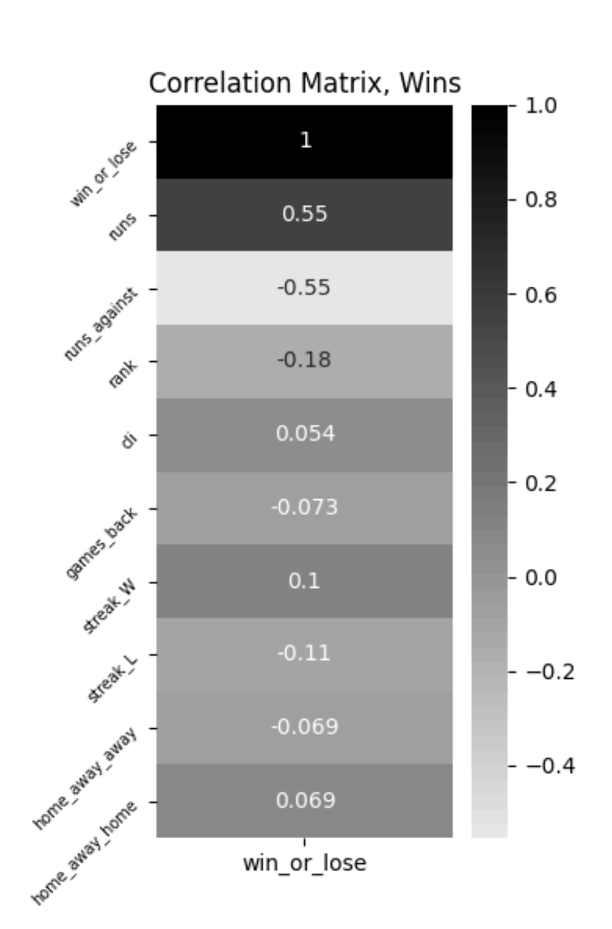
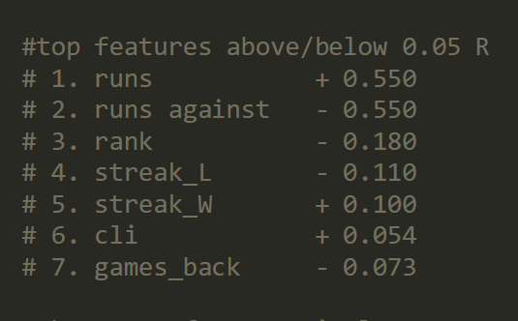
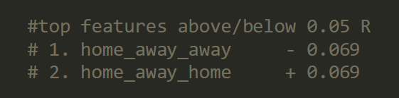
Preprocessing
Data cleaning
Crunching the columns
29 cols, 1 dependent variable
String cleaning, replacement, feature creation
Two ways
Before expl analysis vs with expl analysis
Distilled analysis
“Run” feature
Cleaned, 9 features
Other corr to look at?
Export
csv
Notes:
It might take more time, energy, effort to get a similar result, but that the easiest is still the one you know the best.
Now that I’ve done the bare minimum, where should my focus be?
Where do I want to be focusing this analysis?
What do those corr values mean, how might they help your analysis?

Slide 6

Project overview
Step 1
Preprocessing
Step 2
Data Analysis
Step 3
Dashboard
Notes:
Export package
(cleaned df, + heatmap)

Slide 7
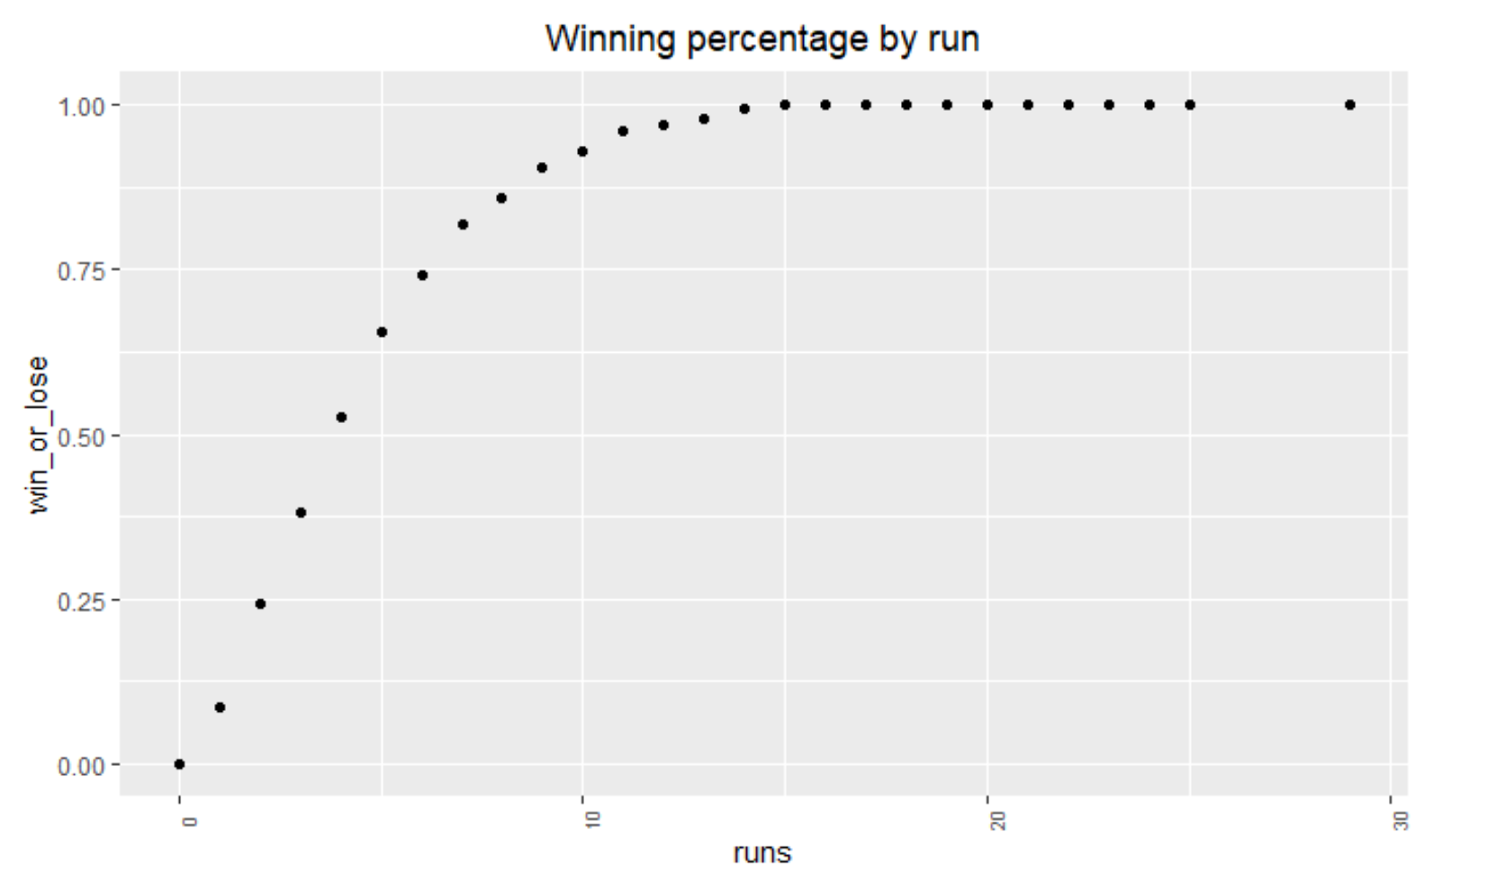
Data Analysis

Slide 8
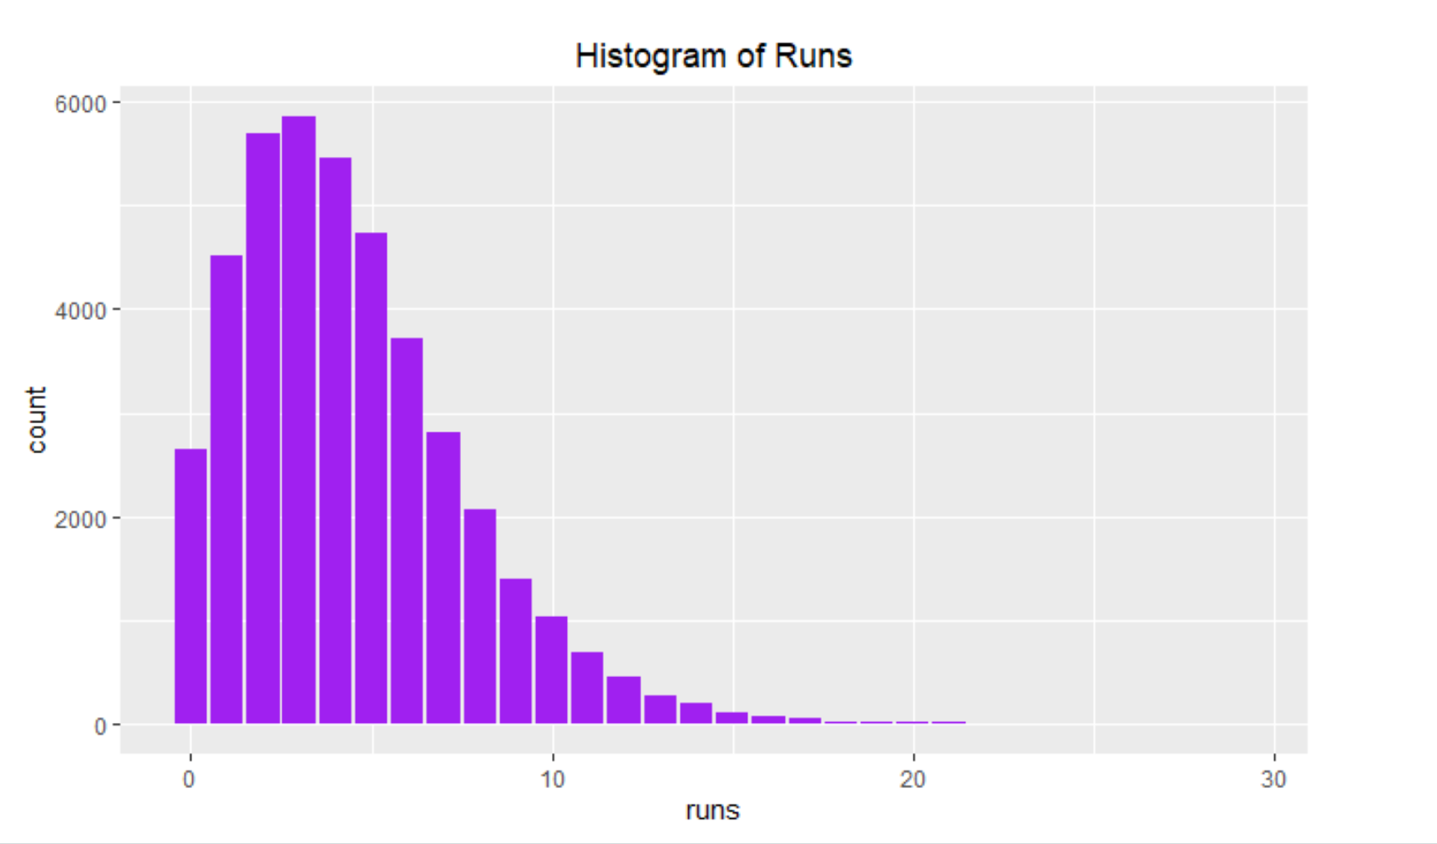
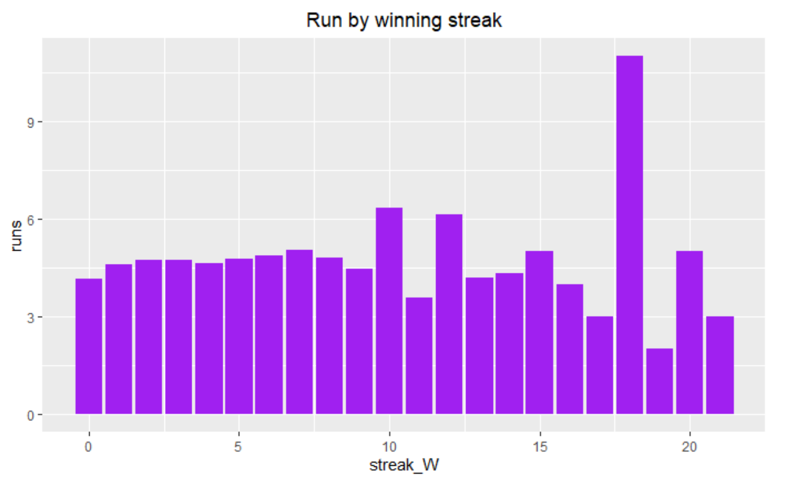
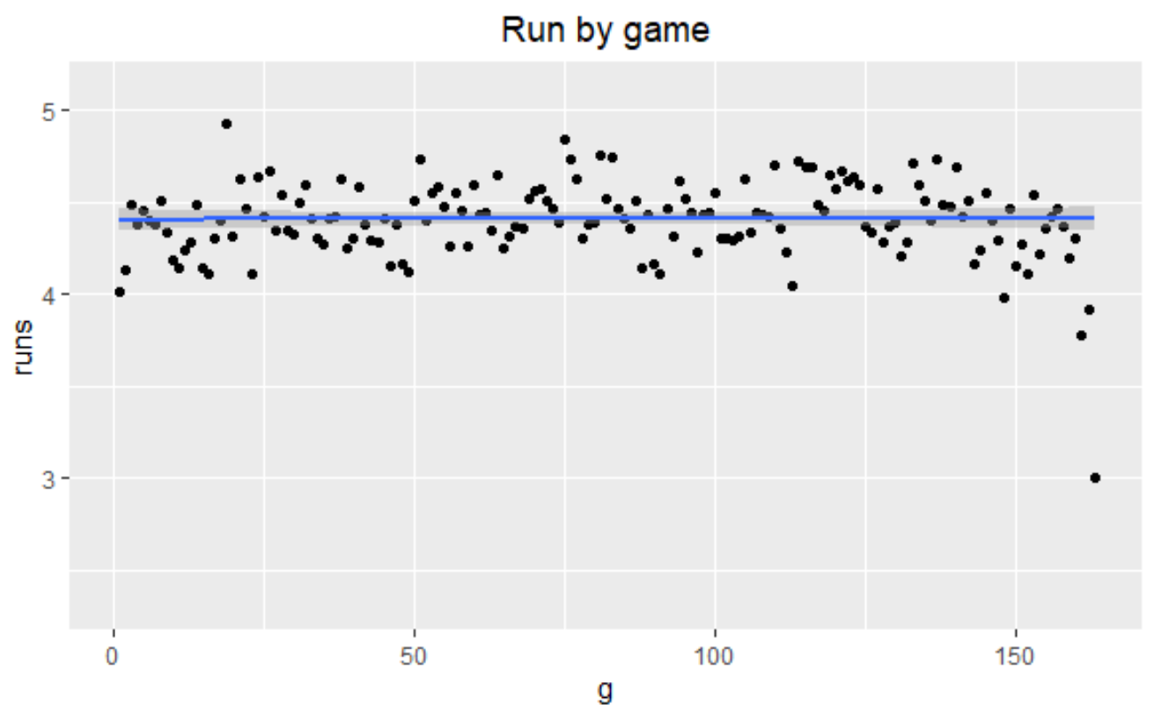
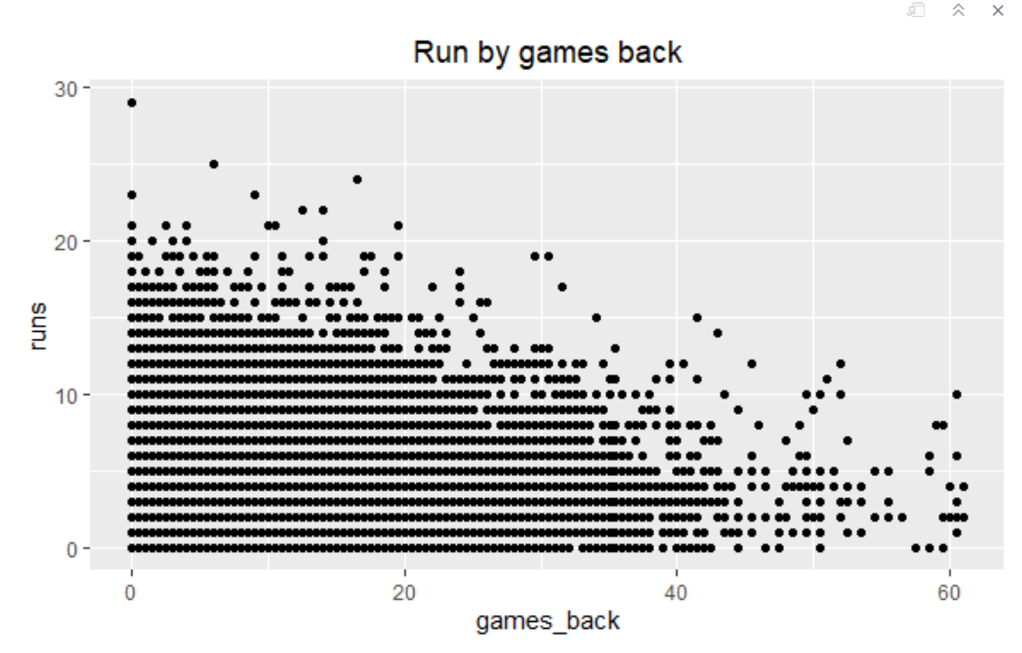
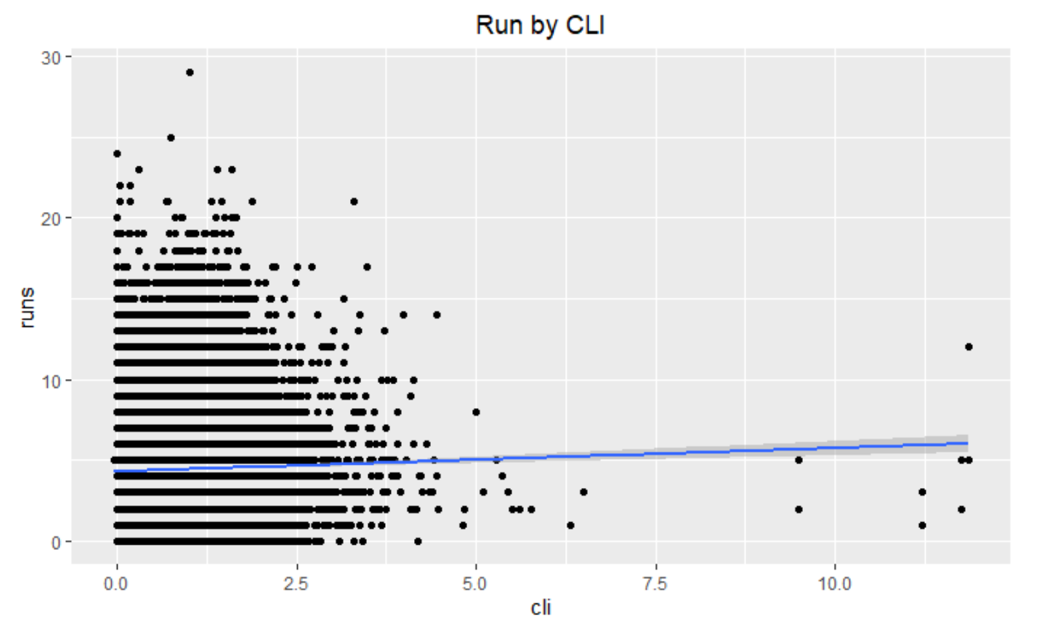
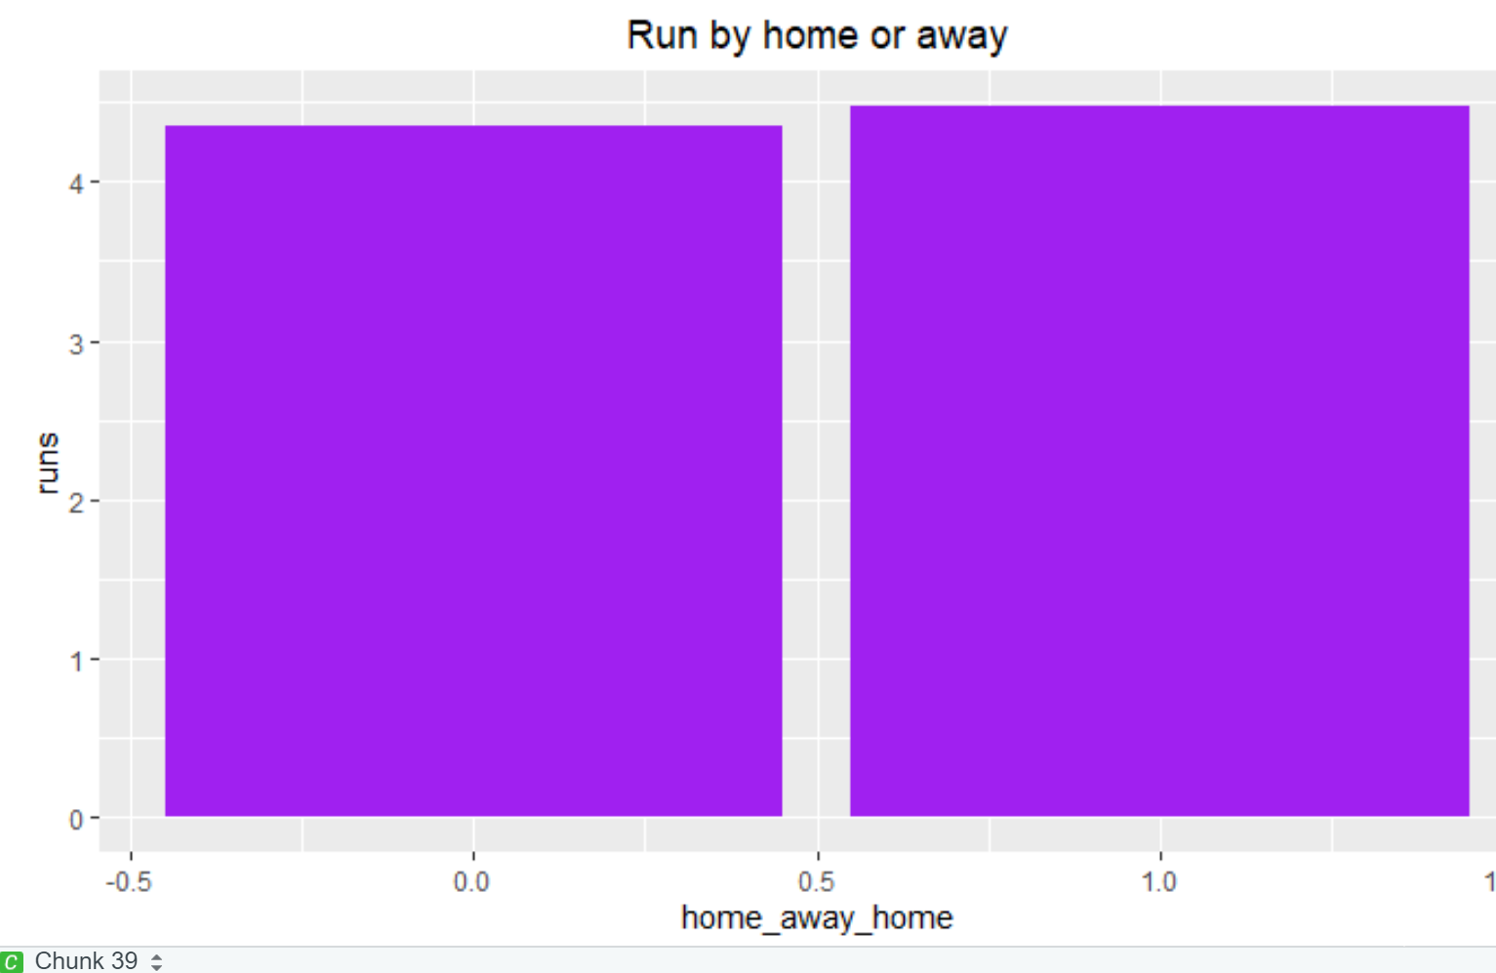
Data Analysis

Slide 9
Data Analysis
Questions
Correlation vs causation
Games_back
Rank
CLI (Championship Leverage Index)
Insights
The more important a game is, according to the CLI – the closer the game is to the championship title – the more runs will be scored in a game.
Positive reinforcement in baseball
“when there is a big opportunity, teams may perform better”
What that means
How managers pay their players (bonuses, sponsorships, etc.)
At what time to apply strategies and tactics
How managers should be picking their talent

Slide 10
Project overview
Step 1
Preprocessing
Step 2
Data Analysis
Step 3
Dashboard

Slide 11
Dashboard
Simple

Slide 12
Project overview
Step 1
Preprocessing
Step 2
Data Analysis
Step 3
Dashboard

Slide 13
In History
Moneyball
Billy Beane creates a new strategic approach to picking baseball’s top talent
Theoretical projections based on hard stats (RBIs, ERA, Saves, etc.)
The A’s won 18 games in a row, tying the 1908 White Sox
Impressive stats
The right stats

Slide 14
Goals
1
One notable insight – complete
2
ETL pipeline – complete
Notes:
Teams perform better when the pressure is on

Slide 15
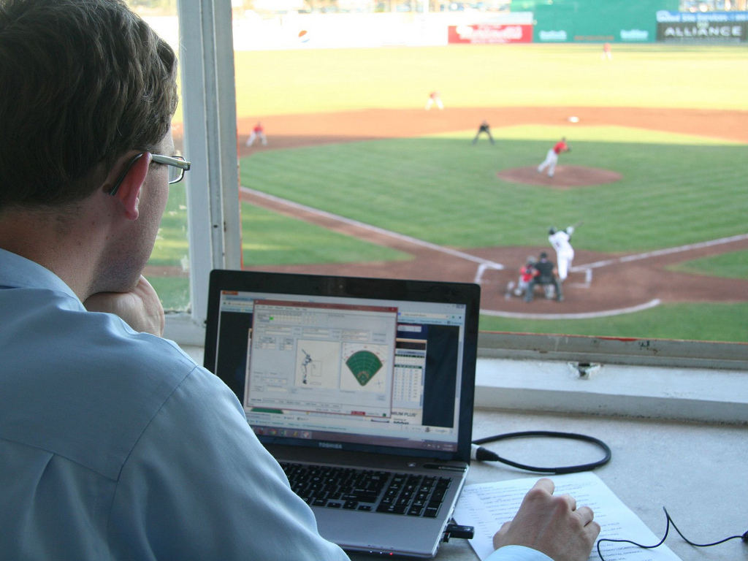
Questions?

