Slide 1
React Course – L4
XIE Guochao

Slide 2
Group Project Show Time

Slide 3
JavaScript Revision
Statement Grammar
Data Type
Data Type Conversion
If
While
For

Slide 4


JavaScript Function
Why Function?
把代码块包装成一个函数 → Clear, Simple, Easy to manage

Slide 5
JavaScript Function
Grammar:
1. function name1( parameters 参数) { . . . return 返回值 }
2. (var like) var name1 = function( parameters 参数) { . . . return 返回值}
3. (箭头函数) ( parameters 参数) => { . . . return 返回值 }
Note: 参数，返回值均可以没有，也可以有多个

Slide 6
JavaScript Function
Example: // The max of an array
var list1 = [2, -1, 10, 5, 3];
function max( list ){
var m = null;
for (var i of list){ if (m==null || m<i) m = i; }
return m;
}
max(list1); → 返回最大值

Slide 7
JavaScript Function
Example: // Multi returns
function xor(a, b){
if (a!=b) {return true}
else {return false}
}

Slide 8
JavaScript Function
Exercise: How to exchange two variables with a function swap?

Slide 9
JavaScript – Get more practice
Go to leetcode.
https://leetcode-cn.com/
Choose language: JavaScript!
Example: https://leetcode-cn.com/problems/two-sum/

Slide 10
JavaScript - DOM
DOM: 与 HTML & CSS进行交互!
如何定位一个元素？
1. 通过id: document.getElementById(id)
2. 通过class: document.getElementsByClassName(class_name)
3. 通过tag name: document.getElementsByTagName(tag_name)
Reference: http://www.runoob.com/js/js-htmldom.html

Slide 11
JavaScript – DOM Event
如何添加事件？
element.addEventListener(event, function, useCapture);
element.removeEventListener("mousemove", myFunction);
element.eventfunction = function;
E.g. element.onclick = calculate;

Slide 12
JavaScript – DOM Event
Example: 制作一个计算器！
Another demo: User Table!
Suggestion: 为group profile添加一个登录页面？收集用户信息的输入框？搜索框？
We may have a break here.

Slide 13
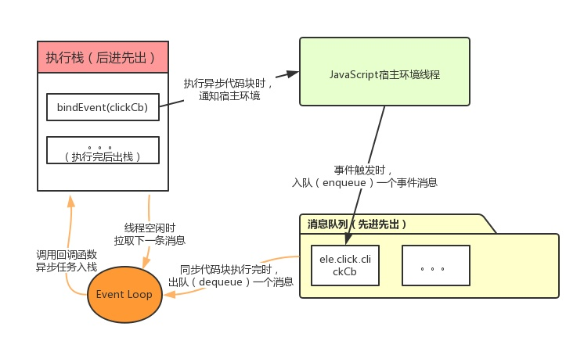
JavaScript – 异步(定时器)
假如我们想某个函数每秒调用一次，how？
异步：https://zhuanlan.zhihu.com/p/26567159

Slide 14
JavaScript – 异步
setTimeout( function, time(ms) )
setInterval( function, time(ms) )
停止：
window.clearTimeout( timeoutVariable )
window.clearInterval( intervalVariable)
http://www.runoob.com/js/js-timing.html

Slide 15
JavaScript – 异步
Example 1: A Clock
Example 2: A Stopwatch (页面打开后开始计时)
Some reference of Date:
http://www.runoob.com/js/js-obj-date.html

Slide 16
JavaScript – 异步
Look into the SIS:
http://116.31.95.2:81/psp/csprd/EMPLOYEE/HRMS/h/
http://116.31.95.2:81/psp/csprd/?&cmd=login&languageCd=ENG
Open question: Why the bug occurs?

Slide 17
Revision of what we have learnt
HTML5
CSS3
→ A good looking website.
JavaScript
→ A powerful website.

Slide 18
NEXT STEP – React
React: a powerful platform.
Use JavaScript ES6 to write HTML.
More fancy UI libraries!

Slide 19
NEXT STEP – React
React Tutorial: https://react.docschina.org/
Ant Design: https://ant.design/index-cn
Material UI: https://material-ui.com/
React Bootstrap: https://react-bootstrap.netlify.com/
Belle: http://nikgraf.github.io/belle/
React Toolbox: http://react-toolbox.io/
Grommet: https://grommet.io/
Semantic UI React: https://react.semantic-ui.com/
Onsen UI: https://onsen.io/react/
For more, Google: React UI

Slide 20
What to do during the break?
Get your group website better – more pages, functions, creative styles . . .
Practice JavaScript programming with LeetCode!
Enjoy learning React with tutorial.

Slide 21
Extension 1 How to use Jupyter iJavascript
Step 1: install miniconda: https://conda.io/miniconda.html
Step 2: install jupyter notebook: in command/terminal: 输入 pip install jupyter 按回车，等一下就可以了。测试能否正常运行：jupyter notebook
Step 3: install iJavaScript: 输入 npm install -g ijavascript，等一下，运行完之后输入ijsinstall即可
Step 4: 运行：jupyter notebook – new – JavaScript(node.js)

