Slide 1

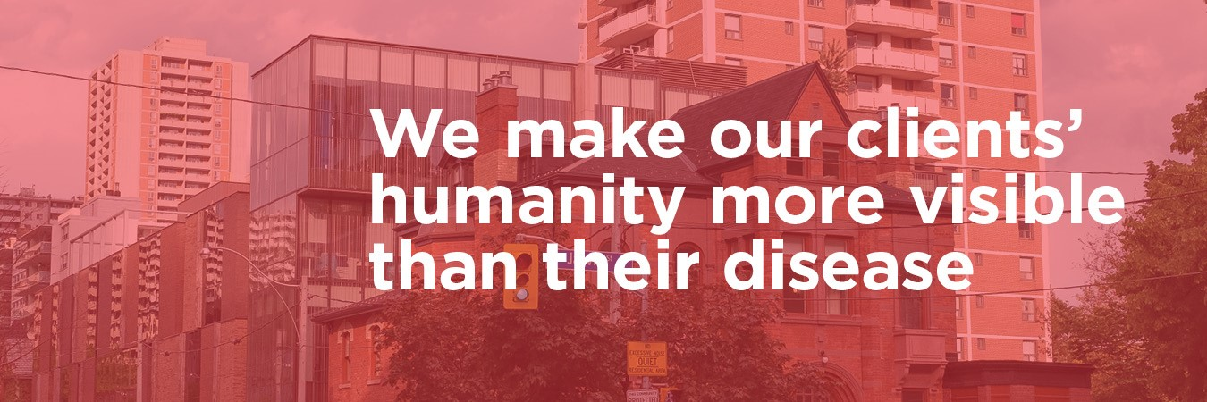

Slide 2
“
Casey House is looking for a confidential and private application to communicate reminders to clients, such as for appointments, to take medication, or any health-related follow-up. It would also provide Casey House a secure way to check-in with and reach out to clients who have not been to Casey House recently.
”

Slide 3
Key Considerations:
Privacy & Confidentiality
Accessibility (Web Based Tool vs. SMS Chat-bot)
Voice & Tone
Target Audience
Minimal Staff Effort

Slide 4
Concept:
Using a combination of Twilio (SMS management), Zapier (automation service), Google Calendar, and Google Sheets we envision an easy to use patient reminder system for Casey House to utilize with clients.

Slide 5
Key Features:
Discrete reminders for appointment and medication reminders using a private number (not associated with Casey House)
Opt-in or out of reminders based on client’s needs
Can be used to communicate with clients who have either missed an appointment or whom the organization has lost contact with.
Automatic messaging
**Additions: Application would allow for clients to request readouts of upcoming appointments and daily medication logs.

Slide 6
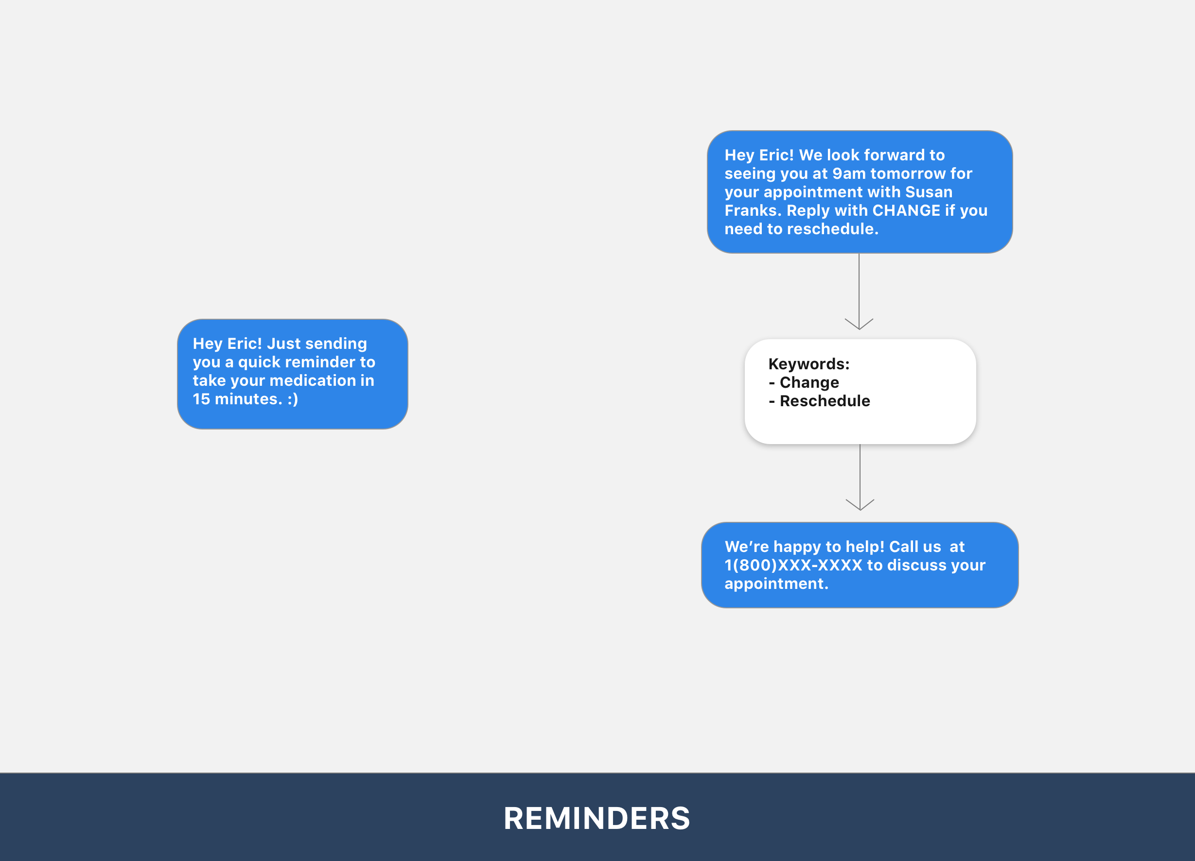

Slide 7
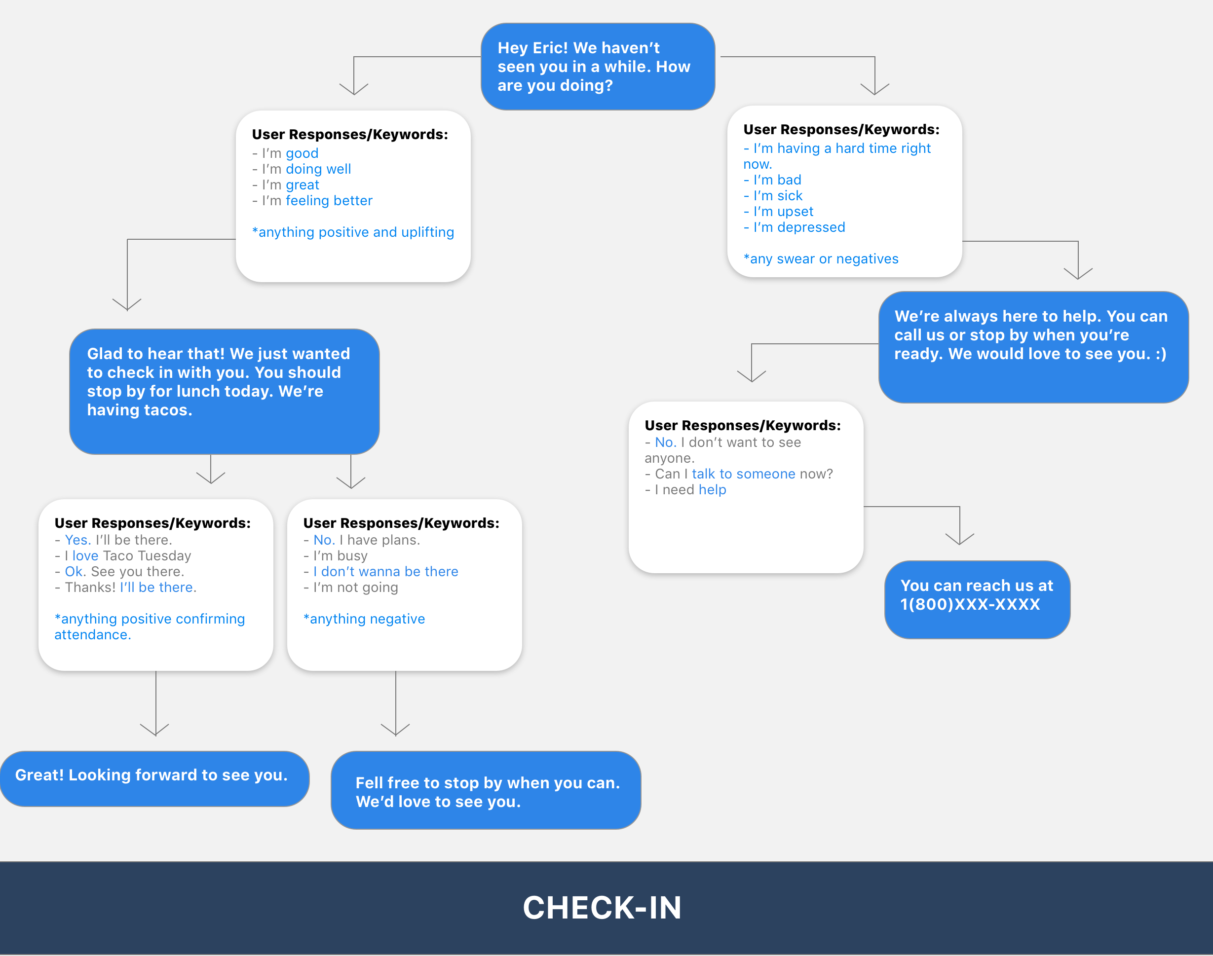

Slide 8
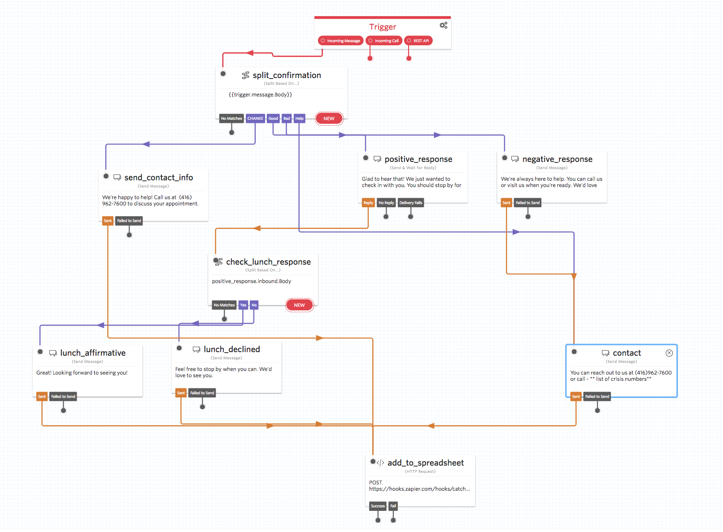

Slide 9
Cost Analysis:
Cost Per Text: $0.0075
Zapier Account Subscription: $20+/month
 | Tier 1 | Tier 2 | Tier 3 | Tier 4
Clients | 50 | 100 | 200 | 400
Texts Per Year: | 83,200 | 166,400 | 332,800 | 665,600
Annual Cost: | $864 | $1,488 | $2,736 | $5,232
*Assumptions 4 texts daily (in/out) from medical reminders, 4 texts weekly from appointment reminders

Slide 10
Implementation:
While using Google tools, the ultimate hope would be to integrate with Casey House’s internal database programs (patient records/scheduling systems).
Approximately 40 Hours (1 week) of implementation time assuming internal programs have the joining capabilities.
Resources needed: 2 technical resources, 1 functional resource

Slide 11
Values to Partners:
Fewer missed appointments
Increased engagement
Stronger support system.
Increase in client satisfaction.
Stronger communication between clients & Casey House

Slide 12
Key Issues:
Cost/Resource Needs: Along with regular upkeep costs, staff resourcing is needed for training and ongoing management.
Adoption Fears: Important that staff supports clients in addressing fears and demonstrating application benefits in action.
Mitigating Unforeseen Consequences: A pilot project will be needed to see application benefits as well as if there are any unseen consequences caused as a result of using this app.

Slide 13
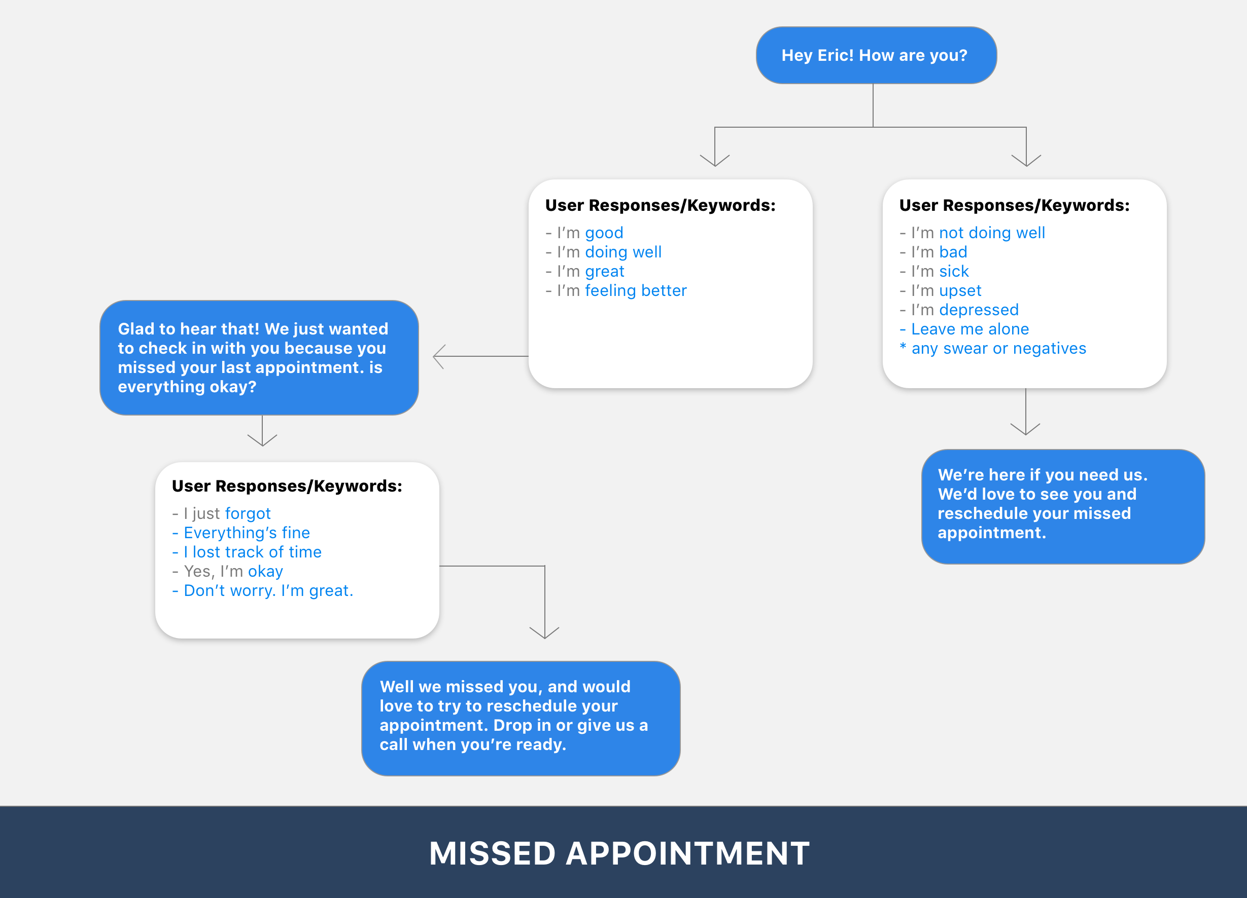

Slide 14
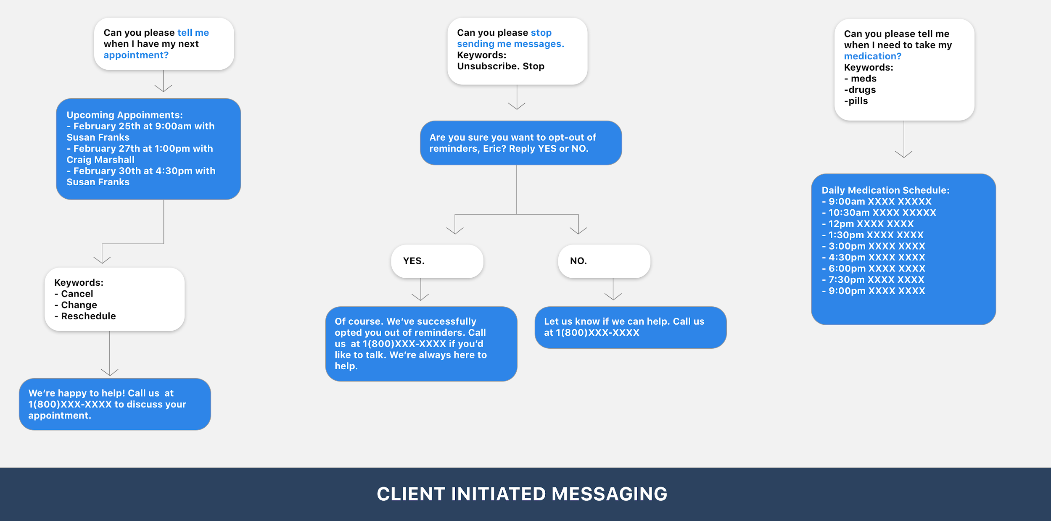

Slide 15
Questions?

