Slide 1
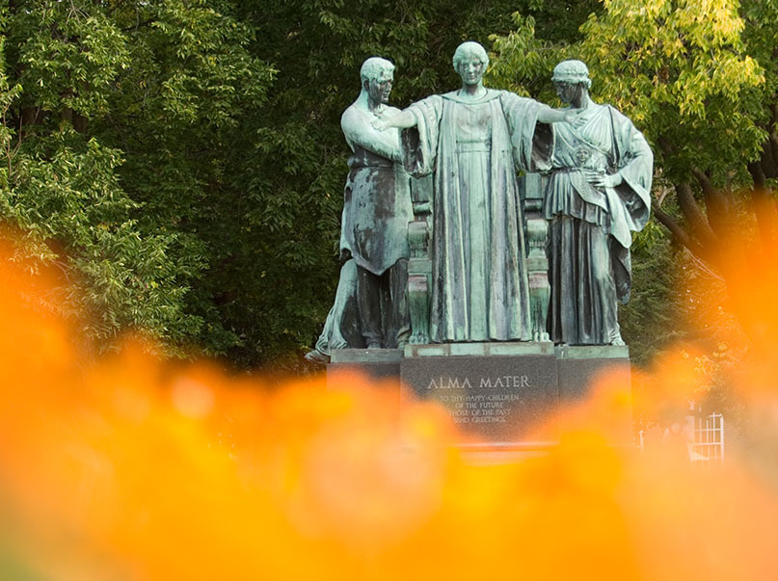
Finding a Problem
ECE 445
University of Illinois at Urbana-Champaign

Slide 2
Before you come to the meeting
Be aware
Don’t be complacent
Be open
Find new ways to see the world (news outlets, people you talk to, places you go…)
Believe in your ability to change the world
Finding a Problem

Slide 3
At the meeting
Be brave!
Be supportive of your teammates
Analyze, improvise, synthesize, don’t criticize
Even ``bad’’ ideas can be helpful in the process
Don’t worry about details… yet
Finding a Problem

Slide 4
Generating Solutions
ECE 445
University of Illinois at Urbana-Champaign

Slide 5
The idea tree
The high-level problem forms the trunk
Try to identify the roots of the problem
Be inspired by the roots to grow solution branches
Generating Solutions

Slide 6
Diving Deeper
ECE 445
University of Illinois at Urbana-Champaign

Slide 7
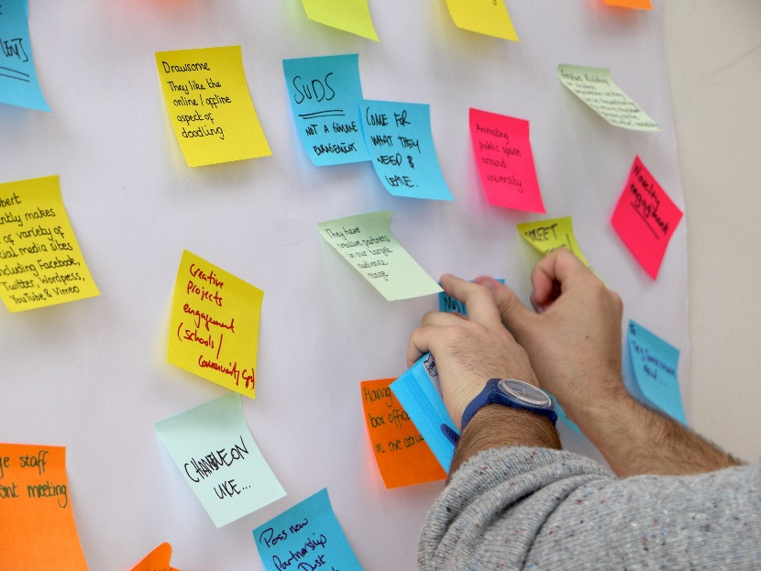
Organizing the group discussion
Post it notes can be used to clarify idea potential:
Yellow: Core idea
Blue: improvement or modification
Red: problem or challenge
Diving Deeper

Slide 8
Voting
ECE 445
University of Illinois at Urbana-Champaign

Slide 9
How voting works
Deselect at end
2 positive votes
1 negative vote
Voting

Slide 10
Reverse Brainstorming:
Explore Improvements by Making Things Worse
ECE 445
University of Illinois at Urbana-Champaign

Slide 11
How reverse brainstorming works
Come up with ideas as to how you could cause this problem or how you could make the product worse
Reverse these ideas of how to make things worse into potential ways to solve the problem or make the product better
Voting

Slide 12
Homework
ECE 445
University of Illinois at Urbana-Champaign

Slide 13
At the end of the meeting
Review all the tasks
Assign at least one task to each group member
All assigned tasks to be done by next meeting
Voting

