Slide 1

Performance evaluation of a CRAN
Pellicci Giacomo, Nicola Mota, Alexander De Roberto
Giacomo Pellicci, Nicola Mota, Alexander De Roberto
1
Notes:
1

Slide 2
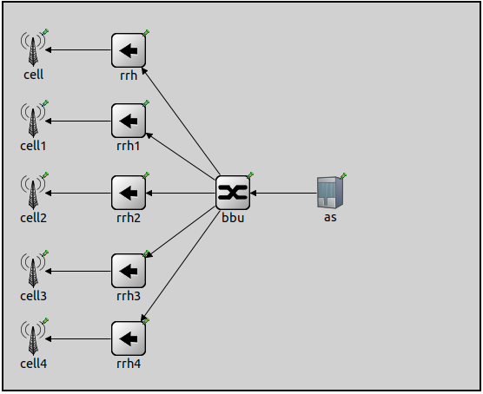
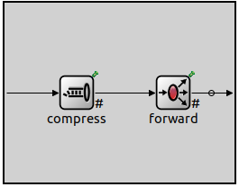
Model of the System
Entities:
1 Application Server (AS), which generates packets to be transmitted over the network
1 Central Processing Unit (BBU) Stations, which forwards packets incoming from AS to the proper cell though the RRH
N Remote Radio Heads (RRH), which receives packets transmitted by the BBU and forwards them to its own cell
N Cells, which are the final destination of all packets
Network topology for N=5
Internal view of the BBU
Giacomo Pellicci, Nicola Mota, Alexander De Roberto
2

Slide 3
Constraints and requirements
Constraints:
The target cell of a packet is uniformly taken from the available ones
The BBU communicates with only one RRH at a time
The BBU operates using FIFO policy and has an infinite queue
Requirements: evaluate system behavior in following scenarios
Exponential distribution of interarrival time t, exponential distribution of packet size s
Exponential distribution of interarrival time t, lognormal distribution of packet size s
Giacomo Pellicci, Nicola Mota, Alexander De Roberto
3

Slide 4
Simulation Parameters
List of parameters used in the simulation:
Number of cells/RRHs, N = 1
Mean size of packets, E[s] = 1KB
Line capacity, C = 30KB/s (1)
Compression ratio, X = {0,10, 20, 30, 40, 50} (2)
The following general simulation parameters were used:
Number of Repetitions, REP = 35
Simulation Time, ST = 60m
Warm-up period, WP = 6s
1) The line capacity was chosen to be in same order of magnitude w.r.t. packet size (to obtain meningful results)
2) Up to 50%, due to general behavior of loseless compression algorithm
Giacomo Pellicci, Nicola Mota, Alexander De Roberto
4

Slide 5
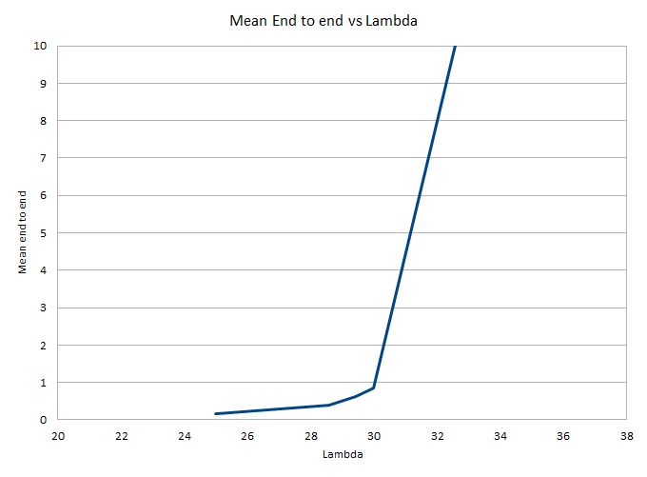

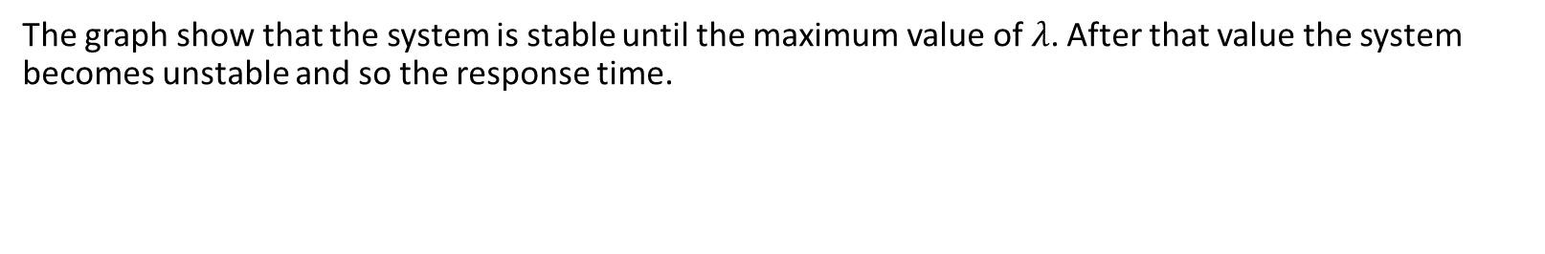


Model validation (1/2)
With C and E[s] fixed at 30KB/s and 1KB respectively and no compression
(X=0) the system is reduced to a M/M/1 and we have the following stability
condition:
$\frac{E\left[s\right]}{C∗E\left[t\right]}$ = $ρ$ < 1
$$E\left[t\right]>\frac{E\left[s\right]}{C}$$
$$E\left[t\right]>0.03333⇔λ<30.003$$
Mean End to End without compression
The graph show that the system is stable until the maximum value of $λ$. After that value the system becomes unstable and so the response time.
Giacomo Pellicci, Nicola Mota, Alexander De Roberto
5

Slide 6
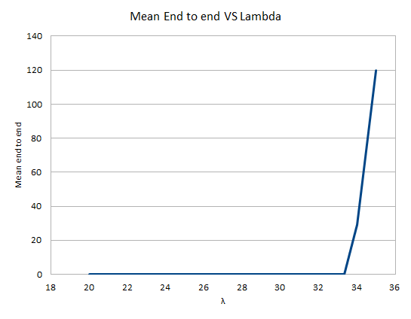
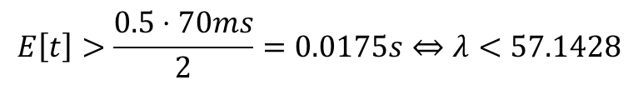

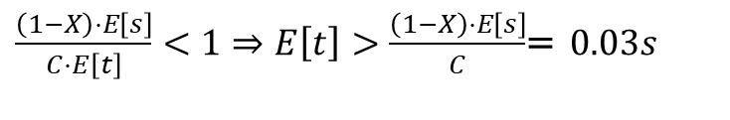
Model validation (2/2)
With same values for C and E[s], but with compression enabled we have:
which is the strictest case (X=0.5) for compression unit.
Let’s consider now the strictest case for the forwarding unit, which is
at X=0.1:
In order to evaluate whole the system, we have to fulfill the
strictest condition between the two above
$$E\left[t\right]>\frac{0.5⋅70ms}{2}=0.0175s⇔λ<57.1428$$
Mean End to End with X=0.1
$\frac{\left(1−X\right)⋅E\left[s\right]}{C⋅E\left[t\right]}<1⇒E\left[t\right]>\frac{\left(1−X\right)⋅E\left[s\right]}{C}$ =$0.03s$
$$E\left[t\right]>0.03⇔λ<33.333$$
Giacomo Pellicci, Nicola Mota, Alexander De Roberto
5

Slide 7
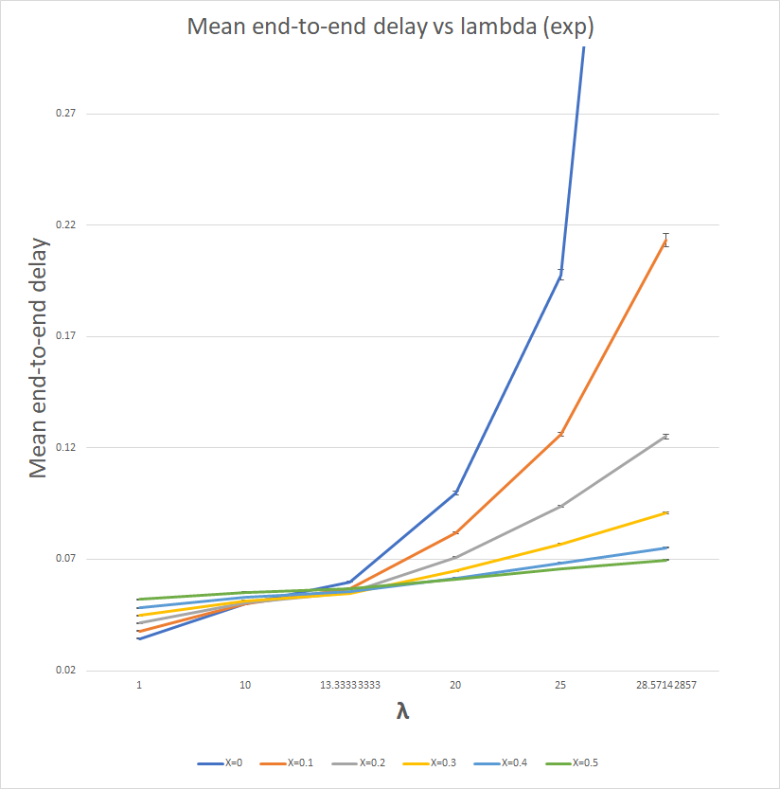
Simulation Results (Exponential scenario)
For λ ≤ 10 is preferable to forward the packets without compressing them
For λ ≥ 13 compressing packets helps the system to keep the mean end to end delay low
Giacomo Pellicci, Nicola Mota, Alexander De Roberto
6

Slide 8
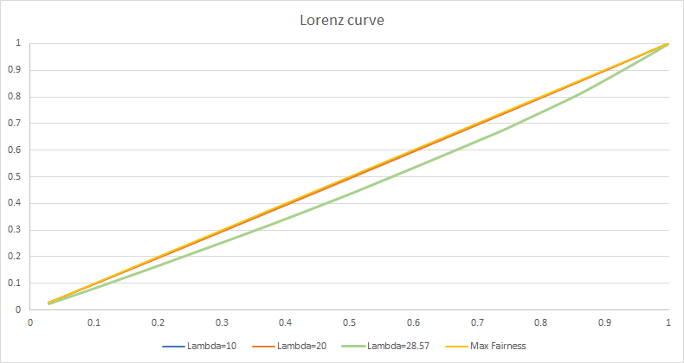
Simulation Results (Exponential scenario)
As λ increases, the fairness between the mean end to end delay decreases instead. This happens because in general the queue will contain some packets which will affect the behavior of the end to end delay.
Giacomo Pellicci, Nicola Mota, Alexander De Roberto
7

Slide 9
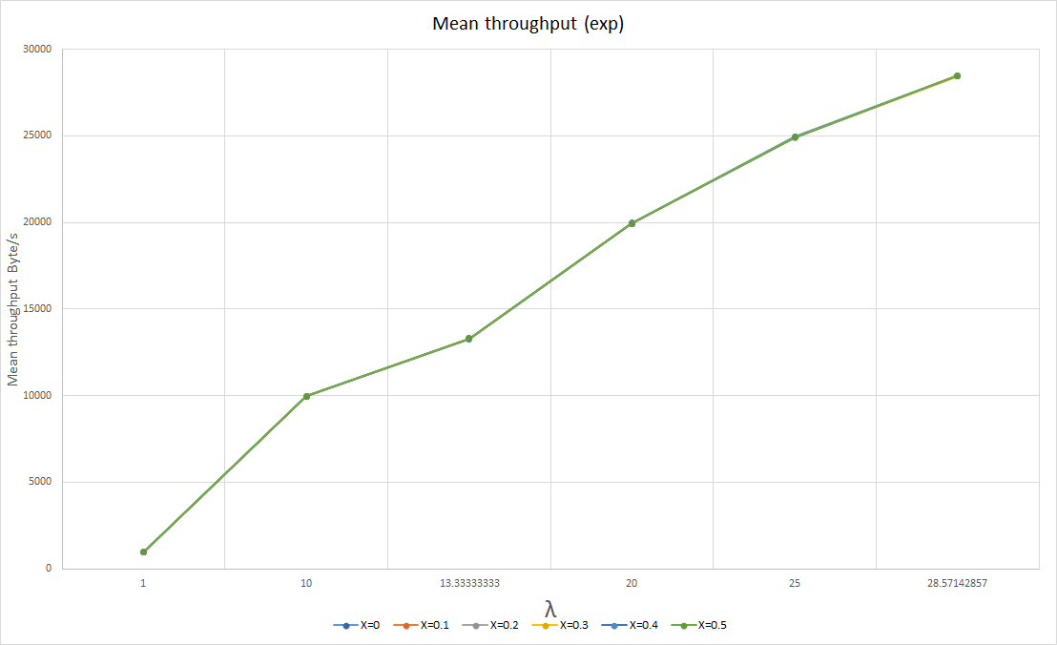
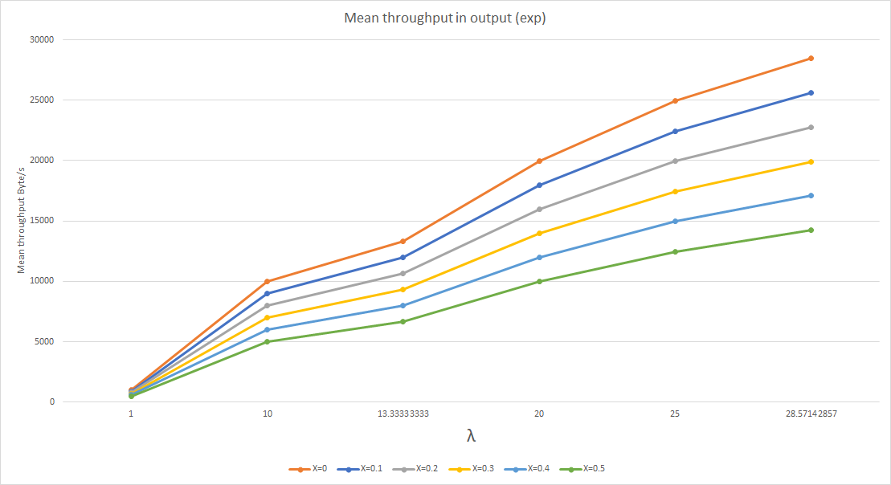
Simulation Results (Exponential scenario)
The mean throughput considered as “the number of jobs served per unit of time” is not affected by the compression because we process the same amount of byte/s for any value of X
If interested in the throughput seen at the output of the BBU, considered as “number of jobs forwarded on the link per unit of time” we have a scaling according to the compression ratio
Giacomo Pellicci, Nicola Mota, Alexander De Roberto
8

Slide 10
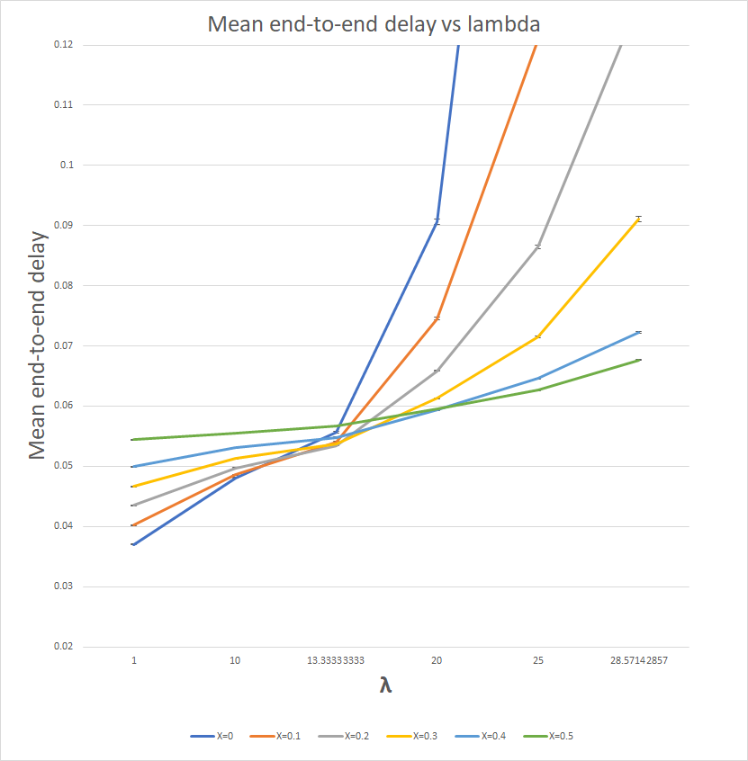
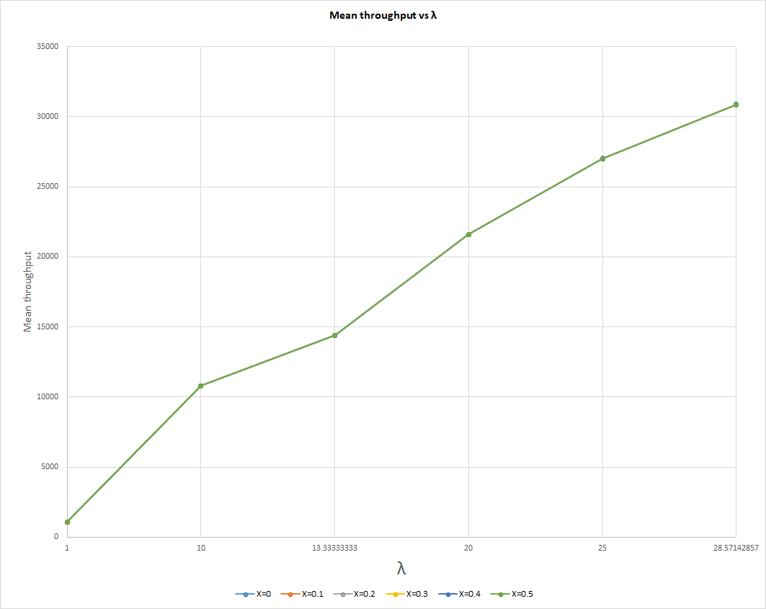
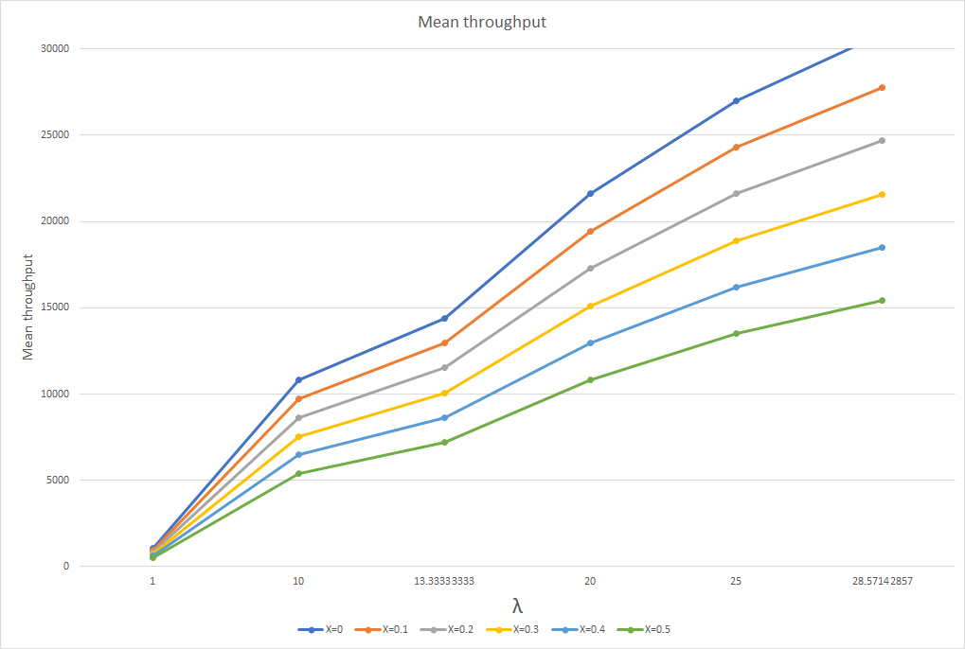
Simulation Results (Lognormal scenario)
The behavior of the system is similar to the exponential scenario. By the way there are some difference.
Giacomo Pellicci, Nicola Mota, Alexander De Roberto
6

