Slide 1


Analysis of Temporal Changes in Youtube Viewing Habits in Different Periods
Polat Vatansever 30974

Slide 3

Primary Data Source:
  YouTube Watch History (extracted using Google Takeout service).
File Format:
  Converted HTML file from Google Takeout into structured data for analysis.

Slide 5
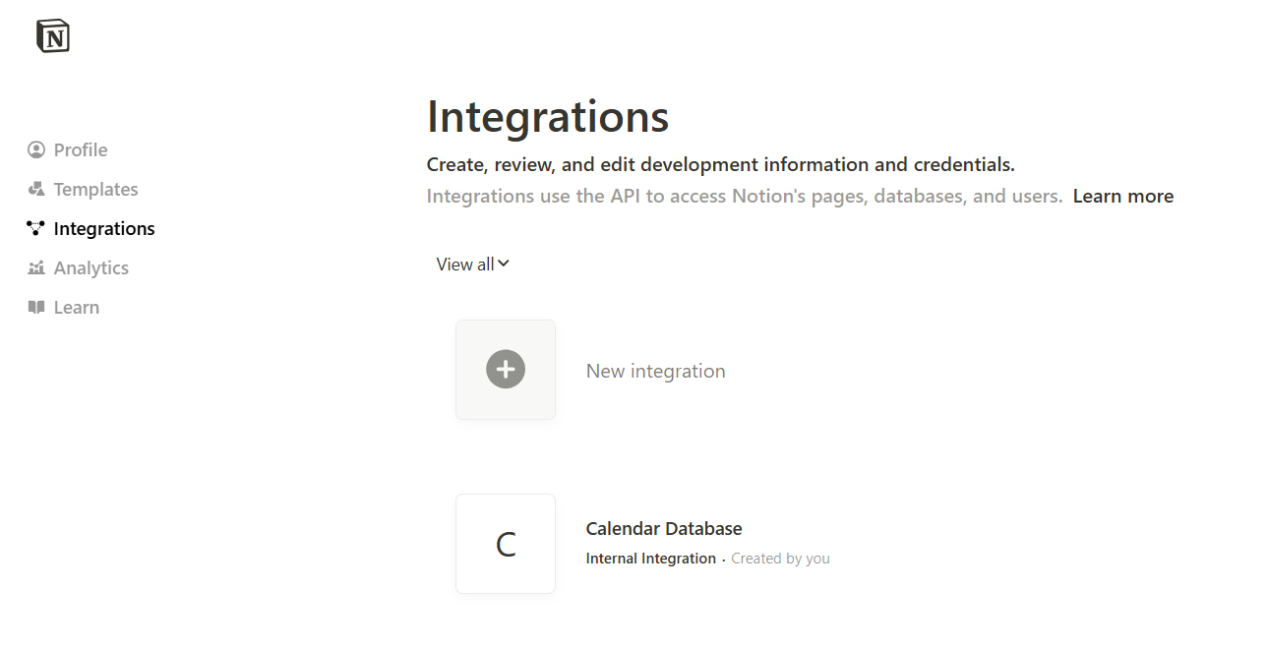
I got my Notion calendar dataset by requesting it from Notion's own integration as takvim.csv
Supporting Information:
  Notion Calendar Data (providing major academic dates and events).

Slide 6
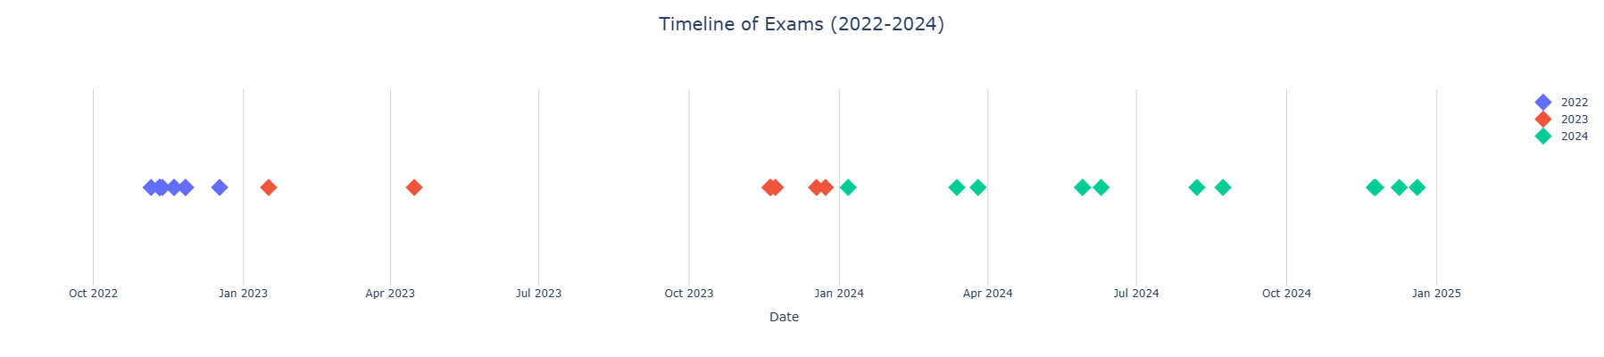
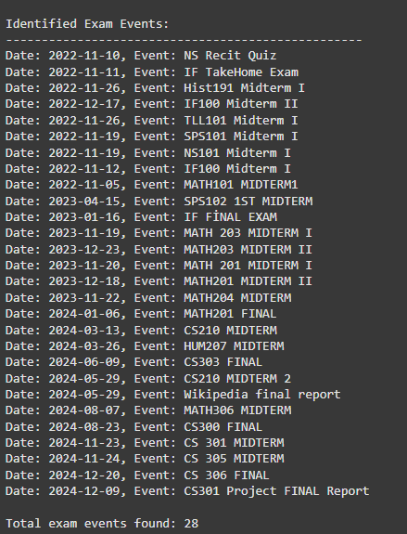
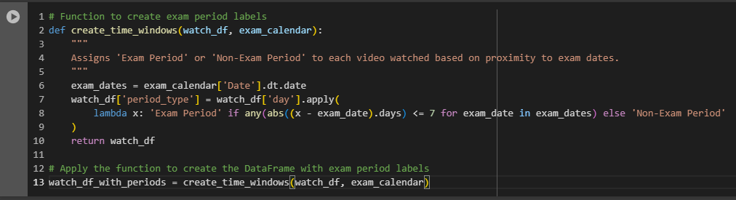
Extracting exam periods from calendar data
This code was created according to the purpose of the project by specifying the separated exam dates as a period instead of a single day.

Slide 7
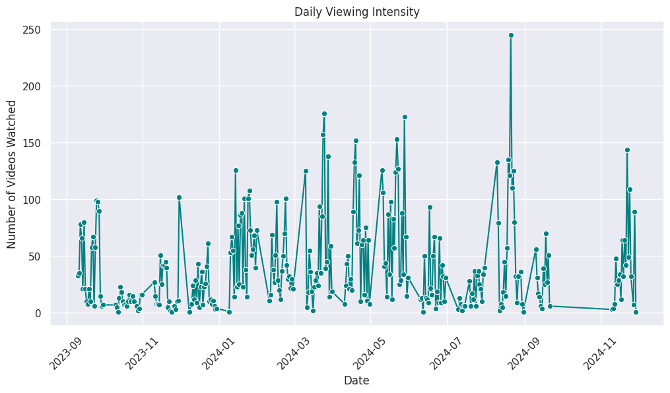
Exploratory Data Analysis (EDA)
1. Viewing Intensity Over Time
visualize the number of videos watched over different periods.

Slide 8
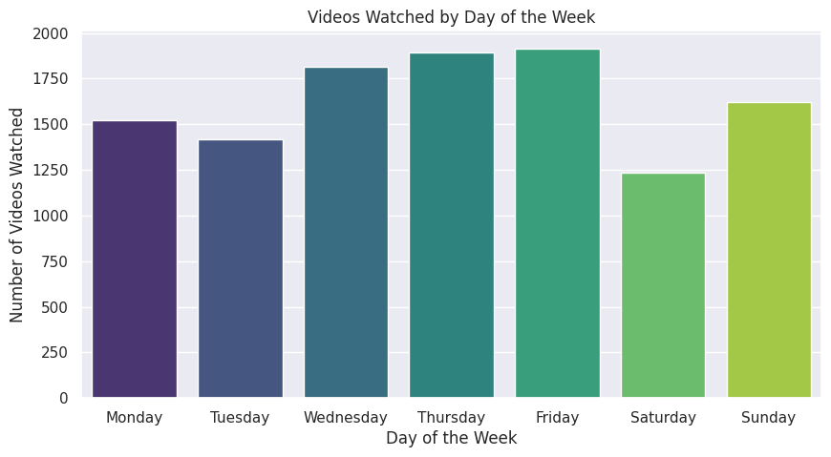
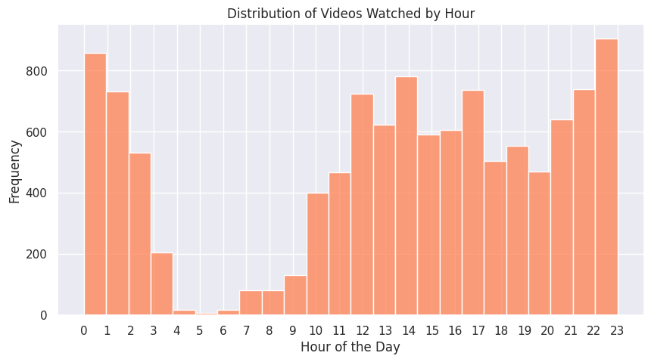
2. Weekly and Hourly Trends
explore viewing behavior by day of the week and time of day.

Slide 9
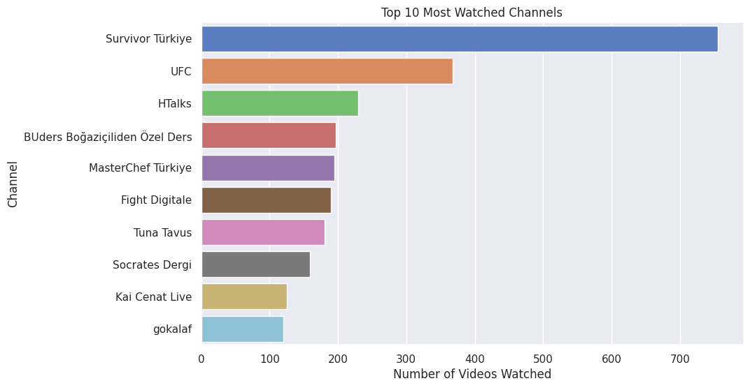
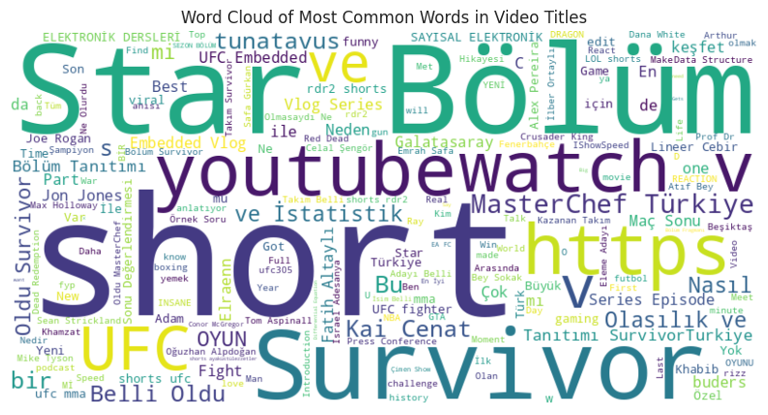
Content Analysis

Slide 10
Hypothesis Testing
Objective
We want to determine whether there is a statistically significant difference in the number of videos watched during exam periods compared to non-exam periods. This will help us understand whether the viewing intensity changes during stressful times.
Hypothesis Formulation
Null Hypothesis (H₀): There is no significant difference in the average number of videos watched during exam and non-exam periods.
Alternative Hypothesis (H₁): There is a significant difference in the average number of videos watched during exam and non-exam periods.
Testing Approach
We will conduct the following steps:
Calculate the daily number of videos watched during exam and non-exam periods.
Perform a normality test to check if the data follows a normal distribution.
Based on the normality test, choose an appropriate hypothesis test:
  If the data is normally distributed: use an independent t-test.
  If the data is not normally distributed: use the non-parametric Mann-Whitney U Test.

Slide 11
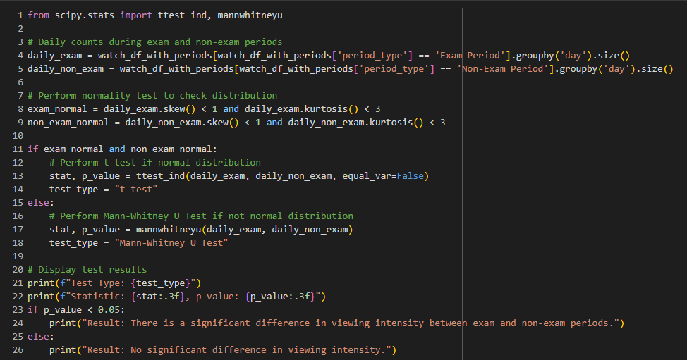
Code of the Hypothesis Testing

Slide 12
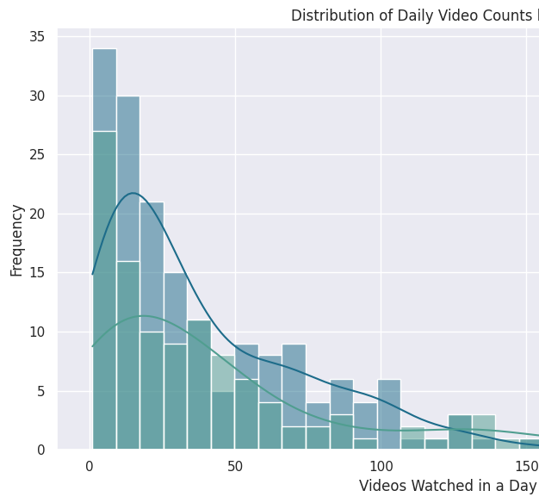
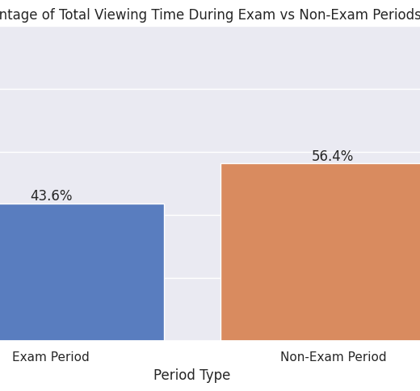
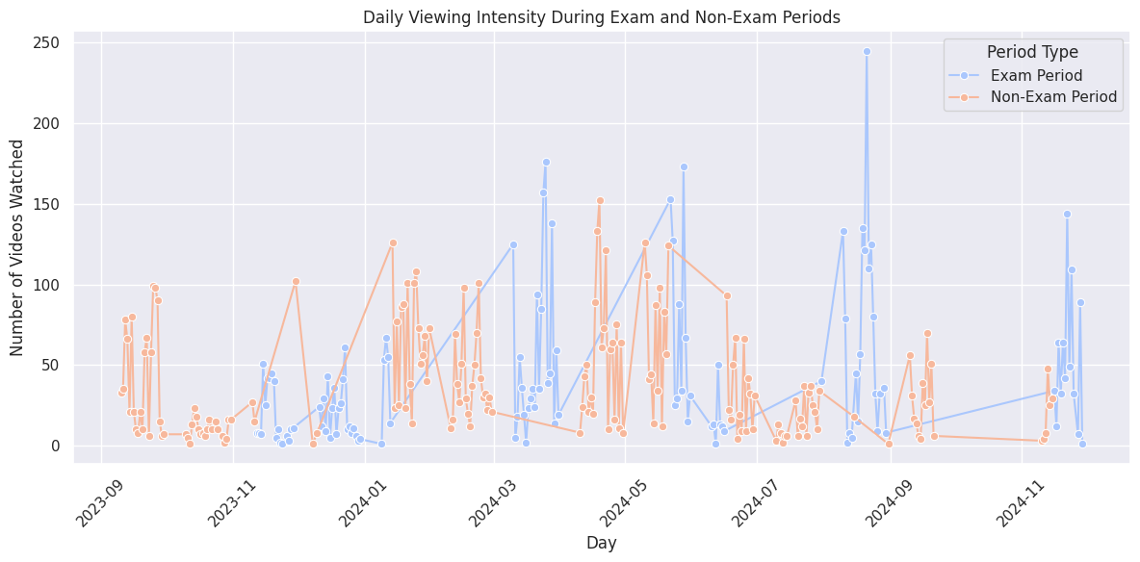
Results Summary
Test Type: Mann-Whitney U Test (since the data did not follow a normal distribution).
Statistic: 9745.500
p-value: 0.868
Conclusion
The p-value (0.868) is much greater than the significance threshold (0.05), indicating that we fail to reject the null hypothesis. This suggests that there is no significant difference in the viewing intensity between exam and non-exam periods.

Slide 13
Sentiment Analysis: Emotional Tone of Video Titles
Objectives:
  What types of videos do I consume more frequently—educational or entertainment content?
  Are there shifts in the emotional tone of the videos I watch during stressful times?

Slide 14
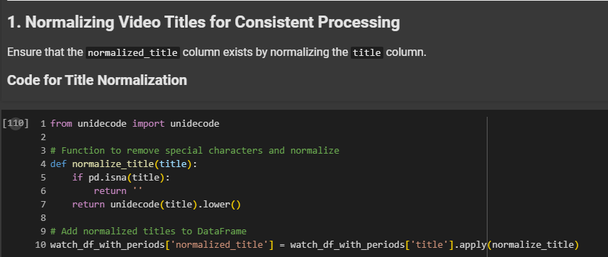
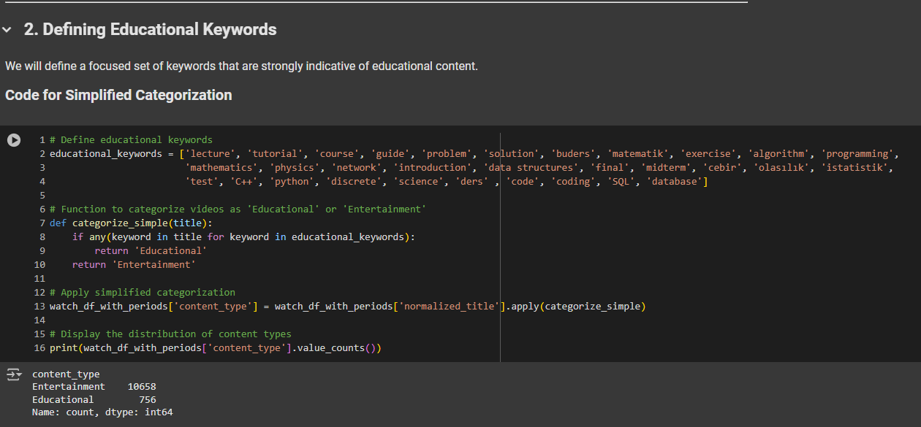
I searched for keywords related to education in the ideo titles and divided the contents into two as "Educational" or "Entertainment". I did this to see the distribution of educational content while analyzing the data set.
Since the titles of YouTube videos may have different spellings (UPPERCASE letters, special characters, Turkish characters, etc.), I normalized all the titles to ensure consistency in data analysis. That is, I brought the titles to a standard format with unicode.

Slide 15
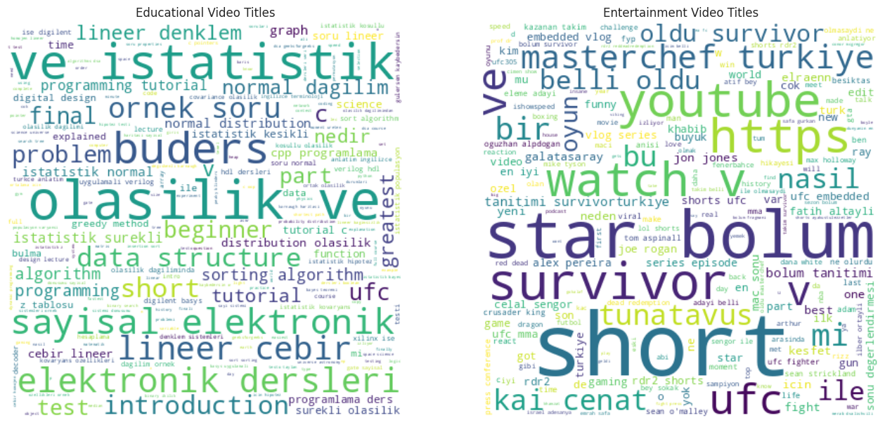
3. Generating Word Clouds for Content Types

Slide 16
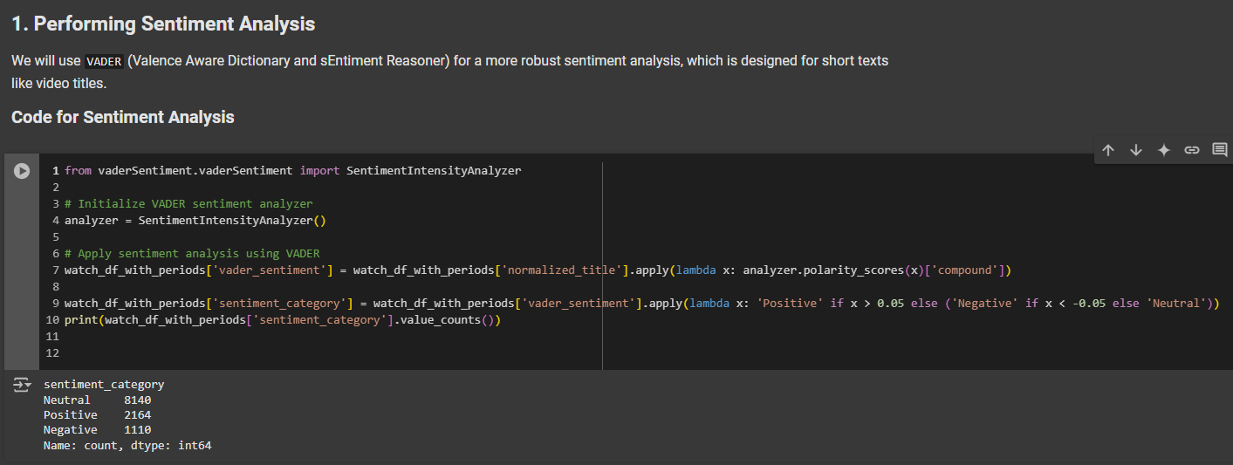
Sentiment Analysis for Categorized Video Titles
  Before using Vader, I used textblob, but the results of Vader were better than textblob.
  However, since there were insufficient resources in understanding the video content, correct predictions could not be made.

Slide 17
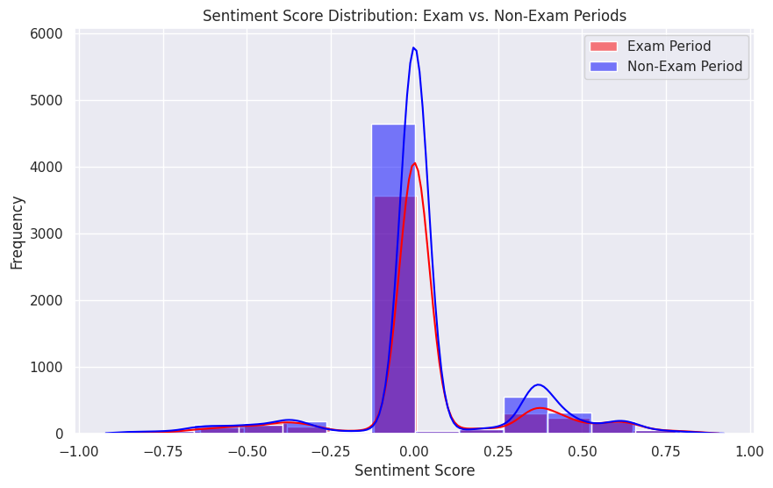
Sentiment Score Distribution

Slide 18
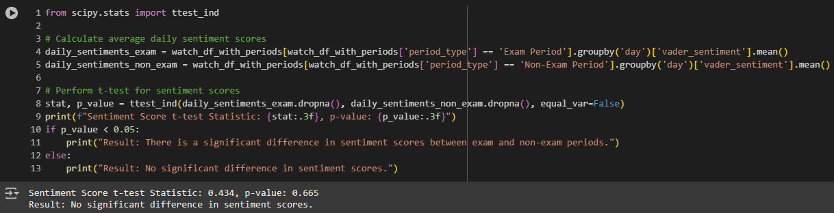
Sentiment Score Comparison
Test Type: T-Test (unequal variances)
Results:
  Statistic: 0.434
  p-value: 0.665
Conclusion:
Since p-value > 0.05, we fail to reject the null hypothesis. No significant difference in sentiment scores between exam and non-exam periods.

Slide 19
Title: Machine Learning Model: Predicting Viewing Preferences
Objective:
To predict the content type (educational or entertainment) based on features such as time of day, exam period, and sentiment score.
Model Details:
Algorithm Used: Random Forest Classifier
Features: Time of day (binned), exam period (yes/no), sentiment score (VADER)
Target: Content type (1 for educational, 0 for entertainment)
Train-Test Split: 80% training, 20% testing

Slide 20
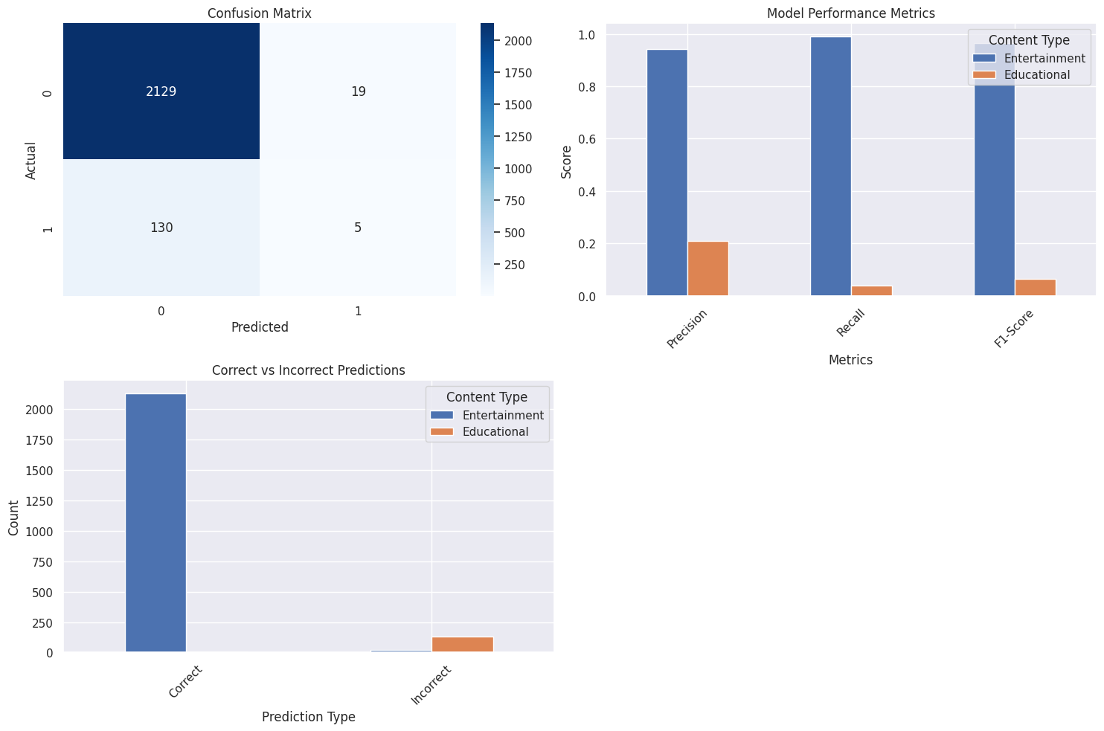
Confusion Matrix:
Entertainment: 2129 correct, 19 incorrect
Educational: 5 correct, 130 incorrect
Classification Report:
Accuracy: 93% (driven mostly by correct predictions of entertainment content)
Educational Content Performance:
  Precision: 21%
  Recall: 4%
  F1-Score: 6%

Slide 21
Conclusion
Key Findings:
Viewing Intensity:
No significant difference in the number of videos watched during exam periods compared to non-exam periods.
The viewing pattern remained consistent across both periods.
Sentiment Analysis:
Sentiment scores showed no significant change in emotional tone between exam and non-exam periods.
The hypothesis that viewers consume emotionally different content during stressful times was not supported by the data.
Content Type Distribution:
The distribution of educational vs entertainment content remained largely unchanged during exam periods.
Entertainment content dominated both periods.
Machine Learning Model:
A Random Forest Classifier was trained to predict the content type based on features like time of day, exam period, and sentiment score.
The model achieved an overall accuracy of 93%, but struggled to predict educational content due to class imbalance.
The precision, recall, and F1-score for educational content were low, indicating the need for further improvements in feature selection and dataset balancing.

Slide 22
Overall Conclusion:
The data suggests that academic stress does not have a significant impact on YouTube viewing habits in terms of frequency, sentiment, or content type. However, the predominance of entertainment content across all periods highlights a potential preference for relaxation and leisure regardless of academic pressure.
Future Work:
Collecting a larger, more balanced dataset to improve model performance.
Applying advanced classification techniques or feature engineering to enhance predictions.
Exploring additional contextual features such as video length or watch time to deepen the analysis.

Slide 23
Thank you for your time.

