Slide 1







Stack overflow developer survey 2019
Jakub Polcsak
20.4.2024

Slide 2



OUTLINE
Executive Summary
Introduction
Methodology
Results
Visualization – Charts
Dashboard
Discussion
Findings & Implications
Conclusion
Appendix

Slide 3

EXECUTIVE SUMMARY
Point1
Point2
Sub Point 1
Sub Point 2
Sub Point 3
Point3
Point4
Point5

Slide 4

INTRODUCTION
Analysis of influence experience in using dev skills on salary
Analysis of future trends in programming language
Analysis of future trends in databases

Slide 5

METHODOLOGY
Point1
Point2
Point3
Point4
Sub Point1
Sub Point2

Slide 6
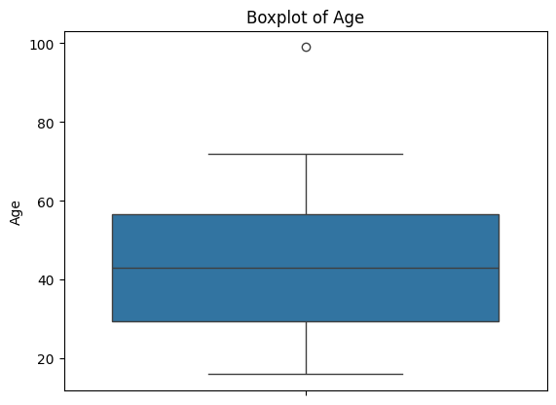
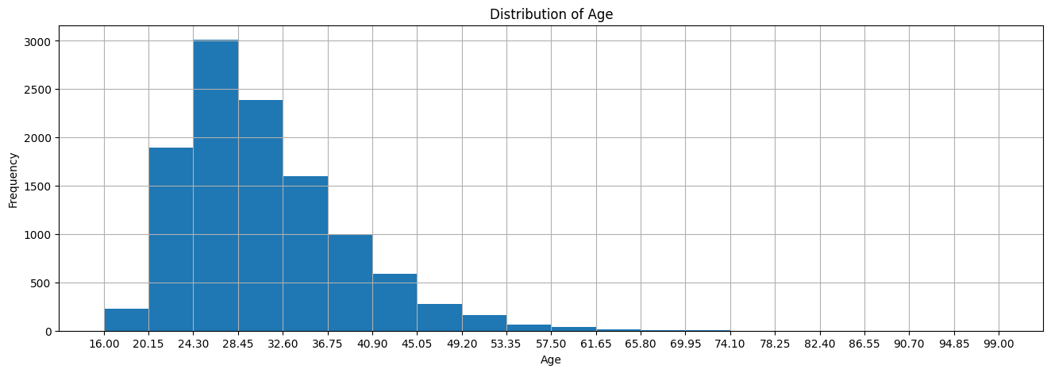
RESULTS

Slide 7
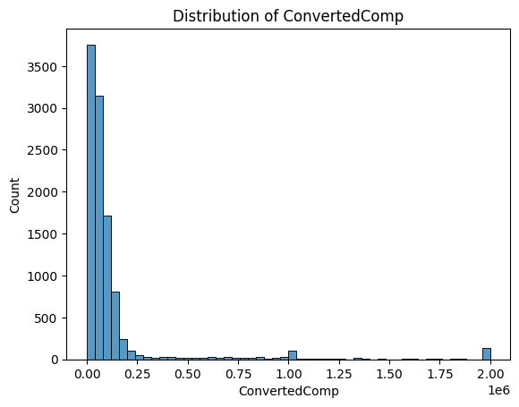
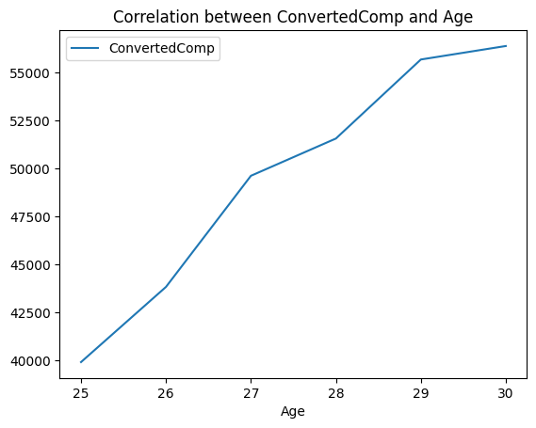
RESULTS

Slide 8
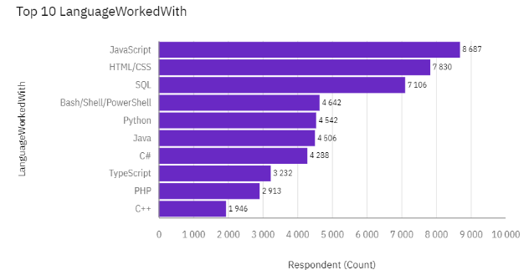
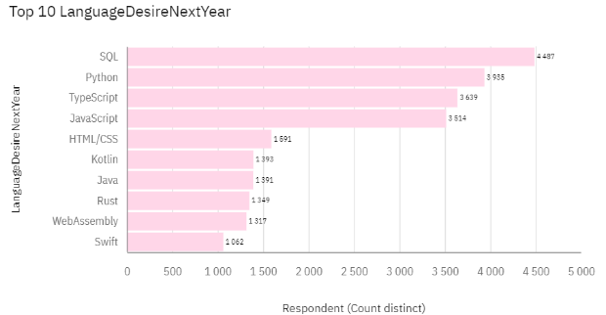
PROGRAMMING LANGUAGE TRENDS
Current Year
Next Year

Slide 9
PROGRAMMING LANGUAGE TRENDS - FINDINGS & IMPLICATIONS
Findings
Expected high dominance of SQL, Python, Typescript & JavaScript languages
Steady Popularity of SQL
Down trend of HTML/CSS
Implications
Investments in Training for future top 4 languages
Znížiť naklady pre trenovanie HTML/CSS
Focus on Python/SQL Developer Skills

Slide 10
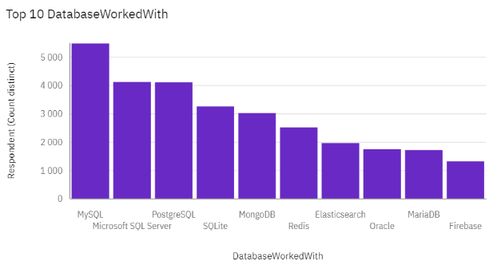
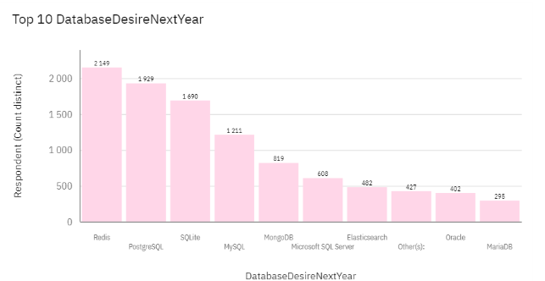
DATABASE TRENDS
Current Year
Next Year

Slide 11
DATABASE TRENDS - FINDINGS & IMPLICATIONS
Findings
estimated increase in popularity of PostgreSQL & SQLite
Redis clearly leads the future of Database
MySQL slump in popularity
high Diversification of database technologies
Implications
Need for training in PostgreSQL
Preparation for Redis Integration
Expanded Support for Multiple Databases

Slide 12

DASHBOARD
Click here for view the dashboard.

Slide 13
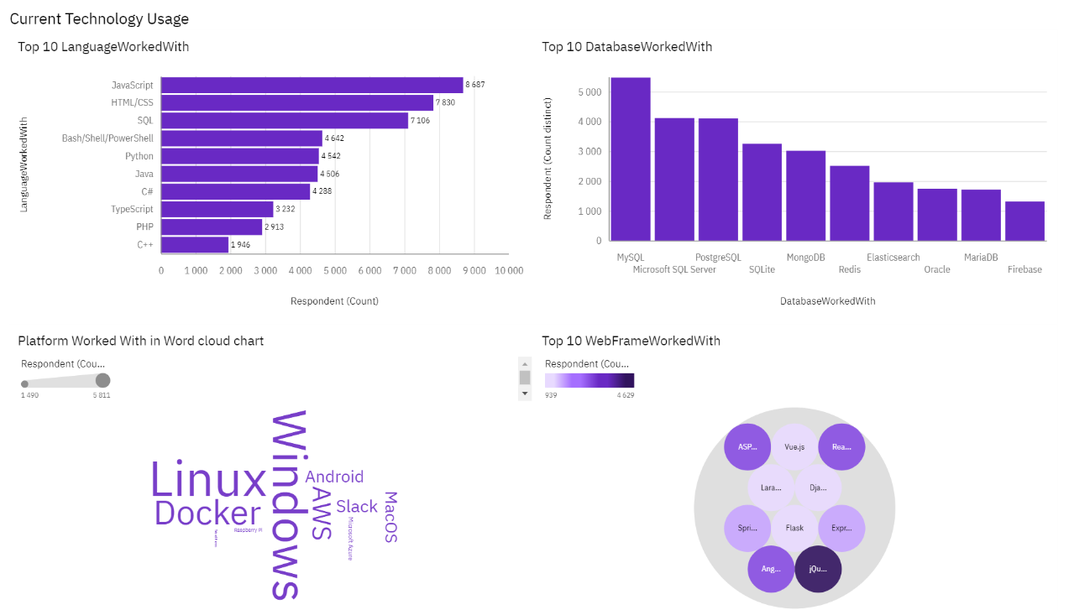
DASHBOARD TAB 1 / Current tech. usage

Slide 14
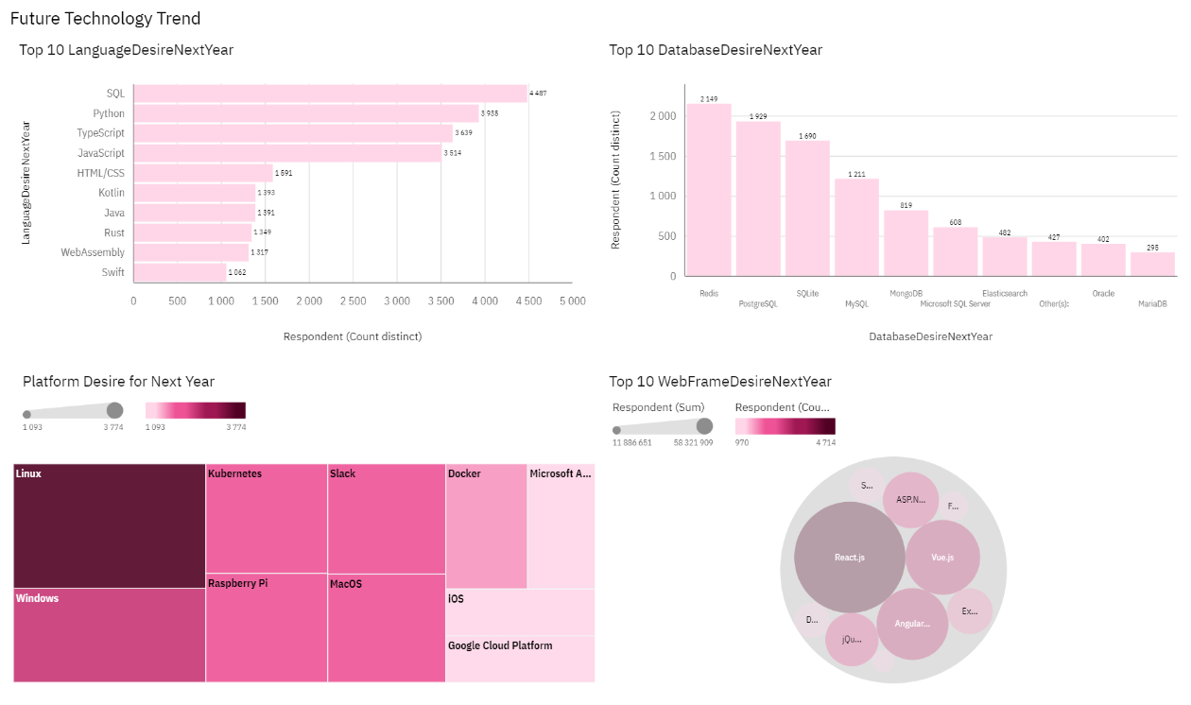
DASHBOARD TAB 2 / Future tech. tend

Slide 15
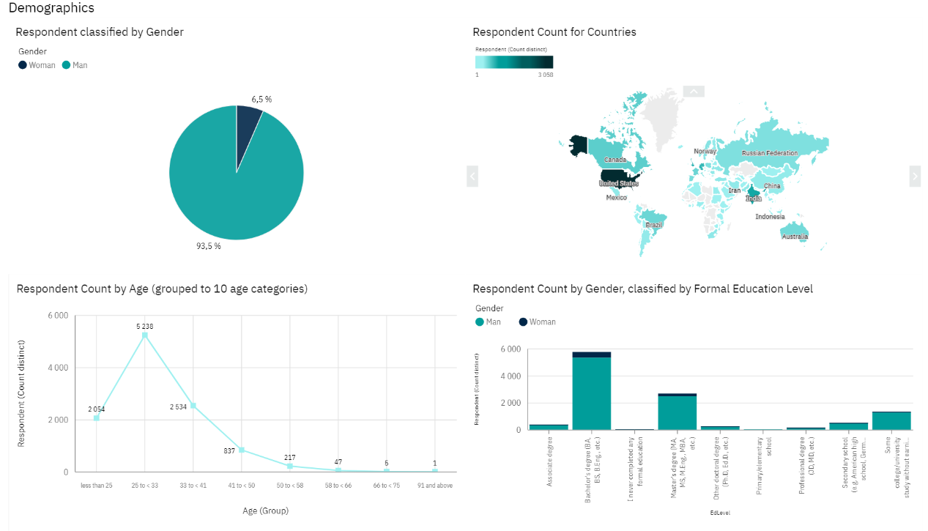
DASHBOARD TAB 3 / Demographics info

Slide 16
DISCUSSION

Slide 17
OVERALL FINDINGS & IMPLICATIONS
Findings
Finding 1
Finding 2
Finding 3
Implications
Implication 1
Implication 2
Implication 3

Slide 18

CONCLUSION
Point 1
Point 2
Point 3
Point 4

Slide 19

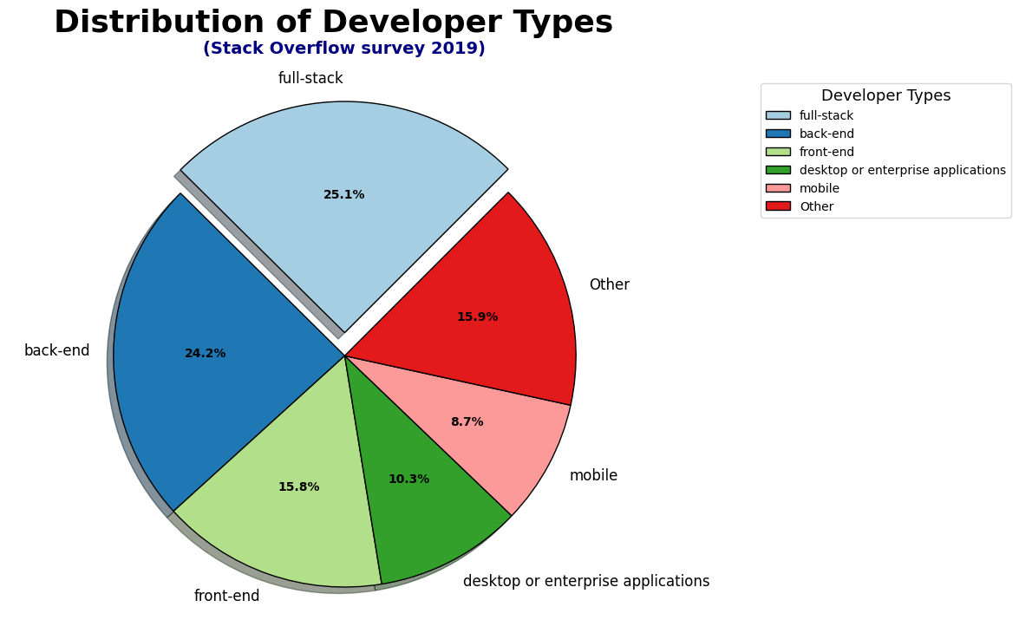
APPENDIX

Slide 20
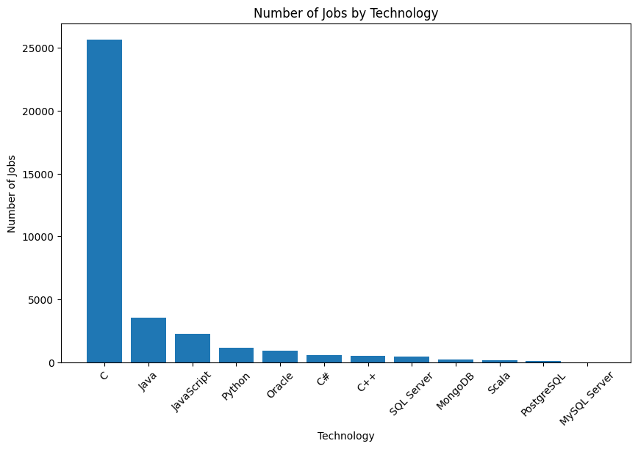
JOB POSTINGS

Slide 21
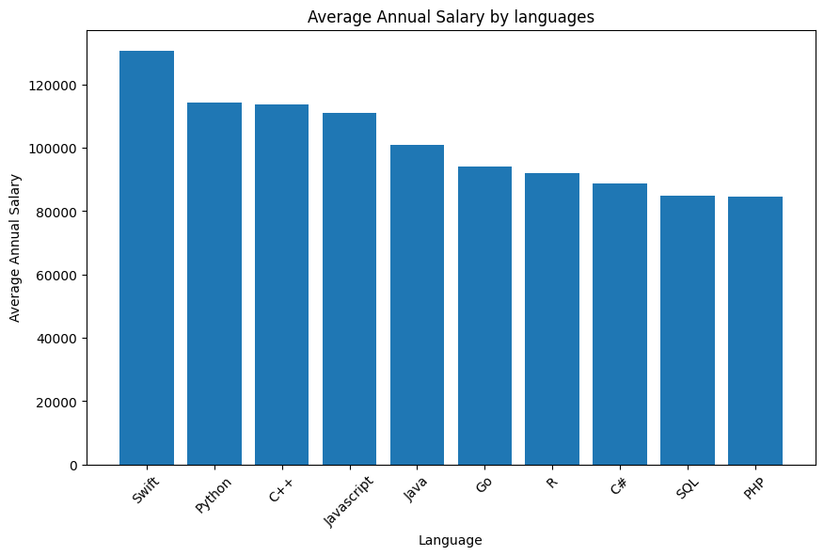
POPULAR LANGUAGES

