Slide 1







Z-Boxes Case Study
Jakub Polcsak
06.06.2024

Slide 2




OUTLINE
Introduction
Methodology
Results
Visualizations
Recommendations
Criteria for Selecting Specific Locations for Z-Boxes
Main competitors
Conclusion
Appendix

Slide 3

INTRODUCTION
Plan for building new Z-Boxes (3000) in Czech Republic
Visually represention of recommendations.
Quick competition research

Slide 4

METHODOLOGY
Population Data Gathering from CSU official website (latest data 1.1.2024)
Data Cleaning & and creation of DIM and FACT tables in MS excel
Data Transformations in Power Query
Data analysis using Python → application of created calculations into DAX (key metrics were Population Proportion and Zbox Proportion)
Data Visualizations in PowerBI desktop

Slide 5
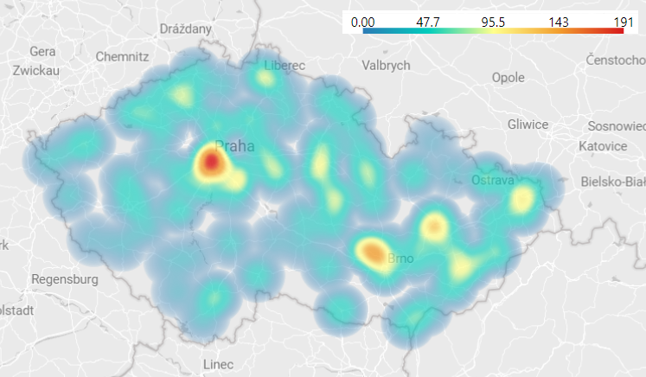
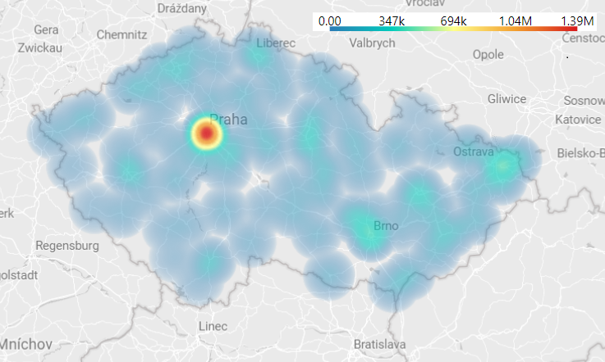
Before implementation of new Z-boxes
Heat map of current num of Z-boxes in Czech republic
Heat map of current population in Czech republic

Slide 6
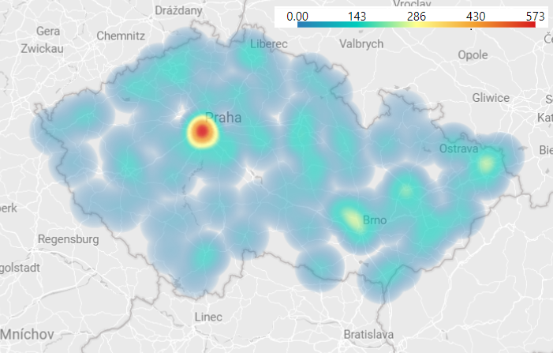
After implementation of new Z-boxes
Heat map of NEW num of Z-boxes in Czech republic
Heat map of current population in Czech republic

Slide 7
RESULTS
My goal was to get similar Population & Z-box Proportions¹ across Czech republic.
My new Z-Box distribution across Czech republic decrease the difference between Population & Z-Box Proportion by nearly 50%.
Difference before & after by selected regions across Czech Republic
Difference Before | Difference After
1,61 % | 0,89 %
Difference before & after by population groups² across Czech Republic
Difference Before | Difference After
10,07 % | 5,57 %
¹ Population / Z-box proportion is calculated as a division of population / num of z-boxes for selected region/city or other group by whole in Country.
² Population groups are explained on the next slide.

Slide 8
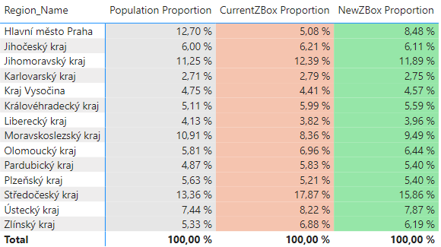
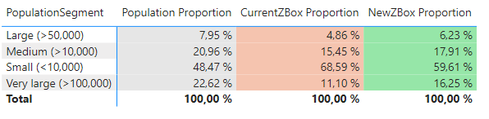
RESULTS
Population proportion by Region
Population proportion by population segments across Czech Republic
*Population / Z-box proportion is calculated as a division of population / num of z-boxes for selected region/city or other group by whole in Country

Slide 9
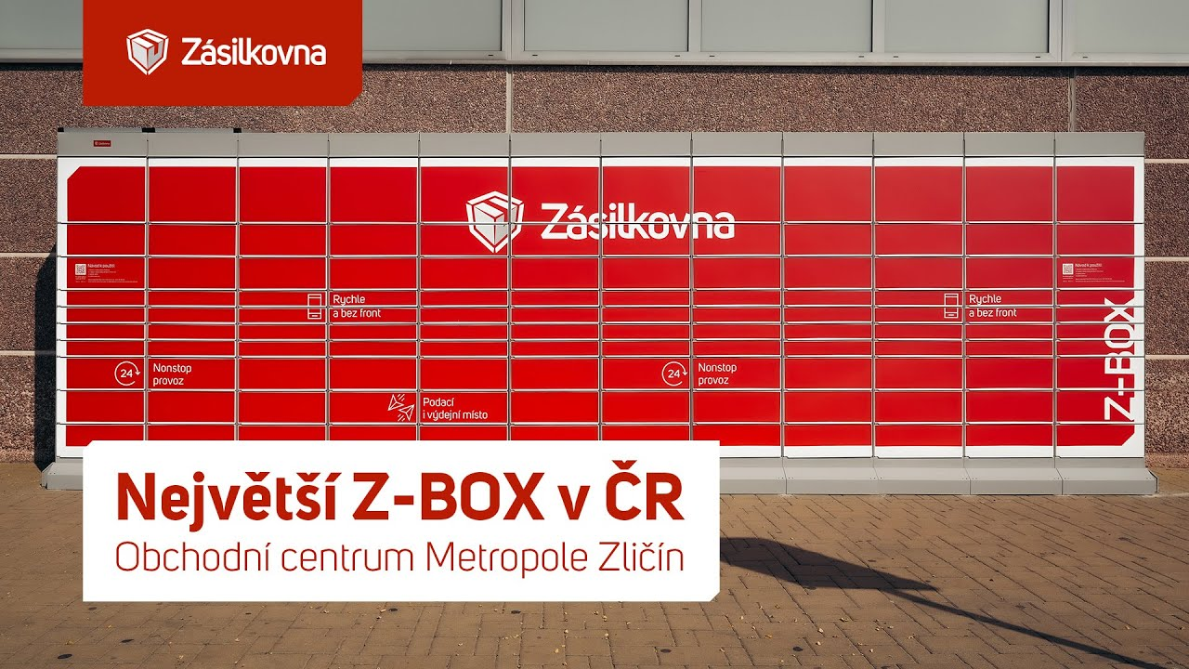
Criteria for Selecting Specific Locations for Z-Boxes
Locations with easy access (Ensure the location is accessible to people with disabilities)
Safety and Security place (to always ensure safety for users)
Areas with high population density to maximize potential users
High foot traffic areas (shopping malls, train stations, bus stops etc.)

Slide 10
Competition research
Four main competitors:
Alza (API)
DPD – data are in repository (link to official web)
Balíkovna (Czech Post API) – data are in repository (link to official web)
PPL

Slide 11
CONCLUSION
The primary goal was to achieve a balanced proportion between the population and the distribution of Z-Boxes, enhancing accessibility and utilization.
Results indicate that the new distribution plan has significantly decreased the disparity, making Z-Boxes more accessible to a larger portion of the population.
The next steps should be to include other important influences like age, areas, the number of inhabitants per square km etc.

Slide 12

APPENDIX

Slide 13
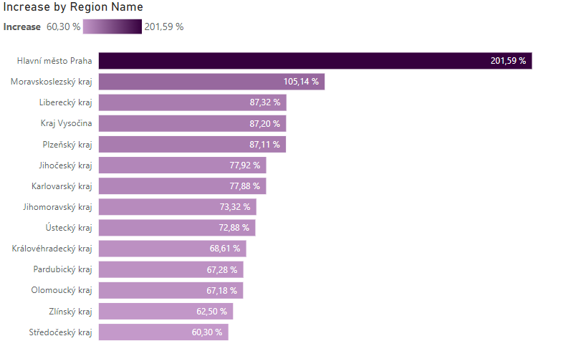
Increase of Z-boxes in regions

Slide 14
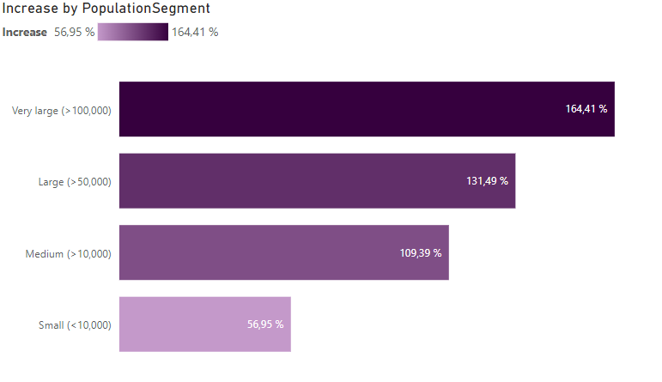
Increase of Z-boxes in segments

Slide 15
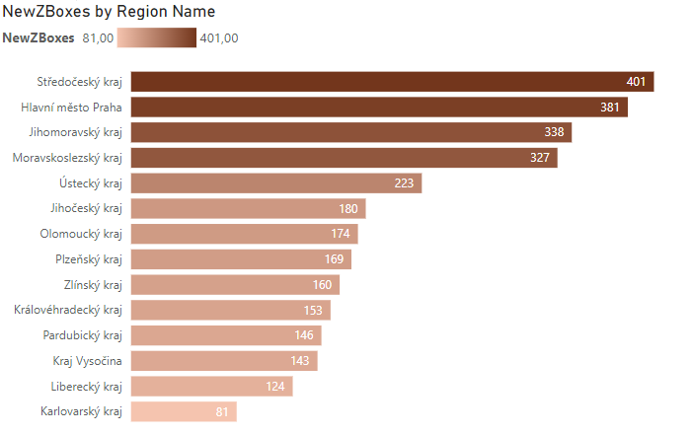
Num of new Z-boxes in regions
*Only new Z-Boxes (3,000 new Z-boxes)

Slide 16
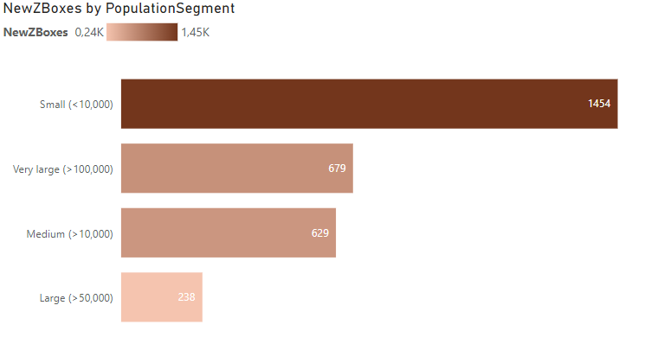
Num of new Z-boxes in segments

