Slide 1







Stack overflow developer survey 2019
Jakub Polcsak
20.4.2024

Slide 2



OUTLINE
Executive Summary
Introduction
Methodology
Results
Visualization – Charts
Dashboard
Discussion
Findings & Implications
Conclusion
Appendix

Slide 3

EXECUTIVE SUMMARY
The age distribution among developers is concentrated between 25 to 34 years
JavaScript, HTML/CSS, and SQL dominate current technology usage
SQL and Python lead the languages developers intend to adopt next year
Swift, Python, and C++ developers tend to have higher earnings

Slide 4

INTRODUCTION
Analysis of influence experience in using dev skills on salary
Current trends in programming languages ​​and databases
Findings and implications for programming languages/databases

Slide 5

METHODOLOGY
Survey Design
Data Gathering
Data Cleaning
Data Validation
Data Analysis
Data Visualization

Slide 6
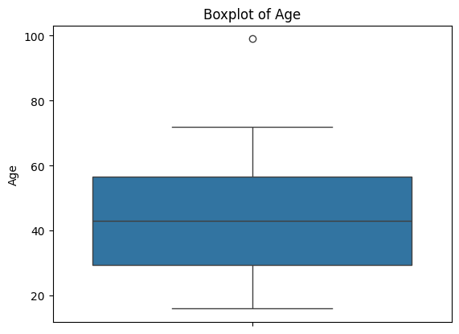
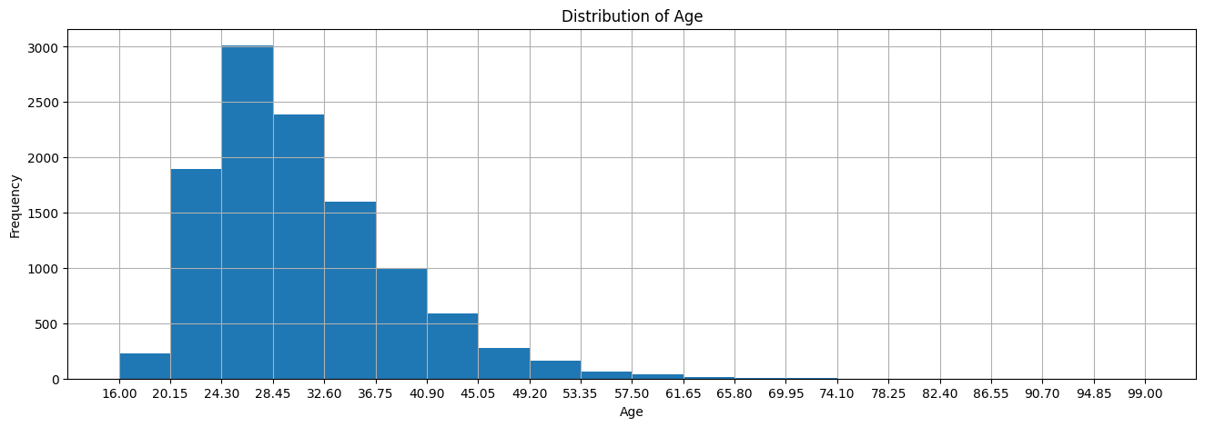
RESULTS

Slide 7
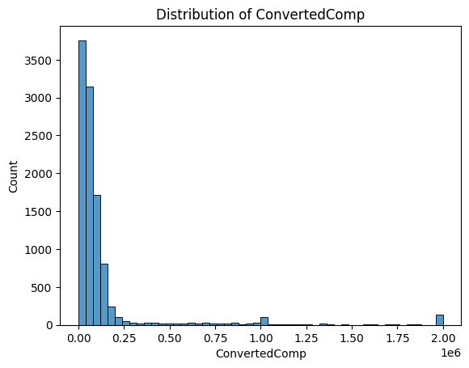
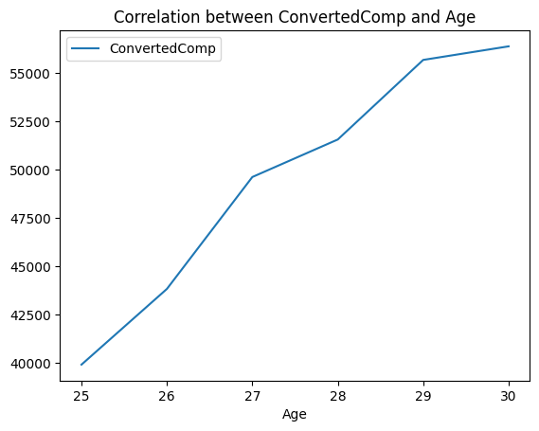
RESULTS

Slide 8
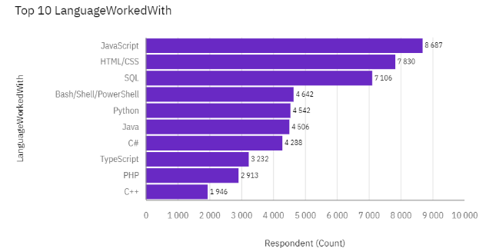
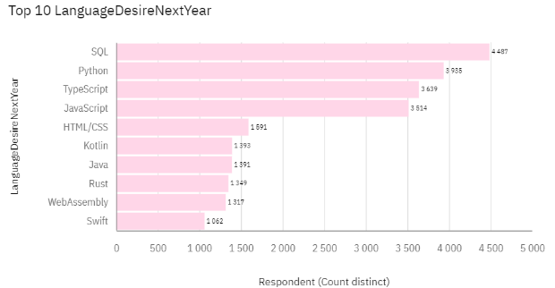
PROGRAMMING LANGUAGE TRENDS
Current Year
Next Year

Slide 9
PROGRAMMING LANGUAGE TRENDS - FINDINGS & IMPLICATIONS
Findings
Expected high dominance of SQL, Python, Typescript & JavaScript languages
Steady Popularity of SQL
Down trend of HTML/CSS
Implications
Investments in Training for future top 4 languages
Znížiť naklady pre trenovanie HTML/CSS
Focus on Python/SQL Developer Skills

Slide 10
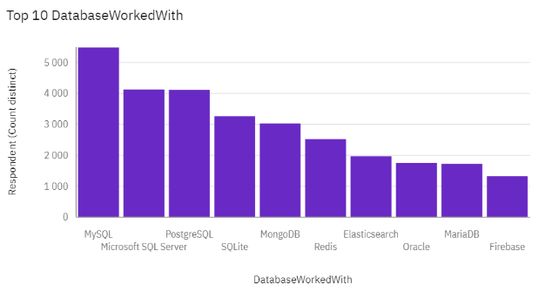
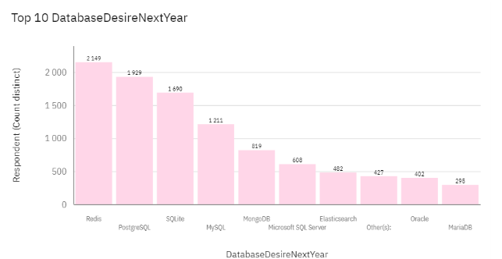
DATABASE TRENDS
Current Year
Next Year

Slide 11
DATABASE TRENDS - FINDINGS & IMPLICATIONS
Findings
estimated increase in popularity of PostgreSQL & SQLite
Redis clearly leads the future of Database
MySQL slump in popularity
high Diversification of database technologies
Implications
Need for training in PostgreSQL
Preparation for Redis Integration
Expanded Support for Multiple Databases

Slide 12

DASHBOARD
Click here for view the dashboard.

Slide 13
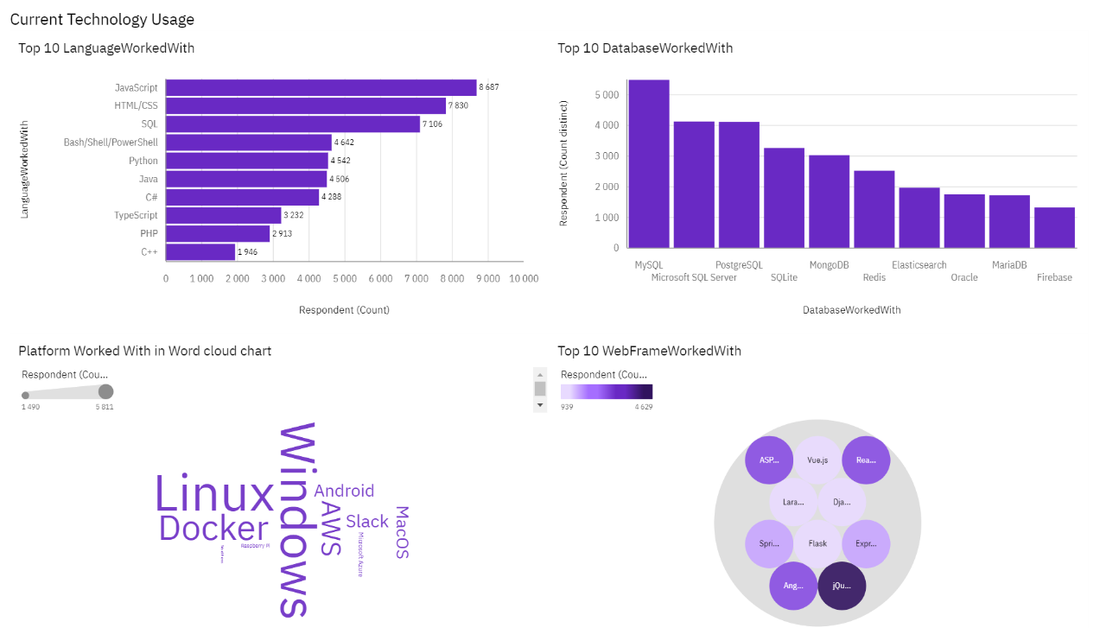
DASHBOARD TAB 1 / Current tech. usage

Slide 14
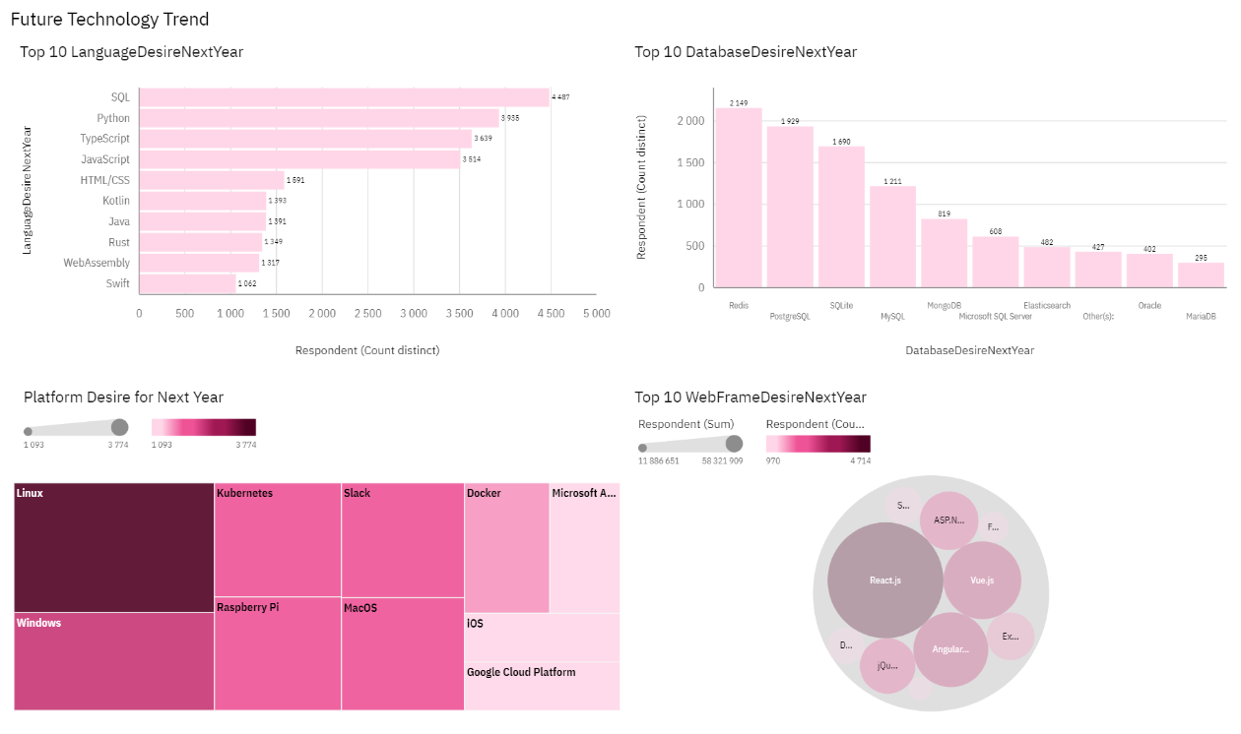
DASHBOARD TAB 2 / Future tech. tend

Slide 15
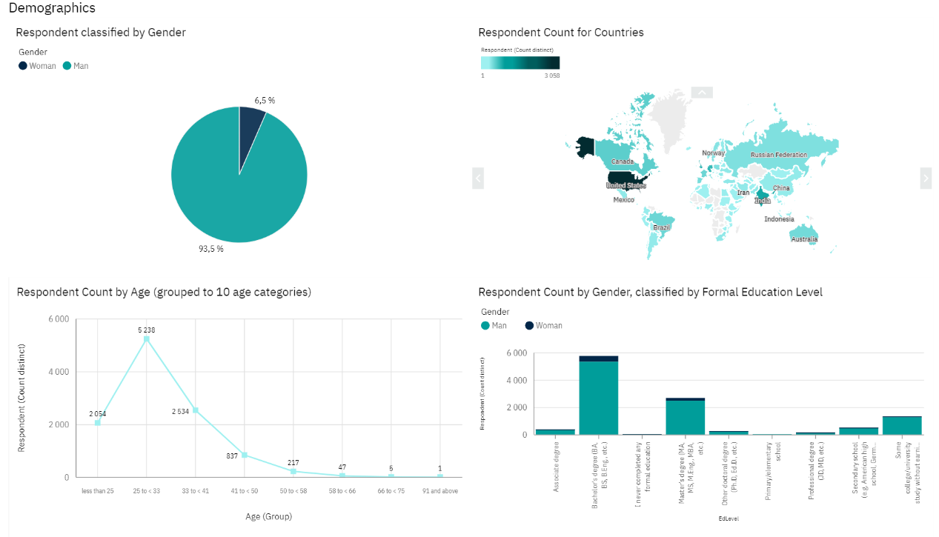
DASHBOARD TAB 3 / Demographics info

Slide 16
DISCUSSION

Slide 17
OVERALL FINDINGS & IMPLICATIONS
Findings
The age distribution among developers is concentrated between 25 to 34 years
JavaScript, HTML/CSS, and SQL dominate current technology usage
SQL and Python lead the languages developers intend to adopt next year
Swift, Python, and C++ developers tend to have higher earnings
Implications
Educational programs and developers should focus on SQL, Python
Companies should consider investing in Redis and Kubernetes training for their teams
Employers should align their hiring strategies with the job market demand

Slide 18

CONCLUSION
Our data shows a workforce that is young yet spans a broad age range, suggesting adaptability and continuous learning as key traits for success.
The projected trends in programming language adoption emphasize the need for developers to continue enhancing their skills in SQL and Python. The strong market demand for C, Java, and JavaScript reflects the necessity for expertise in these languages.

Slide 19

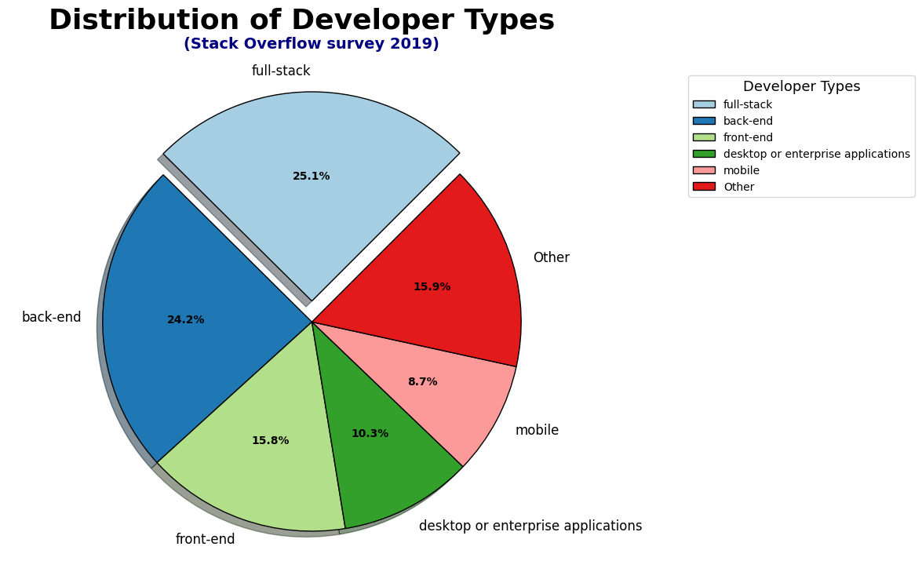
APPENDIX

Slide 20
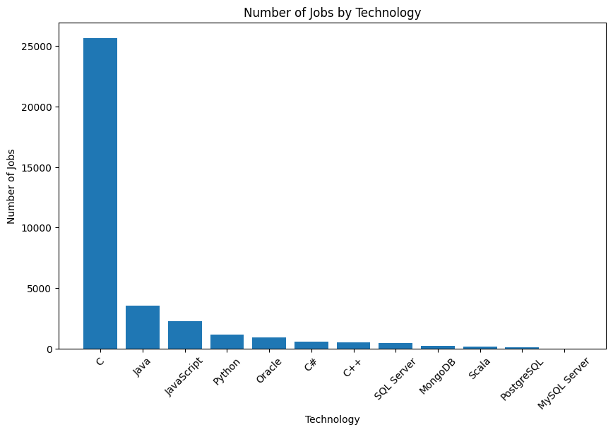
JOB POSTINGS

Slide 21
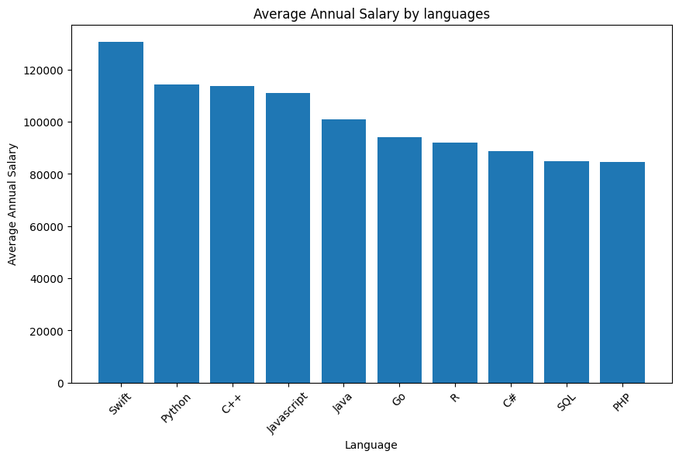
POPULAR LANGUAGES

