Slide 1
SIRV Model for COVID-19
Alberto Gori
Matteo De Luca
Pol De Dalmau
Notes:
In this project we used a simplified SIRV model to analyze the spread of a disease, like Covid-19.

Slide 2
Importance of models
Estimate disease transmission, recovery
Impact of mitigation measures
Impact of vaccine
Prediction of trends

Slide 3
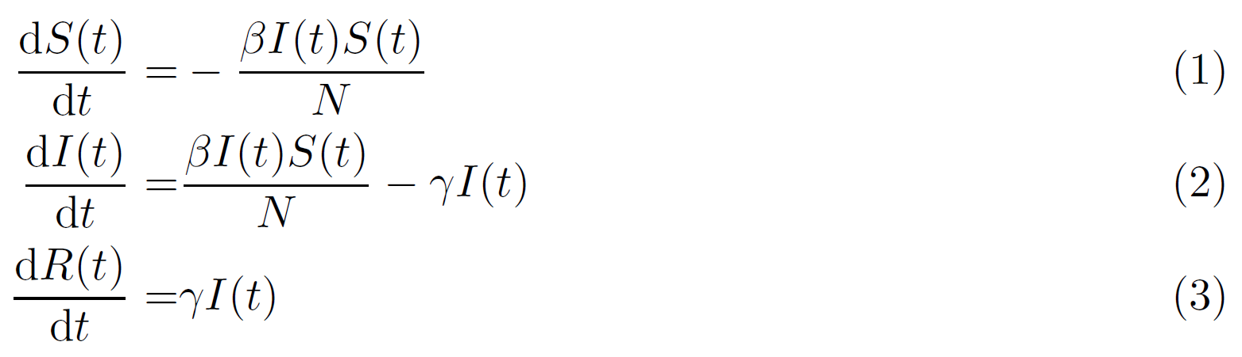
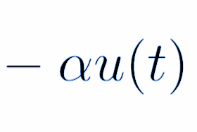
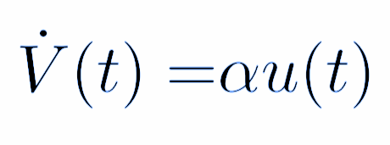

SIR(V) model [1]
S(t): number of susceptible individuals
I(t): number of infected individuals
R(t): number of removed individuals
β: infection rate
ɣ: removal rate
α: vaccine efficacy
u(t): daily vaccination rate

Slide 4
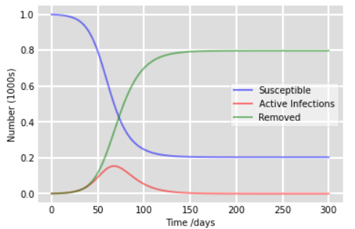
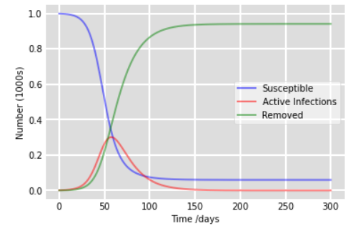
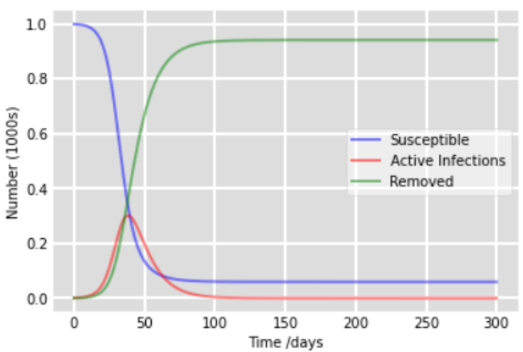
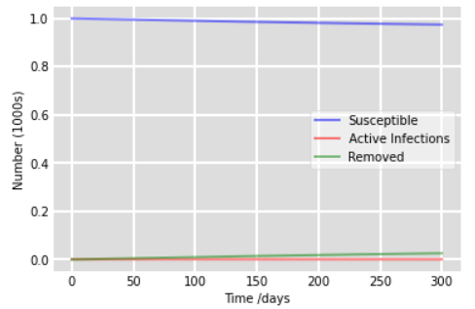
β=0.2, ɣ=0.1
β=0.2, ɣ=0.0667
β=0.3, ɣ=0.1
β=0.1, ɣ=0.1
Notes:
Initially one infected

Slide 5
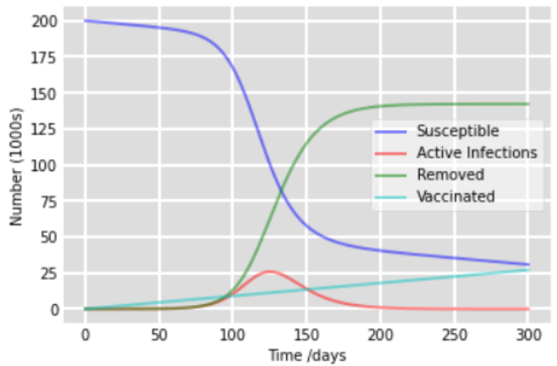
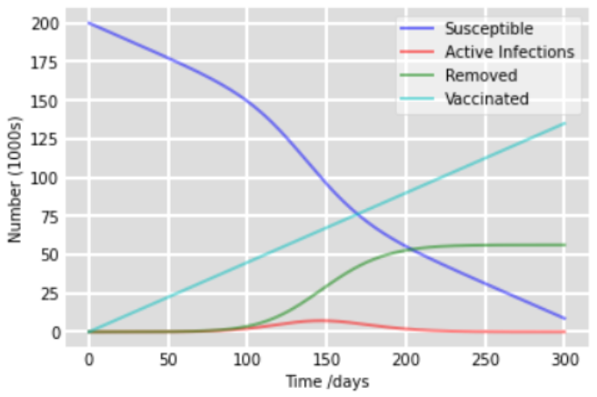
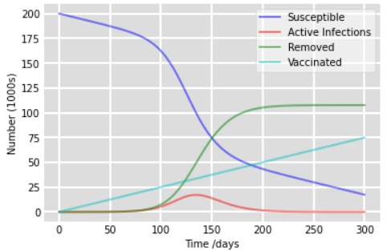
u = 100, α = 0.9
u = 500, α = 0.5
u = 500, α = 0.9

Slide 6

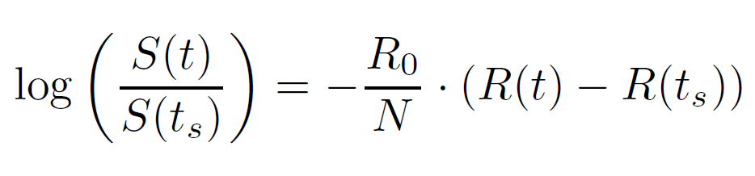
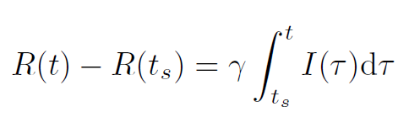
Canada: A real case study [1]
Notes:
To fit the model we want to find parameters beta and gamma(or eta) from the data.
Go back to SIR model without vaccine. Divide eq 1 by 3, integrate from t_s (starting time) and obtain relationship between logS and R. Linear regression to obtain R_0 (basic reproduction number)
Linear regression:
with some validity checks (results and validity checks are the same...)

Slide 7
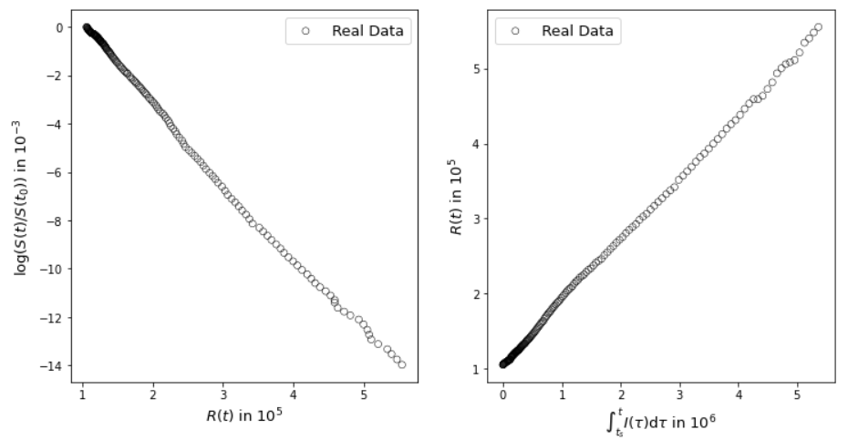
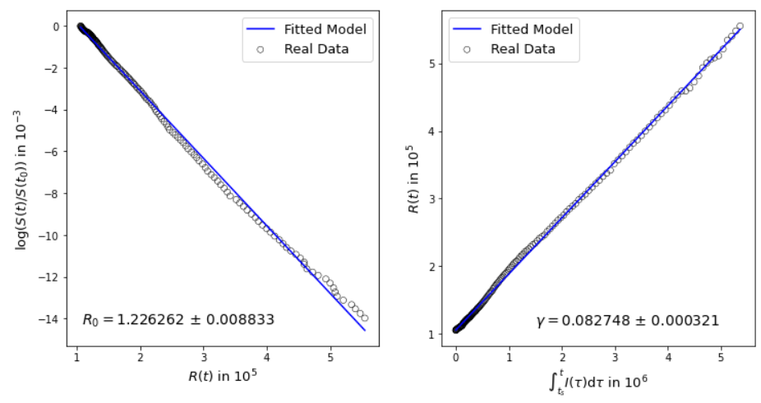
Canada: linear regression (see [2] for data)
Notes:
Data for Canada. R_0 and gamma are obtained. Since R_0 can be expressed as the ratio between beta and gamma, we can find gamma. Data from July 17, 2020 to January 8, 2021 under no vaccination input and the effect of vaccination is then introduced on January 8, 2021.

Slide 8
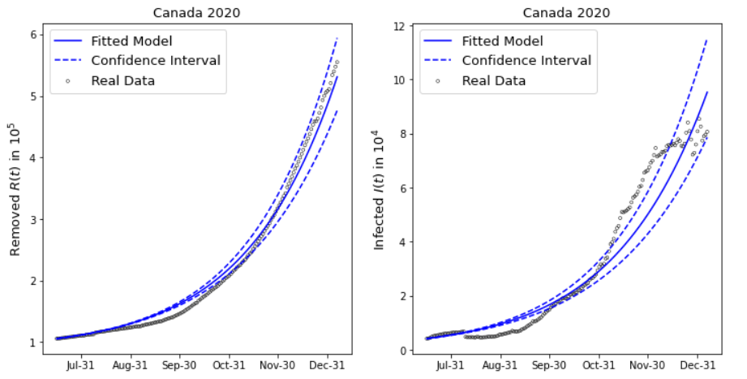
Fit with obtained parameters
Notes:
Validity check. Data is online. Paper refers to it. literature provides quite similar plots.

Slide 9
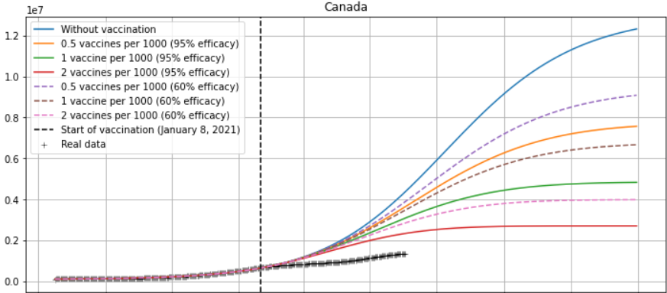
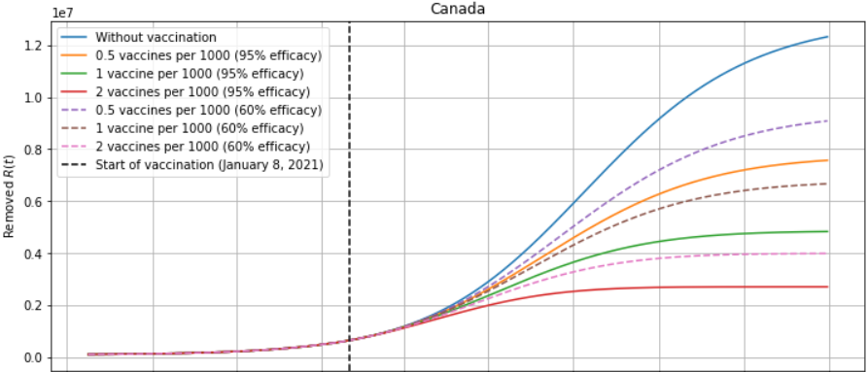
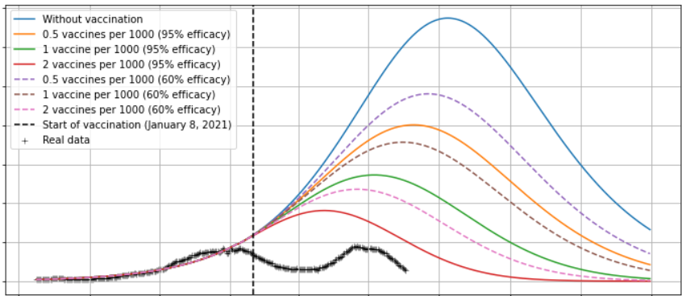
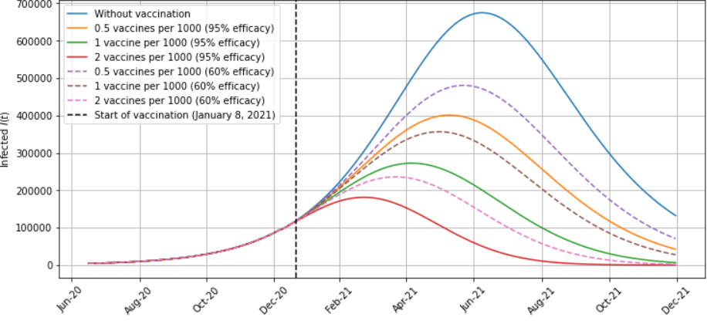

Results
Different Scenarios:
0.5, 1, 2 vaccines per thousand
with 60% and 95% efficacy
Notes:
Prediction model for vaccine (plots are already done)
Use data more recent than paper and see impact of vaccine (scenario 2)
Model does not predict very well. No waves, time dependent infection rate -> Measures change in time
literature uses January 8 for vaccine, reality: December 15

Slide 10
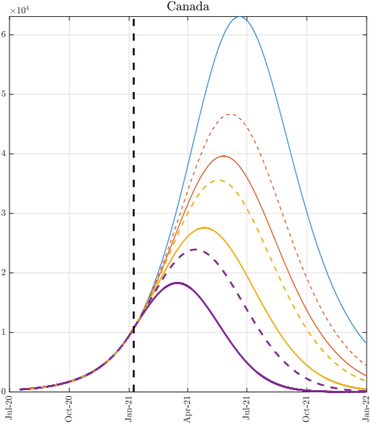
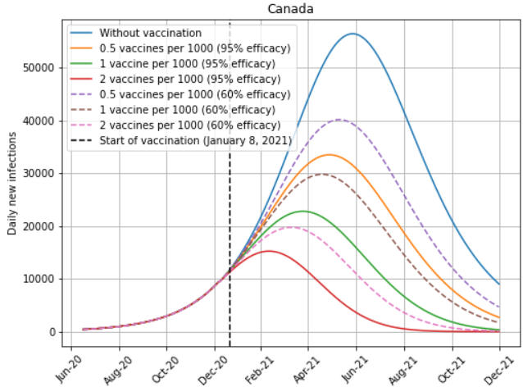
Comparison with Literature
Notes:
parameters not obtained as accurately as literature because literature uses values from linear regression as initial conditions and then uses a nonlinear programming solver to really fit the data.

Slide 11
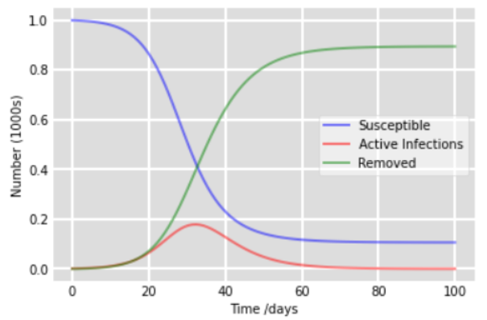
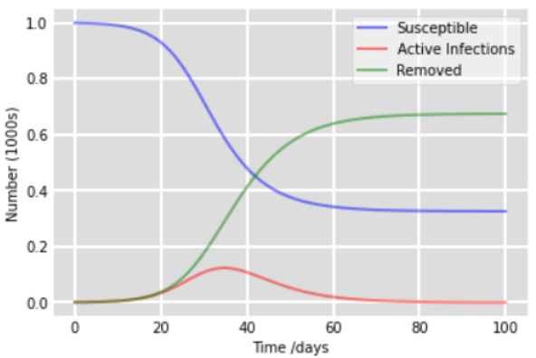
SIR for several populations [3]
Non-diagonal elements for beta and gamma determine interactions

Slide 12
Conclusions
Our code behaves as expected
Performance: regression~50ms, SIR~ 5ms
Our model does not predict waves. Possible extension: time-dependent infection rate
Several population SIR has a lot of parameters. Not worth it.

Slide 13
References
[1] S. Berkane, I. Harizi, and A. Tayebi, “Modeling the effect of population-wide vaccination on the evolution of covid-19 epidemic in canada" medRxiv, 2021. [Online]. Available: https://www.medrxiv.org/content/early/2021/04/05/2021.02.05.21250572
[2] COVID-19 daily epidemiology update: https://health-infobase.canada.ca/COVID-19/epidemiological-summary-COVID-19-cases.html
[3] Magal, Pierre, O. Seydi, and G. Webb, “Final size of an epidemic for a two-group SIR-model”SIAM J. Appl. Math., vol. 76, no. 5, p. 2042–2059, Oct. 2016. [Online]. Available:https://doi.org/10.1137/16M1065392

