Slide 1




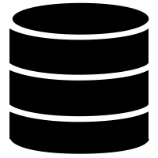



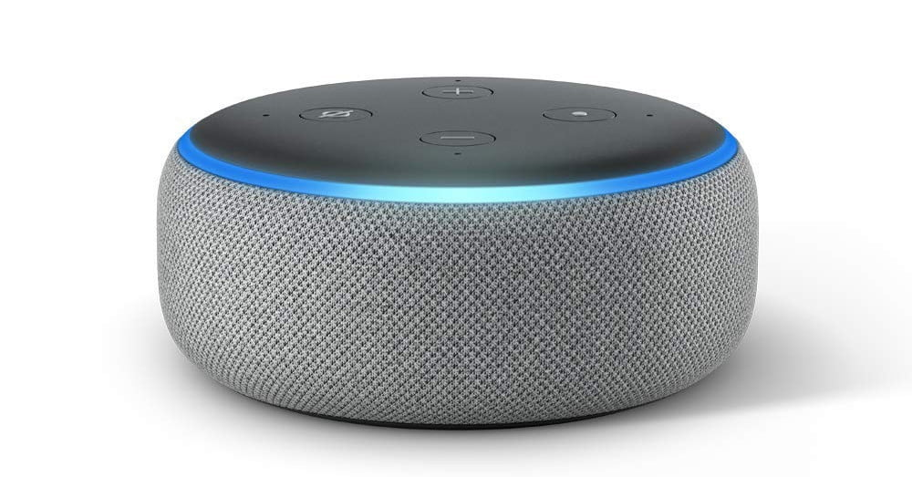

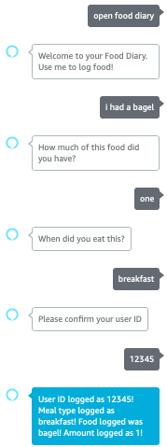
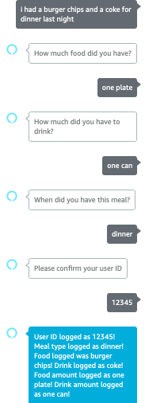
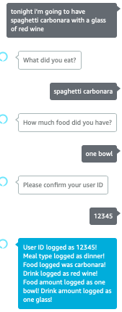
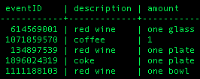
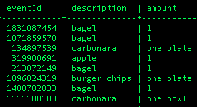
Smart Assistant for Data Collection In Epidemiology
Leonard Goldschmidt
Supervisor 1: Louise Millard
Supervisor 2: Samuel Neaves
Introduction:
Health research is interested in understanding factors that influence people’s food intake and how different diets affect health. Collecting reliable and accurate dietary information is a difficult process in this area and can result in inconsistent and poorly evidenced data for epidemiological research.
“By definition, epidemiology is the study (scientific, systematic, and data-driven) of the distribution (frequency, pattern) and determinants (causes, risk factors) of health-related states and events (not just diseases) in specified populations (neighborhood, school, city, state, country, global).”
Motivation:
Example: “The second generation of the Avon Longitudinal Study of Parent and Children ”
This is a generational study, analysing behaviour,, including nutrition of a large group of participants over three generations.
Logging data of over 14,000 participants
Data has to be reliable/consistent and centralised
Traditional methods involve pen/paper
Prone to mistakes
Tedious
Can be lost
Challenge:
Investigate whether a smart assistant
can provide an alterantive way of logging nutritional data for Epidemiology.
Added value:
Create a fast and easy way of logging nutrition using a voice assistant.
Easily distribuitable
Data can be stored immediately in one, centralised database
Approach:
Develop Alexa Skill on Developer Portal
Create Java Application to handle intents dispatched by the skill.
Set up mySQL database for nutrition data storage
Host Java App and database on Tomcat Server
Configure Alexa skill to use the server endpoint.
Create Docker image of stack
Deploy docker image on university server.
Testing:
Ngrok creates a public URL for local server inculding HTTPS.
Make changes to Java
Rebuild .war
Add .war to Tomcat directory
Restart Tomcat server
Start ngrok on localhost port 8080
Set public URL as endpoint for skill
Jojo.epi.bris.ac.uk:9449
“For breakfast I had
a bagel and a cup of coffee”
mySQL
Jojo.epi.bris.ac.uk:9449 → 443
{
Meal: “breakfast”,
Food: “bagel”,
Amount_food: “1”,
Drink: “coffee”,
Amount_drink: “1 cup”,
UserID: “12345”
}
Drinks
Foods

