Slide 1


Can SARIMA Time Series Forecasting Accurately Predict Sea Level Change?
When will my Delaware home be threatened by rising sea levels?
OR
Notes:
My family is blessed to have a home a few km from the Bethany Beach DE, and we’ve noticed less beach pretty much every year.

Slide 2


Data Source
Global Mean Sea Level Data (GMSL)
Computed by the NASA Goddard Space Flight Center under the auspices of the NASA MEaSUREs
(Making Earth System Data Records for Use in Research Environments) program.
Samples from 1993 – 2020, with 36 or 37 samples per year
Samples collected using satellite altitudes and common terrestrial reference points, with
corrections applied
Data includes raw data, standard deviations, and various smoothing techniques
Measurements are with respect to a 20-year TOPEX/Jason collinear mean reference
The date and raw measurements were used for this analysis

Slide 3
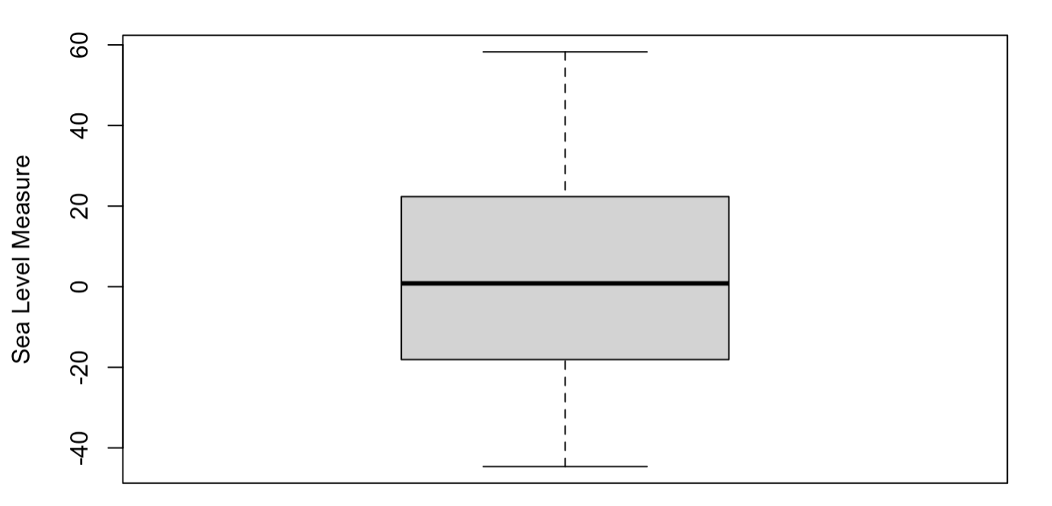
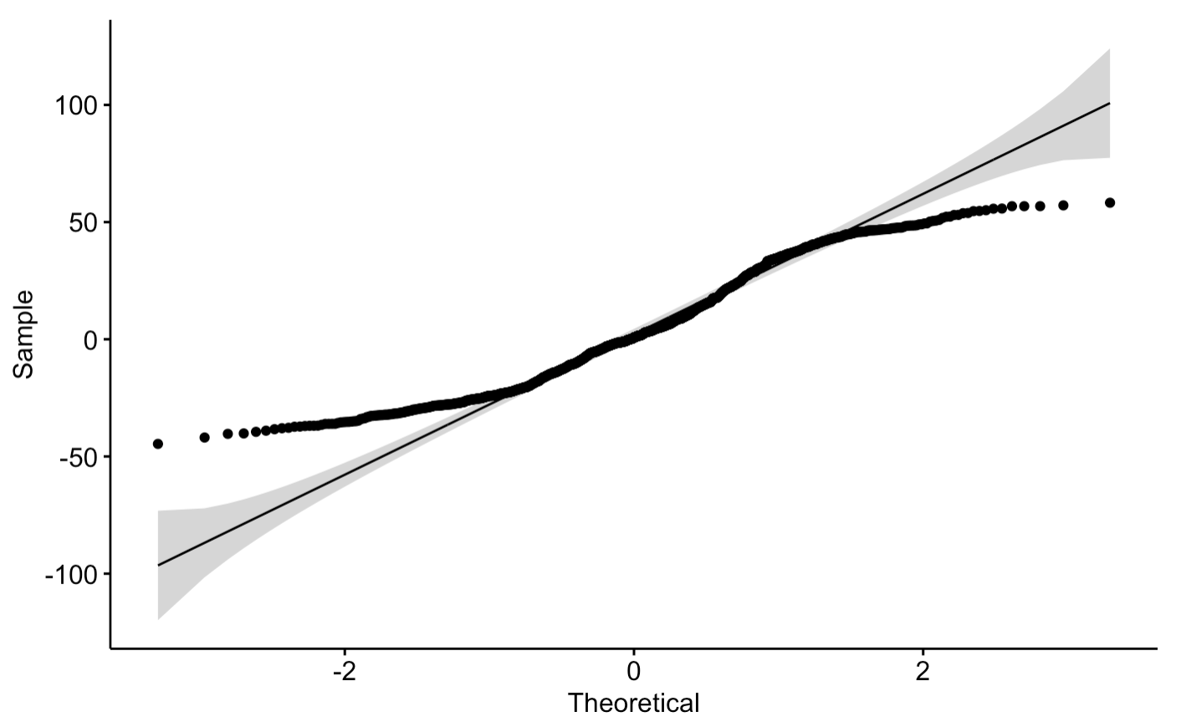
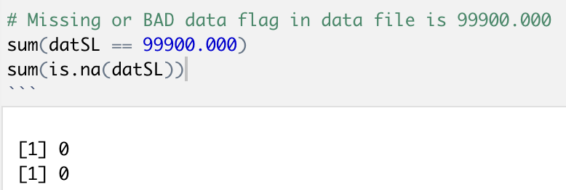
Basic Data Analysis
Box Plot: No apparent outliers QQ Plot: Not great because the data is not stationary
No missing or bad Data:
Notes:
QQPLOT? The QQ Plot doesn’t look great – this is because the data is Not Stationary. The mean and variance will be changing over time.
No missing or bad data.

Slide 4
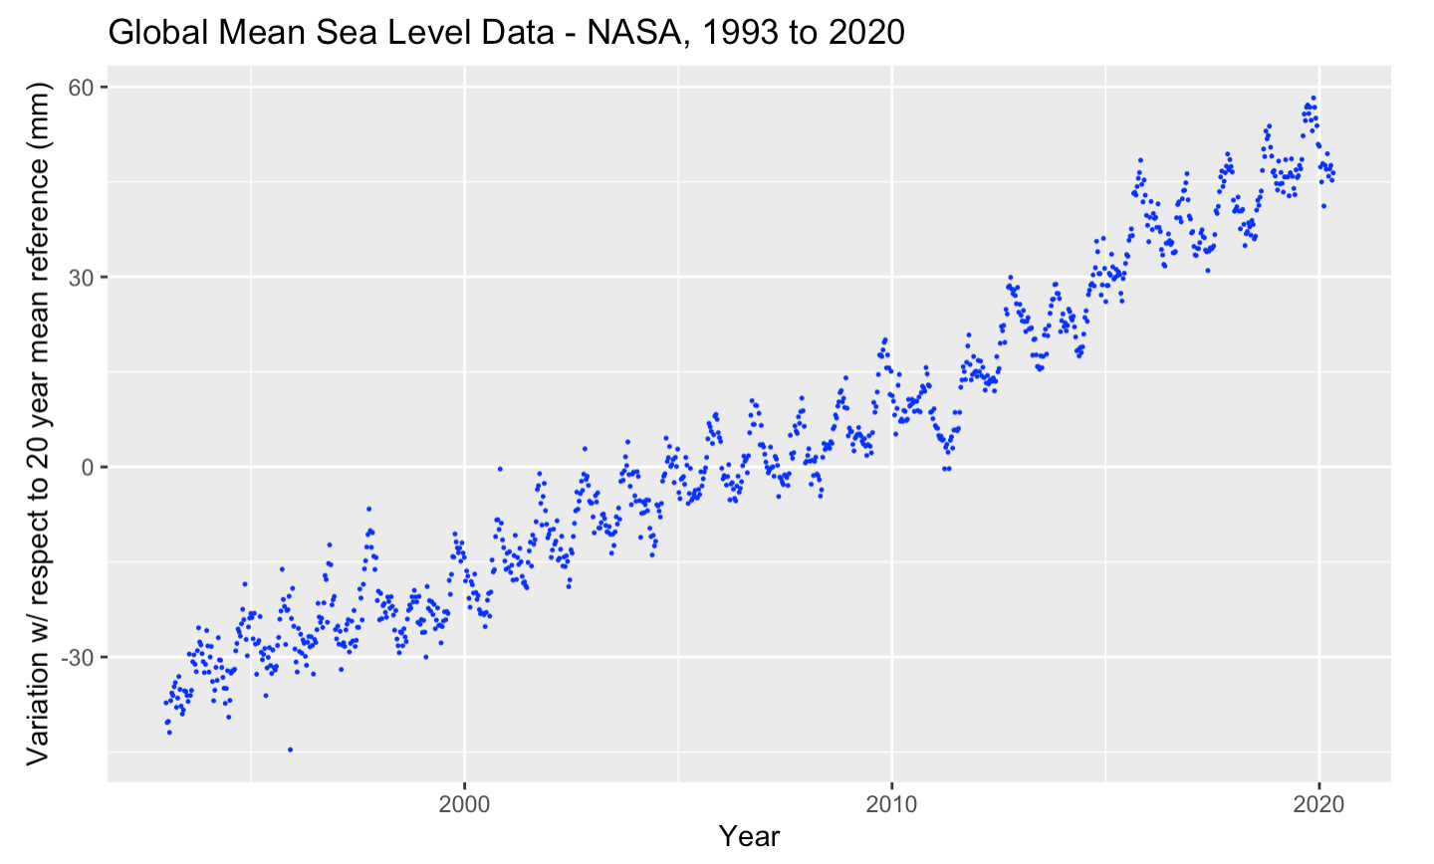
Scatter Plot, Raw Sea Level Data
Notes:
Scatter Plot of the raw data.

Slide 5
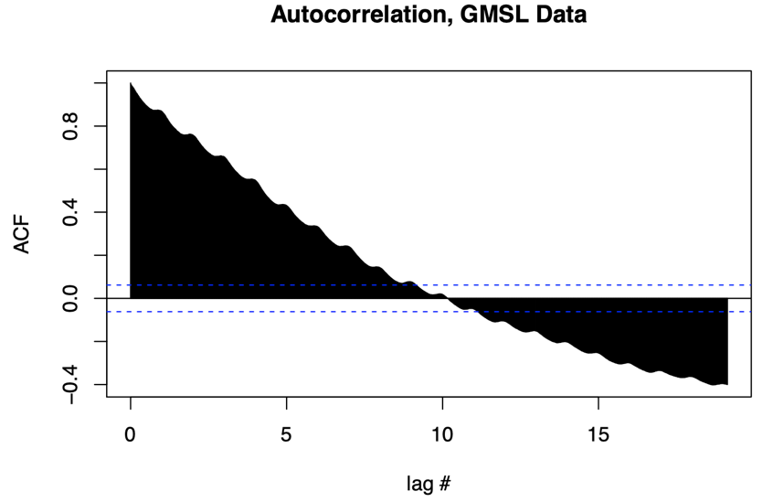
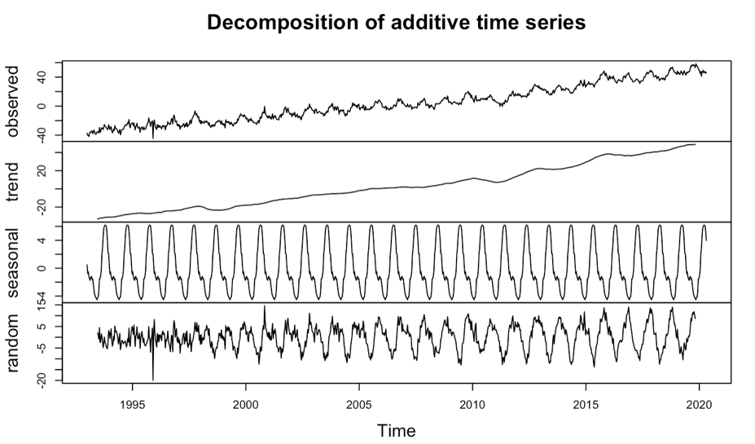
Aspects of Time Series Data
Is the data Additive or Multiplicative? This sea level data is Additive
Is the data Stationary? Are the mean and variance Is the data Seasonal?
constant over time? The decompose function breaks the
Check the Autocorrelation (acf) of data into components.
the data, or use an Augmented Dickey-Fuller Data shows a clear cyclical
Test. This data is not stationary. for each year of data.
Notes:
Additive or Multiplicative: Look at a particular year from the data – say 1994. The difference between the min and max will be roughly the same as that difference from 2019. The data is additive.
This serial correlation graph calculates the correlation with observations from previous time steps, called lags. Almost all the lags for this data are outside the 95% confidence interval. The mean is changing over time, so the data is NOT stationary.
The decomposition shows: Observed is the raw data.
Trend: The data is trending upwards.
Seasonal: A clear cyclical pattern
Random: Shows the noise part of the data.

Slide 6
Can univariate SARIMA Time Series Forecasting Accurately Predict
Sea Level Change?
What is SARIMA?
“Seasonal AutoRegressive Integrated Moving Average”
SARIMA adds a “seasonal” component to ARIMA, which is already a combination of
Autoregression and Moving Average processes.
Data will be split into a Train Set (70%) and a Test Set (30%).

Slide 7
SARIMA Forecasting details
SARIMA(p, d, q)(P, D, Q)m
The first three components are from the ARIMA model, and are trend elements:
p – The autoregressive component of the model, the number of autoregressive terms.
This can be estimated from the partial autocorrelation of the differenced data.
d – Number of differencing steps to make the data stationary
q – The moving average component of the model, the number of lagged forecast errors.
This can be estimated from the autocorrelation of the differenced data.
The Seasonal extension of ARIMA adds:
P – A seasonal autoregressive order component
D – A seasonal difference order
Q – A seasonal moving average order
m – The number of time steps for a single seasonal period – 36 in this case.

Slide 8
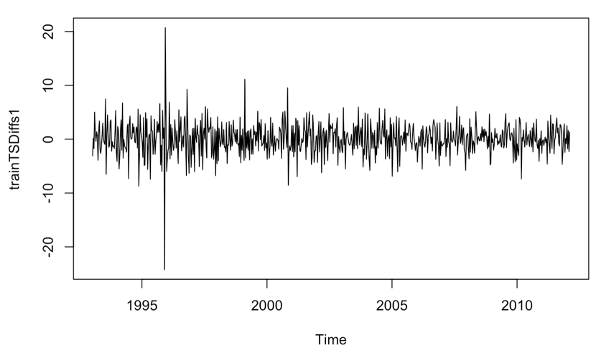
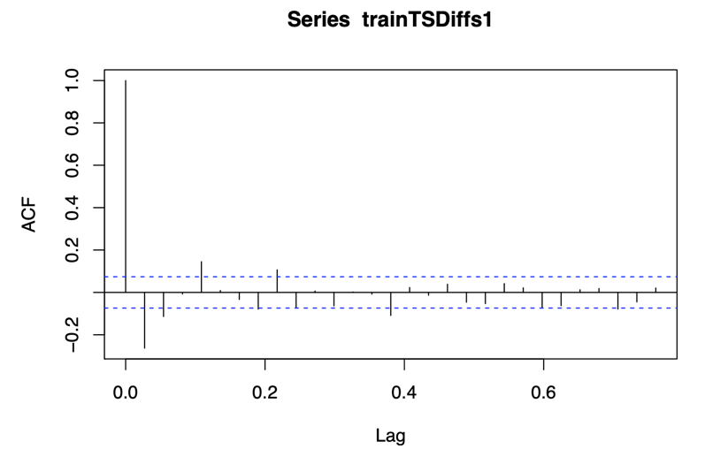
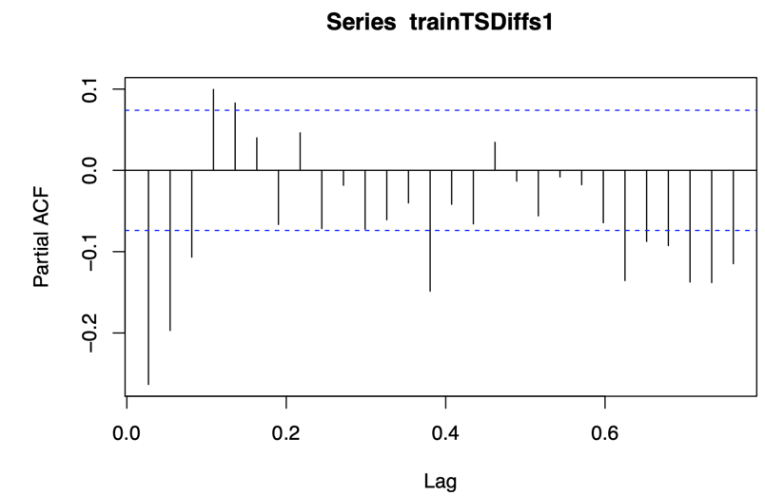
Estimating SARIMA components
Differencing to make stationary: This plot shows one difference. The mean is roughly constant at 0.
ACF: The Autocorrelation plot for the PACF: The Partial Autocorrelation plot for the
differenced data differenced data
Notes:
For Differencing, I tried through 4 differences. I also tried log differencing, with similar results.
The trend (ARIMA) components can be chosen with careful analysis of the above ACF and PACF plots. For example, we can count the number of lags until the ACF lags are completely within the confidence interval to estimate q for moving averages, and similar for p with the PACF for the autoregressive term. A similar process can be used for the Seasonal components.
I attempted to do this multiple times, without decent results. I attempted different methods of differencing as well.
Luckily, the FORECAST package has an auto.ARIMA function!

Slide 9
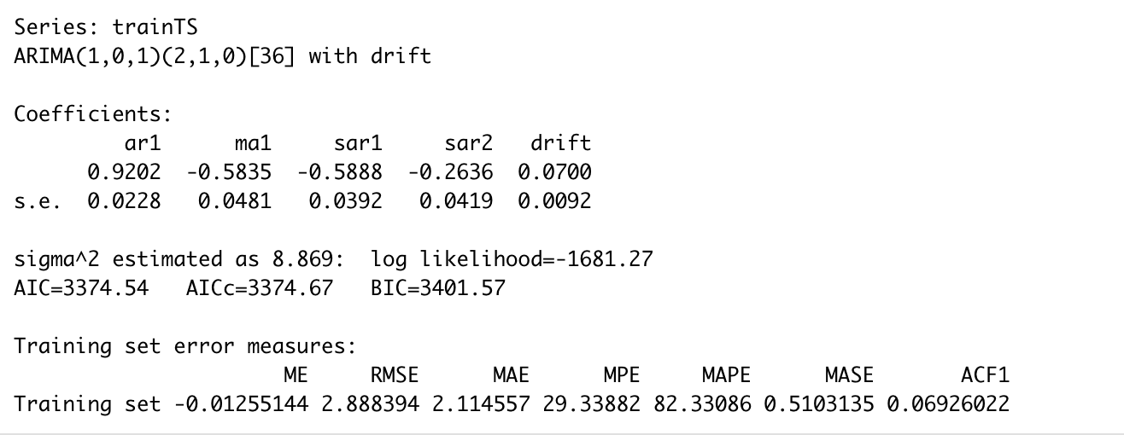
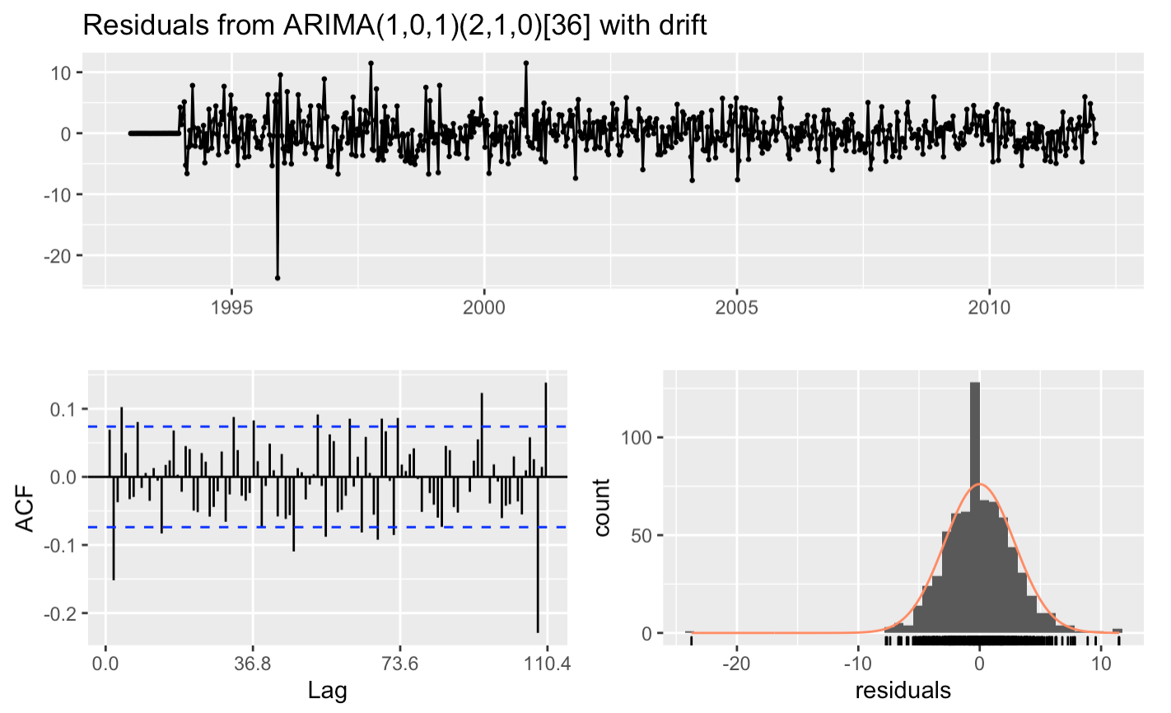
Auto.ARIMA and Results
Summary of the model results:
Check Residuals of the model:
Notes:
The Auto ARIMA function in the Forecast package takes the univariate raw data, and steps through all possible likely values for p, d, q, and P, Q, D and m. The command has 34 parameters, and allows for starting and max values for the components. The function chooses the set of components that minimize the AIC, AICc and BIC. This took 3.5 minutes to run on my machine.
Residuals are estimates of the error, with the difference between the observed response and the predicted response. The errors are pretty roughly centered around 0. But there are a lot of lags outside the significance bounds – suggests the model could be improved.
AIC: Akaike Information Criterion – should be minimized. BIC: Bayesian Information Criterion – should be minimized.

Slide 10
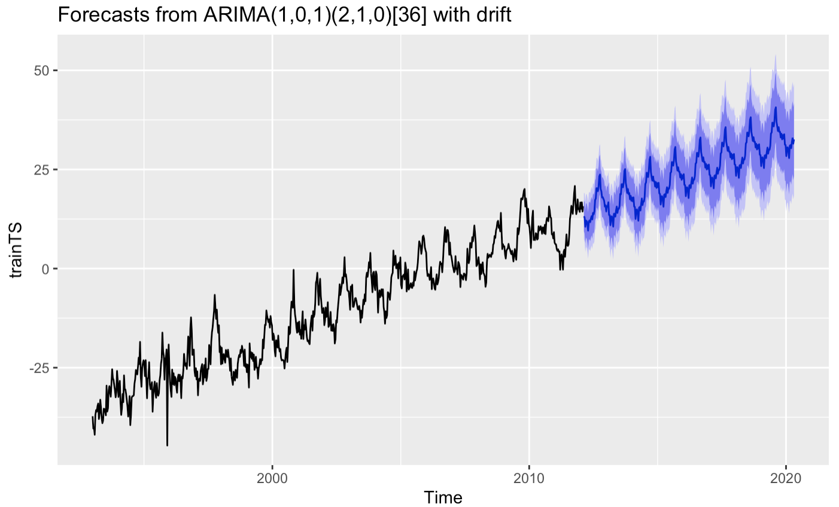
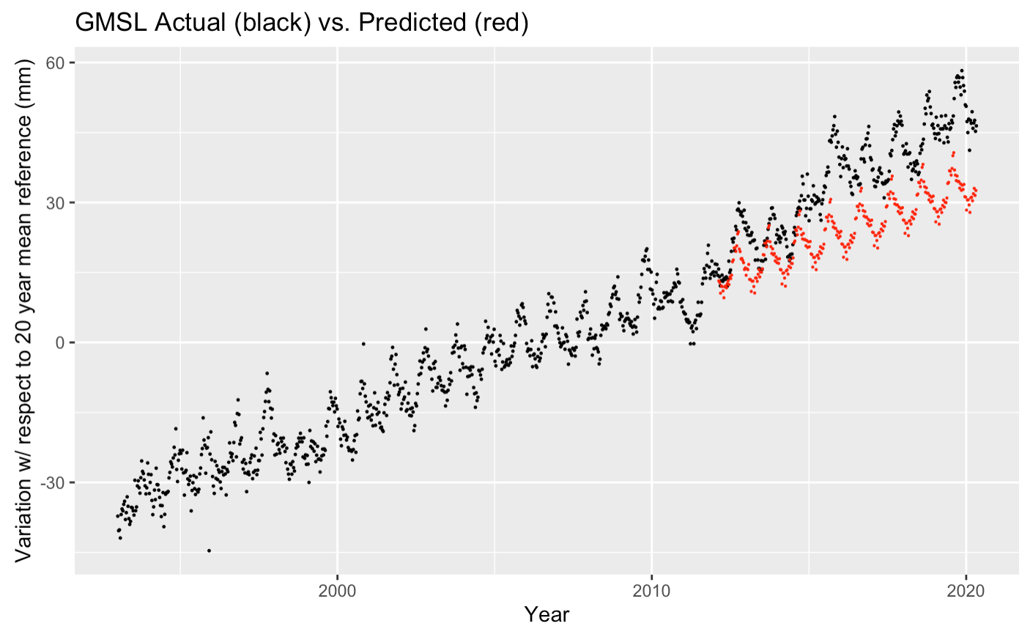
Visualizations of Prediction based on SARIMA model:
Notes:
The prediction looks pretty good. UNTIL, you see the predicted vs. the actual test data.
It appears that the Sea Level rate increased right where the 70%/30% split is.
Temperature would be the next logical predictor to bring into this model. Temperature obviously affects the density of water, and also affects how quickly the various ice sheets are melting.

Slide 11
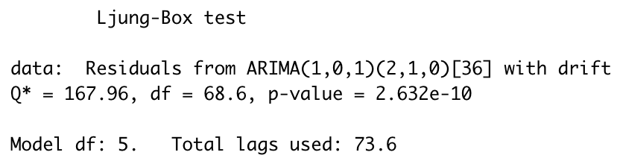
“Goodness of Fit” Results
How does the predicted values from the SARIMA model compare to the actual Test Set.
Ljung-Box Test: The small p-value suggests that the model shows a lack of fit.
R-Squared Test: 76%. R-Squared is the percentage of the variation between predicted and actual data points explained by a linear model. In general, the higher the R-Squared, the better the prediction.
MSE (Mean Square Error): 157.5. In general, smaller MSE values are better. The squaring can heavily weight larger differences. This may not be a good test for TS data.
MAPE (Mean Absolute Percentage Error): 29.6%. A measure of the size of the error in the model in percentage terms.
Notes:
Various methods to check test set against the predicted outcome.
The Ljung-Box test: The null is that our model DOES NOT show a lack of fit. We can reject that, meaning there is evidence of lack of fit.
R-Squared Test:
MSE: Mean Square Errors: Is the average absolute percent error for each time period minus actual values divided by actual values. Can be influenced by extreme values and by 0s in the data.
MAPE

Slide 12
Conclusion
SARIMA is an effective tool for predicting univariate seasonal
time series data.
The model prediction is only as good as the train set.
Many other factors, including global temperatures, also affect sea level.
What about my DE home?
My home is at an elevation of 4m, a few km from the beach.
Based on this SARIMA model, the home will be at sea level in the year 3296.

