Slide 1
presentation

Slide 2
Title:
AI-Based Management of Food Wastage
Subtitle: Addressing Food Waste in Hostel Messes

Slide 3

Introduction

Slide 4
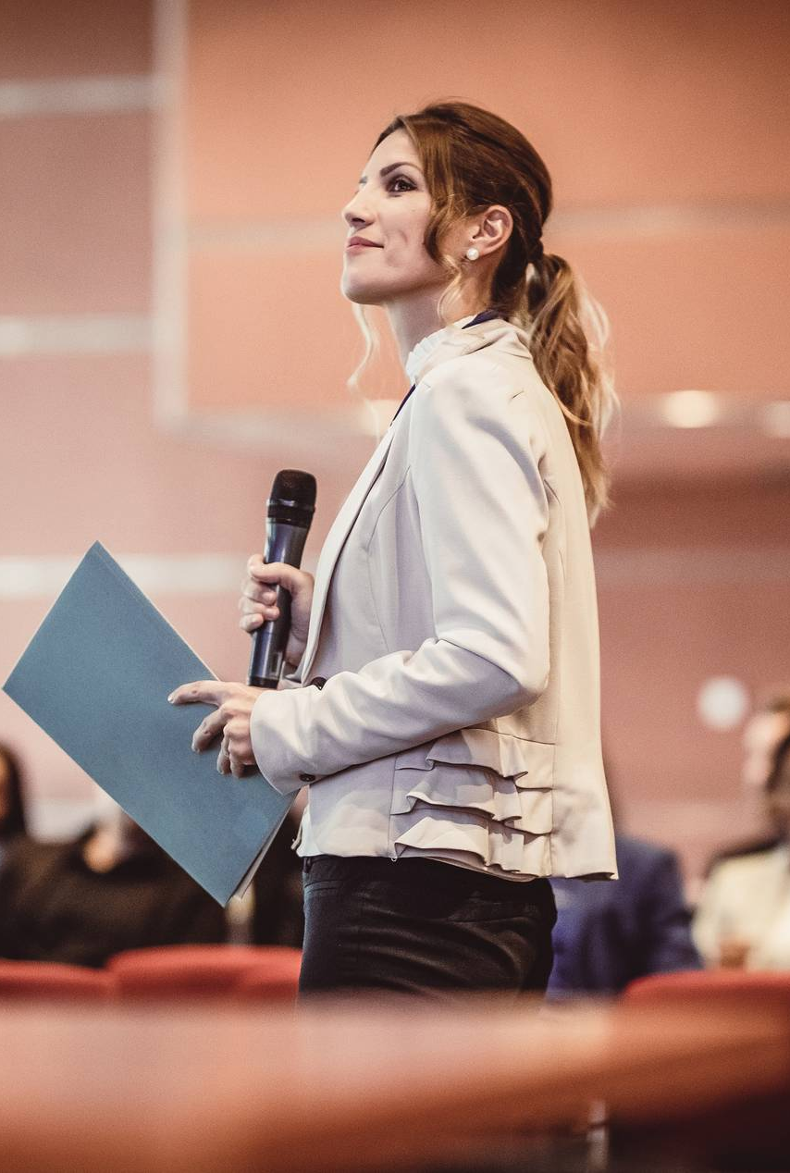
Overview of the Problem:
Despite enough food production, 820 million people suffer from hunger.
Food waste generates greenhouse gases, contributing to climate change.
Example: 3.3 billion tons of CO2 are produced annually from food wastage.

Slide 5
Objectives
Research Objectives:
Decrease food wastage using AI.
Implement a model in university hostels to minimize food waste.
Specific Goals:
Data collection and analysis.
Development of a predictive model.
Application and continuous improvement.

Slide 6
Literature Survey
Related Work:
Various methods for predicting solid waste generation.
Use of machine learning techniques (SVM, kNN).
Previous projects and research on food waste management using AI and data analysis.

Slide 7
Problem Formulation
Problem Statement:
Managing food wastage in hostel messes using AI.
Specific challenges in measuring and reducing food waste.
Proposed Solution:
Development of an AI model to optimize food preparation and minimize waste.

Slide 8

Proposed Scheme
System Overview:
Creation of a general model for food wastage management.
Use of algorithms to detect patterns in food preparation and consumption.
Implementation Steps:
Arduino-based system for data collection.
Continuous monitoring and adjustment of food preparation.

Slide 9

Methodology
Steps Involved:
Detailed study and data collection.
Data cleaning and integration.
Identification of AI parameters.
Model development and comparison with existing systems.

Slide 10
Technologies and Tools
Hardware:
Arduino: For counting the number of plates and monitoring food wastage.
Software:
Machine Learning Algorithms: SVM, kNN, Decision Trees.
Data Analysis Tools: Python libraries (Pandas, NumPy, Scikit-learn).
Data Visualization: Tools like Matplotlib and Seaborn.
Data Collection:
Sensors: Arduino-connected sensors to measure food wastage.
Surveys: Online and face-to-face questionnaires for qualitative data.

Slide 11
System Architecture
Data Collection:
Use Arduino sensors to count plates and measure food waste.
Collect data from surveys and observations.
Data Processing:
Clean and integrate data.
Use machine learning algorithms to analyze data.
Model Development:
Train predictive models to forecast food requirements.
Use iterative testing to improve model accuracy.
Implementation:
Apply the model in hostel messes.
Monitor results and adjust as needed.

Slide 12
Workflow
Data Collection:
Arduino System: Measures number of plates and quantity of food wasted.
Surveys: Collect qualitative data on food consumption habits.
Data Processing:
Integration: Combine data from different sources.
Cleaning: Remove inconsistencies and ensure data quality.
Model Training:
Algorithm Selection: Choose appropriate machine learning algorithms (SVM, kNN, Decision Trees).
Training: Train models on collected data.
Prediction and Adjustment:
Prediction: Use trained models to predict food requirements.
Adjustment: Adjust food preparation based on predictions.
Monitoring:
Feedback Loop: Continuously monitor food wastage and model performance.
Improvement: Refine models based on new data.

Slide 13
Results
Findings:
Reduction in food wastage in hostel messes.
Improved accuracy in predicting food requirements.
Economic and environmental benefits.
Key Insights:
Effective use of AI can significantly reduce food wastage.
Importance of continuous data collection and model refinement.

Slide 14
Conclusion
Summary:
AI-based models can effectively manage food wastage.
Importance of integrating hardware and software solutions.
Future Work:
Scaling the model to other institutions.
Integration with broader waste management systems.

Slide 15
Thank you

