Slide 1
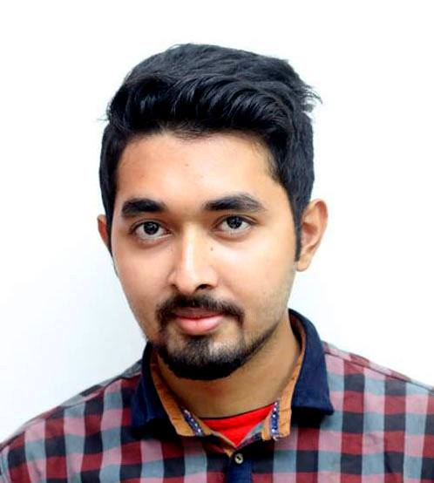







MD.NAZMUL
+8801724960086
ISLAM
polen5895@gmail.com
Polen Ershan
Web Developer
md-nazmul-islam-329283158/
Bachelor of Science Study (B.sc)
University Private University
Institute Independent University ,Bangladesh
Subject Major : Computer Science (CS)
Minor : Marketing
Result CGPA -2.75
Year 2014-2018
Higher Secondary Certificate Examination (H.S.C)
Institute Govt. Tolaram College
Result GPA – 5.00
Year 2013
Group Science
Board Dhaka
Education
Experience
Junior Web Developer AdaSoft International Limited
Length 2018 to present
Customer Care Representative Banglalink
Length 2016-2017
Computer Language Proficiency
Project
Skill
ASP.NET
C#
JAVA
HTML.CSS
PHP
Café Management System
Ada Service TraCker

