Slide 1
FINIRAG
Document Intelligence
Platform
DOCUMENT
→
AI Engineer Internship • Technical Case Study
EXTRACT
PDF / JPG / PNG
4 document types
AI + rules
✓
VALIDATE
Candidate
Poli Reddy
Mistral OCR • Gemini • Groq
FiniRAG • AI Engineer Case Study
01

Slide 2
Problem Statement
Turn heterogeneous financial documents into trustworthy, reviewable structured data.
Layout-heavy inp
Semantic ambigui
Scanned images, vector-outlined PDFs, tables and multi-page statements.
Missing ≠ zero ≠ unreadable; tax-inclusive totals, discounts and units need context.
Financial correc
Operational deli
Extraction alone is insufficient: arithmetic must be checked deterministically.
Persist attempts, expose APIs, provide history/dashboard and deploy the system.
Input: PDF/JPG/PNG • User selects type: Invoice / Balance Sheet / P&L / Cash Flow • Max 3 pages • Max 10 MB
FiniRAG • AI Engineer Case Study
02

Slide 3
Solution Overview
A provider-abstracted pipeline separates AI extraction from deterministic financial truth.
01
02
03
04
05
06
File Gate
Text / OCR
Structured AI
Canonical Model
Financial Rules
Persist + Serve
Signature, readability,
size + page checks
Native PDF probe
or Mistral OCR
Gemini primary
Groq fallback
Pydantic + normalization
+ evidence
Decimal arithmetic
PASS / FAIL / N/A
PostgreSQL + FastAPI
+ dashboard
AI reads
Rules decide
Evidence stays
LLMs handle visual/text understanding and schema extraction.
Python Decimal validators own arithmetic and reconciliation.
Original representation, page and source text remain attached.
FiniRAG • AI Engineer Case Study
03

Slide 4
Architecture Diagram
Single FastAPI service serves the dashboard, API and processing pipeline; PostgreSQL stores attempts.
HTML / CSS / JavaScript Frontend
FastAPI • REST API • Swagger
File Validation
Text Extraction Router
PostgreSQL
PDF / JPEG / PNG • 10MB • 3 pages
Native PDF probe ↔ Mistral OCR
JSONB results • attempts • history
Mistral OCR → Gemini extraction → Groq fallback → Pydantic normalization → Evidence → Decimal validation
FiniRAG • AI Engineer Case Study
04

Slide 5
Document Processing Pipeline
Each stage has a clear responsibility; failures remain explicit instead of being silently converted.
01
02
03
04
05
06
07
08
Upload
Validate
Extract text
AI extract
Normalize
Ground
Validate
Persist
Read bytes
sanitize filename
Magic/signature
readability • limits
Native PDF
or Mistral OCR
Typed JSON
all meaningful fields
Decimal values
units • signs • status
Source text
page + evidence
Financial formulas
PASS / FAIL / N/A
PostgreSQL
latest + history
Field state model
Evidence payload
Persistence
EXPLICIT
EXPLICIT_ZERO
Original source text
Page number • optional block/box
One row per processing attempt
Latest-by-name retrieval
MISSING
UNREADABLE
FiniRAG • AI Engineer Case Study
05

Slide 6
AI / OCR Extraction Approach
Mistral OCR handles visual document reading; Gemini structures the result; Groq provides fallback capacity.
Primary OCR
Primary LLM
Fallback LLM
Mistral OCR
Gemini
Groq
49/50 dataset docs
47/50 dataset docs
3/50 dataset docs
Layout-aware OCR blocks • page text • block confidence • bounding-box support
Structured extraction into document-specific Pydantic schemas
Provider fallback for quota/rate-limit/parse-oriented failures
Routing observed in the 50-document run
Trust boundary
49
1
LLM = extraction authority for structure. Python Decimal = arithmetic authority.
Mistral OCR
native PDF text
FiniRAG • AI Engineer Case Study
06

Slide 7
Financial Validation
Deterministic Decimal checks distinguish genuine inconsistencies from extraction ambiguity.
Invoice / Receipt
Balance Sheet
Profit & Loss
Cash Flow
• quantity × unit price
• discount-aware line totals
• subtotal / tax / total
• tax-inclusive readings
• cash − total = change
• assets ≈ capital + liabilities
• asset component sums
• liability component sums
• each period independently
• income components
• expenditure components
• profit / minority reconciliation
• appropriation equation
• carried-forward balance
• operating / investing / financing
• section component sums
• opening + net increase
• FX / amalgamation guards
• closing cash reconciliation
Dataset regression example
batch3-1495
$3,480 line sum
vs $5,257 total
FAIL
The validator preserves the inconsistency instead of weakening rules to force PASS.
FiniRAG • AI Engineer Case Study
07

Slide 8
API + Database + Deployment
A single Render web service serves the frontend and API, backed by Render PostgreSQL.
REST API
PostgreSQL
Render
POST
/api/v1/documents/process
Upload + process
documents
JSONB payloads
Web Service • free plan
GET
/api/v1/documents/{document_name}
Latest result
PostgreSQL • free plan
Every processing
attempt is retained
GET
/api/v1/documents
History / attempts
Health check
/api/v1/health
GET
/api/v1/health
API + DB health
latest-by-name
Swagger: /docs
Frontend: /
Operational boundary: secrets via environment variables • no raw files persisted • historical attempts preserved
FiniRAG • AI Engineer Case Study
08

Slide 9
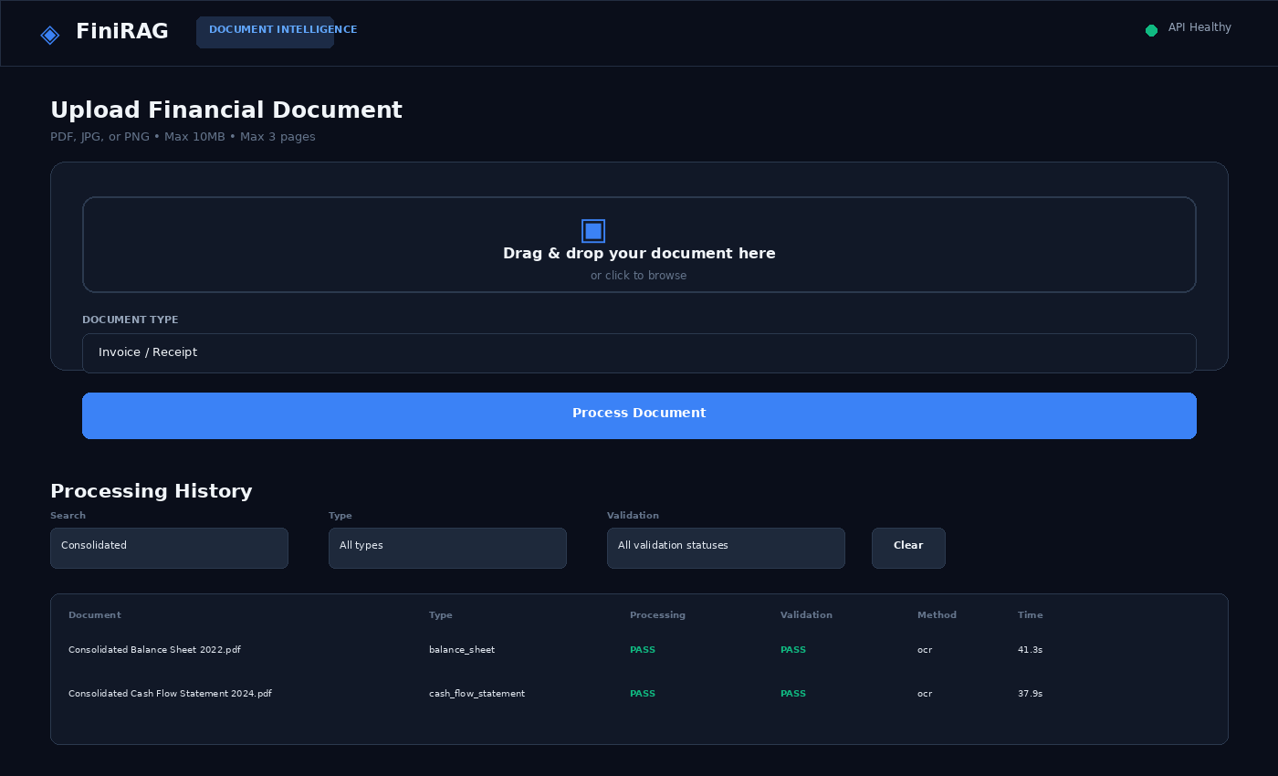
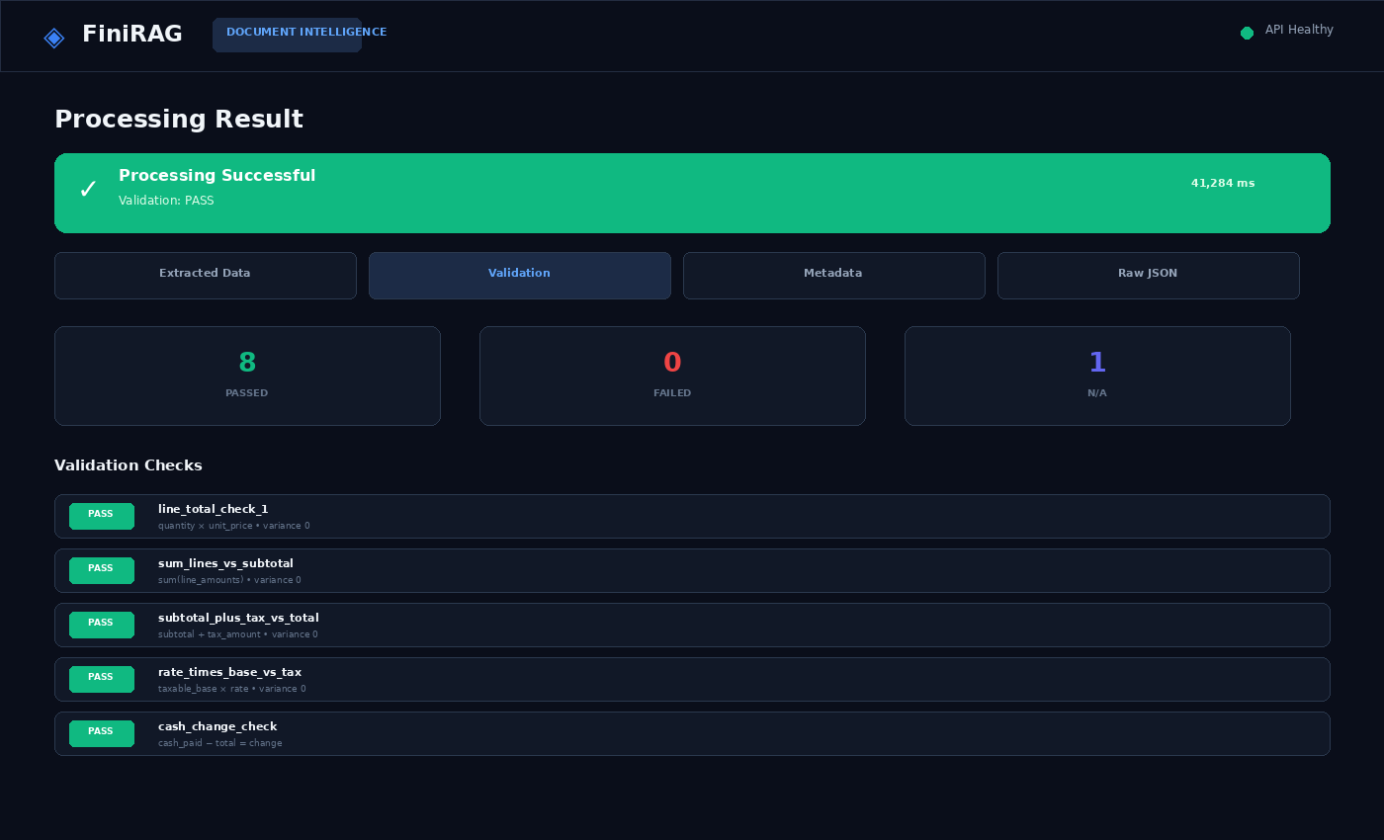
Frontend Screenshots / Demo
Implemented HTML/CSS/JavaScript dashboard: upload, processing result, validation, metadata, raw JSON and history.
Upload + processing history • representative render of current UI
Result + validation view • representative render of current UI
FiniRAG • AI Engineer Case Study
09

Slide 10
Testing + Limitations + Future Improvements
The current repository is feature-complete for the case study, with clear production hardening opportunities.
TESTING & EVALUATION
CURRENT LIMITATIONS
FUTURE / PRODUCTION
• Evidence has source text + page, but block-level verification is not yet reliable for every field.
• Provider latency and free-tier availability can vary.
• History search/filtering is client-side over the loaded dashboard page.
• Authentication, rate limiting and background jobs are deferred.
• Database migrations are deferred in favor of startup table creation for the prototype.
• Verified OCR block-to-field grounding + bounding boxes.
• Background queue/workers for long-running document processing.
• Alembic migrations + stronger DB operations.
• Authentication, authorization, rate limits and audit logging.
• Provider circuit breakers, observability and staging E2E tests.
50/50
47/50
processing PASS
validation PASS
290
3
test functions
intended FAILs
350 PASS • 10 FAIL • 56 N/A
2,665 field slots measured
980 line items extracted
Bottom line: correct extraction + explicit uncertainty + deterministic validation — without weakening rules to manufacture PASS results.
FiniRAG • AI Engineer Case Study
10

