Slide 1
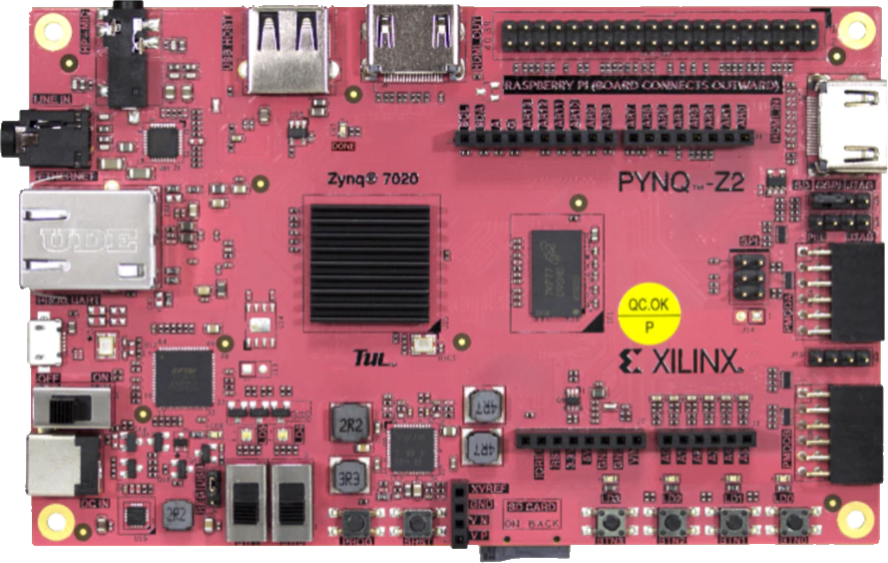

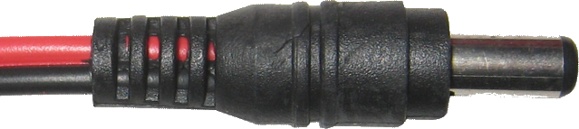
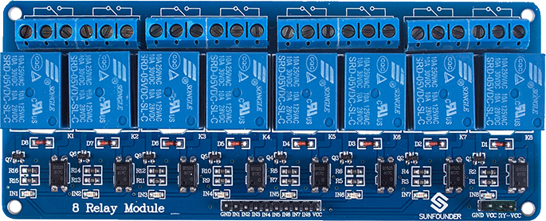
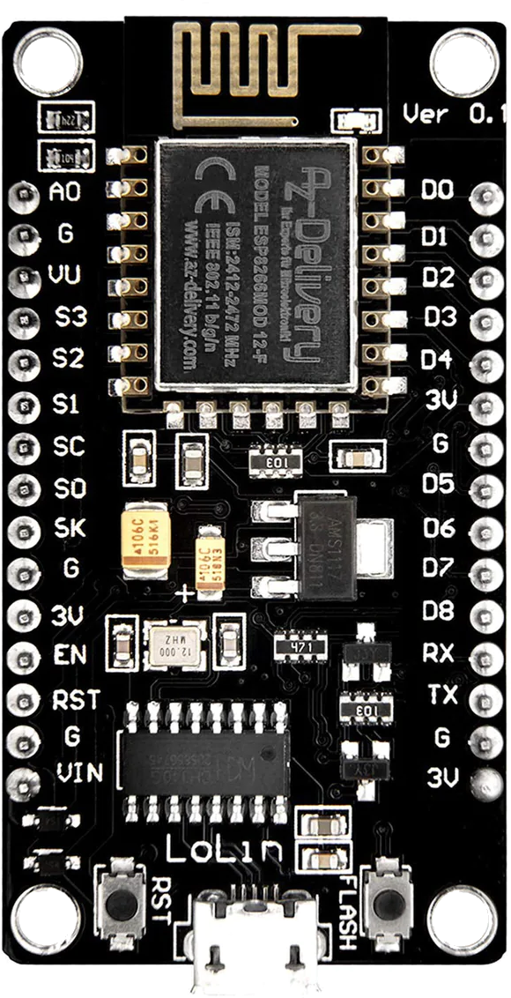
FPGA/MPSoC Cluster
Power Supply
12V-5A (min)
1
-
+
2
Monitoring
Computer
3
4
5
6
NodeMCU V3 (ESP8266)
7
8
Serial-USB (UART)

Slide 2
Pin | Connect to
D0 | Relay IN-1
D1 | Relay IN-2
D2 | Relay IN-3
D3 | Relay IN-4
D5 | Relay IN-5
D6 | Relay IN-6
D7 | Relay IN-7
D8 | Relay IN-8
3V | Relay Ctrl VCC
G | Relay Ctrl GND
NodeMCU V3 (ESP8266)

