Slide 1



Computing Public Policy for Everyone
Re-imagining how to engage policy professionals
April 2025

Slide 2
AGENDA
1 | PolicyEngine Vision
2 | UX Research Overview
3 | Key Findings
4 | New Design
5 | Future Roadmap

Slide 3
PolicyEngine Vision and Mission
Need vision and mission from Max and Anthony
Focus of UX research
Web App
TBD
Vision
TBD
API
Mission
TBD
TBD
Open Source Community
TBD

Slide 4
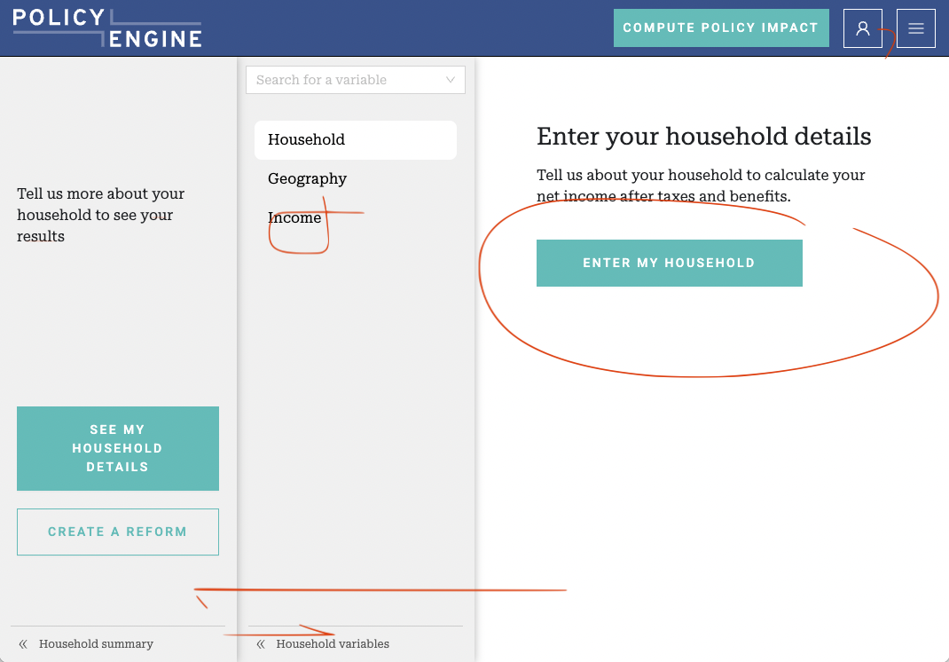
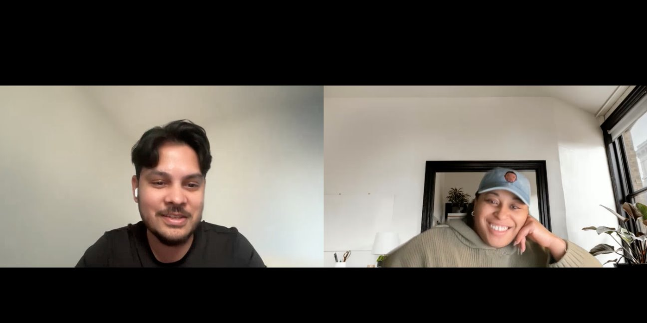
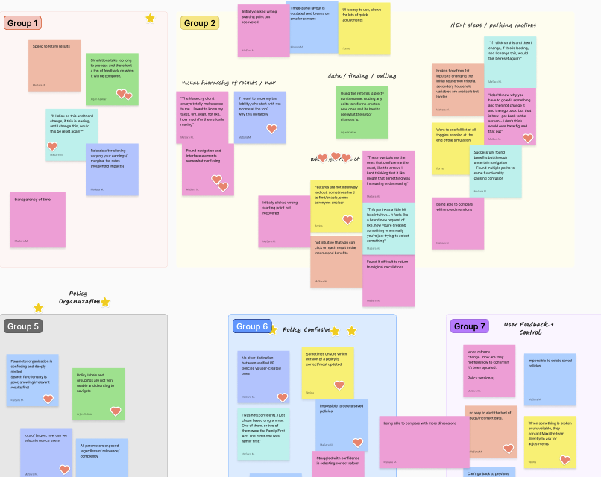
UX Research Overview
Objectives
Understand how users have been engaging with the PE app, identify pain points in the usage, collect feedback on user experience, and design a new experience.
Participants
Policy analysts
Economists
Researchers
Journalists
PolicyEngine team
Novice users
Niskanan Center
Gary Ventures
Northwestern University
EPCC
Brookings Institute
Vox Media
Methods
Stakeholder interviews
User interviews
Usability testing / Observations
UX audit
Affinity Mapping
User Archetype Analysis

Slide 5
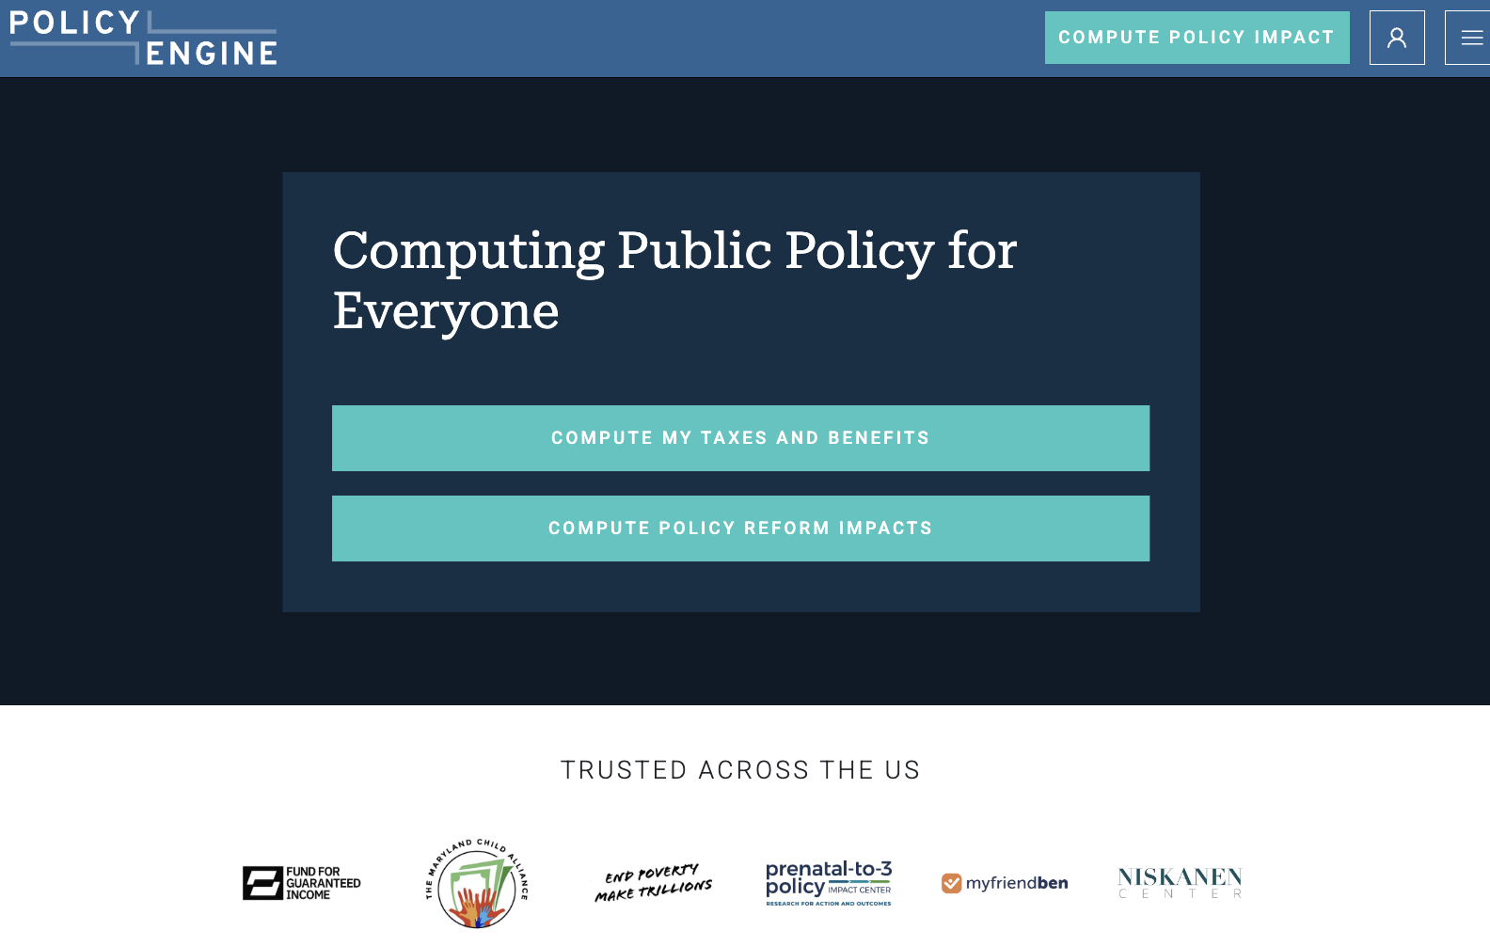
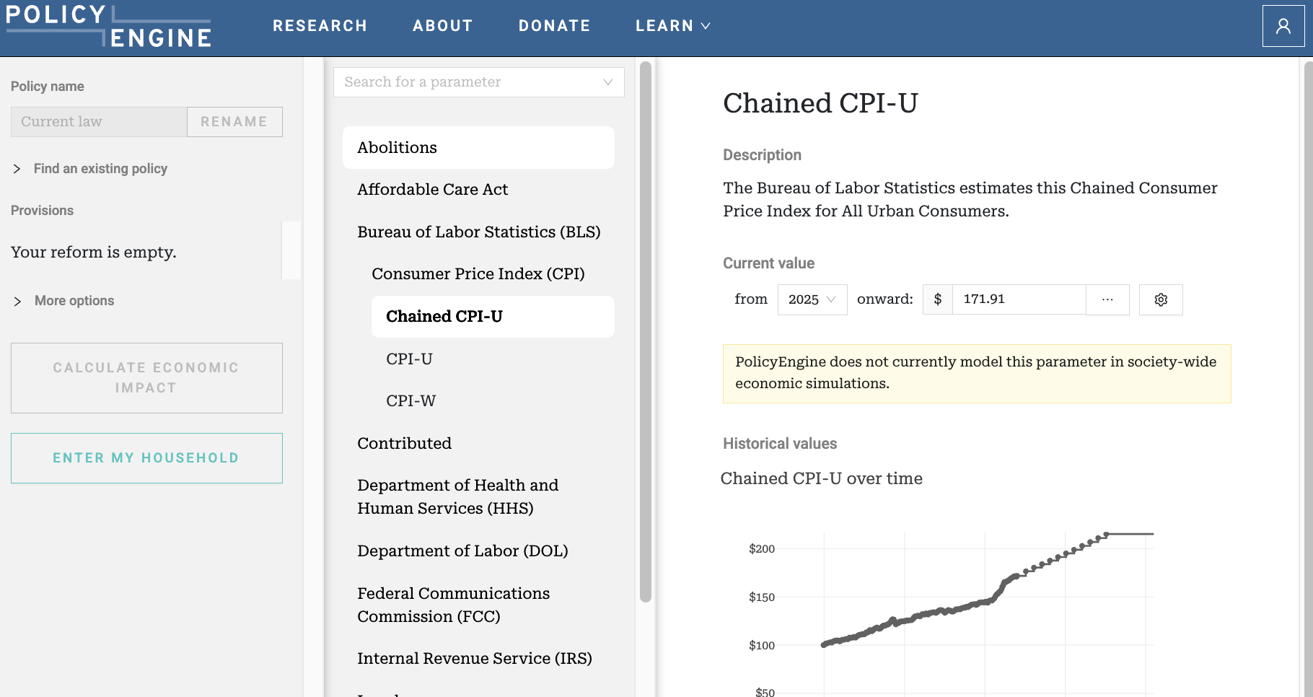
Key Findings – Current experience
What users like
Open source; not a ‘black box’
Easily able to use and share work
Having a UI for people who don’t know how to code (or know python); not just for programmers
Being able to quickly test out different hypotheses
Ability to add reforms and contribute to the PolicyEngine library
Progress that’s been made over the past year with bugs and model output
Responsiveness from the pe team
One of a kind. “There are probably 5 other tools but they are either in the government or proprietary”
What users wish for
Policy Organization
Insight: Users found the search functionality and parameter structure confusing.
Policy Confusion
Insight: Users were sometimes unsure which version of a policy was correct or most up-to-date and wanted more control over their actions. Users wanted the ability to identify vetted reforms and differentiate between other user-submitted reforms.
Feedback & Community
Insight: Notifications and pop ups were unclear or broken (deprecated policies, sign in to save). New users and some power users were unaware of the PE Slack, limiting their ability to communicate feedback.
UI + User Flow​
Insight: Users struggled to navigate the app in a clear, concise manner.
Familiarity
Insight: Users felt the need to be familiar with the tool in order to use it accurately.

Slide 6
Key Findings – User Archetypes
Power User (Policy Analyst)
Niche User (Policy Expert)
Light User (Connected Citizen)
Analytical / Competitive / Independent / Speed-oriented / Accuracy-focused
Methodical / Validation-focused / Institution-aligned / Bridge between technical and policy worlds
Digitally native / Time-conscious / Value-oriented / Social sharer / Policy-curious / Solution-focused
Goals
Establish and maintain policy domain expertise
Shape policy through timely analysis and creative ideas
Build influence through speaking and thought leadership
Be first to market with new policy perspectives
Frustrations
Rigid analytical tools limit comparative analysis
Constraints of "closed box" systems
Barriers to quick iteration and scenario modeling
Behaviors
Desires swift analysis while maintaining high accuracy
Networks actively through conferences and policy hearings
Continuously monitors policy landscape
Conducts independent, multidimensional research
Prioritizes efficient, cost-effective analytical tools
Goals
Model specific tax policy issues and specific populations
Provide evidence-driven analysis for policy positions
Present findings to technical and non-technical audiences
Frustrations
Version control challenges and time-consuming parameter updates
Difficulty explaining methodologies/ limited coding expertise
Complex handoffs to assistants and extensive validation time
Balancing rapid analysis needs with thorough research needs
Behaviors
Validates outputs against benchmarks and documents methodology meticulously
Tests multiple policy variations
Alternates between rapid analysis and deep research
Collaborates with research teams and diverse stakeholders
Goals
Calculate personal tax/benefit impacts quickly and understand policy effects on their household
Navigate tax reform news with confidence
Share concrete numbers within social circles
Frustrations
Tax calculators are either too basic or overly complex
Difficult to find trustworthy, free tax impact tools
Policy jargon obscures actual financial impacts
Limited ability to test "what-if" scenarios or save/share
Needs quick answers but often gets lost in technical details
Behaviors
Mindset of Journalists and ‘citizen researchers’
Visits during policy news cycles
Uses calculator for individual household analysis
Cross-references findings with social media discussions
Prefers visual breakdowns of tax impacts

Slide 7
Guiding Principles for Redesign:
Unlocking the full potential of PolicyEngine for all.
Build confidence quickly with new and niche users | Smooth the path to successful outcomes | Supporting core user base with enhanced features

Slide 8

UX Areas of Opportunity
Build confidence quickly with new and niche users​
Unified Policy Navigation Architecture
Contextual Feature Discovery
Enhanced Calculation Status System
Redesign the policy navigation to be crystal clear​
Help users find the right features for their needs
Show users their progress and celebrate successes
Smooth the Path to Successful Outcomes
Contemporary Interface Evolution
Cross-Product Navigation Framework
Accelerated Time-to-Value Experience
Bring the interface into 2025 with modern design patterns
Connect the dots between policy actions and household calculations
Make success instant for first-time users​
Support Core Power Users with Enhanced Features
Personalized Power User Workspace
Create personal workspaces for power users’ research

Slide 9
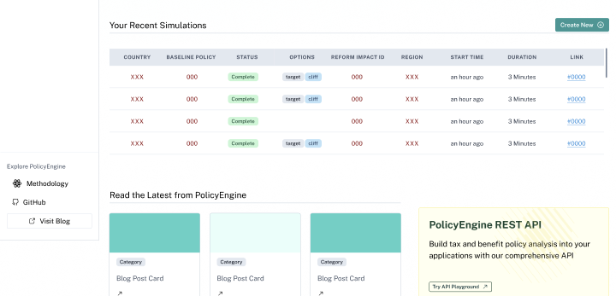
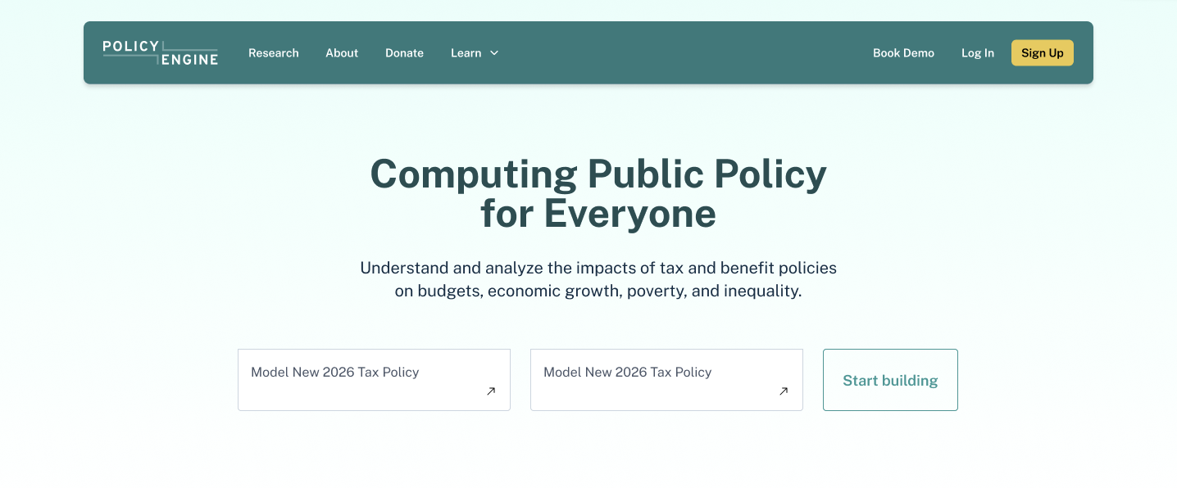
Prototype walk through on this page
The New PolicyEngine Platform
Unlocking the full potential of PolicyEngine for all.

Slide 10
Exciting future – Feature Roadmap
Today
Tomorrow
Future
Build confidence quickly with new and niche users​
Smooth the Path to Successful Outcomes
Support Core Power Users with Enhanced Features

Slide 11
Will delete this page and incorporate into prior page
Areas of Opportunity
Initial Ideas
Unified Policy Navigation Architecture | Contextual Feature Discovery | Enhanced Calculation Status System | Contemporary Interface Evolution | Accelerated Time-to-Value Experience | Cross-Product Navigation Framework | Contemporary Interface Evolution
Improve organization and separation of input controls and information displays | Add clear visual distinctions between existing policies and user simulations | Implement comprehensive notification system for completed actions and updates | Implement Slack integration for user feedback | Create streamlined user onboarding to collect essential information | Optimize household setup and configuration process | Implement Slack integration for user feedback
Optimize policy organization structure | Enhance data visualization and navigation system | Display output availability and status indicators | Update visual hierarchy for modern standards | Simplify complex terminology throughout the platform | Provide real-time impact analysis during reform creation | Update visual hierarchy for modern standards
Enhance reform selection and comparison experience | Ensure consistent and clear call-to-action messaging | Show simulation progress with estimated completion times | Enhance data visualization layouts | Enhance approachability of complex topics | Connect household process to reform selection seamlessly | Enhance data visualization layouts
Streamline reform creation and editing workflows |  | Create automated policy change notification system | Modernize input controls and form patterns | Implement standard household profiles for quick comparisons |  | Modernize input controls and form patterns

