Slide 1


PolicyEngine
[UPDATE FOR EVENT]
Max Ghenis, Co-founder and CEO
Nikhil Woodruff, Co-founder and CTO
2025-05-29
Notes:
Intro ourselves
Empowering policymakers and the public with high-quality evidence

Slide 2
Agenda

Slide 3
VAT analysis with synthetic firm microdata
Notes:
Intro ourselves
Empowering policymakers and the public with high-quality evidence

Slide 4
VAT threshold reform and synthetic data
The UK requires businesses to register for VAT and charge 20% on sales once annual turnover exceeds £90,000, an increase from £85,000 in 2024–25.
There is active policy debate about whether the VAT registration threshold should be increased further.
We analyse the effects of different VAT registration thresholds and smoothed phase-ins on revenues and the number of VAT-registered firms.
We calibrate synthetic firm microdata using ONS UK Business Statistics for firm distributions and HMRC VAT Statistics for VAT-registered business profiles.

Slide 5
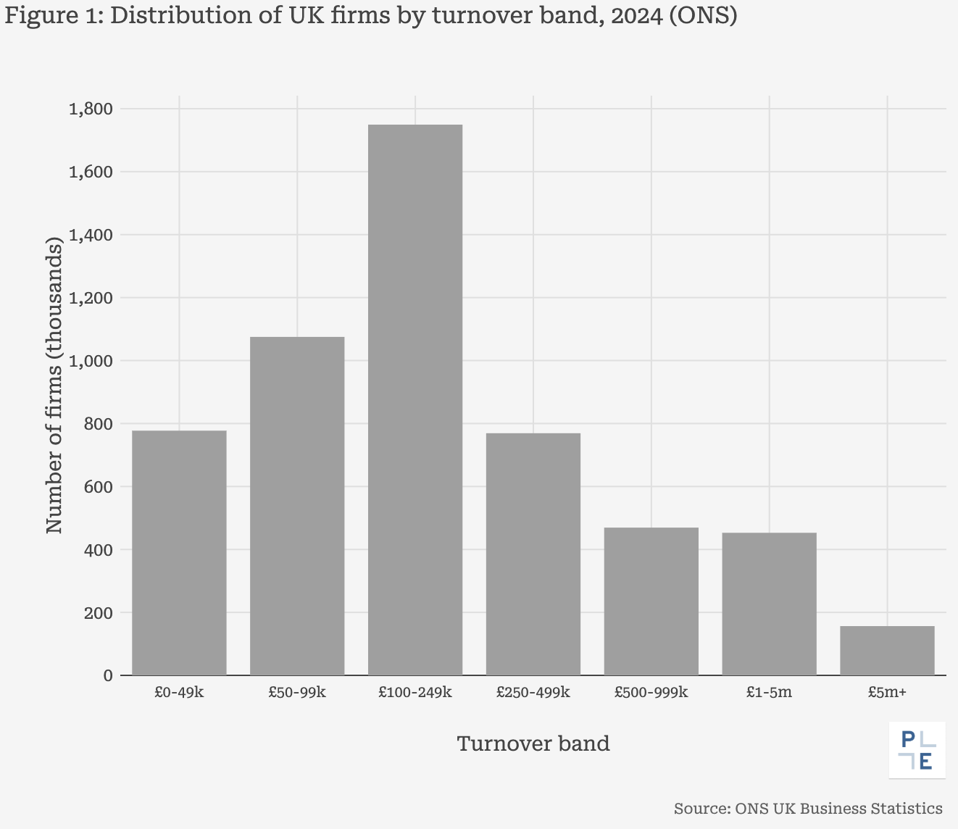
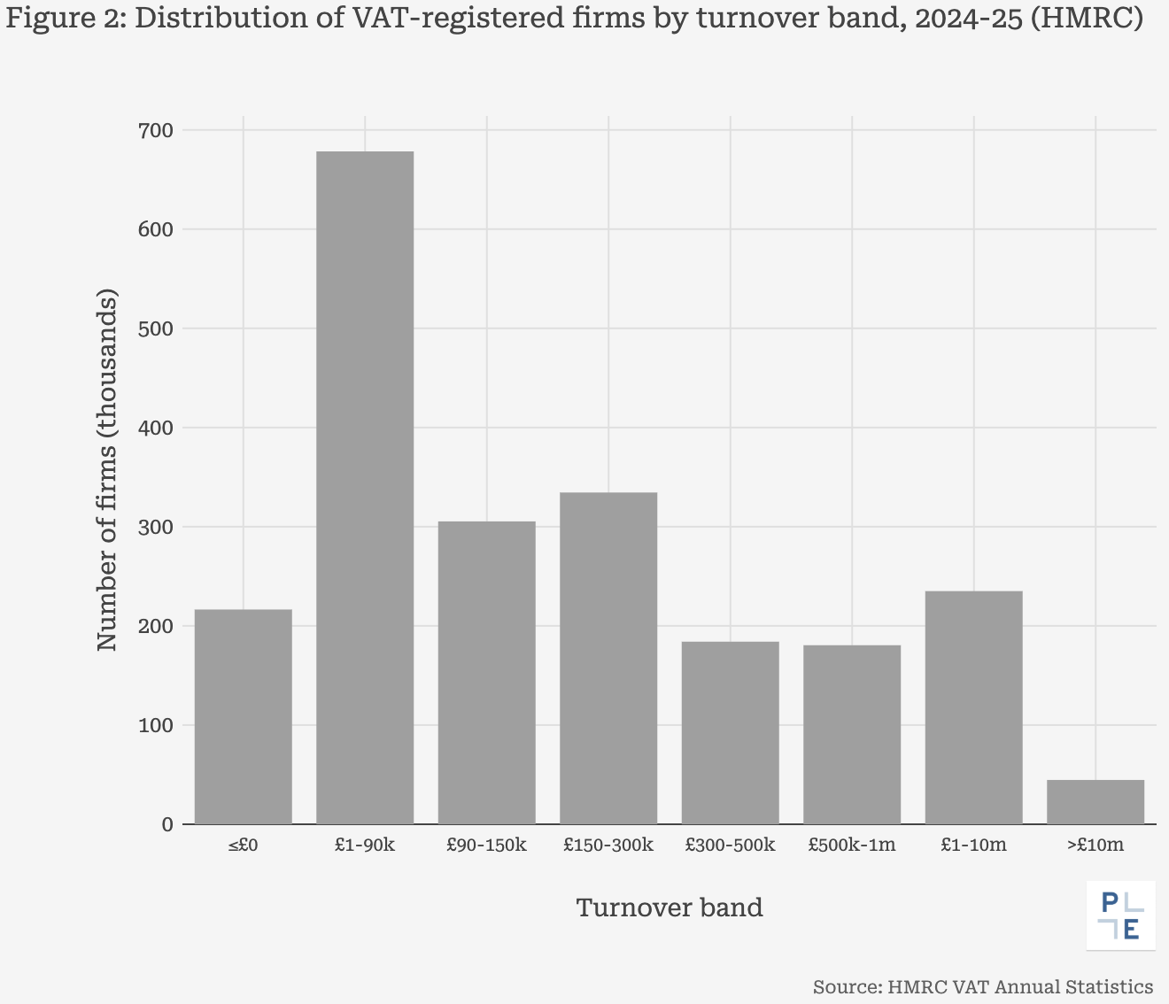
Firm turnover distribution (ONS and HMRC)

Slide 6
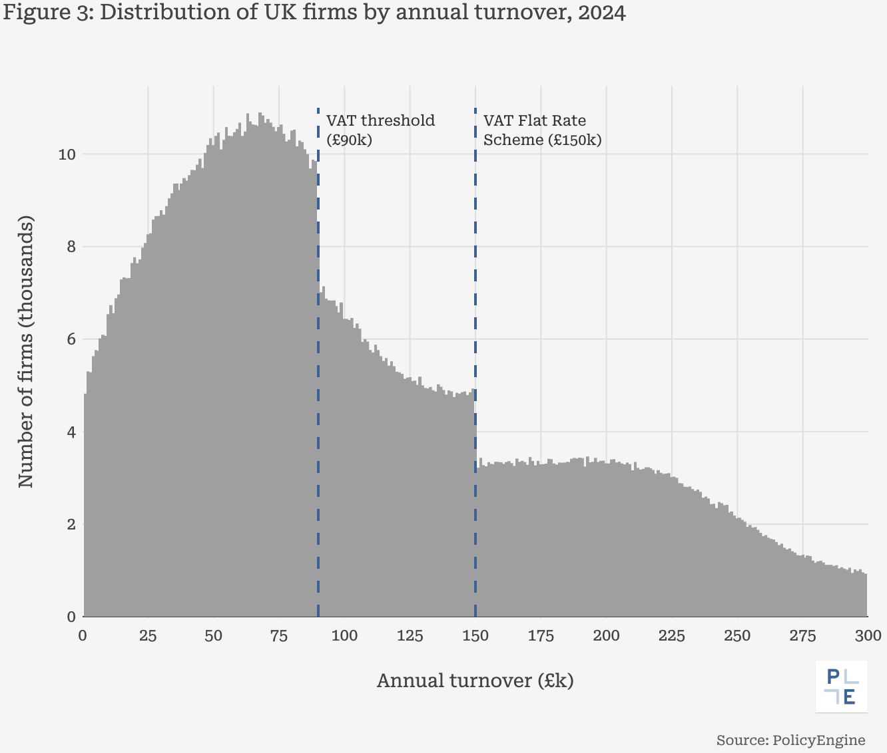
Firm-level microdata
We construct synthetic firm microdata using weight optimisation and multi-objective calibration to match ONS firm structures and HMRC VAT profiles.
We capture turnover, sector, employment size, and VAT liability with over 200 calibration targets.

Slide 7
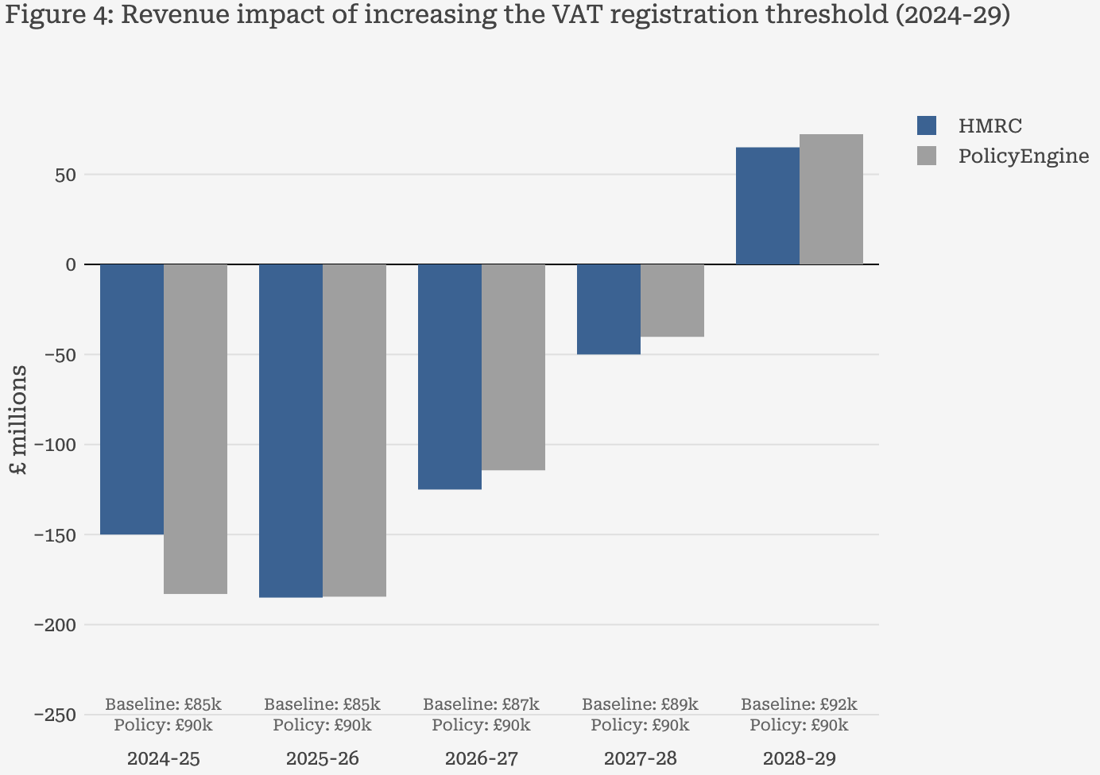
Comparison with HMRC projections
We benchmark our results against HMRC's published projections for raising the VAT threshold from £85k to £90k.
We apply OBR Retail Price Index growth to firm turnover and VAT liabilities, holding firm counts constant and assuming no behavioural responses.

Slide 8
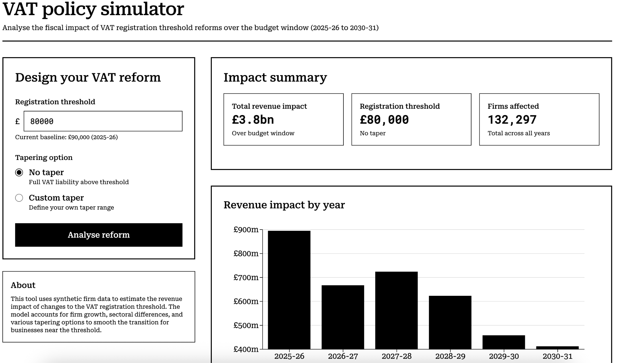
Static simulation dashboard

Slide 9


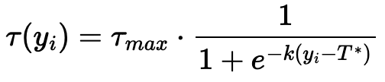
Firm VAT dynamic modelling
Firms respond to tax incentives! We extend the model to capture behavioural responses.
Firms maximise profits by choosing output:
Firms choose output where marginal revenue net of VAT equals marginal cost.
We assume a Cobb–Douglas production technology:
This lets us back out firm-specific marginal costs from observed input and output data, capturing heterogeneity in productivity across firms.
We model VAT using a smooth sigmoid tax schedule:

Slide 10

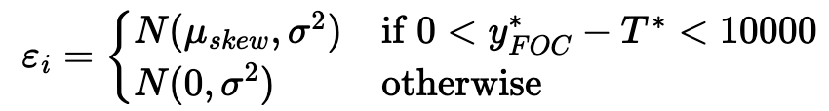
Behavioural extension and elasticity
Extension: We incorporate asymmetric uncertainty around the threshold to capture realistic firm variation:
No-notch: We follow the bunching literature (Saez, 2010; Chetty et al., 2011; Kleven & Waseem, 2013; Liu & Lockwood, 2015) by fitting a smooth polynomial to the turnover distribution.
Elasticity Estimation: We find the mapping from each firm’s real-world turnover to its turnover under the counterfactual scenario (here, the no-notch distribution), and then estimate elasticities.

Slide 11
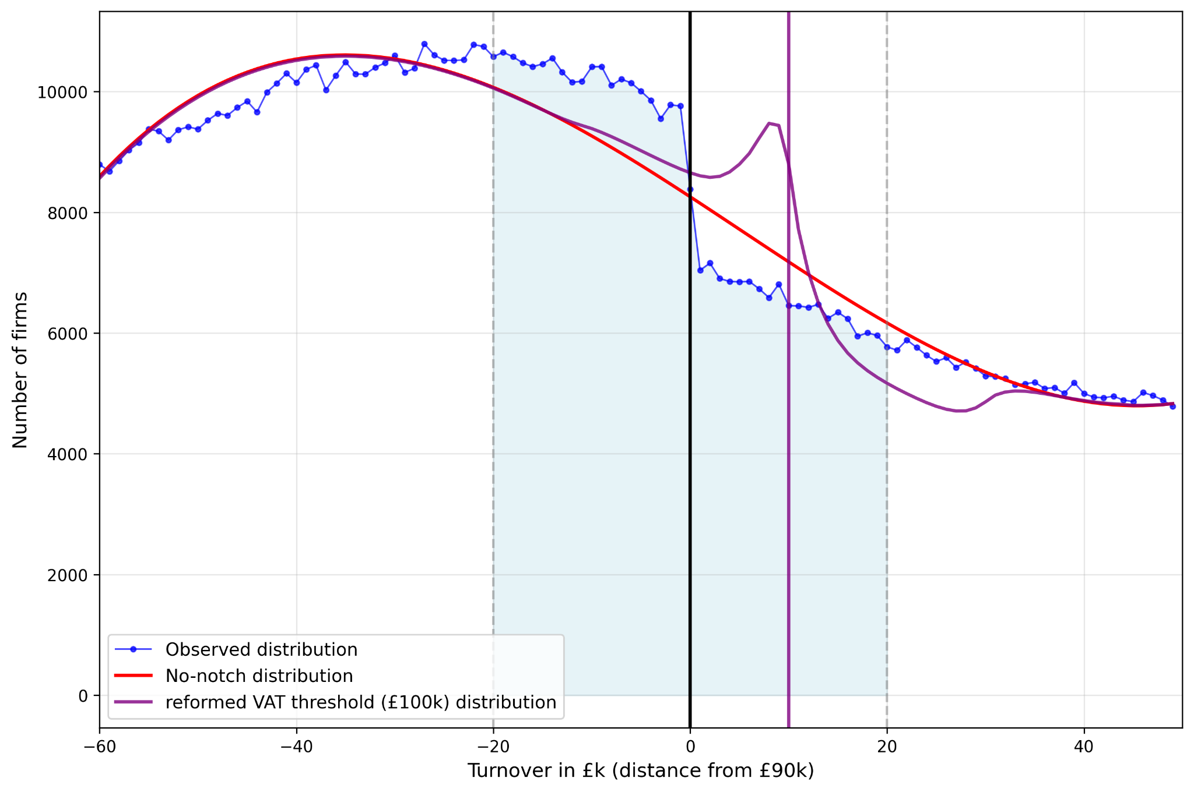
Turnover distributions

Slide 12
Questions

