Slide 1

Reducing medication harm through high quality images Jovan Krstik, Ahmed Marmoush, Nee Ker Ling, Bojana Mincheva Krstikj, Mireya Marte Pepen, Ayman Al-Ibousi, Sarah Marmoush

Slide 2
Our story and mission
Story
Idea started at the Auckland healthcare hackathon 2016 organised by Karen Day
Mission
Improve current state of NZ health literacy
Provide an easy to utilise medication image database to be used in the public and private sector
Non-profit sector to benefit from our services with a permissive creative commons licence. Licence type: CC BY-NC-ND

Slide 3

Context: Medication safety remains a significant issue in New Zealand, accounting for a large number of avoidable deaths
Research on the impact of medication related errors in New Zealand has highlighted that in previous years up to:
Where are medication errors occurring most frequently?
In situations where someone becomes acutely unwell and the complexity of treatment increases
Polypharmacy, affecting the elderly and those with chronic conditions disproportionately
Transitions of care, estimated as up to 25% in NZ e.g. when a patient moves between hospital and the community
44,954 people are severely harmed ¹
2,247 avoidable deaths ¹
$222.5m in cost to the NZ health system for a preventable adverse drug events ¹

Slide 4

Opportunity: Medication images can provide an additional layer of reconciliation at the point of administration, reducing the risk of harm
What do we mean by a Medicines image database?
A repository of medicines images that are of sufficient quality to assist in the accurate identification of medicines, and can be accessed for free at our website: www.medlook.org
The database today:
Contains over 1,200 medicines images of formulations approved for supply in New Zealand and increasing daily
Is API enabled, meaning any provider or software vendor can access these through our service
Is fully aligned with the TPUU field in the NZULM
The potential impact:
Patient Safety
Provides an additional medication reference to reduce preventable dispensing errors
Patient Empowerment
Can link with patient information leaflets to support the safe use of medicines
Service Integration
Can link with rest home or other provider systems to support nurses with the safe administration of medicines
Service Efficiency
Reduces medicine checking time and improves dispensary efficiency

Slide 5
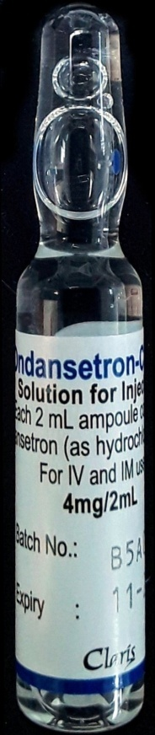
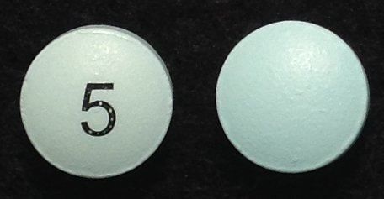
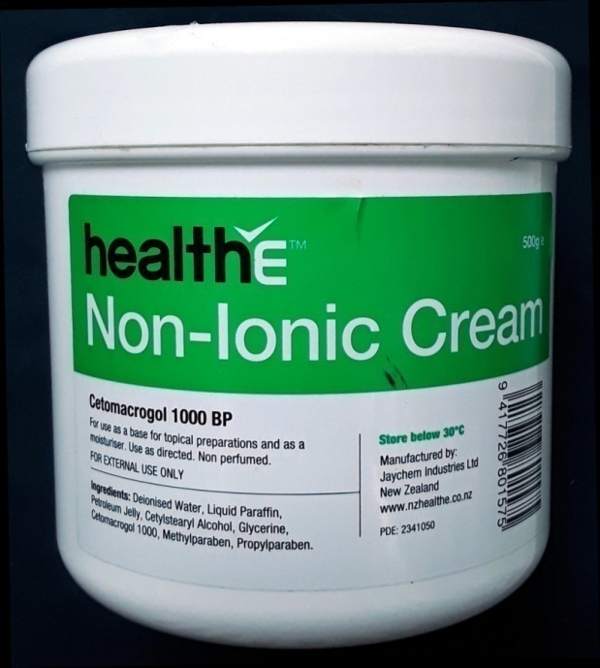
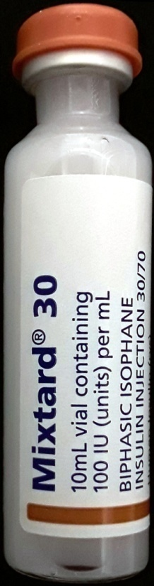
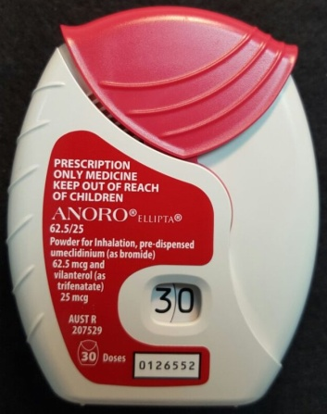
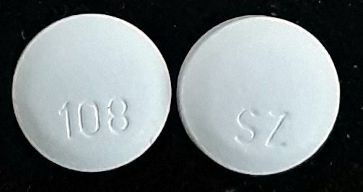
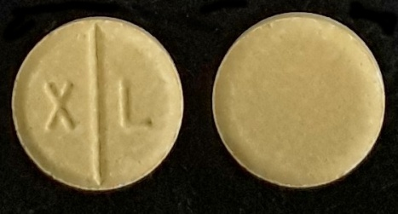
All images available: www.medlook.org
API: http://api.medlook.org/api/Pictures/{TPUU_ID}?apikey{key_provided_by_Medlook}

Slide 6
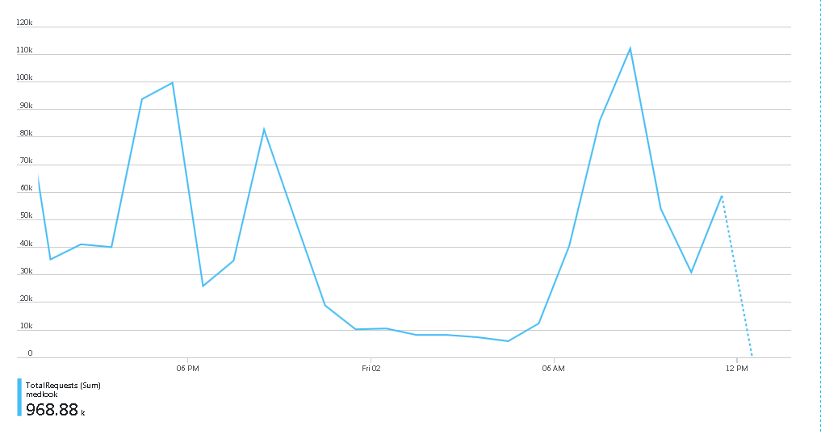
Solution: We have designed a system that provides automated access to the images at the point of script entry and medicine administration
Pilot project ran from November 2017 until February 2018 and was done with medicines management software vendor Medi-Map NZ
Volumes of around 1 to 2 million image requests were processed per day
Our service is still being used by Medi-Map one year later
Currently about 80% of requests come from Medi-Map and 20% from website
Our service has the ability to scale up to hundreds of millions of requests with our current set up
A slow day with under one million requests

Slide 7



Learnings: Design a service with high volume of API calls at a low cost
Solution:
Start-up discounts from big tech companies
Storing of images in the file system avoids SQL licensing costs and improves performance
Cache the database in memory
Start-up discounts offerings

Slide 8
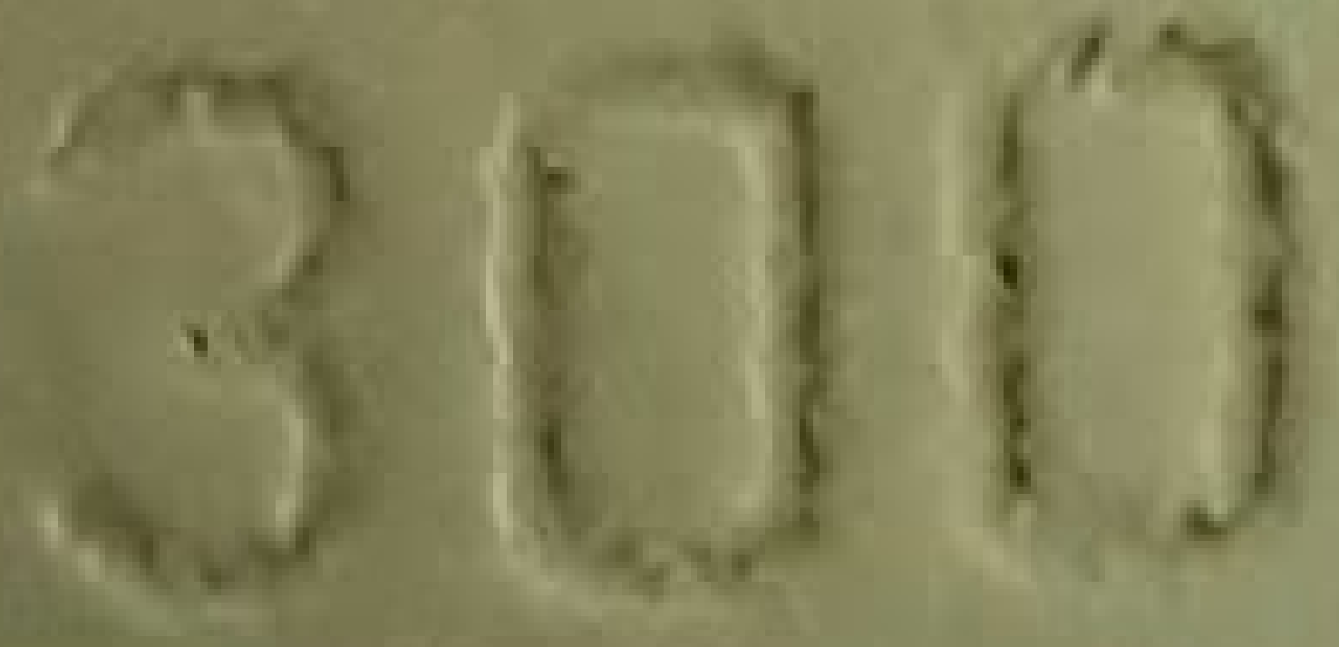
Learnings: Taking high quality pictures without high end cameras, no photography background and varying light sources
Solution:
Utilise several super-resolution deep convolutional neural network models in Keras² as demonstrated by Dong, C et al 2016³
Super-resolution improves picture quality
Unfortunately, neural networks generate artifacts (errors) and have colour degradation
Images have to be edited by a pharmacist after super-resolution
Significant artifacting (errors) on Ranitidine 300mg tablet

Slide 9
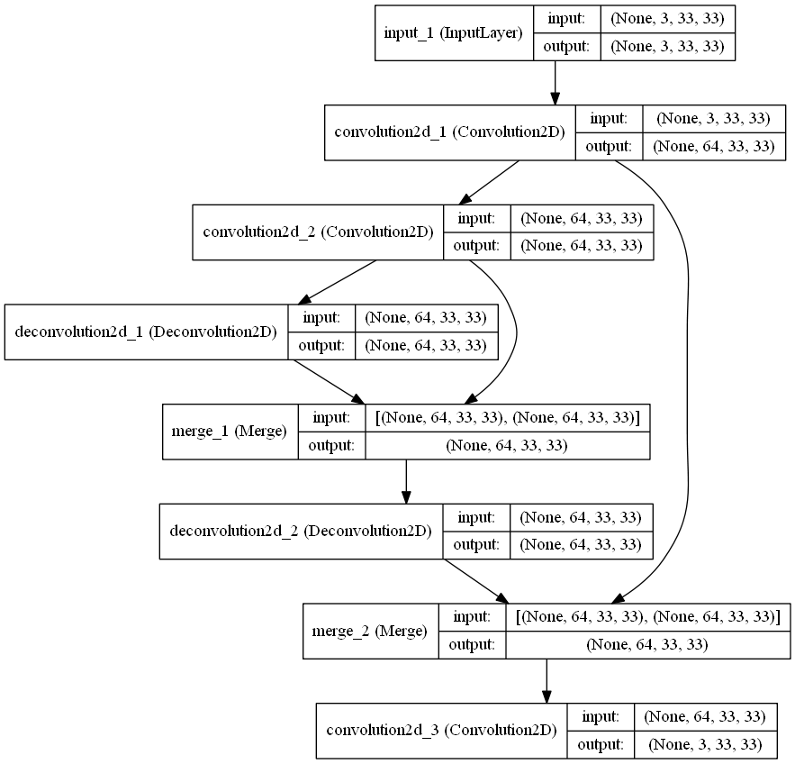
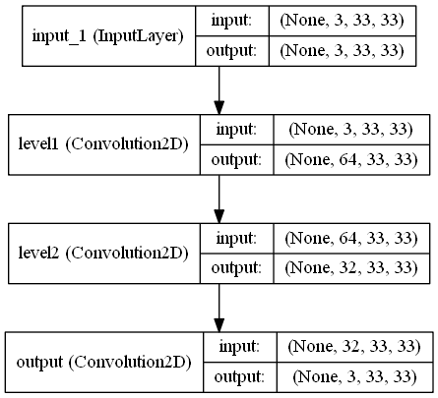
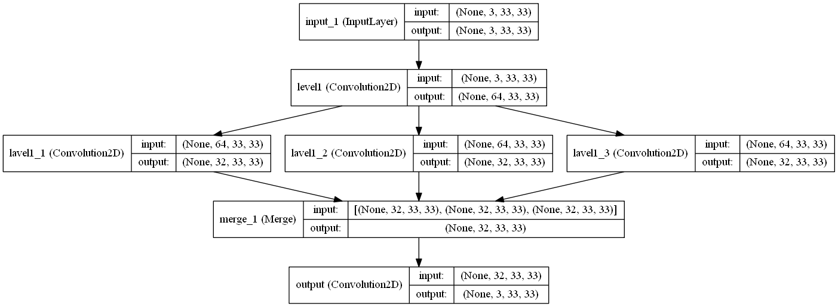
Learnings: Three super-resolution models found to work with our drug image dataset

Slide 10
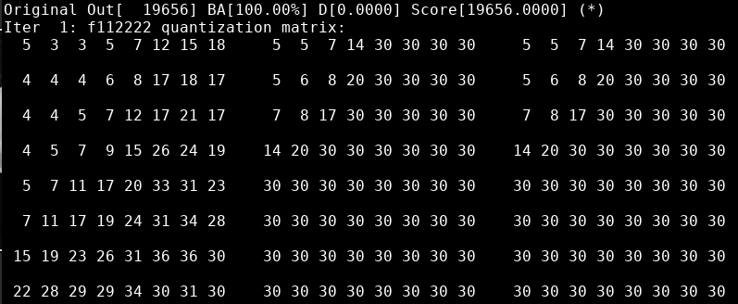
Learnings: Compress image after super-resolution
Solution:
As super-resolution makes the worst areas of the image even worse, optimise image compression based on the worst scoring areas of the image
Guetzli⁴ optimises its JPEG compression based on the butteraugli score derived from the worst scoring areas in the image
Guetzli consequently gave superior compression and visual fidelity compared to other JPEG compression libraries
Chroma subsampling at 4:2:0 is used when Guetzli could not optimise images correctly
Guetzli compressing image of
bromocriptine 2.5 mg tablet

Slide 11
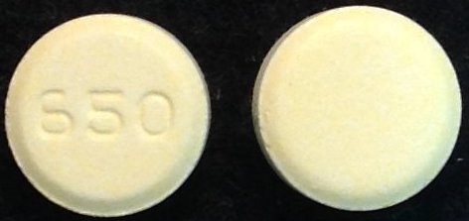
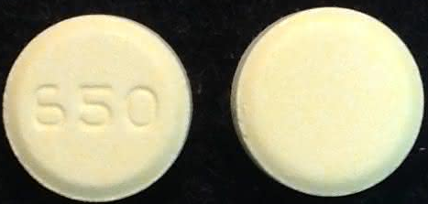
Learnings: Compress image after super-resolution
Image of Sinemet 125/25 without JPEG optimisation
Image size 21kb
Image of Sinemet 125/25 with JPEG optimisation Image size 9kb

Slide 12
Conclusion: Medication images will play a key role in supporting the safe use of medicines in the future.
Conclusion:
We have created New Zealand’s first interoperable medication image database
Medication images can provide health professionals and patients an additional safety net in managing medications, potentially reducing avoidable medication errors
While uptake of the database is currently low, we believe this will increase in line with the utilisation of medication images in other countries such as Australia and the UK
Next steps:
Increase utilisation of the image database across medicines information providers and vendors for medicines management and dispensing software
Build on existing service offering through the following potential avenues:
Virtual counselling services through the use of images
Medication adherence support through the provision of image-based electronic medication cards

Slide 13
References and acknowledgements
References:
1. HQSC 2018. Medicine Management Digital Services. https://www.hqsc.govt.nz/assets/Medication-Safety/Other-PR/Medicines_management_infographic_Mar_2018.pdf
2. Titu1994. Implementation of Super Resolution CNN in Keras. Github https://github.com/titu1994/Image-Super-Resolution
3. Dong, Chao, et al. "Image super-resolution using deep convolutional networks." IEEE transactions on pattern analysis and machine intelligence 38.2 (2016): 295-307.
4. Alakuijala, Jyrki, et al. "Guetzli: Perceptually Guided JPEG Encoder." arXiv preprint arXiv:1703.04421 (2017).

