Slide 1

NY Jobs Postings analysis

Slide 2

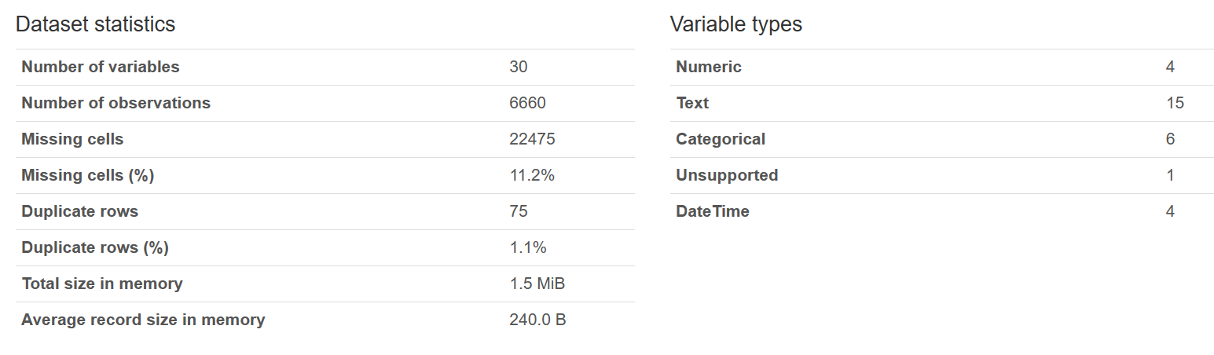
Data source and pre-processing
SOURCE: This dataset contains current job postings available on the City of New York’s official jobs site (http://www.nyc.gov/html/careers/html/search/search.shtml). Internal postings available to city employees and external postings available to the general public are included.
Using ydata_profiling, ProfileReport & df.info() retrieved main dataset characteristics:
Revealed variables types: 4 numeric, others categorical or date
75 duplicates – got read of them
Missing cells belong to categorical not suitable for analysis variables and– no need to replace them with average values

Slide 3
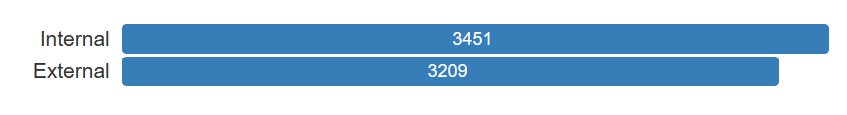
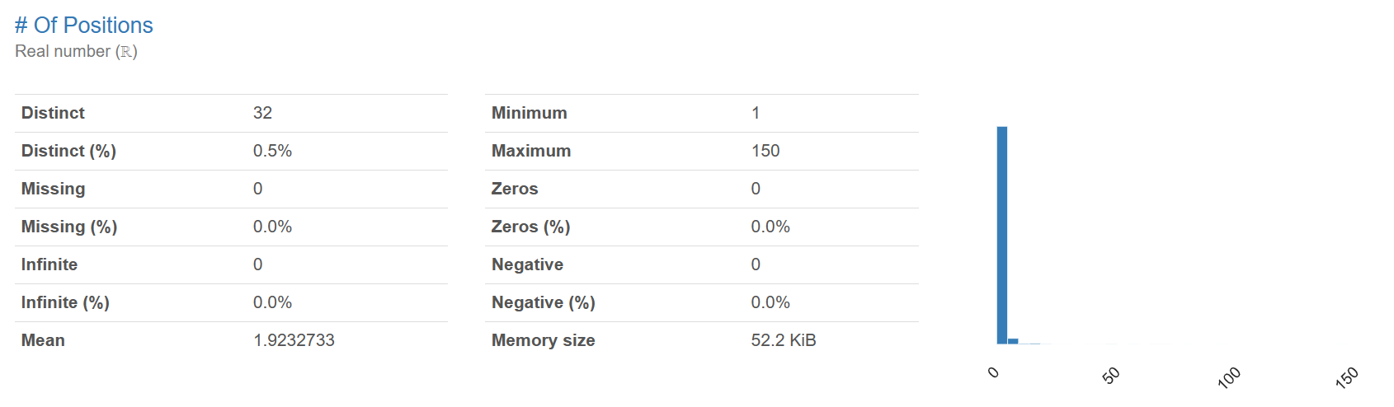
Variables chosen for analysis
Job ID (for COUNT() only) - Integer
Posting Type: Internal/External - Varchar
Number of positions: Integer

Slide 4
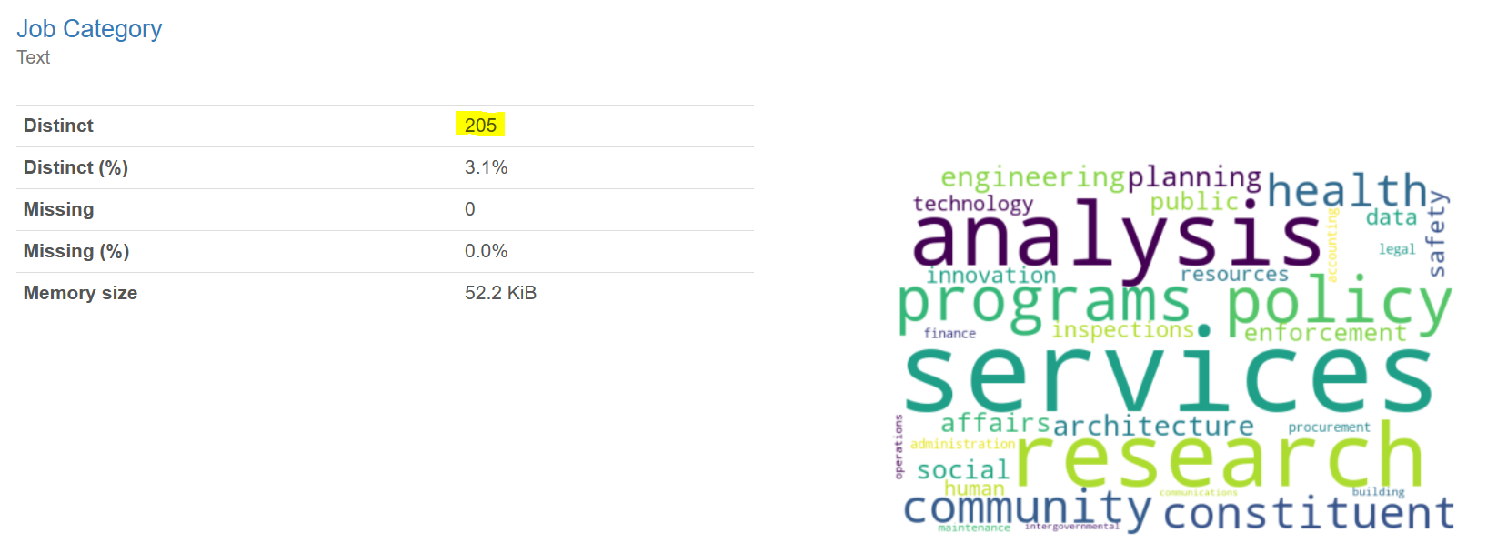
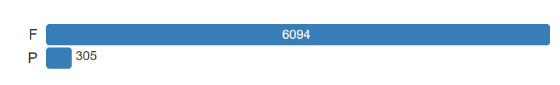
Variables chosen for analysis
Business title: Varchar – for interpretations
Job category: Varchar
Full-Time/Part-Time indicator: Varchar

Slide 5
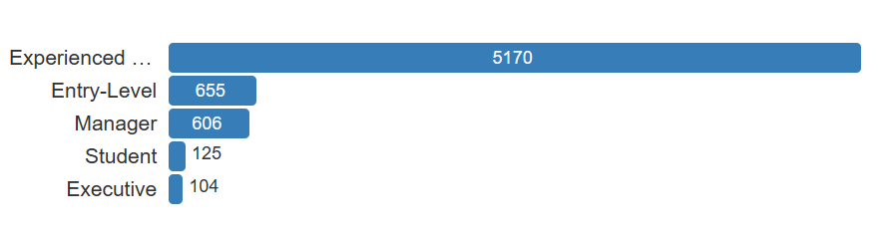
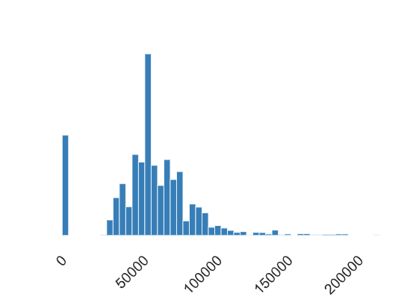
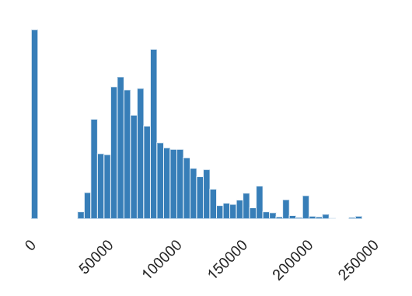
Variables chosen for analysis
Career Level: Experienced, Entry-Level, Manager, Student, Executive
Salary range from: Real
Salary range to: Real

Slide 6
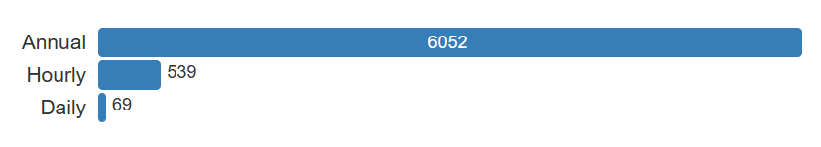
Variables chosen for analysis
Salary frequency: Annual, Hourly, Daily
Posting Date: Varchar
Alerts
Salary range from, Salary range to, Full-Time – Part-Time indicator, Salary Frequency are highly correlated
Full-Time – Part-Time indicator, Career level, Salary Frequency – highly imbalanced

Slide 7
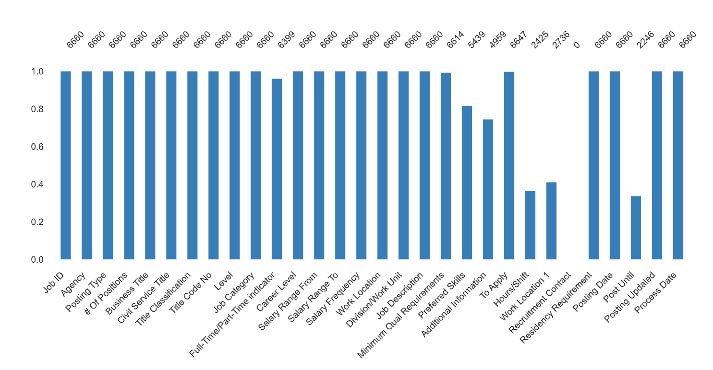
Missing Values

Slide 8
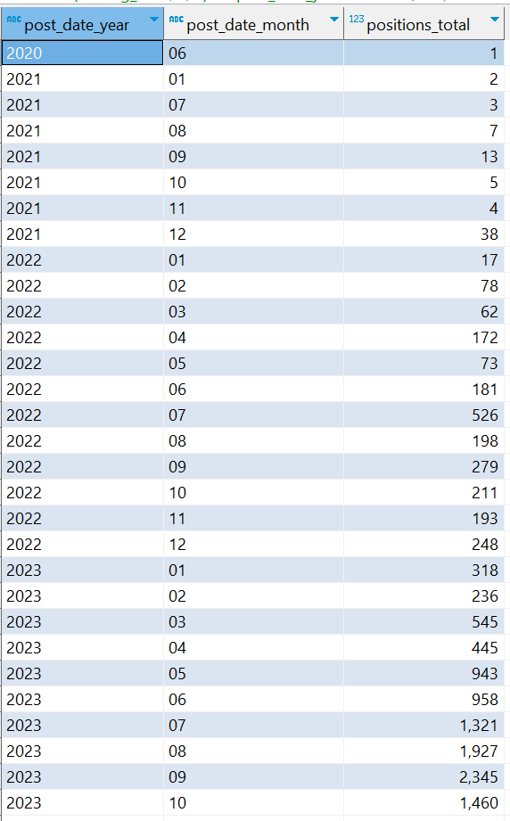
Analysis (Using SQL lite)
Adding columns for year, month and date (Posting Date variable)
2. Retrieving Number of Positions posted per year and Month:
Only one position posted for 2020 year, probably a mistake. One value will not lead to data discrepancy - > ignore it
We see Increasing number of positions
Checking NY labor market articles for this period (in reality it’s gradually freezing) gives an understanding that this dataset is not representative
Q: might be increasing number of positions per posting, but number of postings staying the same or not so dramatically increasing

Slide 9
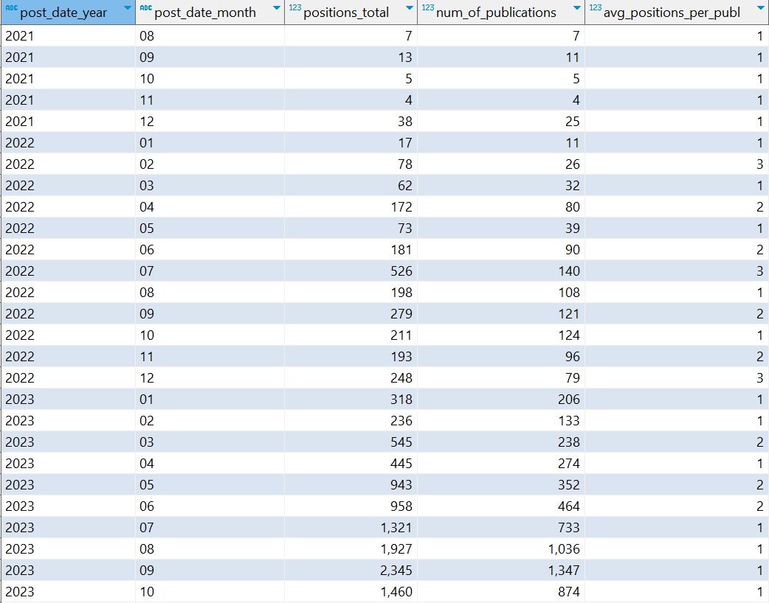
Analysis (Using SQL lite)
Conclusion: nothing changes in terms of avg number of positions per posting over the time

Slide 10
Analysis (Using SQL lite)
Var (Num of positions) = 28.4
Let’s check the posting with maximum number of positions in it:
Description:
Child Protective Specialist
150 positions
External
Experienced (non-manager)
Salary 55463 $ per year (annually)
Posted 16/10/2023
ASC protects and promotes the safety and well-being of New York City for children and families by providing child welfare, juvenile justice, and early care services. In child welfare, ACS contracts with private nonprofit organizations to support and stabilize families at risk of a crisis through preventive services and provides foster care services for children not able to safely remain at home.
Requirements: A baccalaureate degree from an accredited college or university. Supplemented by 24 semester credits in one or a combination of the following fields: social work, psychology, sociology, human services, criminal justice, education

Slide 11
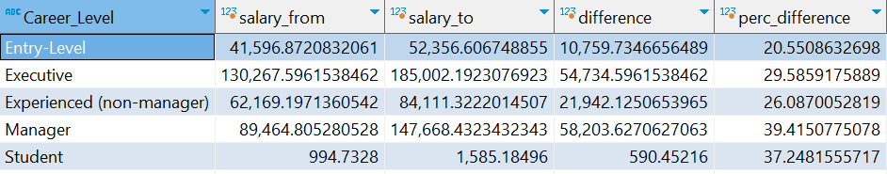
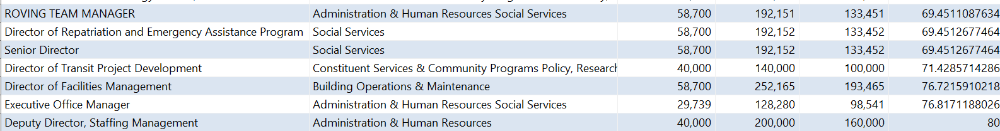
Analysis (Using SQL lite)
Investigating Salary range by Career level:
Looks like percentage difference doesn’t significantly vary with career level.
The highest one is for manager level (39,4%)
Investigating Salary range by Business Title, Job category:
Top 7 vacancies with maximum difference between salary range from and to
*also detected 16 groups with zero salary range from, only salary range to is specified

Slide 12
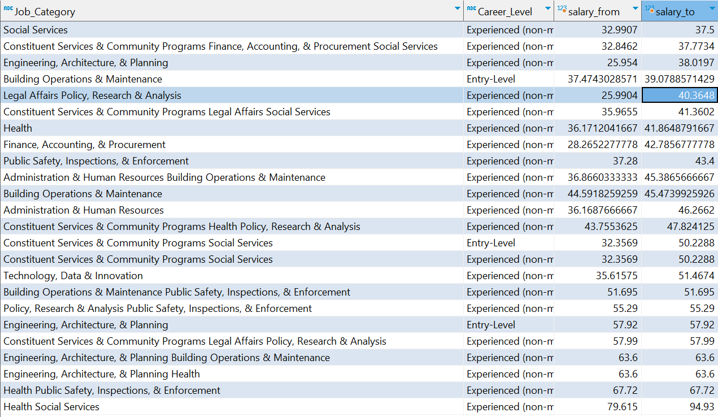
Analysis (Using SQL lite)
Let’s analyze separately postings with Annual, Hourly and Daily salary frequency:
Hourly
The highest salaries per hour – Health – associated job categories. The most frequently encountered level of experience – Experienced (non-manager) and several Entry – level (in Engineering, Architecture, Building operations).
The vacancy with the highest hourly payment: External
Psychologist
Health Social Services
Salary range to 105 $ per hour
Posting date: 06/28/2022
*responsible for promoting best Mental Health practice principles to guide decision-making, program and policy development, and development of resources to ensure that children known to ACS are receiving the best possible care to address psychiatric and behavioral health conditions.

Slide 13
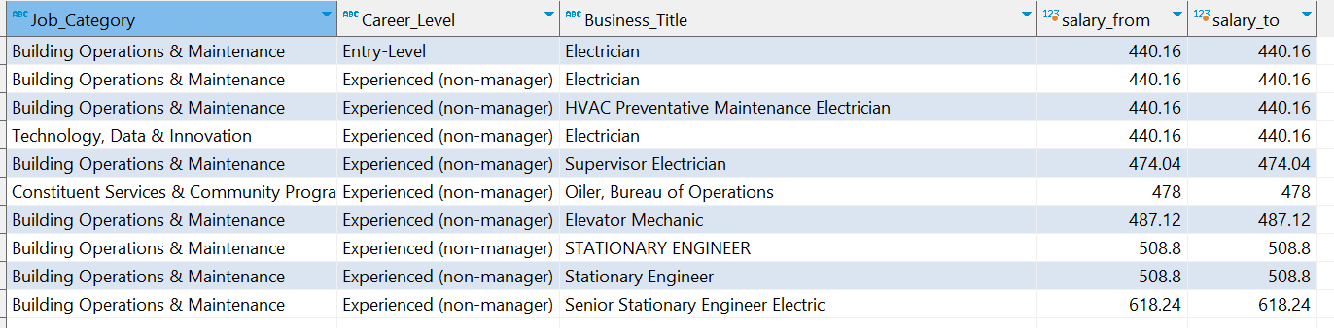
Analysis (Using SQL lite)
Let’s analyze separately postings with Annual, Hourly and Daily salary frequency:
Annually
The highest salaries per year top 5 groups by Joc Category, Career Level, Business Title
2. Daily
The highest salaries per day top 9 groups by Joc Category, Career Level, Business Title

Slide 14

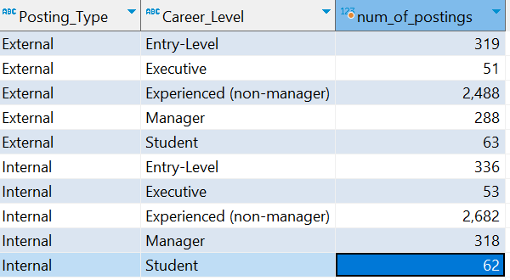
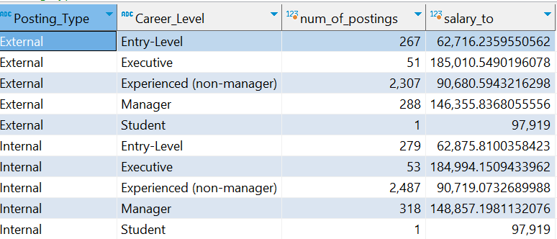
Analysis (Using SQL lite)
Internal/External ratio:
Internal/External by skills:
I had an assumption that for External positions companies are more likely to hire students, and low-skills-level stuff.
It’s refuted, there’s the same pattern for both categories and there are even external Executive positions.
Moreover, no difference in salaries for these categories
*only annual salary frequency

Slide 15
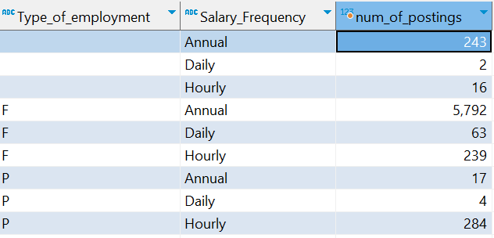
Analysis (Using SQL lite)
Assumption:
Full time – annual salary frequency
Part time – hourly salary frequency
Still there are annual – part time (17), hourly – full time (239)

Slide 16
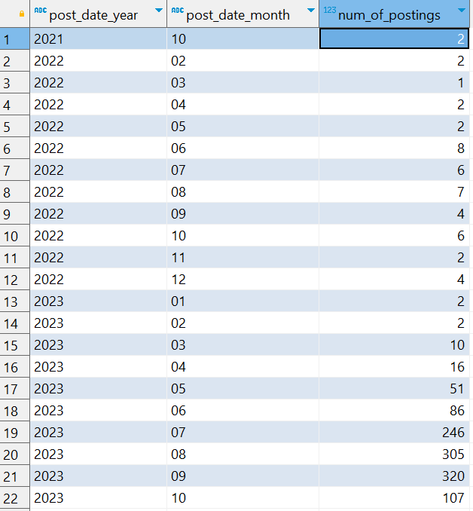
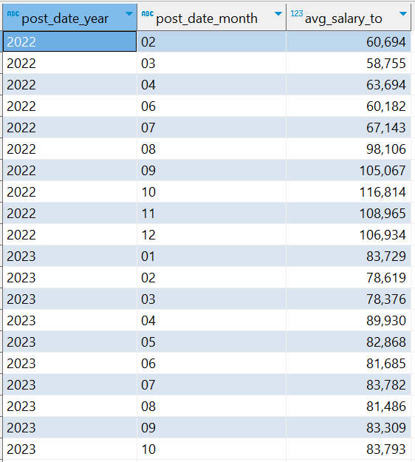
Analysis (Using SQL lite)
«Health» Job category Analysis
Let’s pick out only Health-associated Job categories and assess:
1. The trend in terms of number of postings
1. Salary ceiling moving average

Slide 17
Analysis (Using SQL lite)
Salary trend analysis across different working areas
Let’s distinguish most frequently encountered working areas in data set:
SELECT
*,
CASE
WHEN INSTR(Job_Category, 'Health')<>0 THEN 'Health'
WHEN INSTR(Job_Category, 'Social Services')<>0 THEN 'Social Services'
WHEN INSTR(Job_Category, 'Legal Affairs')<>0 THEN 'Legal Affairs'
WHEN INSTR(Job_Category, 'Human Resources')<>0 THEN 'Human Resources'
WHEN INSTR(Job_Category, 'Engineering, Architecture, & Planning')<>0 THEN 'Engineering, Architecture, & Planning'
WHEN INSTR(Job_Category, 'Finance, Accounting, & Procurement')<>0 THEN 'Finance, Accounting, & Procurement'
WHEN INSTR(Job_Category, 'Technology, Data & Innovation')<>0 THEN 'Technology, Data & Innovation'
ELSE 'Others'
END AS working_area,
SUBSTR(Posting_Date, 7, 4) AS post_date_year,
SUBSTR(Posting_Date, 1, 2) AS post_date_month
FROM Jobs_NYC_Postings_Final jnpf
WHERE Salary_Frequency ='Annual';

Slide 18
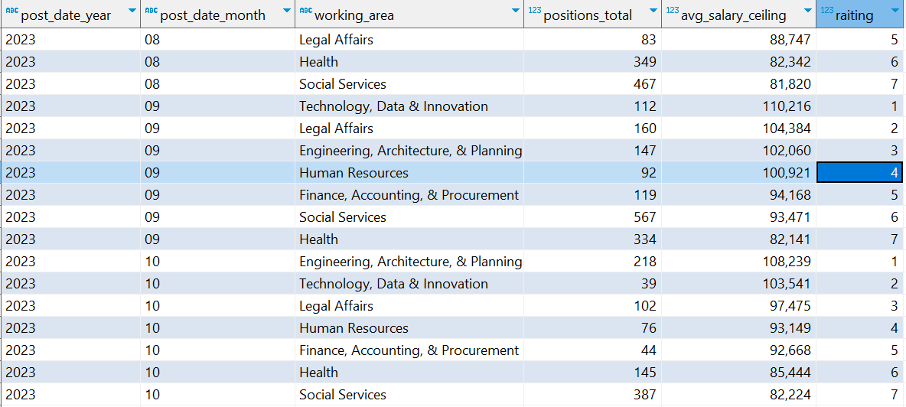
Analysis (Using SQL lite)
Let’s calculate overall number of positions and average salary ceiling by month and rate working areas (excluding Others) depending on avg ceiling:

Slide 19
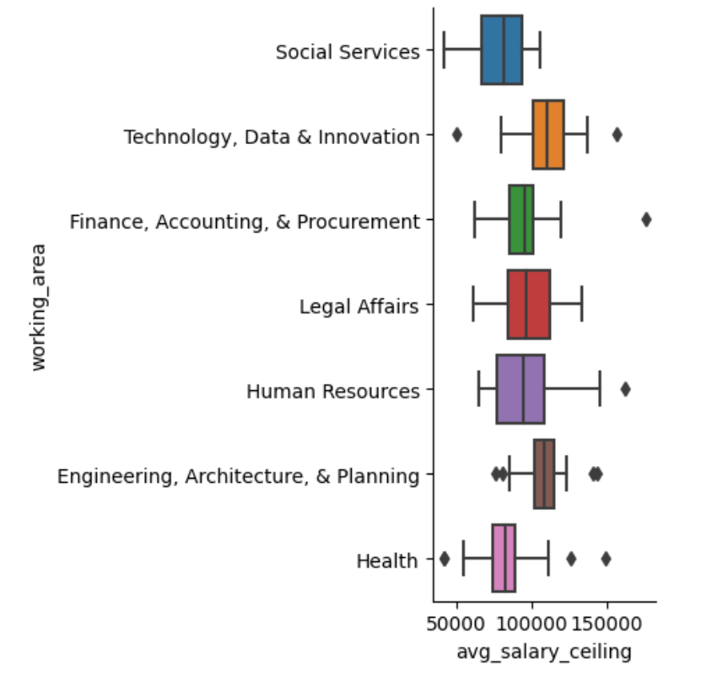
Analysis (Using SQL lite)
The visualization of average salary ceiling by working areas
It’s remarkable, that Health working area has big outlier towards higher values, while the majority is concentrated closer to low values
The biggest outlier belongs to Finance, Accounting and Procurement

Slide 20
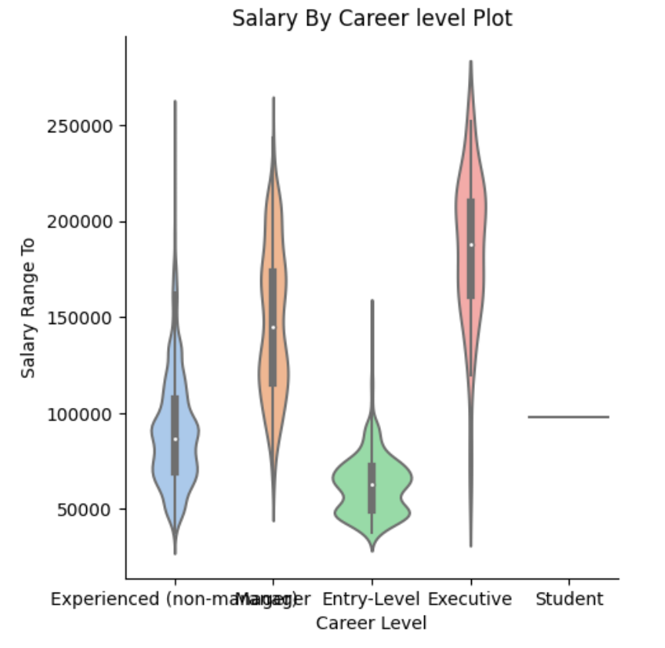
Analysis (Using SQL lite)
The visualization of average salary ceiling by Career Level

