Slide 1
Comprehensive Digital Marketing Project Work

Slide 2

Project given by

Slide 3
STUDENT’S DECLARATION
I POLINA GOWTHAMI a student of A.M.A.L college program RegNo.120120103122of the Department of commerce college do hereby that I have completed. The mandatory internship from 29-05-2023 to 04-08-2023 in DIGITAL MARKETING (name of the intern organization under the faculty guide ship of SMART BRIDE,(name of the faculty guide),Department of COMMERCE A.M.A.L COLLEGE ANAKAPALLI. (name of the college)
P. GOWTHAMI
( SIGUNATURE)

Slide 4
ACKNOWLEDGEMENT
Firstly I would like to Express my indebtedness appreciation "APSCHE" government and Andhra university for providing on excellent opportunity to learn while working through internships. I am grateful to "smart bridge" providing the details of the course in depth and for teaching the topics theoretically and practically to the students kindly smart bridge staff for handling this long-term internship with hard work and patience. I would like to express my sincere thanks to Mr. M.KONDALARAO sir, (mentor name), for his/her valuable guidance and support in completing my project. I wish to express my gratitude towards our comprehensive Digital marketing project coordinators “T. Niranjan Kumar Sir”and“J. sambrajyam Medam ” for their encouragement and problem solving during the project. I extend my gratefulness to our correspondents MR. Dadi. Srinivasa Rao Sir and (Director) K.S.N. Manga Raju sir for their support and heartfelt completing the project. I would also like to express my gratitude towards our(principal) Dr.G. Jayababu Sir for giving me this great opportunity to do a project on “HDFC BANK” (topic name). without their support and suggestions this project would not have been completed
P.Gowthami
(signature.)

Slide 5
TEAM MEMBERS
Team Leader : Mummina Ramalakshmi
Team member : kurmapu Gayathri
Team member :kurmapu Sravani
Team member :Polina Gowthami

Slide 6
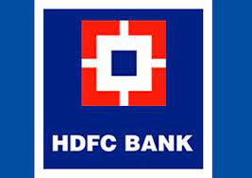

Slide 7
OVERVIEW OF THE ORANIZATION
The bank commenced operations as a Scheduled Commercial Bank in January 1995. On April 4, 2022 the merger of India's largest Housing Finance Company, HDFC Limited and the largest private sector bank in India, HDFC Bank was announced.
The Housing Development Finance Corporation Limited or HDFC was among the first financial institutions in India to receive an “in principle” approval from the Reserve Bank of India (RBI) to set up a bank in the private sector.
he magazine said on its website – “HDFC Bank is India's largest private-sector lender by assets. It has the scale, processes, expertise and vision to meet the needs of its 70 million-plus customers. Those strengths came in handy when the pandemic roiled markets.

Slide 8

Part 1: Brand study, Competitor Analysis & Buyer’s/Audience’s Persona
Research Brand Identity: Study the brand's mission, values, vision, and unique selling propositions (USPs).
ComPany/topic for project: HDFC bank
Brand colours: blue, red
Logo:
Mission/values: The bank is committed to maintaining the highest level of ethical standards, professional integrity, corporate governance and regulatory compliance. HDFC Bank’s business philosophy is based on five core values: Operational Excellence, Customer Focus, Product Leadership, People and Sustainability
USP: HDFC is one of the big four banks in India
Tagline:We understand Your world

Slide 9
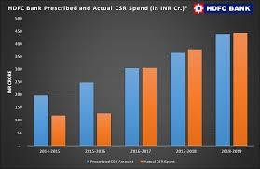
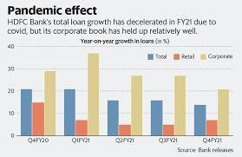
Company/topic for project:HDFC BANK
Brand massaging: The bank was founded by a team of four individuals, led by its first Chairman, Dr. Deepak Parekh. Since its inception, the bank has grown exponentially and employs over 120,000 individuals across various branches in India and overseas. HDFC Bank operates through a network of 5,684 branches and 16,103 ATMs in 2,896 cities/towns in India as of March 2021.
Explain:The Housing Development Finance Corporation (HDFC) was amongst the first to receive an ‘in principle’ approval from the Reserve Bank of India (RBI) to set up a bank in the private sector, as part of the RBI’s liberalization of the Indian Banking Industry in 1994. HDFC Bank is headquartered in Mumbai.

Slide 10
Part 1: Brand study, Competitor Analysis & Buyer’s/Audience’s Persona
Analyze Brand Messaging: HDFC Bank, headquartered in Mumbai, India, is a leading private sector bank that provides a wide range of financial products and services. The bank was founded in August 1994 by Housing Development Finance Corporation Limited (HDFC) and is currently one of the largest banks in India by market capitalization.
●
The bank was founded by a team of four individuals, led by its first Chairman, Dr.
Deepak Parekh. Since its inception, the bank has grown exponentially and employs
over 120,000 individuals across various branches in India and overseas. HDFC Bank operates through a network of 5,684 branches and 16,103 ATMs in 2,896 cities/towns in India as of March 2021.
Expleline the brand tagline: HDFC Bank is an Indian banking and financial services company headquartered in Mumbai, Maharashtra. HDFC bank is the second largest private bank in India as measured by assets.

Slide 11
Part 1: Brand study, Competitor Analysis & Buyer’s/Audience’s Persona
Competitor Analysis: Select three competitors operating in the same industry or niche as the chosen their USPs and online communication
Competitor1: https://www.hdfcbank.com
USP:HDFC is one of the big four banks in India
Communication: The information relating to the Banks financial results and shareholding pattern.
Competitor2:https://www.icicipruamc.com
USP: ICICI is the most efficient and tech Savvy bank in the Indian banking industry
Communication: the address of your house where you are actually living.
Competitor3:https://juno.axisbank.com
USP: Axis Bank is one of the largest private sector financer in Indian agriculture
Comunication: the address of your house where you are actually living

Slide 12
Part 1: Brand study, Competitor Analysis & Buyer’s/Audience’s Persona
Buyer's/Audience's Persona: Clearly define the target audience for the chosen brand. Consider demographics, psychographics, behaviours, and interests.
Consider demographics: individuals, salaried professionals, micro and small businesses, such as kirana stores, Self Help Groups (SHGs), and Non-Resident Indians (NRIs).
Psychographics: lifestyle and reasons
Behaviours:HDFC Bank has an overall rating of 3.5 out of 5, based on over 7,825 reviews left anonymously by employees. 58% of employees would recommend working at HDFC Bank to a friend and 71% have a positive outlook for the business. This rating has been stable over the past 12 months.
Interests:3.00-7.25% p.a. To the general public and 3.50-7.75% p.a. To senior citizens on tenures ranging from 7 days to 10 years.

Slide 13
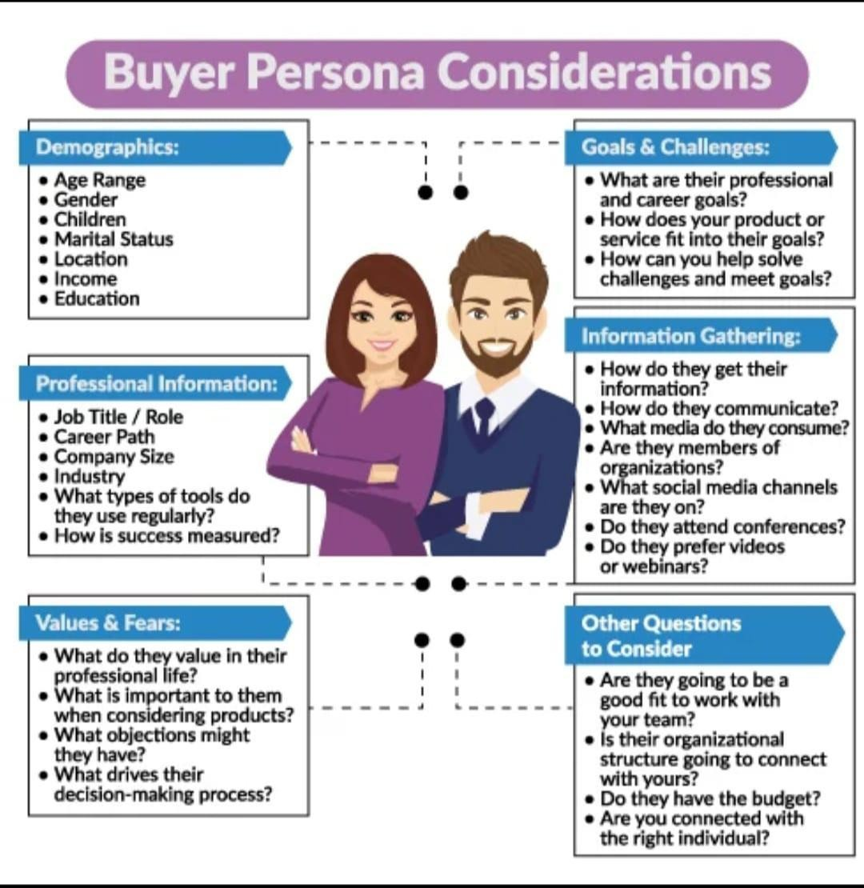
HDFC bank Boys and girls Age:18-55
Hdfc have almost Branches all over of India
Ads:you tube Instagram Communtity platform Like google.
Social status:persona experience Longlasting price.

Slide 14
Part 2: SEO & Keyword Research
SEO Audit: Do an SEO audit of the brands website
Keyword Research: Define Research Objectives, Brainstorm Seed Keywords, Utilize Keyword Research Tools (SEMrush or Moz Keyword Explorer),Analyse Competitor Keywords, Long-tail Keyword Exploration (specific, longer phrases) that align with the research objectives and have lower competition but higher conversion potential.
On page Optimization: Meta Tag optimization & content optimization
Reflect on the process of conducting keyword research and the SEO recommendations provided.
Document the challenges faced during the research and analysis phase, as well as the key insights gained from the keyword research process.

Slide 15
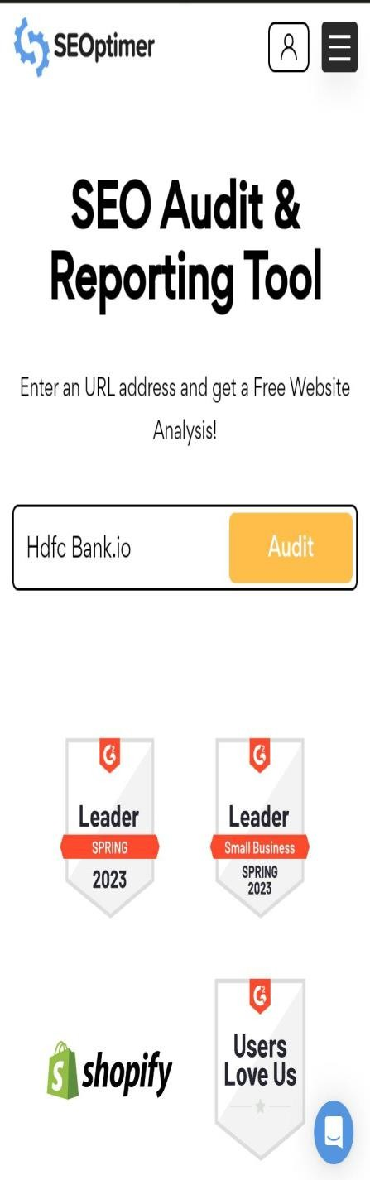
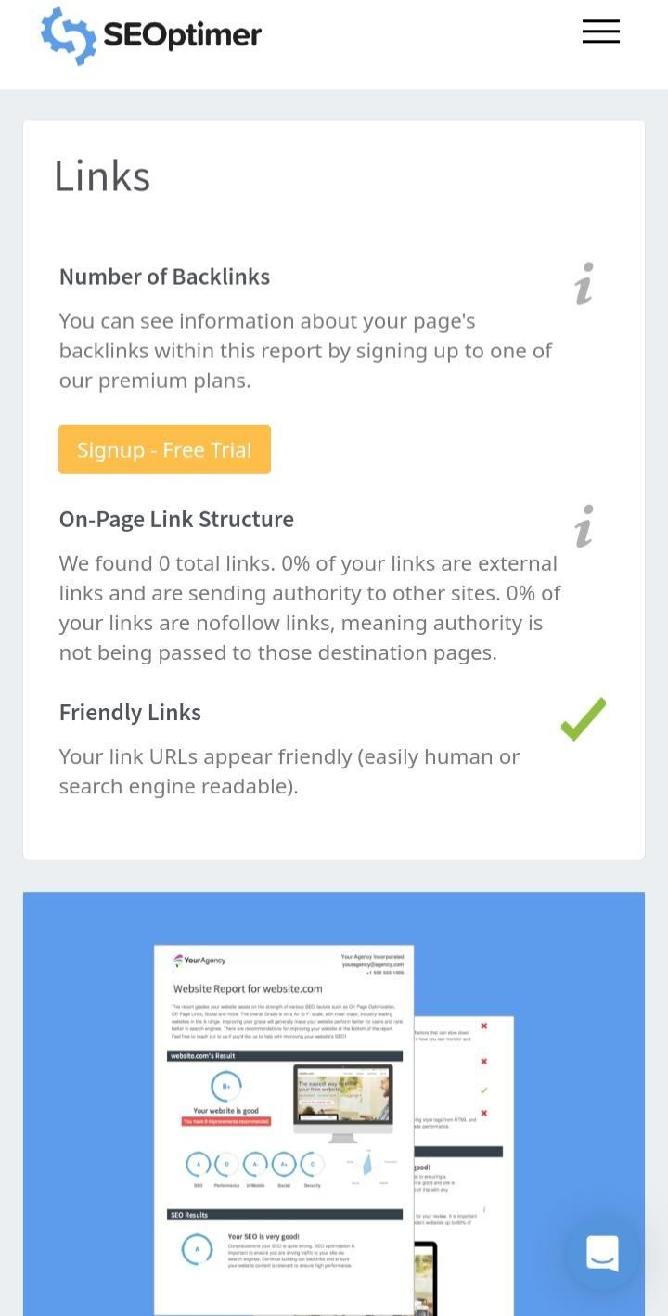
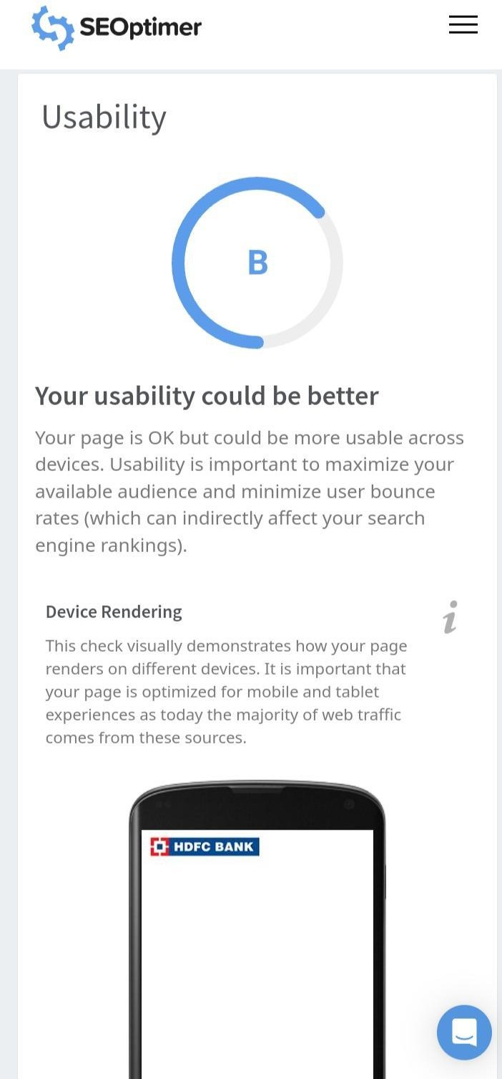
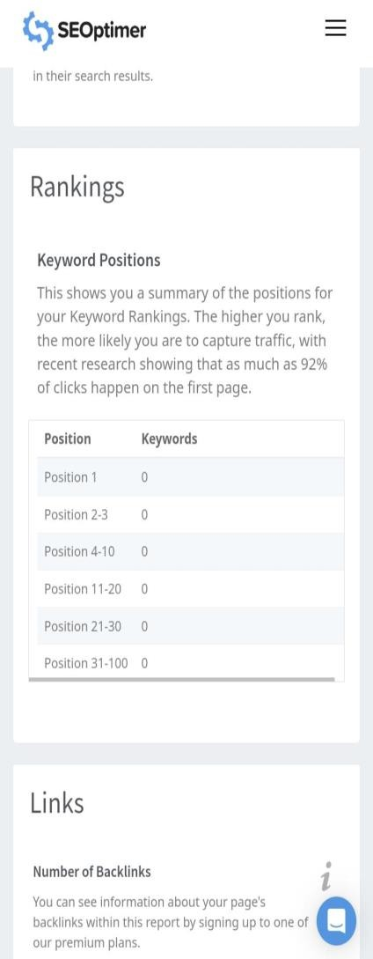

Slide 16
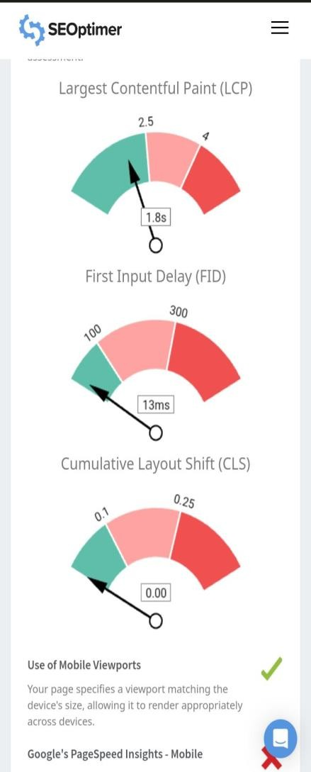
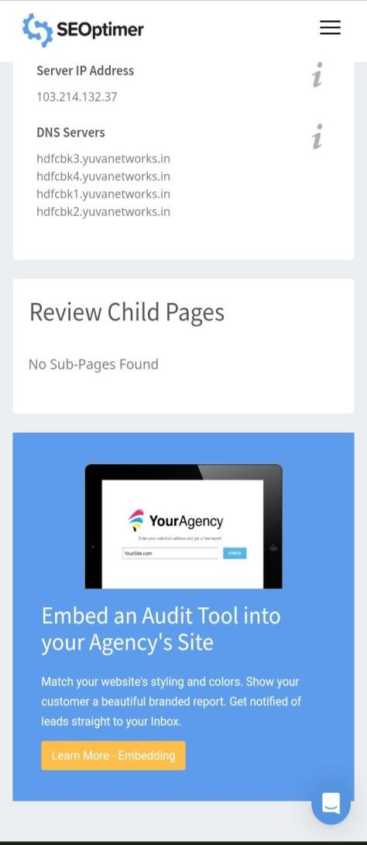
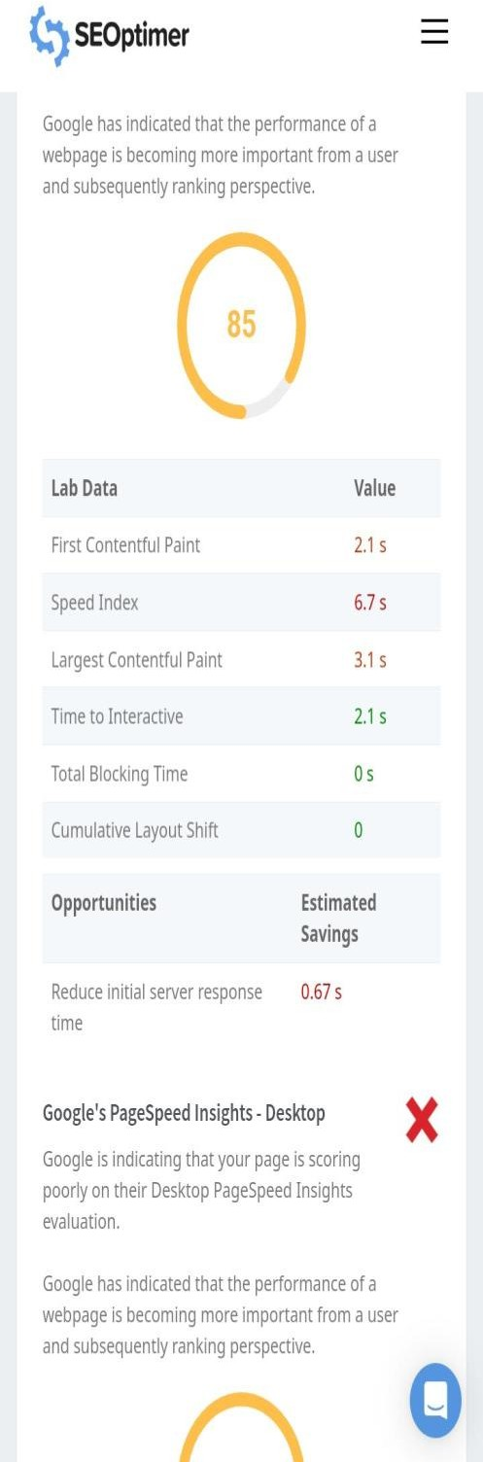
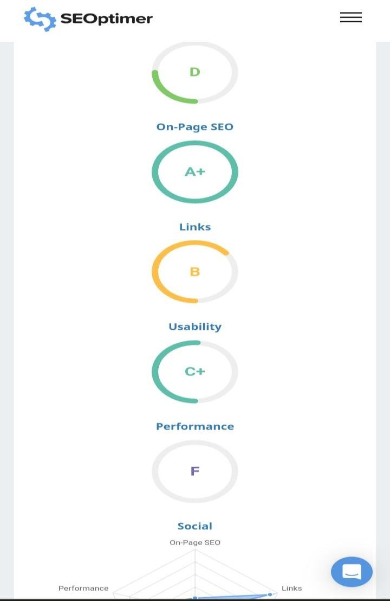

Slide 17
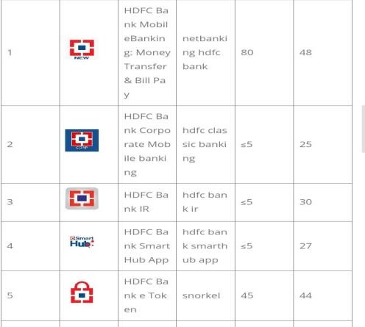
Keyboard research:
The search volume of the core keyword hdfc bank in Google App Store reached 44, its
difficulty level reached 31, and the number of apps related to it reached 250+, among them, there are 158 apps with more than 1,000 comments, and the top 10 apps are Selected.
On page optimization:the tags that you add to your page’s header to describe the page using syntax that Google understands.ncreases brand recognition – Brands today are using a variety of content strategies to improve their visibility. With blog posts and social media posts.

Slide 18
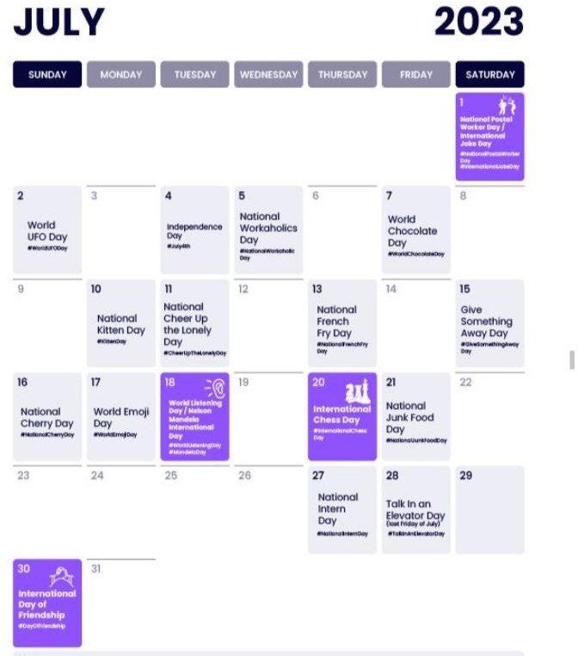
Part 3: Content Ideas and Marketing Strategies
Content Idea Generation & Strategy: Create a content calendar for the remaining month of July by brainstorming content themes, exploring various formats like blog posts, videos, infographics, podcasts, and interactive quizzes, and scheduling publication dates mainly on Facebook & Instagram.
And include the strategy, aim and the idea behind these posts and story
Content Calendar Example (Try creating a table for the month of July)

Slide 19
Part 3: Content Ideas and Marketing Strategies
Content ideas: The idea is to bring the corporates' entire financial world under one. Over the years, we have simplified and digitized processes, thus reducing.
Marketing Strategies :The Bank's strategy is to cover a larger geographical spread, to provide differentiated wealth management solutions using digital tools. The Bank is creating new product offerings and improving its existing solutions to reach out to this population using technology.
challenges : HDFC Bank, the biggest challenges include new payment banks - such as Paytm, Reliance Industries, Tech Mahindra, NSDL and India Post - that are ready to launch operations. In the UK, the online-only Atom Bank is set to challenge brick-and-mortar banks.
lessons : Mahatma Gandhi lessons are immortal in the pages of history. Here are 5 financial lessons what we can learn from his life & plan our financial life ...

Slide 20
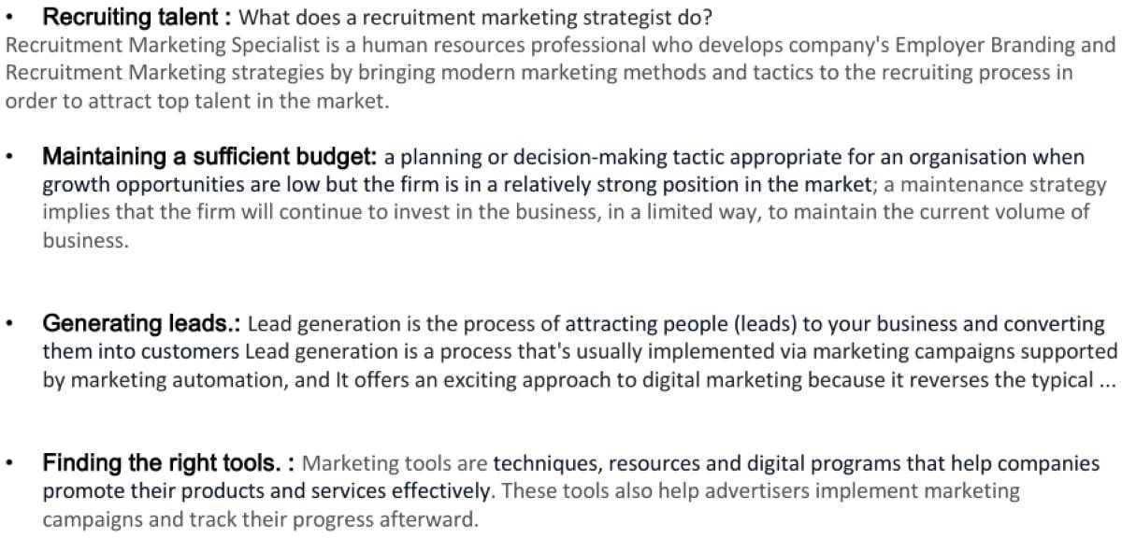

Slide 21
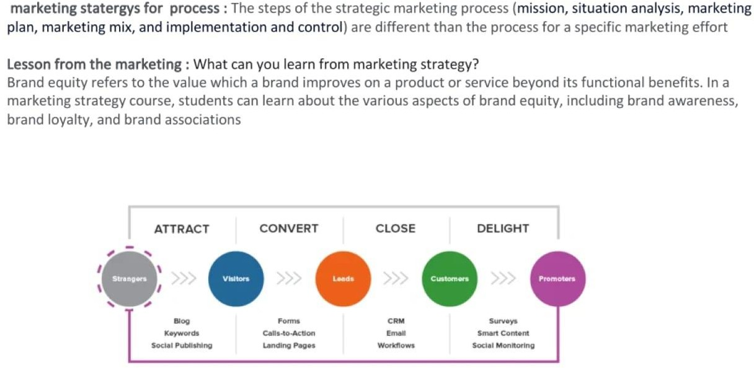

Slide 22
Part 4: Content Creation and Curation (Post creations, Designs/Video Editing, Ad Campaigns over
Social Media and Email Ideation and Creation)
Post Creation:
Select Content Categories: Identify three different content formats relevant to the chosen topic or industry. Research and Brainstorm: Research trending topics, industry news, or audience interests within each category. Brainstorm ideas for social media posts that align with each category. Do note that 1 content format has to be video and additionally 3 stories/status are to be created.
Format 1 : Blog article
Format 2 : video
Format 3: creative

Slide 23
FORMATE 1 : BLOG ARTICLE AIM : Maintning the highest level of ethical standards, professional integrity,corporate governance and regulatory compliance. Date : AUGUST 1994 Ideas : India’s largest private sector bank by assets and world’s fourth largest bank by market capitalization as of July 2023. Topic : Learn about the evaluation criteria and parameters on which your performance is judged in a GOOD BANK Format 2 : video Aim : HDFC Bank's business philosophy is based on five core values: Operational Excellence, Customer Focus, Product Leadership, People and Sustainability Idea : This blog offers a broad range of information in the spheres of home finance, property & real estate, lifestyle & living and non housing loans. Topic : Learn about the evaluation criteria and parameters on which your performance is judged in a GOOD BANK

Slide 24

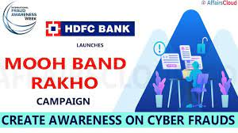
Format 3 : creative
Aim : brand awareness &reach
Date : 06 -04- 2022
Idea : to cover a larger geographical spread, to provide differentiated wealth management solutions using digital tools.
Topic : The Bank is encouraging citizens to take a pledge to adopt safe banking habits while transacting digitally and avoid sharing their confidential banking information (like password, PIN, OTP, etc.) with anyone.

Slide 25
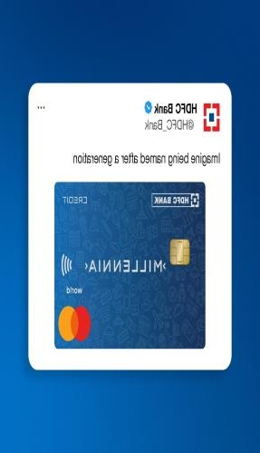
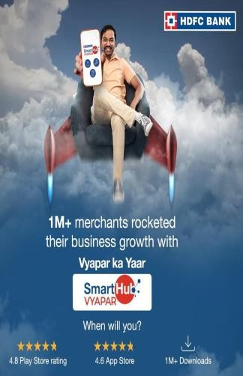
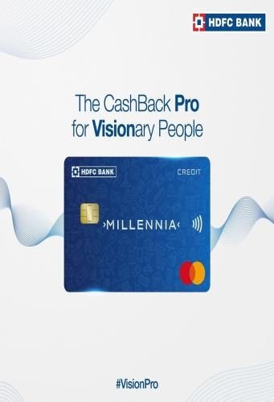
Social Media and Email Ideation and Creation)
Instagram Story
Part 4: Content Creation and Curation (Post creations, Designs/Video Editing, Ad Campaigns over

Slide 26
Social Media and Email Ideation and Creation)
Part 4: Content Creation and Curation (Post creations, Designs/Video Editing, Ad Campaigns over
Designs/Video Editing
Design Tools Familiarization (use Canva for creating visually appealing graphics)
Video Creation: Utilize VN or any video editor of your choice to create videos related to the
chosen topic.

Slide 28
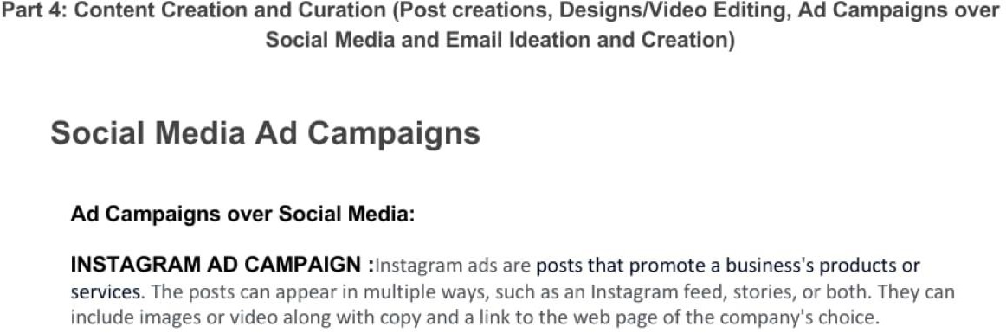

Slide 29
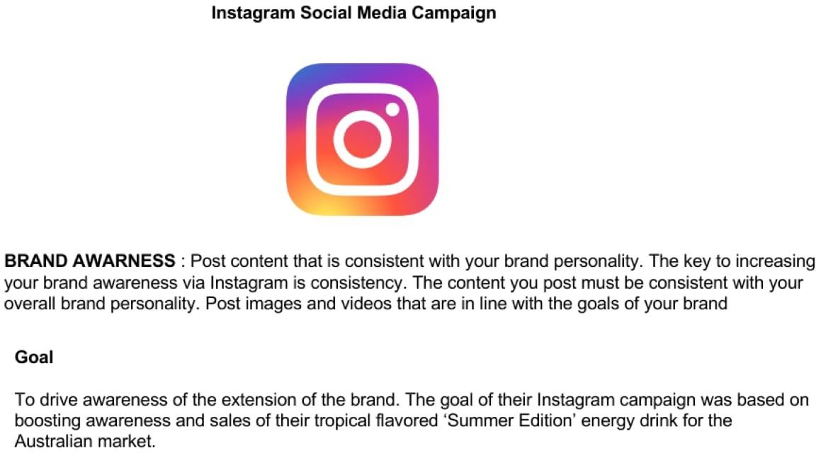

Slide 30


Slide 31
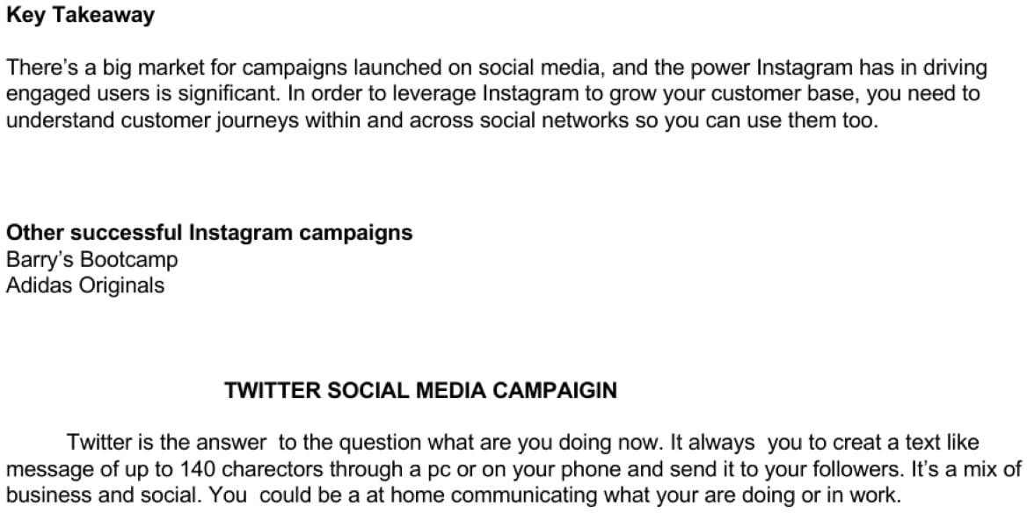

Slide 32
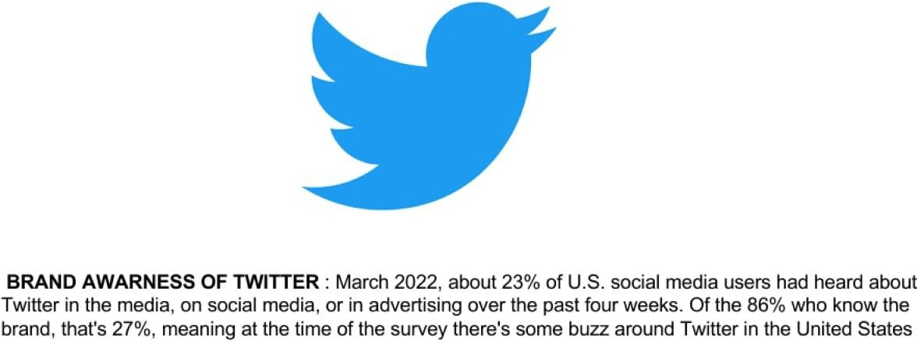

Slide 33
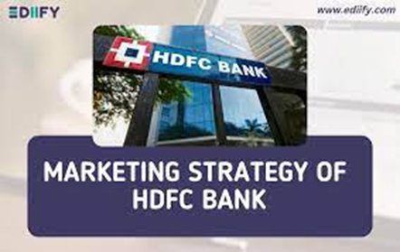
Part 4: Content Creation and Curation (Post creations, Designs/Video Editing, Ad Campaigns over
Social Media and Email Ideation and Creation)
For every campaign clearly define:
Advertising Goals: HDFC Bank's business philosophy is based on five core values: Operational Excellence, Customer Focus, Product Leadership, People and Sustainability.
Audience Targeting : HDFC Bank's Retail business is targeted at individuals, salaried professionals, micro and small businesses, such as kirana stores, Self Help Groups (SHGs), and Non-Resident Indians (NRIs). The Bank caters to this segment by customizing its products and services.
Ad creation :
https://youtu.be/h3EikTjJ3FY

Slide 34
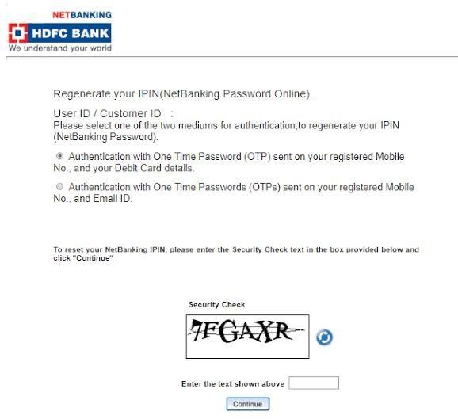
Part 4: Content Creation and Curation (Post creations, Designs/Video Editing, Ad Campaigns over
Social Media and Email Ideation and Creation)
Email Ad Campaigns
Customerservices.cards@hdfcbank.com

Slide 35
Email Ad Campaign 1 - Brand Awareness
(insert emailer image)

Slide 36
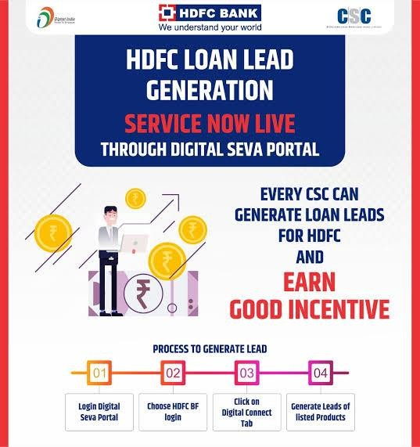
Email Ad Campaign 2 - Lead Generation
(insert emailer image)

Slide 37
Part 4: Content Creation and Curation (Post creations, Designs/Video
Editing, Ad Campaigns over Social Media and Email Ideation and Creation)
Reflect on the content creation and curation process, discussing the challenges faced and lessons learned.
CONTENT CREATION AND CURATION : Shared content can be categorized into two main categories;
Curated, which is content gathered from trusted sources relevant to your industry and created, which is content product within your organization.
Challenges and lessons learned : first of all, I Would like to thank smart bridge for giving me the first project. I played a vital role in marking this project. Also learned every aspect of digital marketing in 3 months internship. During this project, I faced many challenges. At first I did not understand what to do on that topic . Then our mentor give us a suggestion. Through this project the aspects of day to operation of a company were learned. In the end , our entire team learned lesson and successfully completed our project.

Slide 38


https://youtu.be/tkSeZd4Y5wY
https://youtu.be/oi1ntQwBJ9Y

Slide 39
Thank you

