Slide 1
WDI Data Analysis
Ivan Escalona, Oseriemen Ivbaze, Bryan Davison, Christian Moronta,
Paul Draughn, Spencer Dunn

Slide 2
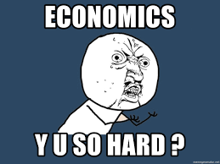
Economics can get Complicated

Slide 3
About Data
Source: https://www.kaggle.com/theworldbank/world-development-indicators
Size: 322MB
Format: CSV

Slide 4
Which five countries have experienced the greatest economic growth?
PPP is an economic theory that compares different countries' currencies through a "basket of goods" approach.
Purchasing power parity (PPP) is a popular metric used by macroeconomic analysts.
PPP compares economic productivity and standards of living between countries.
Some countries adjust their gross domestic product (GDP) figures to reflect PPP.

Slide 5
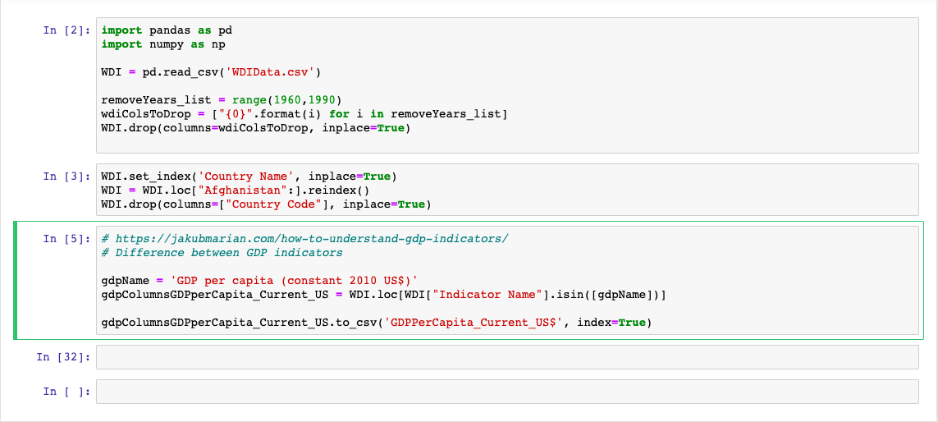

Slide 6
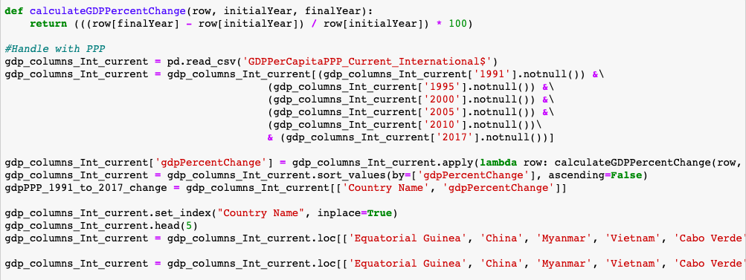

Slide 7
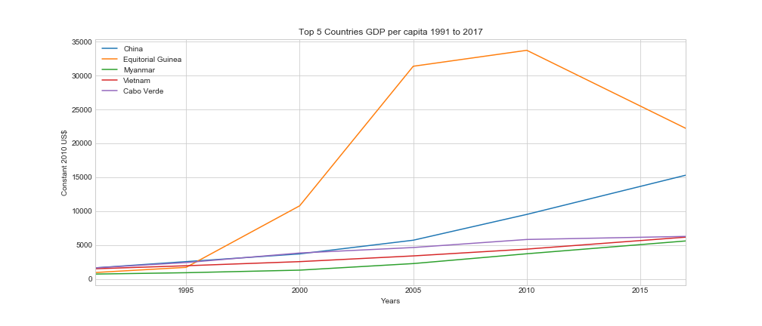

Slide 8
Which countries have the greatest amount of debt?

Slide 9
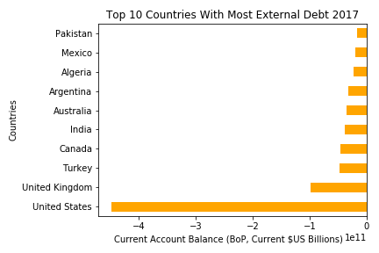

Slide 10
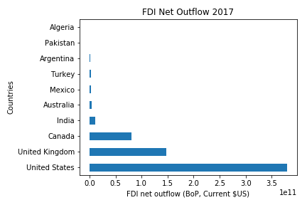

Slide 11
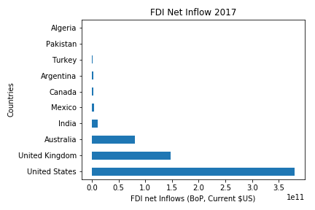

Slide 12
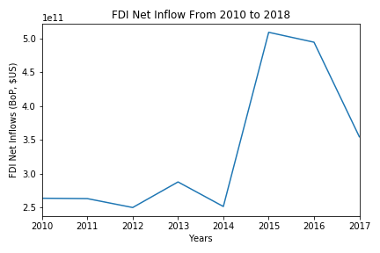

Slide 13
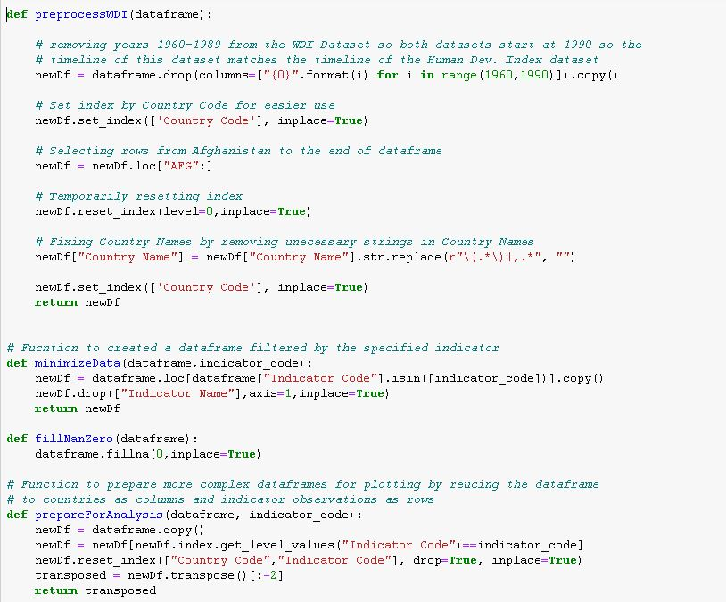
Preprocessing:

Slide 14
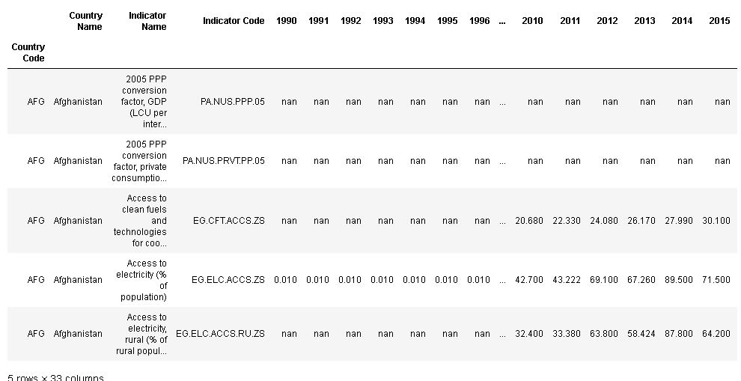
Processed Dataset

Slide 15

Of the top 10 HDI rankings, compare Domestic private health expenditure per capita and Domestic general government health expenditure per capita of each country. What countries have the most expensive healthcare?
Preparing Data for this question:

Slide 16
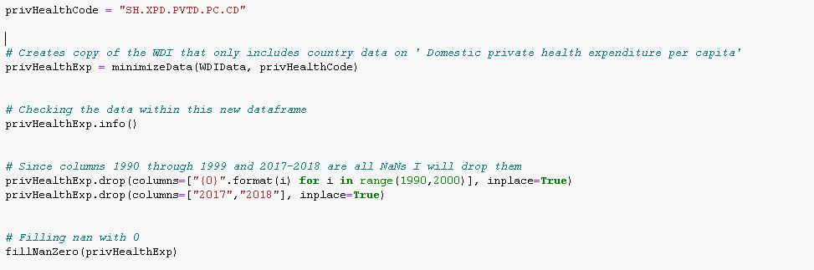
Of the top 10 HDI rankings, compare Domestic private health expenditure per capita and Domestic general government health expenditure per capita of each country. What countries have the most expensive healthcare?
Preparing Data for this question:

Slide 17
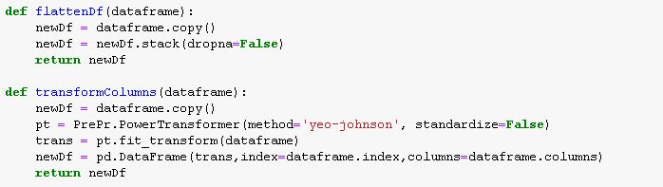
Of the top 10 HDI rankings, compare Domestic private health expenditure per capita and Domestic general government health expenditure per capita of each country. What countries have the most expensive healthcare?
Analysis Functions:

Slide 18
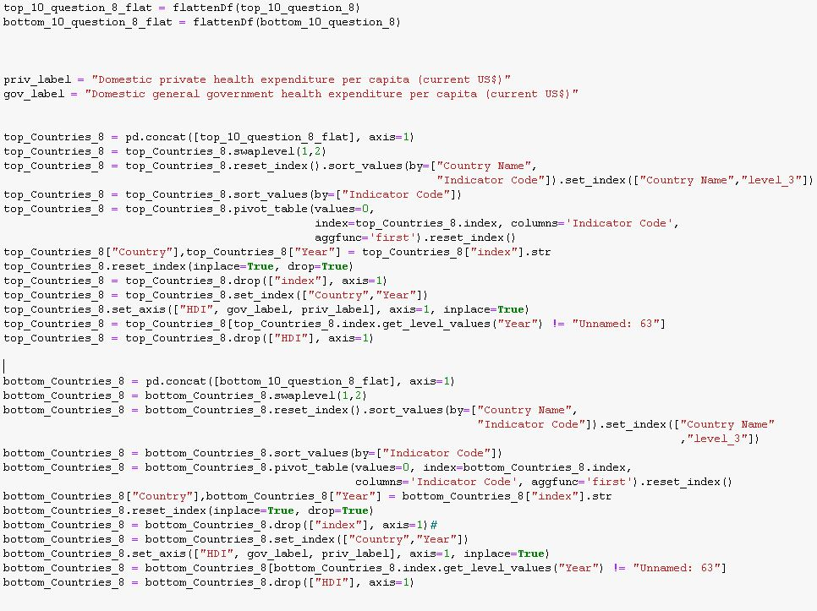
Of the top 10 HDI rankings, compare Domestic private health expenditure per capita and Domestic general government health expenditure per capita of each country. What countries have the most expensive healthcare?
Tidying Data:

Slide 19
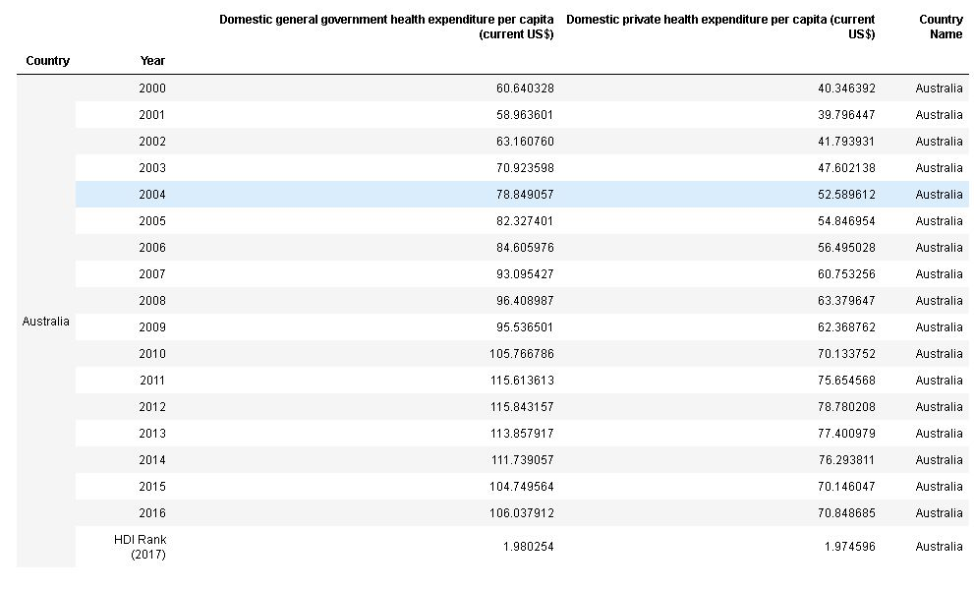
Of the top 10 HDI rankings, compare Domestic private health expenditure per capita and Domestic general government health expenditure per capita of each country. What countries have the most expensive healthcare?
Tidy Data Output:

Slide 20
Of the top 10 HDI rankings, compare Domestic private health expenditure per capita and Domestic general government health expenditure per capita of each country. What countries have the most expensive healthcare?
Transforming Data:
Now I can plot this data...

Slide 21
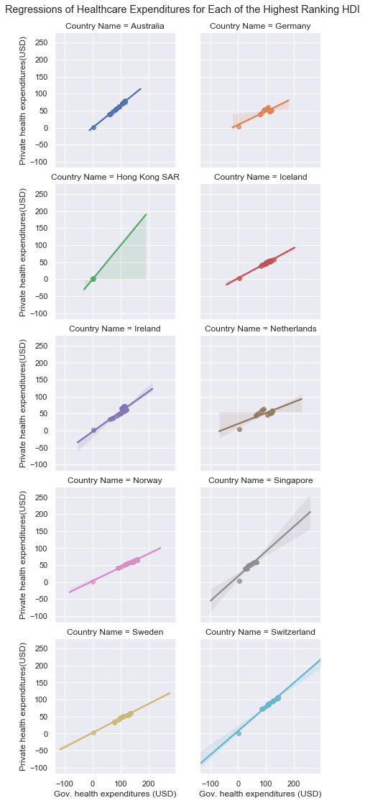
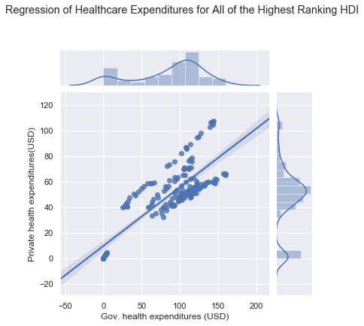
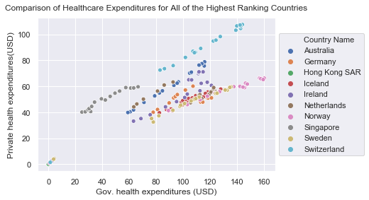
Of the top 10 HDI rankings, compare Domestic private health expenditure per capita and Domestic general government health expenditure per capita of each country. What countries have the most expensive healthcare?
Bryan Davison

Slide 22
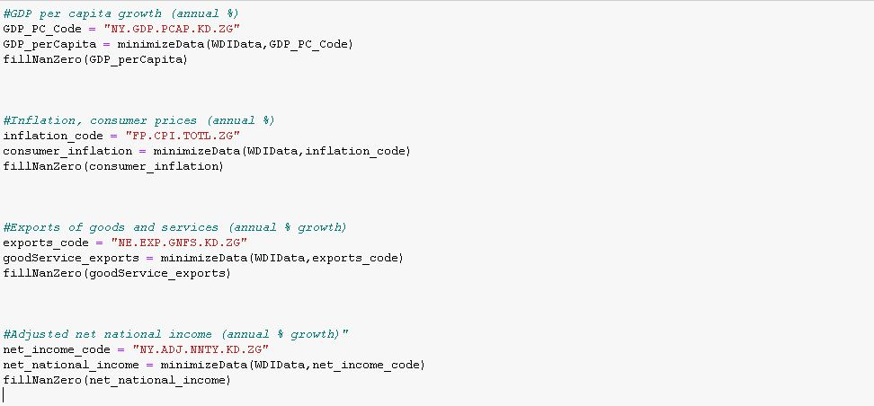
What variables outside the Human Development Index (HDI) also affect economic growth?
Preparing data for this question:

Slide 23
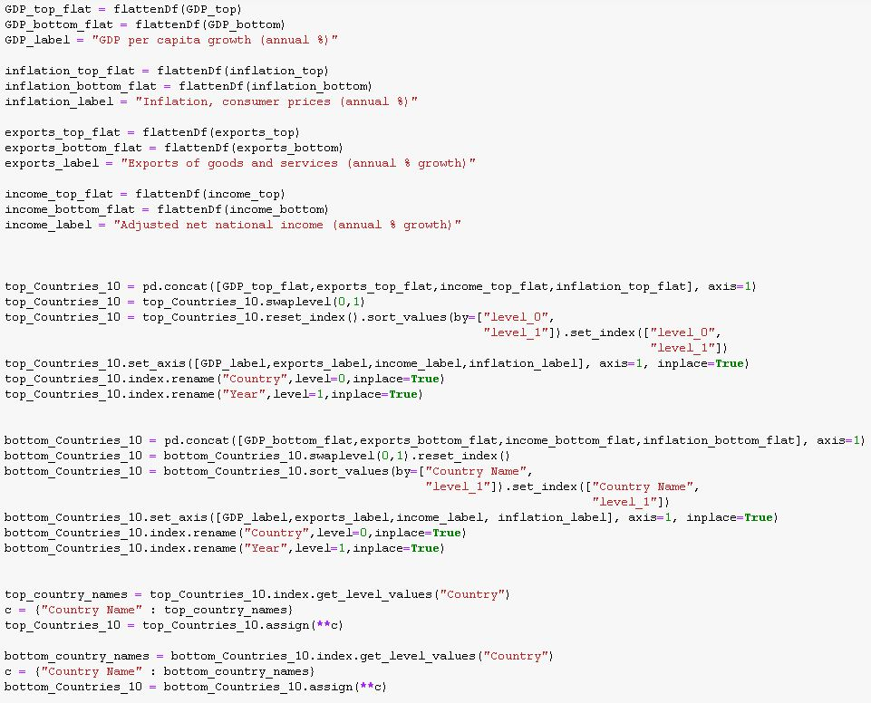
What variables outside the Human Development Index (HDI) also affect economic growth?
Tidying data for this question:

Slide 24
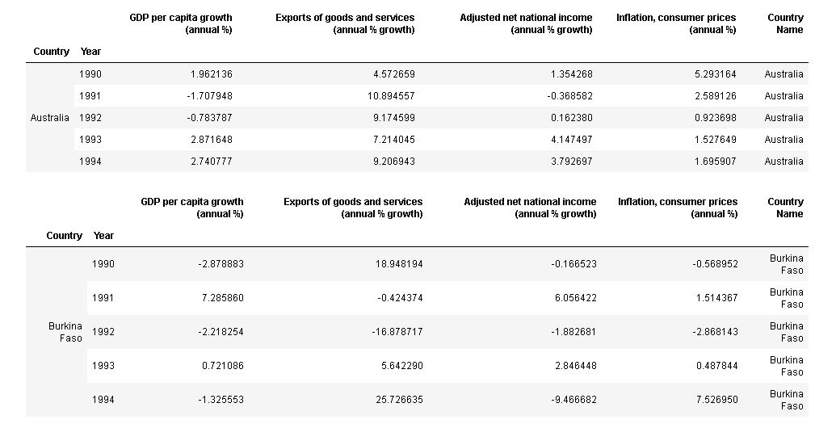
What variables outside the Human Development Index (HDI) also affect economic growth?
Tidying data output:

Slide 25
What variables outside the Human Development Index (HDI) also affect economic growth?
Transforming Data:
Now I can plot this data...

Slide 26
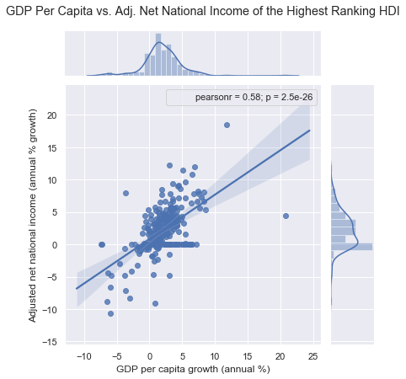
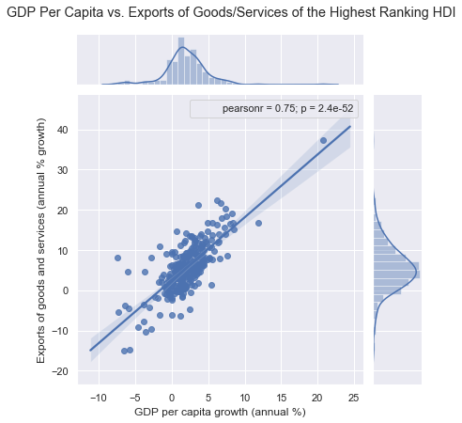
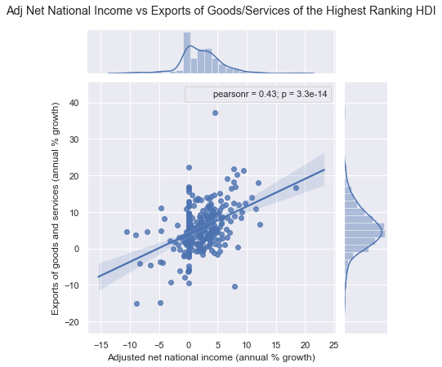
What variables outside the Human Development Index (HDI) also affect economic growth?
Indicators with stronger/positive relationships out of the highest ranking countries:
Bryan Davison

Slide 27
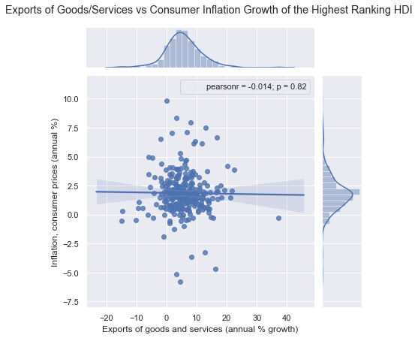
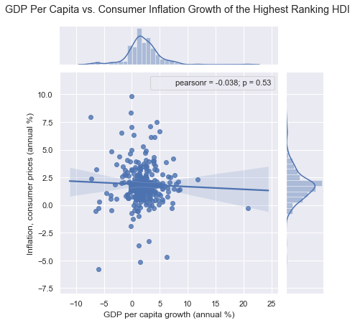
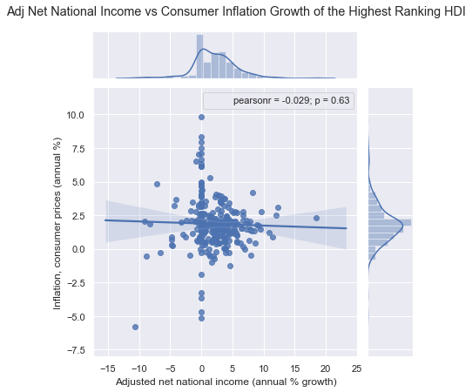
What variables outside the Human Development Index (HDI) also affect economic growth?
Indicators with weaker/negative relationships out of the highest ranking countries:
Bryan Davison

Slide 28
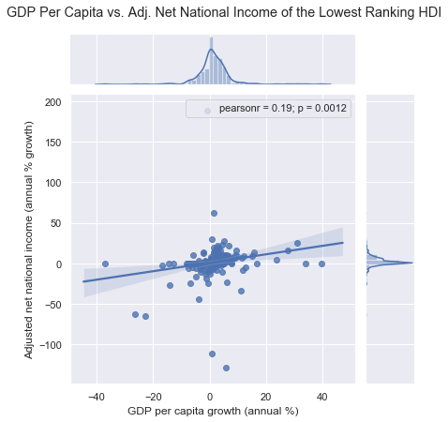
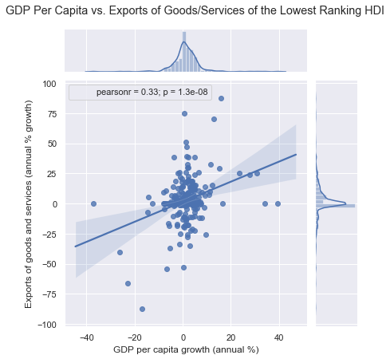
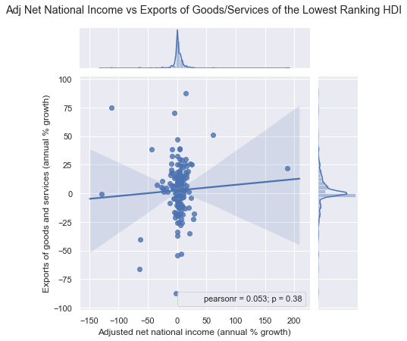
What variables outside the Human Development Index (HDI) also affect economic growth?
Indicators with stronger/positive relationships out of the lowest ranking countries:
Bryan Davison

Slide 29
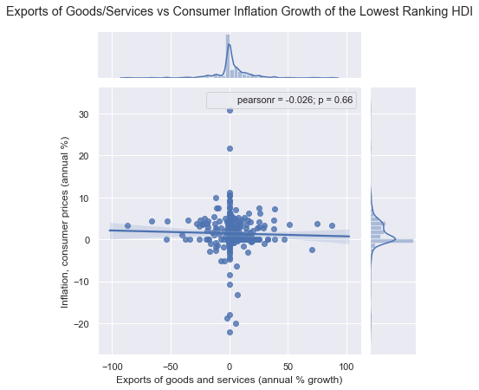
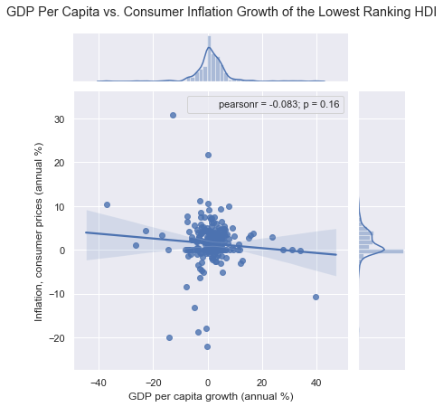
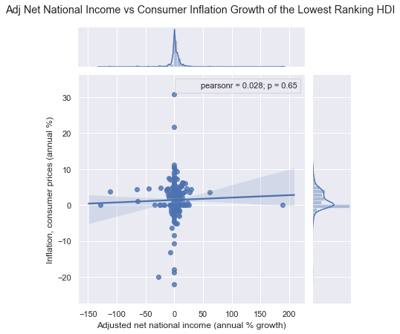
What variables outside the Human Development Index (HDI) also affect economic growth?
Indicators with weaker/negative relationships out of the lowest ranking countries:
Bryan Davison

Slide 30
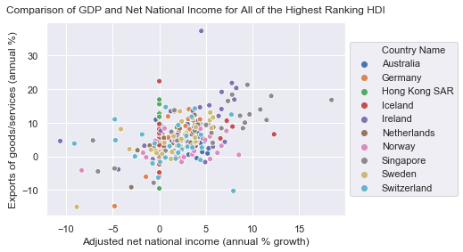
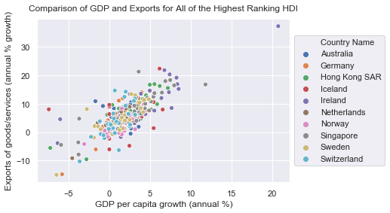
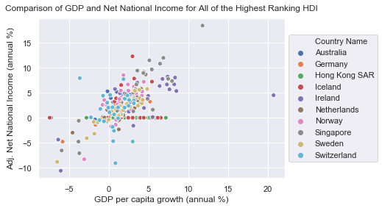
What variables outside the Human Development Index (HDI) also affect economic growth?
A final look:
Bryan Davison

Slide 31
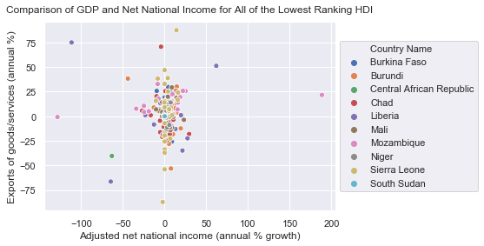
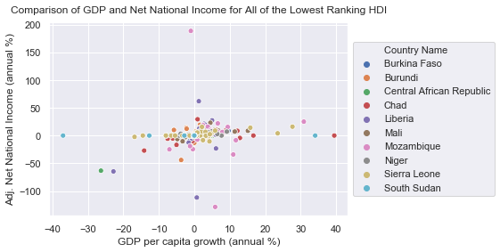
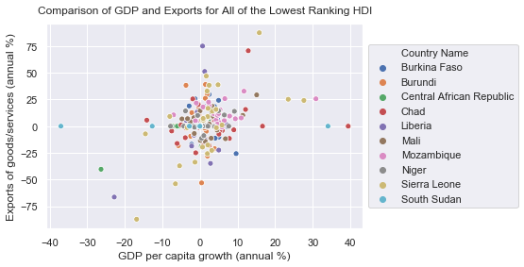
What variables outside the Human Development Index (HDI) also affect economic growth?
A final look:
Bryan Davison

Slide 32
Which factors are the most important in explaining the development of countries (As per the Human Development Index)?
Can we accurately predict which countries saw an increase in income inequality for 2018? (using GINI index)?

Slide 33
Let’s go to the Jupyter Notebook!

Slide 34
PPP Definition
https://www.investopedia.com/updates/purchasing-power-parity-ppp/

