Slide 1

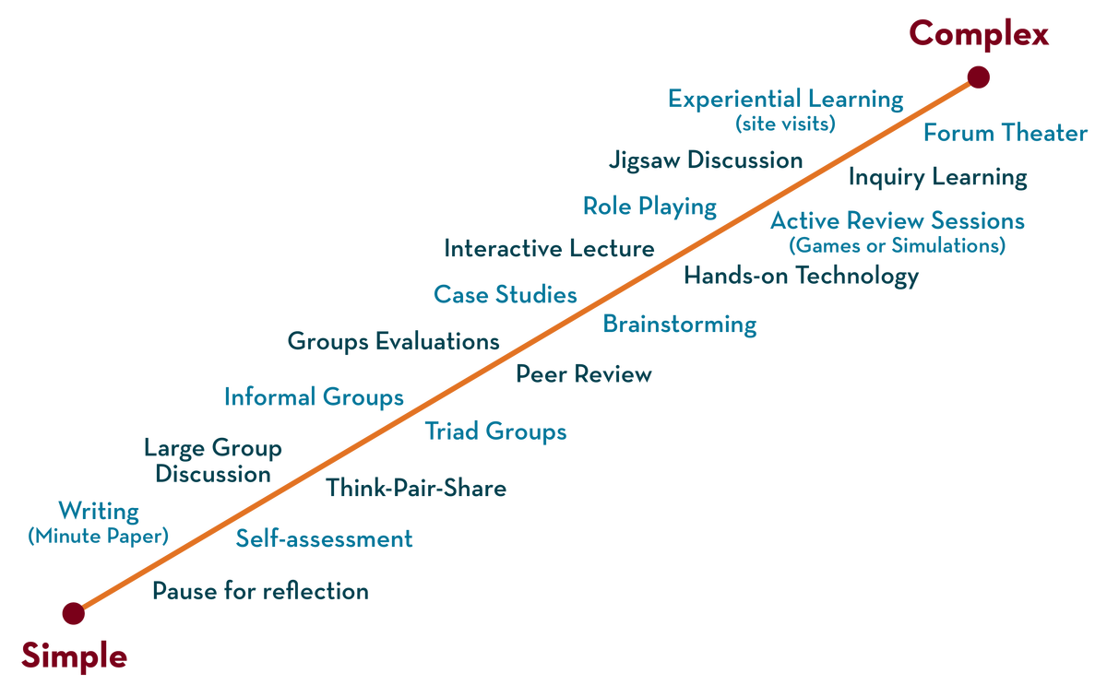
Course Code: 25CS1201E
Department of CSE
Operating Systems and Systems Programming
Course Code: 25CS21014E
CO6

Slide 2
CO- VI
Concurrency and Synchronization
CO-VI: Concurrency and Synchronization, Threads and Processes, POSIX Threads, Race Conditions and Shared Data, Mutual Exclusion Using Mutexes. Condition Variables and Thread Coordination, Counting Semaphores, Deadlocks and Concurrency Hazards, Advanced Synchronization Concepts.

Slide 3
Concurrency and Synchronization

Slide 4
Concurrency
Concurrency in operating systems refers to the capability of an OS to handle more than one task or process at the same time, thereby enhancing efficiency and responsiveness.
It may be supported by multi-threading or multi-processing whereby more than one process or threads are executed simultaneously or in an interleaved fashion.
Concurrency in an operating system refers to the ability to execute multiple processes or threads simultaneously, improving resource utilization and system efficiency.
It allows several tasks to be in progress at the same time, either by running on separate processors or through context switching on a single processor.
Concurrency is essential in modern OS design to handle multitasking, increase system responsiveness, and optimize performance for users and applications.

Slide 5
There are several motivations for allowing concurrent execution:
Physical resource Sharing: Multiuser environment since hardware resources are limited
Logical resource Sharing: Shared file (same piece of information)
Computation Speedup: Parallel execution
Modularity: Divide system functions into separation processes

Slide 6
Threads and Processes
Process
What is a Process?
A process is an active program in execution − more than just program code. It includes the program counter, process stack, registers, and program code. When a program is executed, the operating system creates a process that encompasses all resources needed for execution.
Each process has its own isolated memory space and does not share this space with other processes. This isolation provides security and stability − if one process crashes, it doesn't affect others.

Slide 7
A Process is a program in execution.
The Processes executing in the operating system is one of the following two types:
Independent Processes
Cooperating Processes
Independent Processes
Its state is not shared with any other process.
The result of execution depends only on the input state.
The result of the execution will always be the same for the same input.
The termination of the independent process will not terminate any other.

Slide 8
Cooperating Processes
Its state is shared along other processes.
The result of the execution depends on relative execution sequence and cannot be predicted in advanced(Non-deterministic).
The result of the execution will not always be the same for the same input.
The termination of the cooperating process may affect other process.

Slide 9
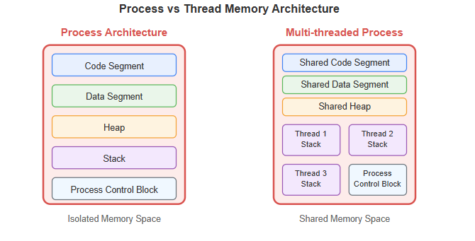
Thread
A thread is a lightweight subprocess that can be scheduled independently. It's often called a "lightweight process" because it requires fewer resources than a full process. Threads enable parallelism within a single application, improving performance.
Threads within the same process share:
Code segment and data segment
Heap memory and global variables
File descriptors and system resources

Slide 10
Differences between PROCESS AND THREAD
Aspect | Process | Thread
Definition | Active program with independent resources | Lightweight subprocess within a process
Memory Sharing | Isolated memory space | Shares code, data, and heap with peer threads
Context Switching | Higher overhead (save/restore all resources) | Lower overhead (only registers and stack)
Communication | Inter-Process Communication (IPC) mechanisms | Direct memory sharing (faster)
Resource Usage | Higher memory and CPU overhead | Lower resource consumption
Creation Time | Slower (allocate separate resources) | Faster (share existing resources)
Failure Impact | Independent − one crash doesn't affect others | Dependent − thread crash can affect entire process
Synchronization | Not required between processes | Required to avoid race conditions

Slide 11
Processes are ideal for:
Applications requiring isolation and security
Independent tasks that don't need to share data
Fault-tolerant systems where one failure shouldn't affect others
Threads are ideal for:
Parallel processing within a single application
Tasks that need frequent data sharing
Performance-critical applications requiring fast context switching

Slide 12
POSIX Threads in OS
POSIX thread libraries (pthreads) are a standard C/C++ API used to create and manage threads for concurrent execution within a program.
They allow multiple flows of execution to run in parallel, especially improving performance on multi-core or multiprocessor systems.
Since threads share the same memory space and resources, they have lower overhead compared to creating separate processes (like using fork).
Even on single-processor systems, threads help improve efficiency by utilizing waiting time during I/O operations.

Slide 13
To use PThreads, we must include the header at the start of the C/C++ program.
#include <pthread.h>
PThreads (POSIX threads) is a standardized API for multithreading in C/C++ on Unix-like systems. It is defined by the POSIX standard, which specifies how operating systems should implement thread-related functionalities.
PThreads provides a set of functions (APIs) for creating, managing, and synchronizing threads within a program.

Slide 14
RACE CONDITIONS
A race condition occurs when two or more processes or threads access and modify the same data at the same time, ad the final result depends on the order in which they run. Without proper coordination, this can lead to incorrect or unpredictable results.
For example: If two people update the same bank account simultaneously without checking each other’s changes, the final balance may be wrong.
Shared Resource: A variable, file, memory location, or device accessed by multiple processes.
Concurrency: Multiple processes or threads executing simultaneously or overlapping in execution.
Non-Atomic Operations: Operations that can be interrupted, such as read-modify-write, which can cause inconsistent states when multiple processes access the same data concurrently.

Slide 15
Causes of Race Conditions
Simultaneous Access: When two or more processes try to read or write the same shared resource at the same time.
Non-Atomic Updates: Operations like increment or decrement are not indivisible.
Lack of Synchronization: No mechanisms like locks, semaphores, or monitors are used to control access.
Improper Scheduling: OS scheduler interrupts processes at critical moments.

Slide 16
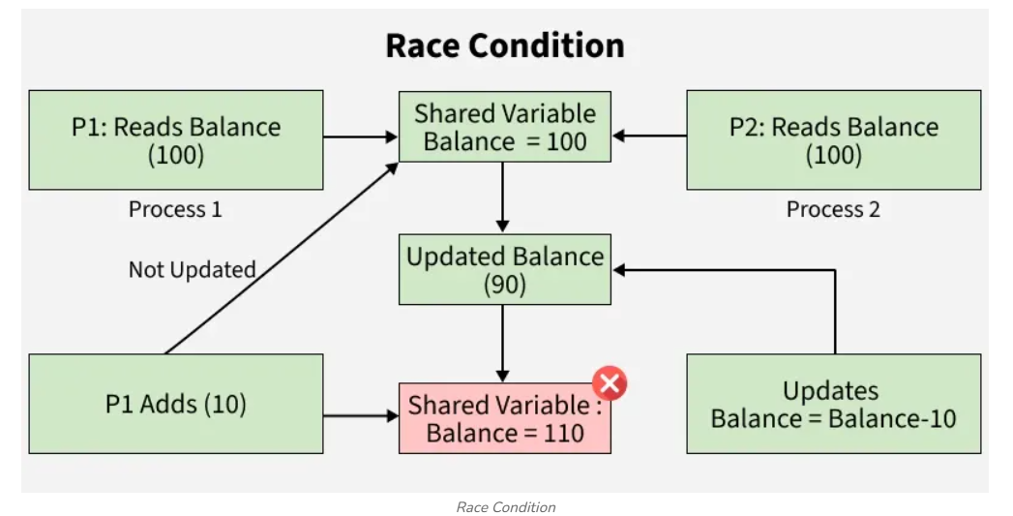
Example: Two Processes Updating a Shared Variable
Let’s take a shared variable balance = 100 and two processes P1 and P2:
P1 wants to add 10 to balance.
P2 wants to subtract 10 from balance.
P1 reads balance = 100 and prepares to add 10.
Before P1 updates the balance with the new value (110), it is interrupted by the process P2.
P2, unaware of P1’s action (of adding 10), reads the balance as 100 (incorrect) and prepares to subtract 10.
After subtracting, P2 updates the balance to 90 and then P1 resumes and writes the balance as 110 which results in an incorrect final value.
In many cases, the final balance may incorrectly be 110 or 90, instead of the expected 100. This is a classic race condition.

Slide 17
Mutual Exclusion Using Mutexes
What is Mutual Exclusion?
Mutual Exclusion is a property of process synchronization that states that "no two processes can exist in the critical section at any given point of time".
The term was first coined by Dijkstra. Any process synchronization technique being used must satisfy the property of mutual exclusion, without which it would not be possible to get rid of a race condition.
The need for mutual exclusion comes with concurrency. There are several kinds of concurrent execution:
Interrupt handlers
Interleaved, preemptively scheduled processes/threads
Multiprocessor clusters, with shared memory
Distributed systems

Slide 18
Mutual exclusion methods are used in concurrent programming to avoid the simultaneous use of a common resource, such as a global variable, by pieces of computer code called critical sections.
The requirement of mutual exclusion is that when process P1 is accessing a shared resource R1, another process should not be able to access resource R1 until process P1 has finished its operation with resource R1.
Examples of such resources include files, I/O devices such as printers, and shared data structures.

Slide 19
Conditions Required for Mutual Exclusion
According to the following four criteria, mutual exclusion is applicable:
When using shared resources, it is important to ensure mutual exclusion between various processes. There cannot be two processes running simultaneously in either of their critical sections.
It is not advisable to make assumptions about the relative speeds of the unstable processes.
For access to the critical section, a process that is outside of it must not obstruct another process.
Its critical section must be accessible by multiple processes in a finite amount of time; multiple processes should never be kept waiting in an infinite loop.

Slide 20
Conditions Required for Mutual Exclusion
According to the following four criteria, mutual exclusion is applicable:
When using shared resources, it is important to ensure mutual exclusion between various processes. There cannot be two processes running simultaneously in either of their critical sections.
It is not advisable to make assumptions about the relative speeds of the unstable processes.
For access to the critical section, a process that is outside of it must not obstruct another process.
Its critical section must be accessible by multiple processes in a finite amount of time; multiple processes should never be kept waiting in an infinite loop.

Slide 21
Approaches To Implementing Mutual Exclusion
Software Method: Leave the responsibility to the processes themselves. These methods are usually highly error-prone and carry high overheads.
Hardware Method: Special-purpose machine instructions are used for accessing shared resources. This method is faster but cannot provide a complete solution. Hardware solutions cannot give guarantee the absence of deadlock and starvation.
Programming Language Method: Provide support through the operating system or through the programming language.

Slide 22
Requirements of Mutual Exclusion
At any time, only one process is allowed to enter its critical section.
The solution is implemented purely in software on a machine.
A process remains inside its critical section for a bounded time only.
No assumption can be made about the relative speeds of asynchronous concurrent processes.
A process cannot prevent any other process from entering into a critical section.
A process must not be indefinitely postponed from entering its critical section.

Slide 23
Conditional Variables
In concurrent programming within operating systems, mutexes and condition variables are both synchronization primitives, but they serve fundamentally different purposes. Below is a detailed comparison from first principles:
Definition
Mutex (Mutual Exclusion Object):
A mechanism to enforce exclusive access to a shared resource. Only one thread can acquire the mutex at a time.
Condition Variable:
A mechanism that allows threads to wait for specific conditions to be met while releasing temporary locks. It is used in conjunction with a mutex.

Slide 24

Purpose
Operation Semantics
Mutex:
  Lock: Thread acquires the mutex; if already held, the thread blocks.
  Unlock: Thread releases the mutex, allowing other threads to acquire it.
  Guarantees mutual exclusion, preventing data races.
Condition Variable:
  Wait: Thread releases the associated mutex and blocks atomically until another thread signals the condition.
  Signal/Notify: Thread wakes one (signal) or all (broadcast) waiting threads when the condition is true.
  Typically requires a mutex to protect the shared condition.
Feature | Mutex | Condition Variable
Core purpose | Protect shared resources from concurrent access | Allow threads to wait efficiently for state changes
Usage scenario | Critical sections (e.g., updating shared counters) | Producer-consumer patterns, event notifications

Slide 25
Interaction
Condition variables cannot be used alone; a mutex is required to protect the condition check.
Mutexes can operate independently to protect a resource, without requiring condition variables.
Efficiency Considerations
Mutex: Direct control over access, minimal overhead for locking.
Condition Variable: Enables sleeping instead of busy-waiting, reducing CPU usage while waiting for a condition.
Example: Producer-Consumer Problem.
Mutex → controls access: Guarantees that critical sections execute mutually exclusively.
Condition Variable → controls execution order: Coordinates threads based on state conditions, not just access to memory.

Slide 26
Aspect | Mutex | Condition Variable
Purpose | Mutual exclusion of resources | Thread synchronization based on state
Operation | Lock, Unlock | Wait, Signal/Broadcast
Requires | No other primitive (can be used standalone) | Always paired with a mutex
CPU usage | May spin if lock unavailable | Sleep efficiently while waiting
Use case | Critical sections | Producer-consumer, event signaling

Slide 27
Counting Semaphores
In concurrent programming, counting semaphores are a synchronization primitive used to control access to a common resource shared among multiple threads or processes. They allow multiple threads to access a set of resources concurrently up to a maximum limit.
Key Concepts:
Definition:
A counting semaphore is an integer variable that can be incremented or decremented atomically. It typically has two operations:
wait() or P(): Decrements the semaphore. If the semaphore's value is greater than zero, the operation continues; otherwise, the thread is blocked until the resource becomes available.
Signal() or V(): Increments the semaphore. If there are threads waiting, one of them is unblocked.

Slide 28
Use Cases:
Controlling access to limited resources (e.g., a pool of database connections, printer access, or slots in a buffer).
  Producer consumer problems where multiple producers and consumers share a finite buffer.
  Controlling concurrent access to multiple instances of a particular resource.
Example: Suppose there are 3 printers, and many threads may need access. A counting semaphore initialized with the number 3 can be used. Each time a thread needs a printer, it performs wait(). When done, it performs signal().
Counting semaphores differ from binary semaphores, which can only take values 0 or 1; binary semaphores are effectively used for mutual exclusion.
Operations on semaphores must be atomic to prevent race conditions. Most programming languages implement this internally.
Improper use of semaphores can lead to deadlocks if threads wait on resources that never get released.

Slide 29
Concurrency Hazards
Concurrency hazards arise in concurrent or parallel programming when multiple threads or processes interact in ways that can cause unexpected or incorrect behavior. Understanding these hazards is crucial for designing reliable and safe software systems. Here are the main types of concurrency hazards:
1. Race Conditions
Definition: Occurs when multiple threads access shared data simultaneously, and the final outcome depends on the relative timing of their execution.
Example: Two threads incrementing the same counter without synchronization may result in lost updates.
Mitigation: Use locks, atomic operations, or higher-level concurrency constructs like semaphores.
2. Deadlocks
Definition: Occurs when two or more threads are waiting indefinitely for each other to release resources.
Example: Thread A waits for a lock held by thread B, while thread B waits for a lock held by thread A.
Mitigation: Ensure a consistent lock acquisition order, use timeout-based locking, or avoid circular dependencies.

Slide 30
3. Livelocks
Definition: Threads are actively changing state in response to each other but never make progress.
Example: Two threads keep yielding to each other while trying to acquire resources.
Mitigation: Incorporate back-off strategies or redesign the interaction protocol.
4. Starvation
Definition: A thread is perpetually delayed from acquiring resources because other threads monopolize them.
Example: High-priority threads continuously preempting lower-priority threads.
Mitigation: Use fair scheduling policies or priority inheritance mechanisms.

Slide 31
5. Atomicity Violations
Definition: Occurs when a sequence of operations must be executed together atomically, but a thread interleaves in between causing inconsistent state.
Example: Checking-then-modifying a shared variable without locks.
Mitigation: Encapsulate operations in atomic blocks, transactions, or locks.
6. Memory Consistency Errors
Definition: When threads have inconsistent views of memory due to caches or delayed visibility of writes.
Example: Thread A writes a value, but thread B reads an old cached value.
Mitigation:Use memory barriers, volatile variables, or concurrency aware constructs from modern libraries.
CO-1 : OS as a Service Layer
7
Notes:
Reinforce the engineering benefits of layering with the building analogy. Ask: 'What would go wrong if applications could call hardware drivers directly?' — lead into the need for strict user/kernel separation, the next topic.

Slide 32
Concurrency hazards are common in multithreaded and parallel systems.
The primary tools to avoid them are locks, semaphores, atomic operations, and careful design of critical sections and communication protocols.
A strong understanding of these hazards helps in writing safe, efficient, and
maintainable concurrent programs. Proper testing with race condition detectors and techniques like thread sanitizers is recommended to identify potential issues early.
CO-1 : OS as a Service Layer
9
Notes:
Trace a concrete example live: reading a file. Request travels app -> syscall -> kernel -> disk driver -> disk; data travels back along the reverse path. This bidirectional flow becomes the exact model used later in the Command Execution Journey slides.

Slide 33
Advanced Synchronization Concepts (Operating Systems)
Advanced synchronization concepts are techniques used to coordinate multiple processes or threads accessing shared resources while ensuring correctness, efficiency, and fairness. These concepts help prevent race conditions, deadlocks, starvation, and inconsistent data.
1. Monitor
A Monitor is a high-level synchronization construct that encapsulates shared data and the operations performed on it. Only one thread can execute inside a monitor at any given time.
Features
Provides automatic mutual exclusion.
Uses condition variables for thread synchronization.
Simpler and safer than using semaphores directly.

Slide 34
Example:
monitor Buffer {
int data;
procedure produce(int item) {
data = item;
}
procedure consume() {
print(data);
}
}
Advantages
Easy to program
Reduces synchronization errors
Supports condition variables

Slide 35
2. Readers-Writers Problem
The Readers-Writers problem deals with concurrent access to shared data.
Multiple readers can read simultaneously.
Only one writer can write at a time.
Writers require exclusive access.
Types
Reader Preference
Readers are never blocked unless a writer is already writing.
Writers may starve.
Writer Preference
Writers get priority.
Readers may wait.
Fair Solution
Both readers and writers are served in FIFO order.

Slide 36
Semaphore Solution:
mutex = 1
rw_mutex = 1
read_count = 0
Reader:
wait(mutex)
read_count++
if(read_count==1)
wait(rw_mutex)
signal(mutex)
Read Data
wait(mutex)
read_count--
if(read_count==0)
signal(rw_mutex)
signal(mutex)
Writer:
wait(rw_mutex)
Write Data
signal(rw_mutex)

Slide 37
Dining Philosophers Problem
Five philosophers sit around a circular table with five forks.
Each philosopher alternates between:
Thinking
Eating
To eat, a philosopher needs both left and right forks.
Problems
Deadlock
Starvation
Resource contention
Solutions
Resource Ordering
Pick forks in a fixed order.
Waiter Solution
A waiter grants permission before philosophers pick forks.
Semaphore Solution
Semaphore fork[5] = {1,1,1,1,1}
Philosopher i:
wait(fork[i])
wait(fork[(i+1)%5])
Eat
signal(fork[i])
signal(fork[(i+1)%5])

Slide 38
Algorithm
Customer:
wait(mutex)
if(waiting < chairs)
{
waiting++
signal(customers)
signal(mutex)
wait(barber)
Haircut
}
else
{
signal(mutex)
Leave
}
Sleeping Barber Problem
A barber shop contains:
One barber
One barber chair
Multiple waiting chairs
Rules
If no customers exist, barber sleeps.
Customer wakes barber if sleeping.
If chairs are full, customer leaves.
Synchronization Objects
Customers semaphore
Barber semaphore
Mutex
Barber:
while(true)
{
wait(customers)
wait(mutex)
waiting--
signal(barber)
signal(mutex)
Cut Hair
}

Slide 39
Barrier Synchronization
A Barrier forces all threads to reach a synchronization point before any thread proceeds.
Applications
Parallel computing
Matrix multiplication
Scientific simulations
GPU programming
Example
Thread 1 ----\
Thread 2 -----\
Thread 3 -------> Barrier ----> Continue
Thread 4 -----/
Thread 5 ----/
pthread_barrier_t barrier;
pthread_barrier_init(&barrier, NULL, 5);
void *worker(void *arg)
{
printf("Thread reached barrier\n");
pthread_barrier_wait(&barrier);
printf("Thread continues\n");
}

Slide 40
Spinlocks
A Spinlock is a lock where a thread repeatedly checks ("spins") until the lock becomes available instead of sleeping.
Advantages
Very fast for short critical sections.
Low overhead.
Disadvantages
Wastes CPU time if lock is held for long.
Not suitable for long waiting periods.
while(test_and_set(lock))
{
// Busy waiting
}
// Critical Section
lock = 0;

Slide 41
Read-Write Locks
A Read-Write Lock allows:
Multiple readers simultaneously.
Only one writer exclusively.
POSIX Example:
pthread_rwlock_t rwlock;
pthread_rwlock_rdlock(&rwlock);
// Read shared data
pthread_rwlock_unlock(&rwlock);
pthread_rwlock_wrlock(&rwlock);
// Modify shared data
pthread_rwlock_unlock(&rwlock);

Slide 42
8. Condition Variables
Condition variables allow threads to wait until a specific condition becomes true.
POSIX Example
pthread_mutex_t mutex;
pthread_cond_t cond;
pthread_mutex_lock(&mutex);
while(condition == false)
{
pthread_cond_wait(&cond, &mutex);
}
pthread_mutex_unlock(&mutex);
Signal another thread:
pthread_cond_signal(&cond);
Broadcast to all waiting threads:
pthread_cond_broadcast(&cond);

Slide 43
9. Deadlock Avoidance
Deadlock occurs when processes wait indefinitely for resources.
Necessary Conditions
Mutual Exclusion
Hold and Wait
No Preemption
Circular Wait
Avoidance Techniques
Banker's Algorithm
Resource Allocation Graph
Resource Ordering
Timeout Mechanisms

Slide 44
Starvation and Aging
Starvation:
A process waits indefinitely because other processes continuously receive priority.
Example: Low-priority process never gets CPU time.
Aging:
Gradually increases the priority of waiting processes to ensure they eventually execute.

Slide 45
Livelock
A Livelock occurs when processes continuously change their state in response to each other but make no actual progress.
Example
Two people repeatedly step aside in the same direction to let the other pass, preventing either from moving forward.

Slide 46
Difference Between Deadlock and Livelock
Deadlock | Livelock
Processes are blocked | Processes remain active
No state changes | State changes continuously
No CPU usage | CPU continues to be used

Slide 47
Compare Synchronization Mechanisms
Mechanism | Busy Waiting | Sleep/Block | Multiple Threads Allowed | Best Use
Mutex | No | Yes | No | Mutual exclusion
Semaphore | Optional | Yes | Yes | Resource management
Monitor | No | Yes | Yes | High-level synchronization
Spinlock | Yes | No | No | Very short critical sections
Read-Write Lock | No | Yes | Multiple readers | Read-heavy workloads
Barrier | No | Yes | All threads synchronize | Parallel algorithms
Condition Variable | No | Yes | Waiting for events | Producer-Consumer, event synchronization

Slide 48
Applications of Advanced Synchronization
Multithreaded web servers
Database management systems
Operating system kernels
Parallel computing
Cloud computing platforms
Distributed systems
Real-time systems
GPU programming
Machine learning and AI training
High-performance scientific computing

Slide 49
Thank You

