Slide 1
Political Framing (v. 1.1) A Computational Analysis of Rhetoric
Dhrumil Mehta
Al Johri
Eiman Siddiqui
dhrumil@politicalframing.com
al@politicalframing.com

Slide 2
Goal
Use Machine Learning and NLP to conduct analysis of data that can help improve reporting and find stories.

Slide 3
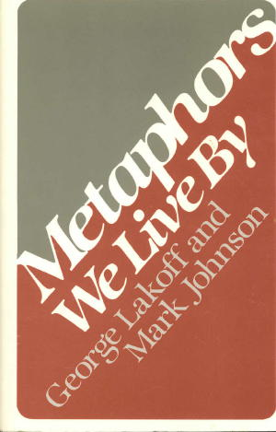
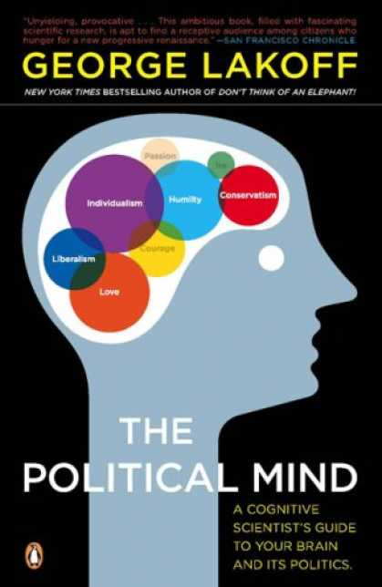
The Motivation
1980
2009

Slide 4

What is a Frame ?
A Frame is a net of words that models a stereotypical scenario. These words are all intimately related
I have written a program that mines Wordnet 2.1 to come up with a 500 word model of a frame.

Slide 5
Example Model Frame : Crime
grand larceny, chain, unlawful, rob, resistance, prices, gang, holdout, children, defraud, cheat breach, housebreaking, inciting, agitating, accuse, abduction, molesting, heist, offender, forged, date rape, helpless, war crime, barratry, capital, jury, victimless crime, blackmail, protection, deceit, molestation, dacoits, brutal, credit, smuggle, armed, confidence, criminals, injure, illegal, election fraud, piracy, minor, plagiarize, entrance statutes, criminal offense, carrying, robbing, capturing, circumstances, rights, cybercrime, breach of trust, fraudulent, scam, rake off, agent high, mayhem, offense, rape, influenced, court, vice, crime, illicit, inhabitants, acts, varies, place, fraud in the factum, intended, shoplift, law, extortion, misleads, malevolent, entrusted, attempt, crippling, larceny, assailant, progressively, pay, representation, playing, executed, distributors, consent, misdemeanor, seizing, depriving, embezzlement, indecent exposure, committed bunco, sleight of hand, armed robbery, thuggery, police, personal, crime, criminal, undermines, embezzling, greater practice, classified, stopped, hijack, nakedness, stealing, sexual intercourse, internet, commits, threatened, free, unwanted, pilferage, perjury, skyjack, hindering, oppose, threat, divorce concealments, retail dwelling, render number, punishable, owner, force, lawsuits, vulgar, traveller, forgery, attack, master, legally, scheme, store, plunderage, relationship, highjacking, punish, corporations, outlaw, kick back … and many more (500 actually)

Slide 6
Dataset
Speeches from the US Senate and House of Representatives dating back 15 years
Data was mined from the Capitol Words API
10,000 speeches per topic for 7 topics
Deficit | Foreign Policy | Health Care | Immigration | Marriage | Middle East | Social Security
*Thanks Tom Saxton and Natalie Murray @ Northwestern

Slide 7
Multinomial Naïve Bayes Clasifier
TF-IDF Based Multinomial Naïve Bayes
Approximately 70% accuracy (no boosting) to classify a novel speech
Chance is approximately 14%, so this is pretty good
20 fold cross validation

Slide 8
The Innovation
You would traditionally train a classifier on a set of speeches and see if it can classify a novel speech into the right category.
Instead of feeding the classifier a speech, I fed it one of my aforementioned rhetorical frames (like the crime frame) to see where the highest correlation of log-likelihoods would be.

Slide 9
Congressional Speeches (approx 3,000 per topic)
 | Deficit | Foreign Policy | Health Care | Immigration | Marriage | Middle East | Social Security
Christianity | -2.64 | -2.25 | -2.50 | -2.46 | -2.02 | -2.52 | -2.52
Crime | -2.44 | -2.13 | -2.62 | -1.98 | -2.48 | -2.44 | -2.16
Finance | -1.83 | -2.13 | -2.39 | -2.48 | -2.44 | -2.40 | -1.67
Sex | -2.46 | -2.27 | -2.42 | -2.33 | -1.94 | -2.46 | -2.38
Military | -2.82 | -1.82 | -2.98 | -2.59 | -2.88 | -1.79 | -2.62
Frame (Modeled as Bag of approx 500 Words)
Mean (μ) = -2.35
Standard Dev (σ) = 0.31
Highlighting: Represents frames that have values that 1 standard deviation above the mean (greater than -2.04). These values show where a rhetorical frame was “present” within a speech topic.

Slide 10
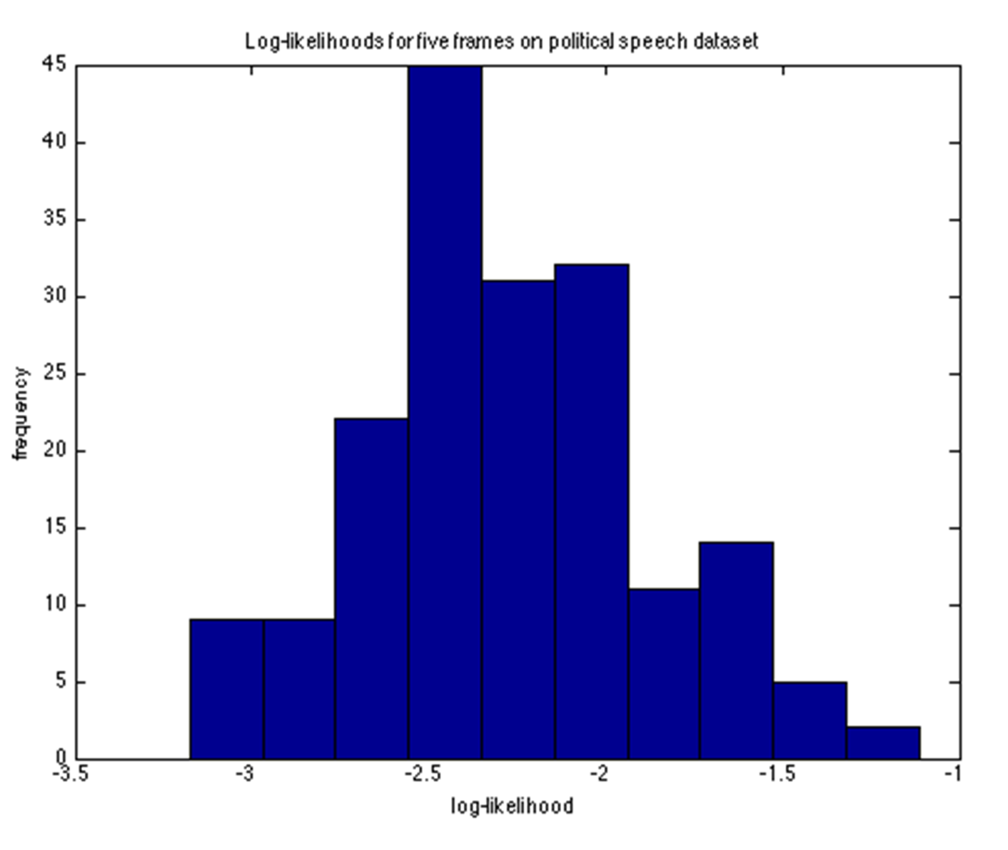
Data Table Visualized
Mean (μ) = -2.35
Standard Dev (σ) = 0.31
Frame is present if Log Likelihood is greater than -2.04, 1 standard deviation above the mean.
2stdev | -1.739740558
1stdev | -2.045013136
Mean | -2.350285714
1Stdev | -2.655558292
2Stdev | -2.96083087
Mean (μ)
Frame Present in Topic:
(highlighted in yellow in chart)

Slide 11
Congressional Speeches (approx 3,000 per topic)
 | Deficit | Foreign Policy | Health Care | Immigration | Marriage | Middle East | Social Security
Christianity | -2.64 | -2.25 | -2.50 | -2.46 | -2.02 | -2.52 | -2.52
Crime | -2.44 | -2.13 | -2.62 | -1.98 | -2.48 | -2.44 | -2.16
Finance | -1.83 | -2.13 | -2.39 | -2.48 | -2.44 | -2.40 | -1.67
Sex | -2.46 | -2.27 | -2.42 | -2.33 | -1.94 | -2.46 | -2.38
Military | -2.82 | -1.82 | -2.98 | -2.59 | -2.88 | -1.79 | -2.62
Frame (Modeled as Bag of approx 500 Words)
Mean (μ) = -2.35
Standard Dev (σ) = 0.31
Interesting, lets dig deeper ….
Highlighting: Represents frames that have values that 1 standard deviation above the mean (greater than -2.04). These values show where a rhetorical frame was “present” within a speech topic.

Slide 12
Digging Deeper on a Single Data Point
Binomial Classifier trained only on Immigration-Related Speeches
 | Democrat | Republican | D:R Ratio | Outcome
Christianity | -0.51396 | -0.9116 | 0.563801 | Democrat
CommonWords | -1.02E+00 | -0.44991 | 2.256513 | Republican
Crime | -1.23073 | -0.34542 | 3.562965 | Republican
Finance | -0.62183 | -0.76994 | 0.807632 | Democrat
Military | -0.7046 | -0.68182 | 1.033402 | Republican
Sex | -0.568 | -0.83623 | 0.679234 | Democrat
RHETORICAL FRAMES
Cool, so in immigration related speeches, republicans use “crime rhetoric” way more frequently than democrats do.

Slide 13
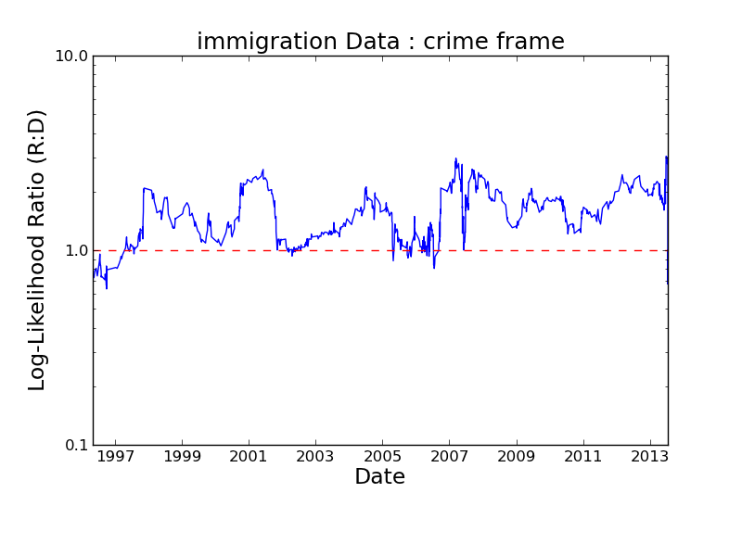
Temporal Analysis

Slide 14
Imagine Being able …
to do computational rhetorical analysis with any deliberative body (local, state, national, international)
compare and contrast rhetoric of parties
follow the rhetoric of particular politicians
analyze changes over time + find key pivot points in rhetoric….
Cross-reference with campaign finance data and voting behavior data !

Slide 15
Feedback Please!
politicalframing@gmail.com
@politicalframin
Become an Alpha Tester!
www.politicalframing.com
Read more:
www.politicalframingblog.com

Slide 16
Appendix 1 - 15 years Data
Data for 15 Years Classifier

Slide 17
Appendix 2 - Graphs
Temporal Analyzer Graphs

