Slide 1


Political Reporting
A Machine Learning Approach

Slide 2
About Me

Slide 3
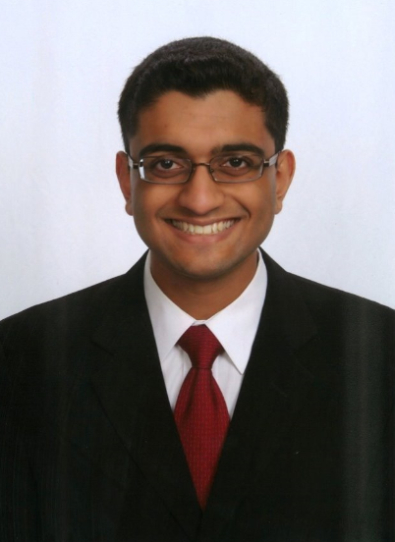

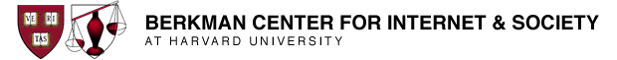
Dhrumil Mehta : Northwestern University
Ba/Ms Candidate – Philosophy & Computer Science
www.dhrumilmehta.com
Student Fellow – Knight Lab for Media Innovation
CTO & Founder – ISBE Tech (tech.nuisbe.org)
Berkman Center Intern (Summer 2013) – MediaCloud (Harvard & MIT)
“I Attended NICAR 2013 in Louisville, KY where I met Jodi and Paul”

Slide 4
Current Methods of Reporting on Congress

Slide 5
Reporting on Congress Today
<< Paul, can you please fill in here the current methods we use >>

Slide 6
Data-Driven Congressional Analysis Today
Today we use computers to study:
Campaign finance data
Record of Voting Behavior
Geographical Data
Party / Affiliation Data
Revolving Door (institutional affiliation) Data
From sources like . . .
http://www.opencongress.org/
http://www.opensecrets.org/
http://thomas.loc.gov/home/thomas.php

Slide 7
But the next step in data-analysis is to see natural language as a form of data itself. The speech of congress-people can be scanned algorithmically to come up with insights that lead to stories …

Slide 8
A New Approach
Finding good stories by using machine learning to study large corpora of natural language data.

Slide 9
My Project
Political Framing : A Machine Learning Approach to Studying Political Rhetoric
-- A more technical analysis can be found at :
www.politicalframing.com
-- Project won 2nd place at the Electrical Engineering and Computer Science (EECS) project fair at Northwestern.
-- The main idea is that we can study the rhetoric of congress-people computationally in order to find new stories…

Slide 10
This approach can answer questions like :
What major shifts have we seen in the rhetoric of congress as a whole, of particular parties/factions, or of particular congress-people with regards to a particular issue?
When have congress people abruptly changed their speaking patterns about a particular issue?
When are voting behavior or sources of financial backing inconsistent with speech patterns?
How closely does a particular congress-person adhere to the party line with regards to a rhetoric surrounding a particular issue

Slide 11
Why this should be adopted by USA Today
This new methodology of rhetoric detection can improve stories by:
Follow a particular topic in depth to see the rhetoric surrounding it
Detect rhetorical anomalies (sudden shifts in rhetoric or politicians who stray from their own habits or from the party line) for a journalist to follow up on.
Cross-reference with other data sources (how does rhetoric align with campaign finance data? , voting behavior?, institutional affiliation?)
Understand the arc of a story over time by analyzing changes in rhetoric

Slide 12
We Propose That…
We apply this methodology to study the corpus of president Obama’s speech as it has changed over time in order to tell a meaningful story about his presidency for publication in USA Today.
The project will focus on his rhetoric overall, contrasting campaign rhetoric to presidential rhetoric as well as understanding the differences in first and second term. We will hone in on particular issues where the program detects the most salience or rhetorical shifts (for example: his rhetoric about the economy, realpolitik in foreign affairs, rhetoric surrounding the wars, or social issues such as marriage equality).

Slide 13
The Goals
To write a good story that is either identified by or made more meaningful with the insights generated from a computational analysis of political rhetoric.
To implement a new method for identifying where important stories are and being able to use this new mode of political rhetoric analysis as a tool for future reporting.

Slide 14
This is a viable project because :
My existing project is a proof-of-concept that shows this type of analysis does yield meaningful results (See Appendix 1).
I can work on this from now through August (we anticipate a 12 week project assuming 5hrs/week) with the support of Paul and Jodi
I have as support from advisers and professors at Northwestern who focus on Machine Learning, Linguistics, AI, and Language Processing and am consulting professors at Medill and in Political Science. I will also be able to consult advisers at the Berkman Center for Internet and Society at Harvard and the Center for Civic Media at MIT in June.

Slide 15

Contact Info
Dhrumil Mehta
www.dhrumilmehta.com
dhrumil.mehta@gmail.com
Please feel free to contact me with any further inquiries.

Slide 16
Appendix 1 : Detailed Analysis of Current Project
This section shows an example of data output of my original project to give the reader a better idea of what this program is capable of
Political Framing: version 0.0 – an analysis of the past 15 years of congressional rhetoric by topic (results shown)
Political Framing: version 1.0 (forthcoming) – contains the results found in these slides but can also detect temporal shifts in rhetorical framing
*A more technical overview can be found at www.politicalframing.com*

Slide 17
Framing of Speeches in Congress by Topic
Congressional Speeches (approx 3,000 per topic)
 | Deficit | Foreign Policy | Health Care | Immigration | Marriage | Middle East | Social Security
Christianity | -2.64 | -2.25 | -2.50 | -2.46 | -2.02 | -2.52 | -2.52
Crime | -2.44 | -2.13 | -2.62 | -1.98 | -2.48 | -2.44 | -2.16
Finance | -1.83 | -2.13 | -2.39 | -2.48 | -2.44 | -2.40 | -1.67
Sex | -2.46 | -2.27 | -2.42 | -2.33 | -1.94 | -2.46 | -2.38
Military | -2.82 | -1.82 | -2.98 | -2.59 | -2.88 | -1.79 | -2.62
Frame (Modeled as Bag of approx 500 Words)
Mean (μ) = -2.35
Standard Dev (σ) = 0.31
Interesting, lets dig deeper ….
Highlighting: Represents frames that have values that 1 standard deviation above the mean (greater than -2.04). These values show where a rhetorical frame was “present” within a speech topic.

Slide 18
Digging Deeper on a Single Data Point
Binomial Classifier trained only on Immigration-Related Speeches
 | Democrat | Republican | D:R Ratio | Outcome
Christianity | -0.51396 | -0.9116 | 0.563801 | Democrat
CommonWords | -1.02E+00 | -0.44991 | 2.256513 | Republican
Crime | -1.23073 | -0.34542 | 3.562965 | Republican
Finance | -0.62183 | -0.76994 | 0.807632 | Democrat
Military | -0.7046 | -0.68182 | 1.033402 | Republican
Sex | -0.568 | -0.83623 | 0.679234 | Democrat
RHETORICAL FRAMES
Cool, so in immigration related speeches, republicans use “crime rhetoric” way more frequently than democrats do (at an almost 3.5 to 1 ratio)!

