Slide 1
Political Framing (v. 0.0) A Computational Analysis of Rhetoric
Dhrumil Mehta
Northwestern University
dhrumil.mehta@gmail.com

Slide 2
Political Framing (v. 0.0) A Machine Learning Approach
Goal: To computationally detect rhetorical framing in political speeches.
*Please note that this project is in the preliminary stages, so although the data is sparse, initial results show that the methodology provides meaningful results.

Slide 3
The Motivation
Our politicians tend to frame issues very deliberately in their speaking patterns (particularly in congress). They may talk about immigration through the frame of crime, or war through the frame of liberation. These framings surface as deeply embedded metaphors in their language.
After reading George Lakoff’s Political Mind and Metaphors we Live By this summer, I got to thinking how cool it would be if there was a way to computationally detect deeply embedded metaphor in natural language.

Slide 4
Methodology : Modeling a Frame
To model a “rhetorical frame” through which a politician may want to present an issue, I wrote a script that would mine WordNet in a way that would provide a list of about 500 relevant words.
* For (v0.0), we pruned the list manually to remove irrelevant noise, but I’m currently working on an algorithm to prune less relevant words automatically.

Slide 5
Example Frame : Crime
grand larceny, chain, unlawful, rob, resistance, prices, gang, holdout, children, defraud, cheat breach, housebreaking, inciting, agitating, accuse, abduction, molesting, heist, offender, forged, date rape, helpless, war crime, barratry, capital, jury, victimless crime, blackmail, protection, deceit, molestation, dacoits, brutal, credit, smuggle, armed, confidence, criminals, injure, illegal, election fraud, piracy, minor, plagiarize, entrance statutes, criminal offense, carrying, robbing, capturing, circumstances, rights, cybercrime, breach of trust, fraudulent, scam, rake off, agent high, mayhem, offense, rape, influenced, court, vice, crime, illicit, inhabitants, acts, varies, place, fraud in the factum, intended, shoplift, law, extortion, misleads, malevolent, entrusted, attempt, crippling, larceny, assailant, progressively, pay, representation, playing, executed, distributors, consent, misdemeanor, seizing, depriving, embezzlement, indecent exposure, committed bunco, sleight of hand, armed robbery, thuggery, police, personal, crime, criminal, undermines, embezzling, greater practice, classified, stopped, hijack, nakedness, stealing, sexual intercourse, internet, commits, threatened, free, unwanted, pilferage, perjury, skyjack, hindering, oppose, threat, divorce concealments, retail dwelling, render number, punishable, owner, force, lawsuits, vulgar, traveller, forgery, attack, master, legally, scheme, store, plunderage, relationship, highjacking, punish, corporations, outlaw, kick back … and many more (500 actually)

Slide 6
Methodology : Getting Speech Data
I got a team onboard* and we downloaded from the Capitol Words API about 10,000 speeches each from the following 7 topics represented in the US house and senate from the past 15 years:
To make sure our data was reasonably clean, we took only the top 3000 search results (speeches) per topic.
Deficit | Foreign Policy | Health Care | Immigration | Marriage | Middle East | Social Security
*Thanks Tom Saxton and Natalie Murray @ Northwestern

Slide 7
Methodology : Establishing a Baseline
We trained a Multinomial Naïve Bayes classifier and used 20 fold cross validation to ensure that it worked. We found that without any modification or boosting, we could classify a novel speech into those 7 topics at about 70% accuracy (chance would be 14%, meaning this task could be performed relatively well).

Slide 8
Methodology : Doing Funky Stuff
You would traditionally train a classifier on a set of speeches and see if it can classify a novel speech into the right category.
Instead of feeding the classifier a speech, I fed it one of my aforementioned rhetorical frames (like the crime frame) to see where the highest correlation of log-likelihoods would be.

Slide 9
… to get Cool Results!
The next slide shows the bare bones data from version 0.0 – I have since collected more exciting data with more frames and more speeches and split by party.
The next iteration of this project will partition and show this Political Framing data for particular politicians, for particular time periods, and for each party as a whole.

Slide 10
Congressional Speeches (approx 3,000 per topic)
 | Deficit | Foreign Policy | Health Care | Immigration | Marriage | Middle East | Social Security
Christianity | -2.64 | -2.25 | -2.50 | -2.46 | -2.02 | -2.52 | -2.52
Crime | -2.44 | -2.13 | -2.62 | -1.98 | -2.48 | -2.44 | -2.16
Finance | -1.83 | -2.13 | -2.39 | -2.48 | -2.44 | -2.40 | -1.67
Sex | -2.46 | -2.27 | -2.42 | -2.33 | -1.94 | -2.46 | -2.38
Military | -2.82 | -1.82 | -2.98 | -2.59 | -2.88 | -1.79 | -2.62
Frame (Modeled as Bag of approx 500 Words)
Mean (μ) = -2.35
Standard Dev (σ) = 0.31
Interesting, lets dig deeper ….
Highlighting: Represents frames that have values that 1 standard deviation above the mean (greater than -2.04). These values show where a rhetorical frame was “present” within a speech topic.

Slide 11
Digging Deeper on a Single Data Point
Binomial Classifier trained only on Immigration-Related Speeches
 | Democrat | Republican | D:R Ratio | Outcome
Christianity | -0.51396 | -0.9116 | 0.563801 | Democrat
CommonWords | -1.02E+00 | -0.44991 | 2.256513 | Republican
Crime | -1.23073 | -0.34542 | 3.562965 | Republican
Finance | -0.62183 | -0.76994 | 0.807632 | Democrat
Military | -0.7046 | -0.68182 | 1.033402 | Republican
Sex | -0.568 | -0.83623 | 0.679234 | Democrat
RHETORICAL FRAMES
Cool, so in immigration related speeches, republicans use “crime rhetoric” way more frequently than democrats do.

Slide 12
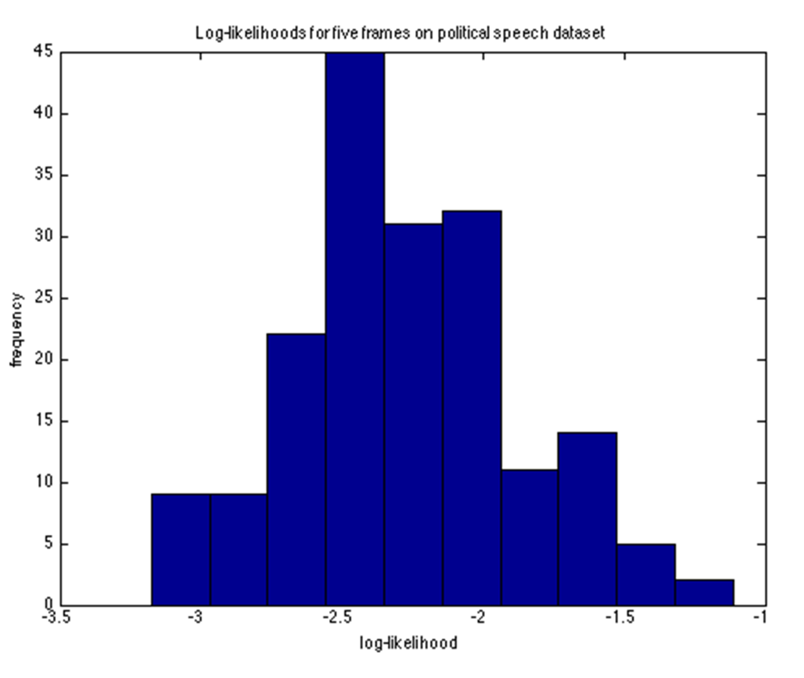
Data Table Visualized
Mean (μ) = -2.35
Standard Dev (σ) = 0.31
Frame is present if Log Likelihood is greater than -2.04, 1 standard deviation above the mean.
2stdev | -1.739740558
1stdev | -2.045013136
Mean | -2.350285714
1Stdev | -2.655558292
2Stdev | -2.96083087
Mean (μ)
Frame Present in Topic:
(highlighted in yellow in chart)

Slide 13
Imagine…
Being able to do this rhetorical analysis with any legislative body
For any law-maker or politician
AND analyze changes over time + key pivot points in rhetoric….

Slide 14
Feedback Please! Is it useful? Is it interesting?
dhrumil.mehta@gmail.com
www.politicalframing.com
p.s. I am seeking a summer internship in data journalism. I’m handy with machine learning and data in general – please email me if you are interested in my work.

