Slide 1
Build System

Slide 2
Features
Commitless

Slide 3
Repo structure
group_repo
build_system
module_1
submodule_1
submodule_1_1
…
...
...
…
module
interface_headers
CMakeLists.txt
dependency.txt
submodule_1
CMakeLists.txt
src
…

Slide 4
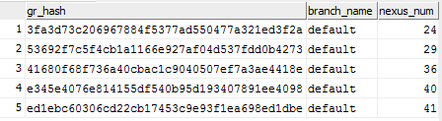
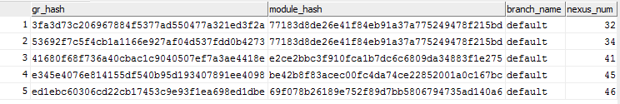
DataBase (tables)
group_repo
module

Slide 5
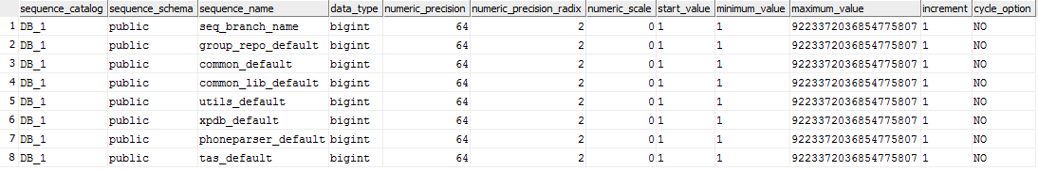
DataBase (sequences)
To get next build version for module (nexus_num)
information_schema.sequences

Slide 6
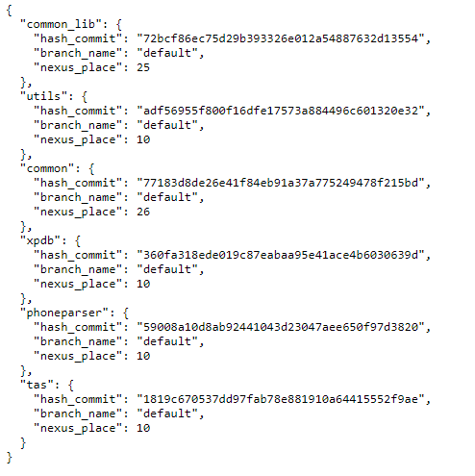
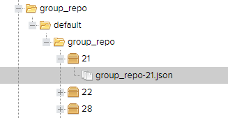
Nexus (group_repo)
group_repo contains json with info for buit modules

Slide 7
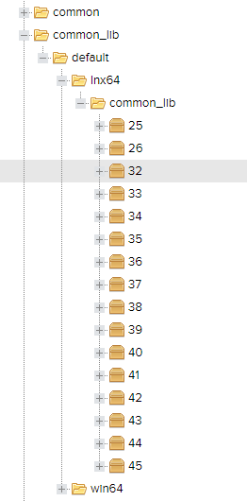
Nexus
For a module contains only one archive with all submodules
Specified build for a module can be found:
Module hash -> DB (get nexus num)
Specified build for a group repo can be found:
Module hash -> DB (get gr_hash(s)) -> DB (get nexus_num for group_repo) -> Nexus (get json)

Slide 8
Control process (python script)
Clone/update group_repo
Find built modules
Detect changed modules
Load 3d party and non-changed modules
Generate solution with Cmake
Build solution
Publish

Slide 9
Find built modules (python script)
Can be found several group_repo commits with built modules. Get commit with most overlap modules.

Slide 10
CMake (group repo)
Global properties:
IMPORT_HEADERS_DIR : import/headers
CMAKE_ARCHIVE_OUTPUT_DIRECTORY : import/libs
PUBLISH_FOLDER : export
For each module in WITH_SOURCES:
add_subdirectory(…)
Cmake run example:
['cmake', '..', '-G', 'Visual Studio 14 2015 Win64', '-DWITH_SOURCES=phoneparser;common;xpdb;tas;utils;common_lib’]

Slide 11
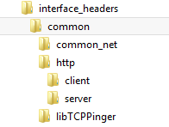
CMake (module)
INTERFACE_HEADERS : ${CMAKE_CURRENT_SOURCE_DIR}/interface_headers
‘interface_headers’ folder should contain files allowed for other modules
add_subdirectory() : for all submodules
publish_to_archive:
function (publish_to_archive archive_name from_folder files_to_archive depends_for_publish)

Slide 12
CMake (submodule)
For submodule with other submodules should be set MODULE_PATH :
string(CONCAT MODULE_PATH "${MODULE_PATH}" "/http")
Set include directory:
target_include_directories(common_net PRIVATE "${INTERFACE_HEADERS}/${MODULE_PATH}/common_net")
target_include_directories(common_net INTERFACE "${INTERFACE_HEADERS}")

Slide 13
Sources
https://github.com/Polladin/BuildSystem
Should be installed and configured:
Postgress DB
Nexus Repository Manager

