Slide 1
Face Mask Detection
Parag Jain

Slide 2
Index
1. Video Analytics Processing Pipeline
2. System Architecture

Slide 3
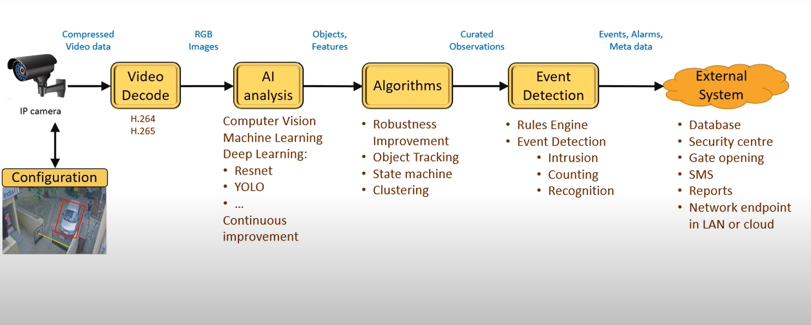
Video Analytics Processing Pipeline

Slide 4
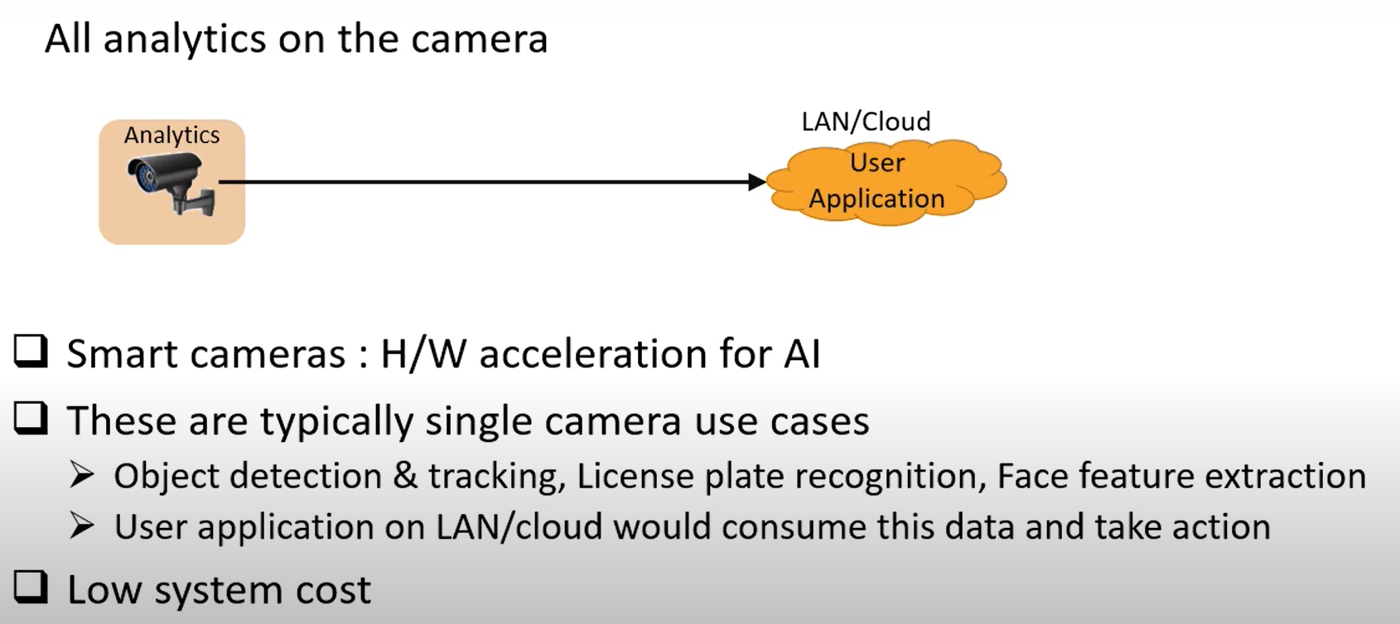
System Architecture : On Camera

Slide 5
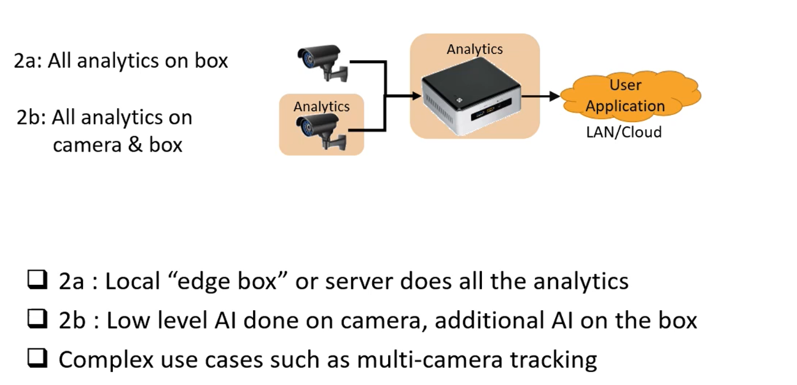
System Architecture : On Premises

Slide 6
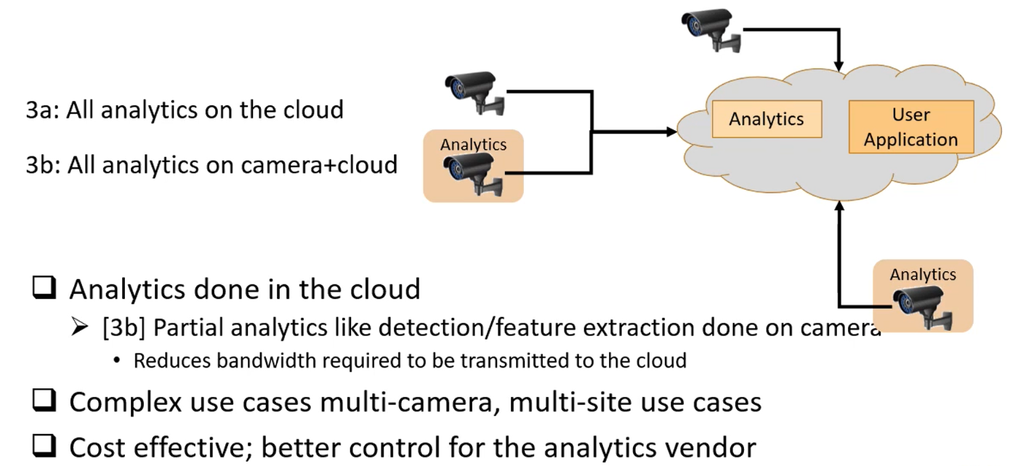
System Architecture : In the Cloud

Slide 7
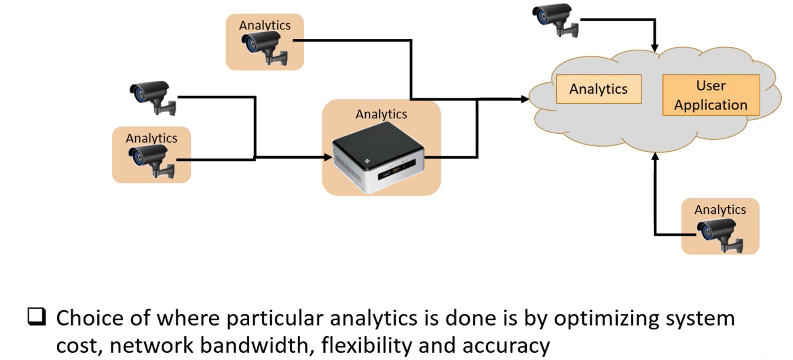
System Architecture : Combination

