Slide 1
Effects of User Feedback on Video Game Patches
By: Jeremy Kroeker

Slide 2
Contents
Problem
Solution
Methodology
Results
Conclusion

Slide 3
Problem
Do developers respond to user feedback submitted through online forums by making changes to the product?
Product changes represented in patch notes
Focus on bug reports and fixes

Slide 4
Solution
Create database
Parse all patch note, store in database
Parse forum post info, store in database
Compare occurrences of keywords between the two datasets. Observe trends.
(Implemented as an interface! :D )

Slide 5
Methodology
Applied solution to 3 exemplar data sets:
League of Legends (LOL)
Team Fortress 2 (TF2)
World of Warcraft (WOW)
Obtain all forum data from Reddit
(due to time constraints)

Slide 6
Methodology
Data Sources:
Patches(LOL): http://leagueoflegends.wikia.com/wiki/Patch
Patches(WOW): http://www.wowwiki.com/Patches
Patches(TF2): https://wiki.teamfortress.com/wiki/Patches
Reddit (LOL): http://www.reddit.com/r/leagueoflegends
Reddit (WOW): http://www.reddit.com/r/wow/
Reddit (TF2): http://www.reddit.com/r/tf2/
Only Reddit posts containing “bug”, “issue”, or “crash” in title

Slide 7
Methodology
Awesome Reddit API:
http://www.reddit.com/r/<SUBREDDIT>/
Search.json?q=(and+timestamp:<STIME>..<ENDTIME>+title:'<KEYWORDS>')
&sort=top&restrict_sr=on&syntax=cloudsearch&limit=100
For example, get the top 100 posts in the League of Legends subreddit on the week of Feb. 8 which contain the words “bug” or “issue” in the title:
http://www.reddit.com/r/leagueoflegends/search.json?q=(and+timestamp:1423382400..1423987200+title:'bug||issue')&sort=top&restrict_sr=on&syntax=cloudsearch&limit=100

Slide 8
Methodology
Graphs:
For a given search term…
Find all Reddit posts which contain this term (body or title)
Assign each Reddit post a weighting:
weight = log10(numberOfComments)+log10(popularity)
Find all Patch notes which contain this term
Graph vs. time (weekly granularity)

Slide 9
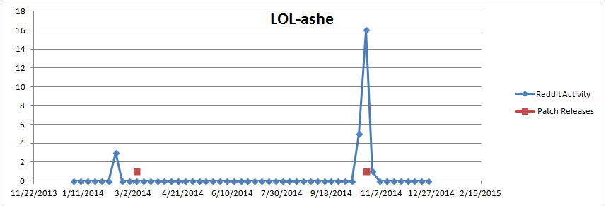
Results
Keyword "Ashe" in the League of Legends data

Slide 10
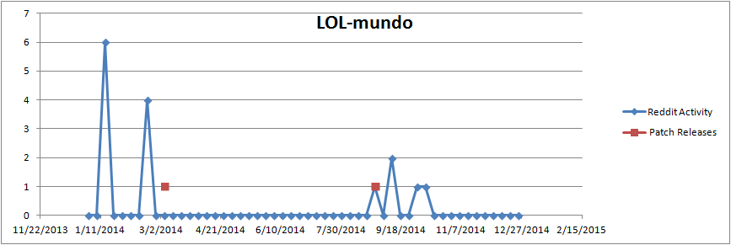
Results
Keyword “Mundo" in the League of Legends data

Slide 11
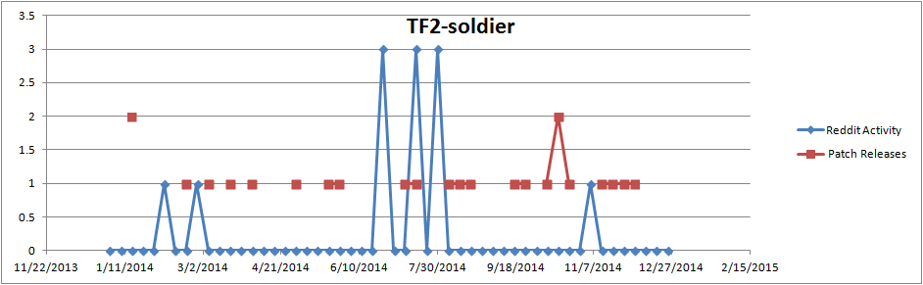
Results
Keyword “Soldier" in the Team Fortress 2 data

Slide 12
Conclusion
Spikes in forum activity are usually followed by a patch
Patch releases drive forum activity
new bugs and new discussion points
Developer procedures affect forum activity
Do they have in-game bug reporting?
Are they active in the forums?

Slide 13
Conclusion
Threats to Validity:
WOW and TF2 subreddits relatively inactive
Keyword searches do not reflect context
Reddit may be a “mirror” of other forums. Even if a correlation is shown between Reddit and Patch Notes. Developers could still be getting their user feedback from elsewhere.

Slide 14
Conclusion
Future Work:
Turn Java code into an actual library
Automated graph creation
Look at other user forums
Obtain developer’s issue tracking data
DTW (Dynamic Time Warping) analysis
“average offset” => developer response time
Expand methodology to non-gaming projects

Slide 15
Conclusion
Lessons Learned:
Parsing websites is slow
APIs are awesome
Graphs are difficult
Game communities are awesome

Slide 16
References
Microsoft SQL Server Express: http://www.microsoft.com/en-ca/server-cloud/products/sql-server-editions/sql-server-express.aspx
Java Apache HTTPComponents: http://hc.apache.org/
Java HTML parsing with jsoup: http://jsoup.org/
Java Microsoft JDBC Driver: http://www.microsoft.com/en-ca/download/details.aspx?id=2505
Java JDBC Tutorials: http://www.tutorialspoint.com/jdbc/
Reddit API: https://github.com/reddit/reddit/blob/master/r2/r2/lib/cloudsearch.py#L172
Date/time convertor: http://www.epochconverter.com/
Background Image, “Trials of the Poro”, Riot Games: http://na.leagueoflegends.com/en/news/champions-skins/champion-preview/trials-poro
Ping Selector, Riot Games: http://forums.na.leagueoflegends.com/board/showthread.php?p=35156161

Slide 17
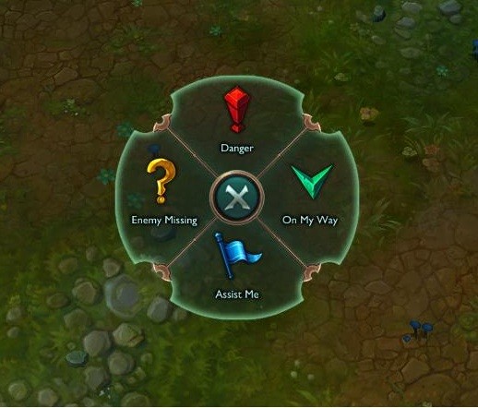
Questions

