Slide 1
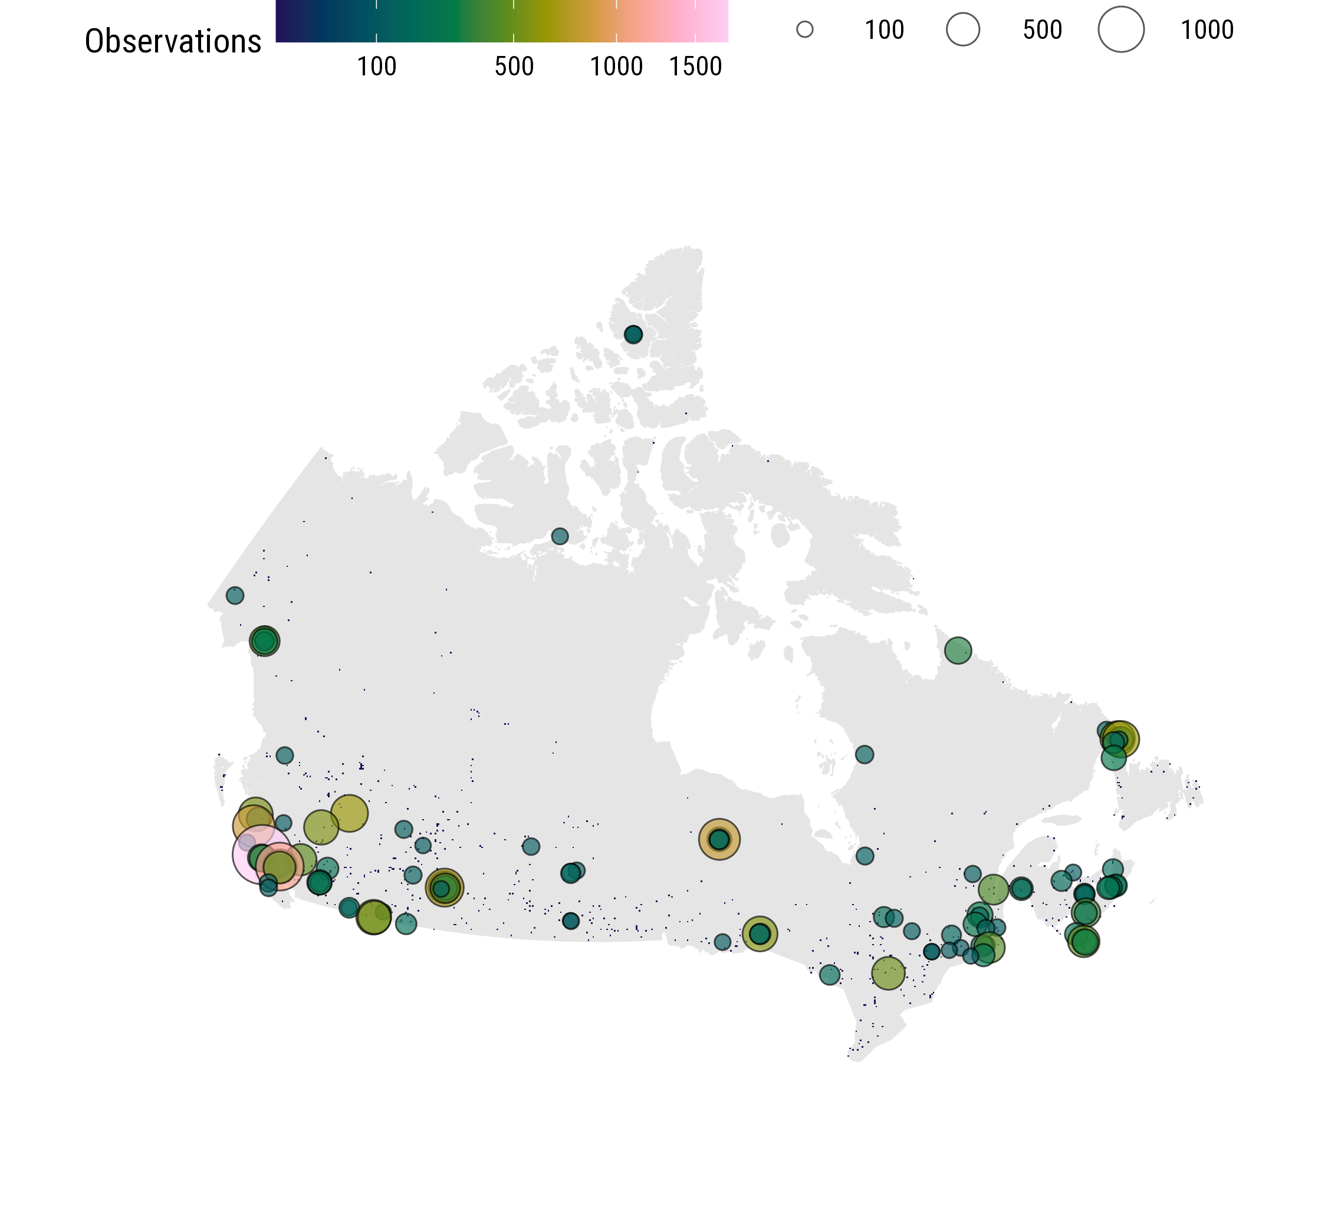
Observations in newly sampled cells

