Slide 1
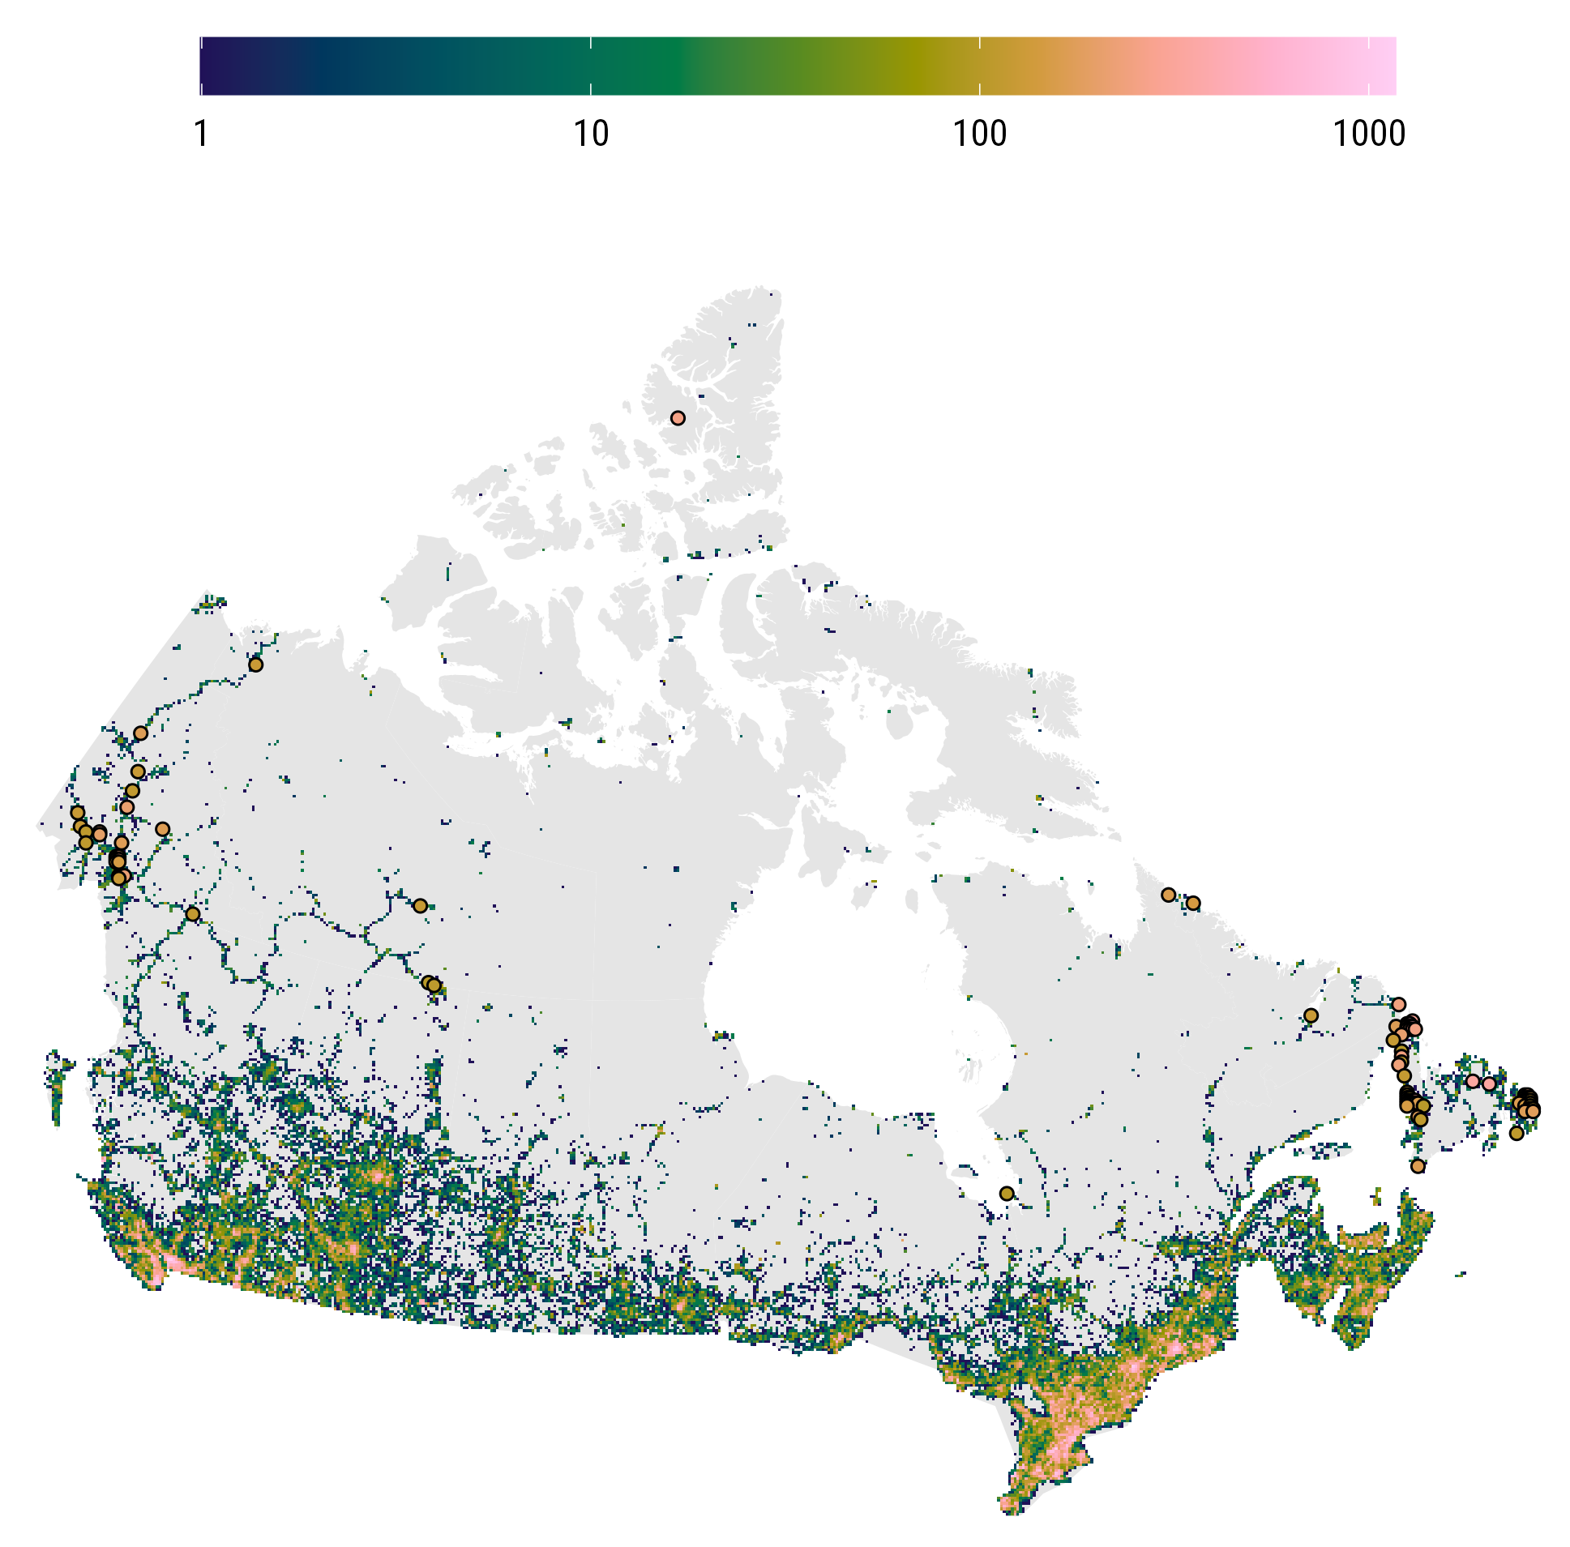
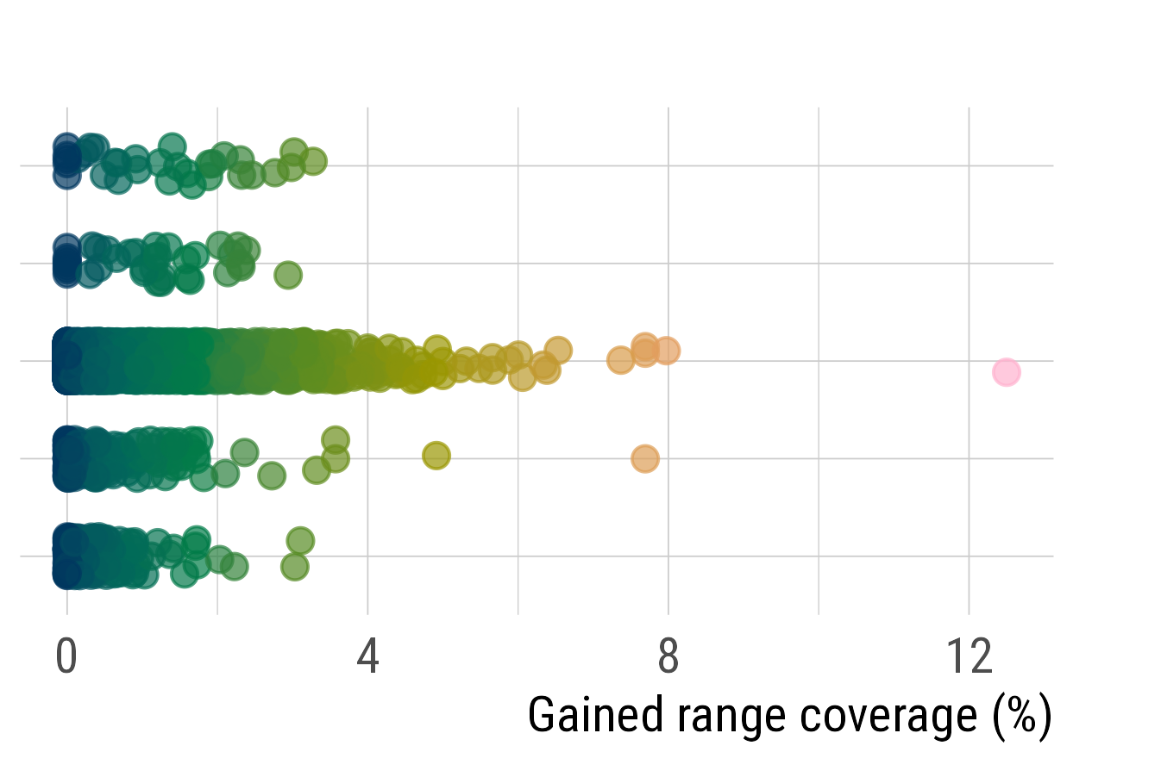
New species observed per site
Expedition Fiord Arctic Bioblitz
Limestone Barrens Bioblitz
CBA 2025 Bioblitz
Reptiles
Blanding’s Turtle
Emydoidea blandingii
Amphibians
Spring Salamander
Gyrinophilus porphyriticus
Fetid Marigold Dyssodia papposa
Plants
Mammals
Vancouver Island Marmot
Marmota vancouverensis
Butterflies
California Tortoiseshell
Nymphalis californica
Notes:
Full 2025 version

Slide 2
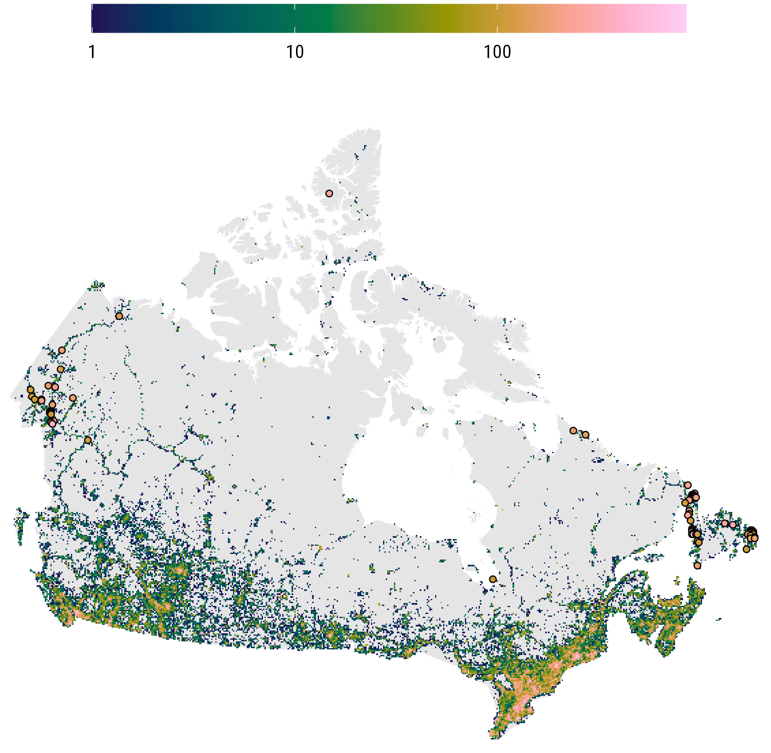
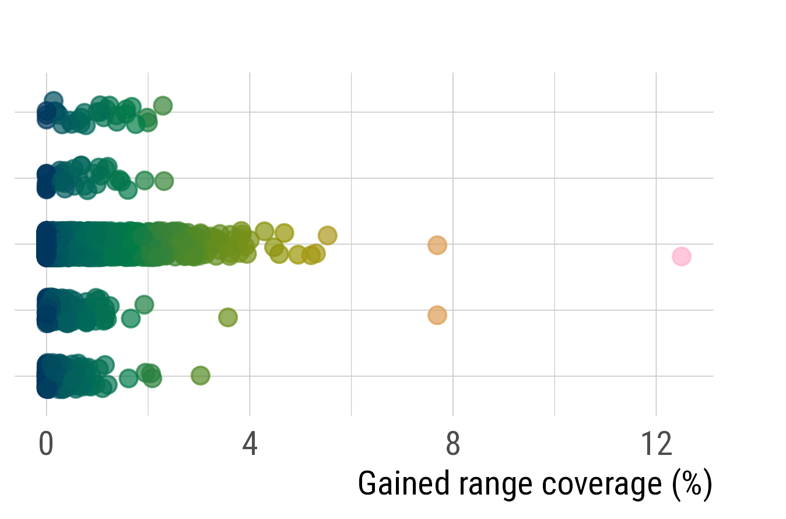
New species observed per site
853
Expedition Fiord Arctic Bioblitz
Limestone Barrens Bioblitz
CBA 2025 Bioblitz
Reptiles
Common Watersnake
Nerodia sipedon
Amphibians
Red-legged frog Rana aurora
Fetid Marigold Dyssodia papposa
Plants
Mammals
Vancouver Island Marmot
Marmota vancouverensis
Butterflies
Clouded Sulphur
Colias philodice
Notes:
Full 2025 version

