Slide 1
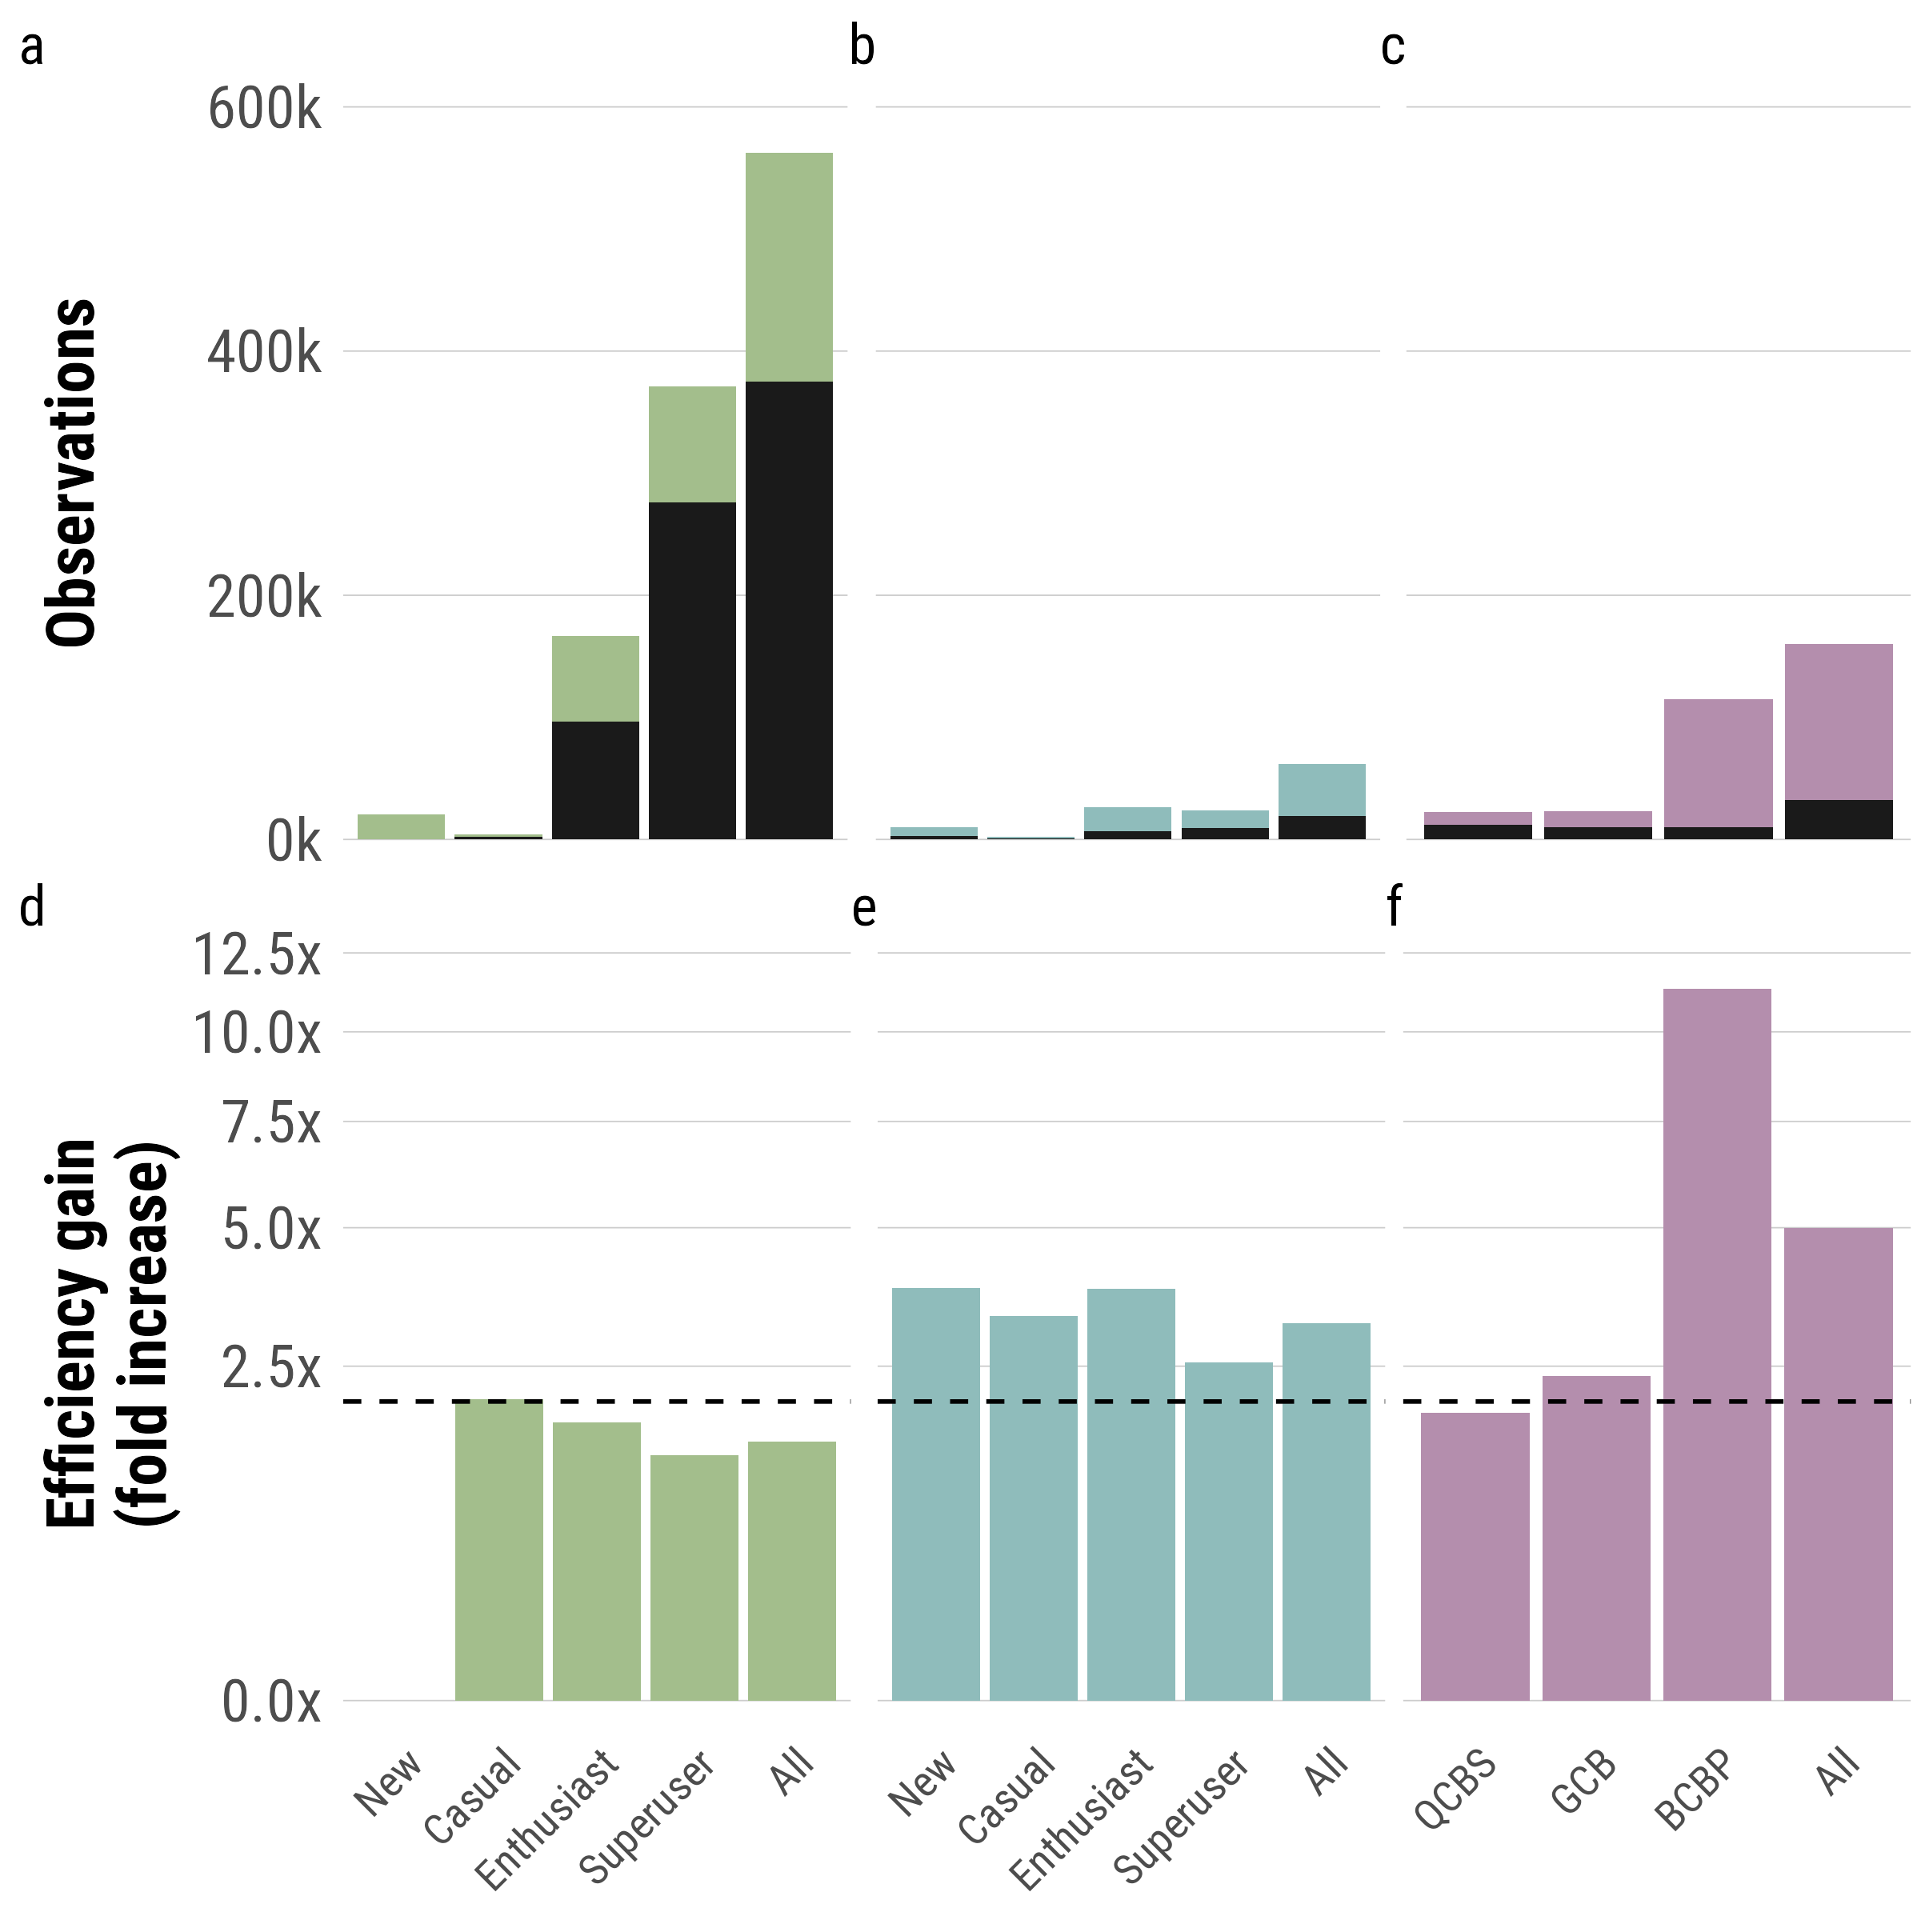
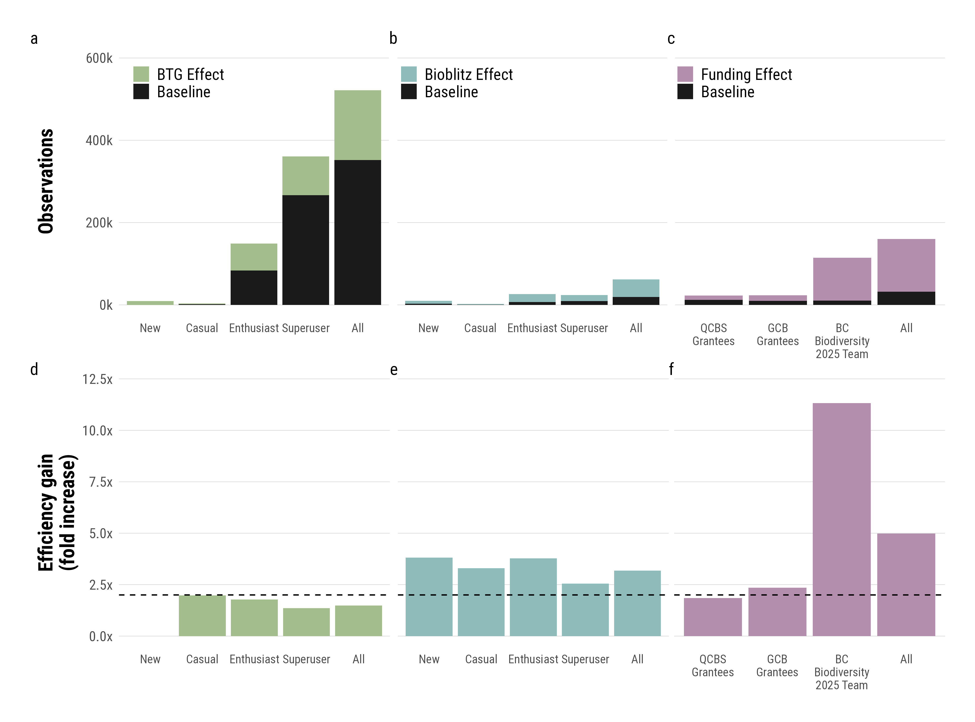
BTG Effect
Bioblitz Effect
Funding Effect
Expectation
doubling

Slide 2
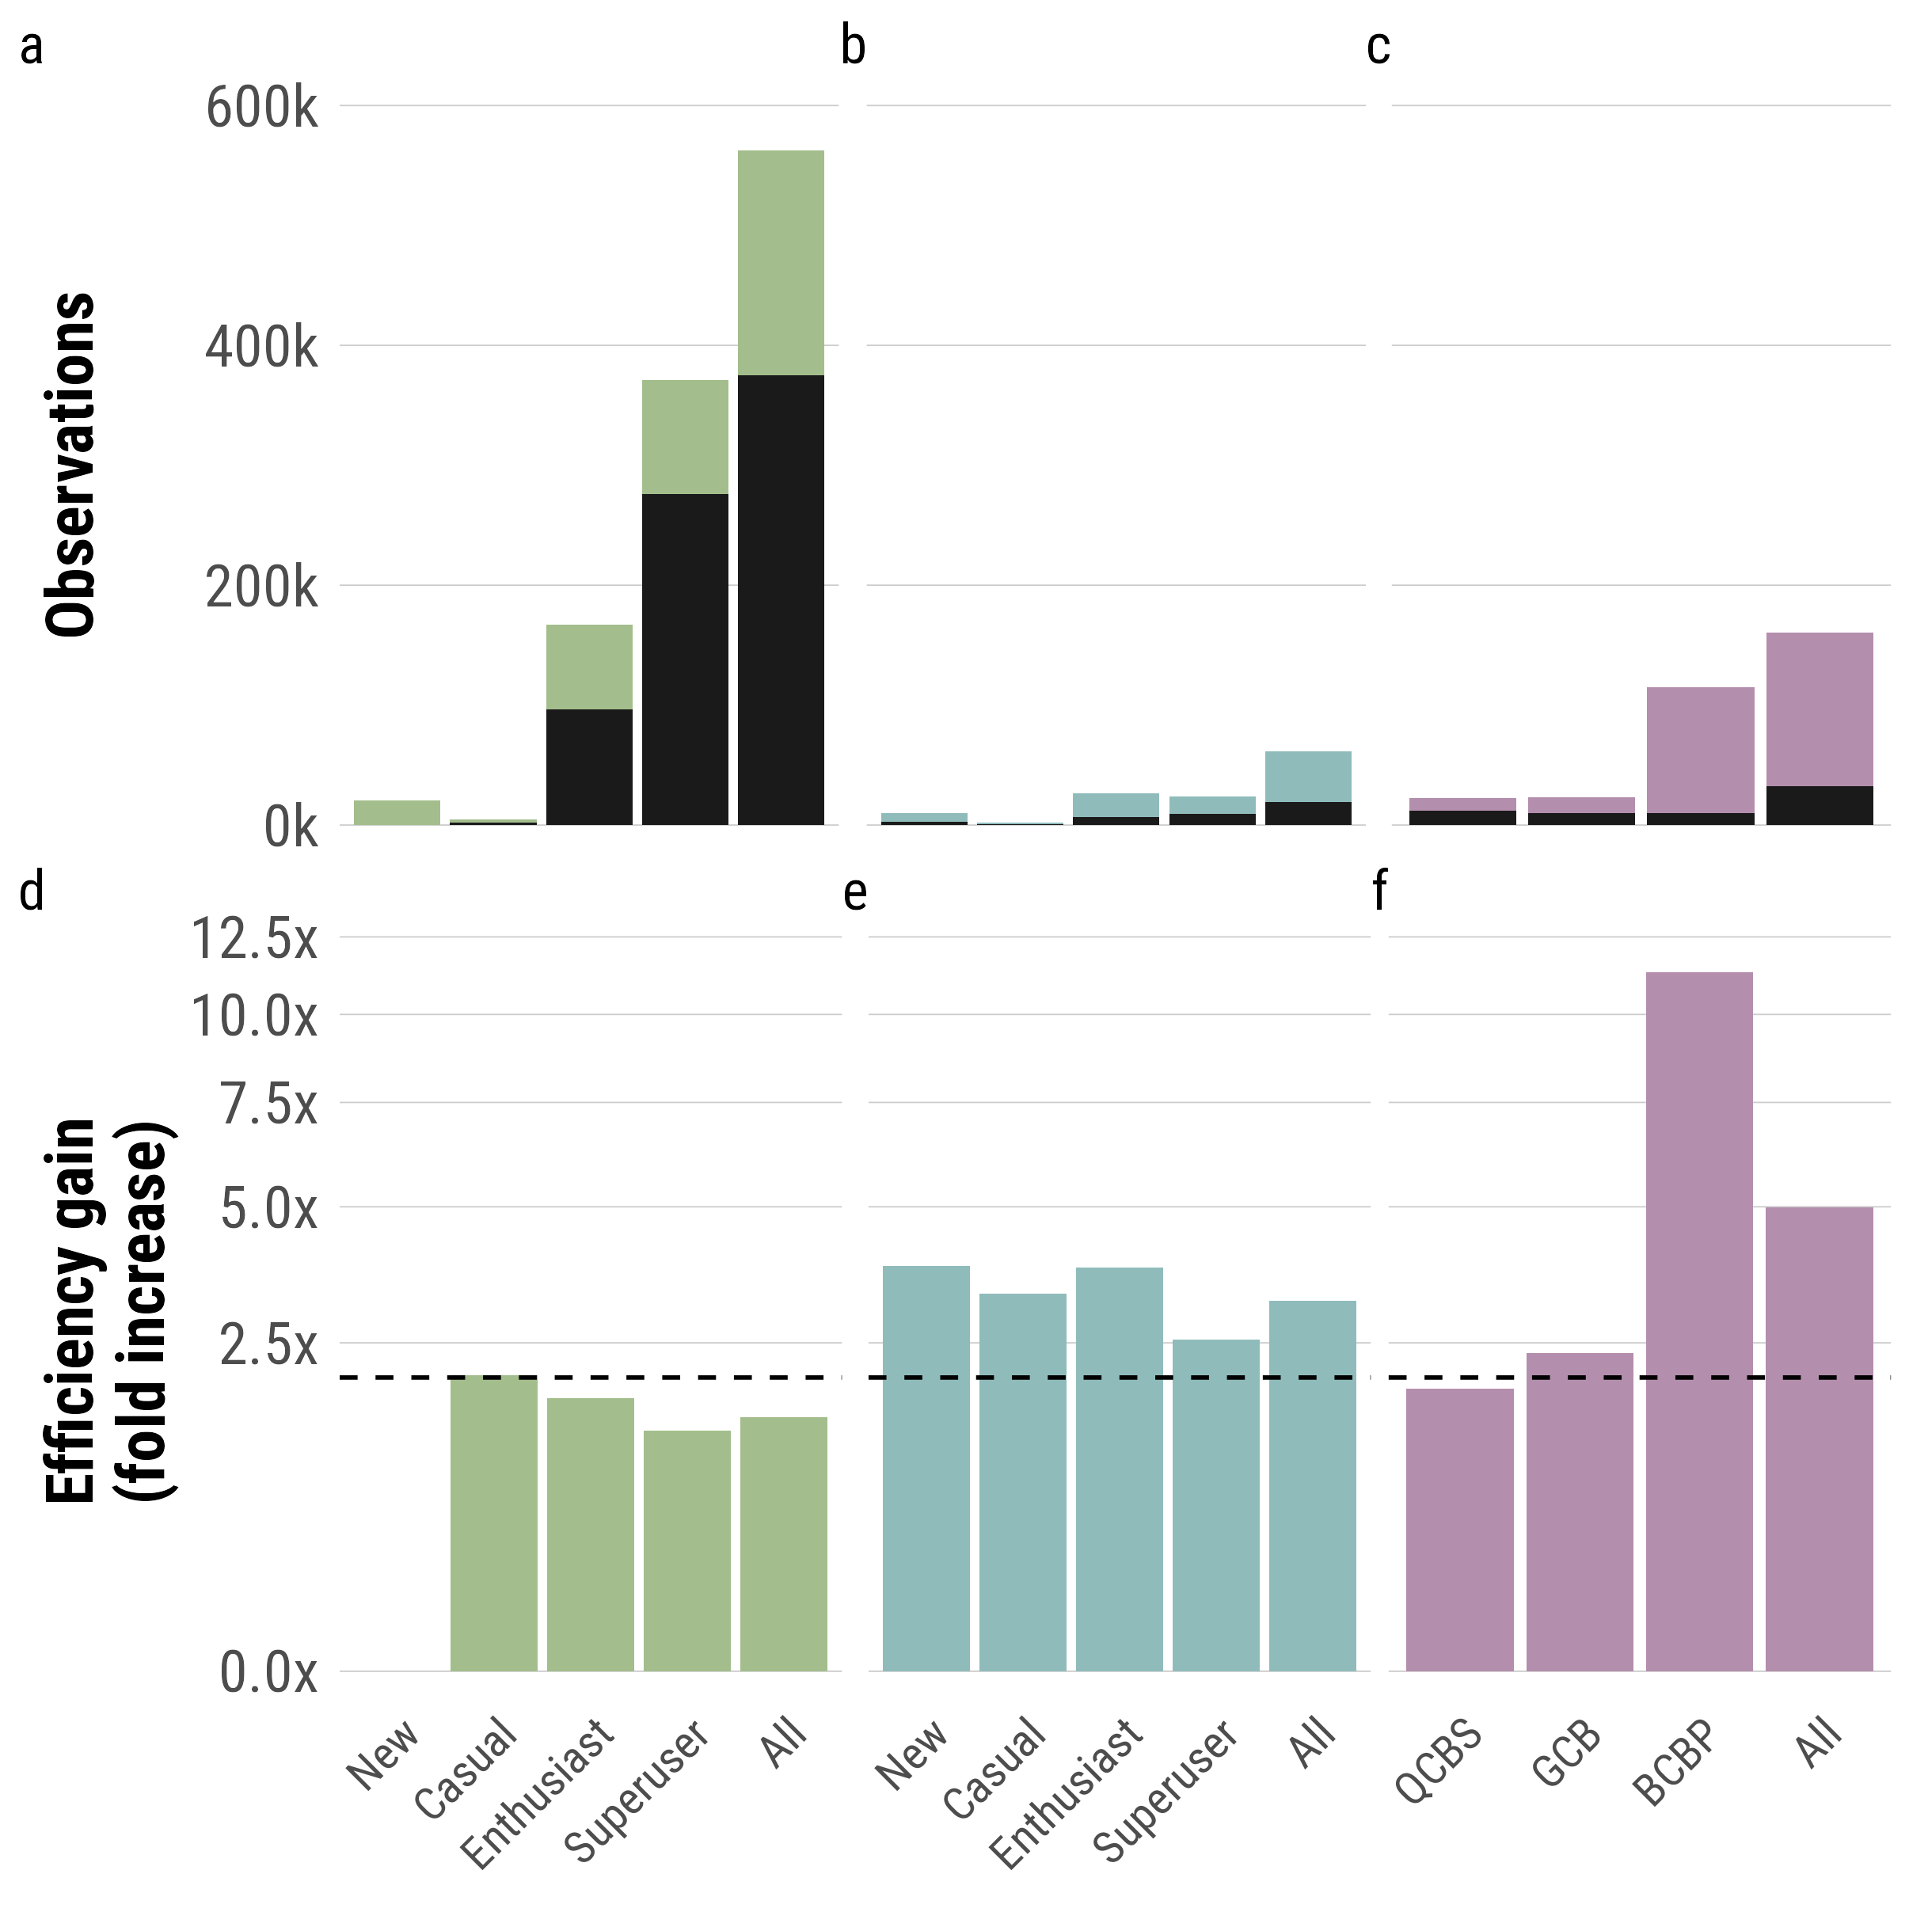
BTG Effect
Bioblitz Effect
Funding Effect
Expectation
doubling

